Slide 1
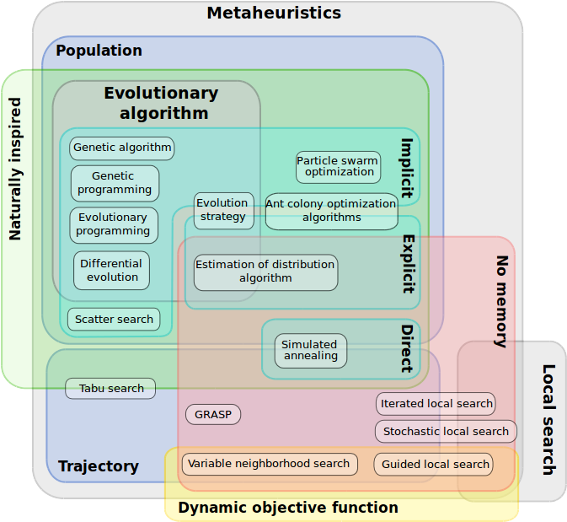
https://en.wikipedia.org/wiki/Metaheuristic

Slide 2
A typical genetic algorithm requires
a “genetic” representation of the solution domain
a fitness function to evaluate the solution domain

Slide 3
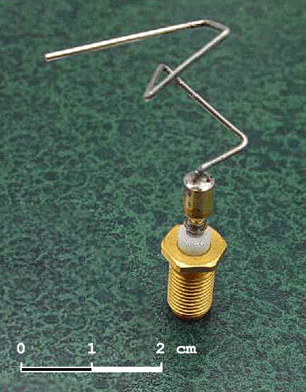
“2006 NASA ST5 spacecraft antenna”
(https://upload.wikimedia.org/wikipedia/commons/f/ff/St_5-xband-antenna.jpg)

Slide 4
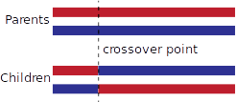
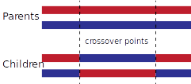
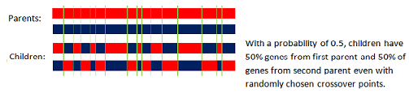
Crossover
https://en.wikipedia.org/wiki/Crossover_(genetic_algorithm)

Slide 5

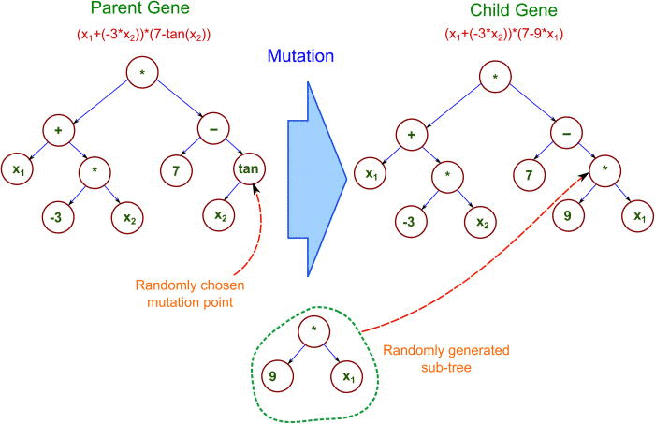
Mutation
https://en.wikipedia.org/wiki/Mutation_(genetic_algorithm)
https://www.researchgate.net/figure/260519597_fig8_Mutation-operation-in-Genetic-Programming

Slide 6
https://en.wikipedia.org/wiki/Evolutionary_art

