Slide 1
MGM Data Breach
IST 623 – Case study Presentation
Fall 2020
Group 3
Team members
Katherine
Jean
Charlie
Trevor
Subbu

Slide 2
Case Summary

Slide 3
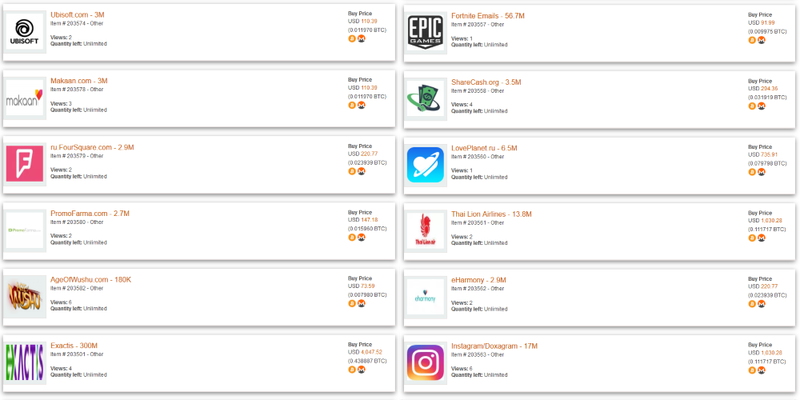
Incident Description
THE DATAVIPER HACK
hacker claims to have spent three months inside DataViper servers while exfiltrating databases
8,200 databases breached; top 50 were put up for sale on the dark web
Owner believed they were selling their own db’s and not real data
Notes:
Trevor
Test server

Slide 4
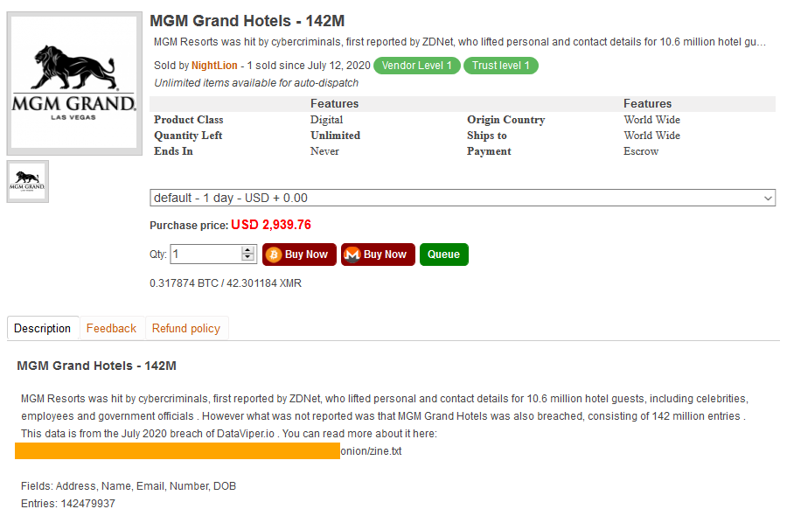
Incident Description
February 2020 after a batch of 10.6 million MGM hotel guests' data was offered as a free download on a hacking forum
MGM spokesperson also pointed out that "the vast majority of data consisted of contact information like names, postal addresses, and email addresses.“

Slide 5
Victims

Slide 6
MGM Response

Slide 7
Similar Scenarios
Notes:
https://www.nytimes.com/2018/11/30/business/marriott-data-breach.html

