Slide 1

Green Pace
Security Policy Presentation
Developer: Trevor Leon

Slide 2

OVERVIEW: DEFENSE IN DEPTH
In the proposed security policy, ten core secure coding principles are stated, explained, and mapped to coding standards in the SEI CERT C/C++ Coding Standards.

Slide 3
THREATS MATRIX
Likely threats have a high chance of being exploited | Priority threats can cause a lot of damage to a system
Low priority threats will not be as harmful to a system | Unlikely Threats are more rarely exploited

Slide 4
10 PRINCIPLES
Validate Input Data – INT50-CPP, STR50-CPP, CWE-89, ERR62-CPP
Heed Compiler Warnings – MEM51-CPP, EXP53-CPP
Architect and Design for Security Policies supported by EXP39-C, INT50-CPP, CWE-89, MEM51-CPP, ERR62-CPP, DCL51-CPP
Keep It Simple – STR50-CPP, MEM51-CPP, PRE31-C, DCL51-CPP
Default Deny –
Adhere to the Principle of Least Privilege –
Sanitize Data Sent to Other Systems – INT50-CPP, CWE-89, ERR62-CPP
Practice Defense in Depth – CWE-89
Use Effective Quality Assurance Techniques – PRE31-C, MSC51-CPP
Adopt a Secure Coding Standard – CWE-89, EXP53-CPP, MSC51-CPP

Slide 5
CODING STANDARDS
EXP39-C – Do not access a variable through a pointer of an incompatible type. L3
INT50-CPP – Do not cast to an out-of-range enumeration value. L3
STR50-CPP – Guarantee that storage for strings has sufficient space for character data and the null terminator. L1
CWE-89 – Improper Neutralization of Special Elements used in a SQL command (‘SQL Injection’); L1
MEM51-CPP – Properly deallocate dynamically allocated resources. L1
PRE31-C – Avoid side effects in arguments to unsafe macros. L3
ERR62-CPP – Detect errors when converting a string to a number. L3
DCL51-CPP – Do not declare or define a reserved identifier. L3
EXP53-CPP – Do not read uninitialized memory. L1
MSC51-CPP – Ensure your random number generator is properly seeded. L1

Slide 6
ENCRYPTION POLICIES
Encryption in rest - Data at rest should be properly and securely encrypted as the coding language specifies. Data accessed on a database could be obtained by a malicious user.
Encryption at flight - Data at flight can be intercepted, read, or manipulated while in transit. This is called a man-in-the-middle attack, and it is why data at flight should be encrypted. Encryption should always be securely implemented as the coding language specifies to protect user data.
Encryption in use - Data in use can be intercepted, read, or manipulated by a malicious user. While data is being used or processed, it should always remain securely encrypted as the coding language specifies.

Slide 7
TRIPLE-A POLICIES
Authentication - The process of authentication determines which user is logging into a system. This policy is implemented first to verify users of an application before they access its features. This is usually accomplished in the form of a login screen.
Authorization – Determine which features the user has access to. Users are often given user levels to limit actions a user can make to only what they need. Usually, features that are inaccessible to a user are hidden from them. This policy is implemented after the user has verified themselves.
Accounting – This is the process of logging user requests to track where issues occur. Logs can be kept for data such as user information, timestamps, data accessed, etc. This policy is implemented after authorization and as the user interacts with the application.

Slide 8
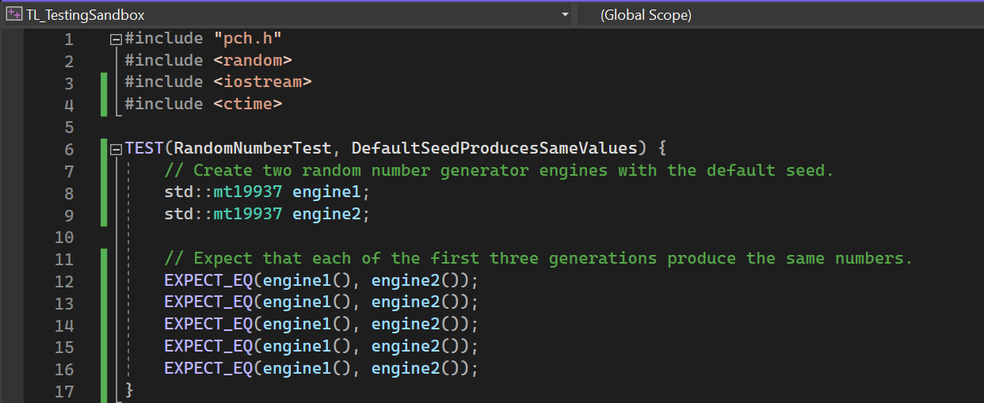
Unit Testing: MSC51-CPP
The following unit test expects that the first five values produced by two random number generator engines created using the default key are the same:

Slide 9
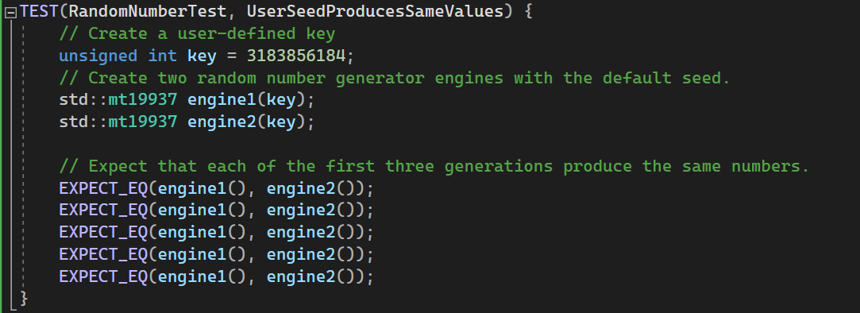
Unit Testing: MSC51-CPP
The following unit test expects that the first five values produced by two random number generator engines created using a key defined by the user are the same:

Slide 10
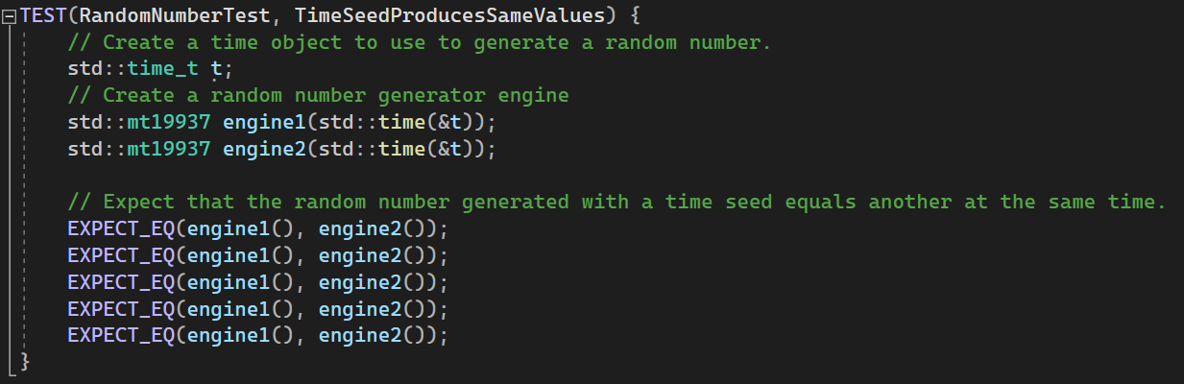
Unit Testing: MSC51-CPP
The following unit test expects that the first five values produced by two random number generator engines created using the current time are the same:

Slide 11
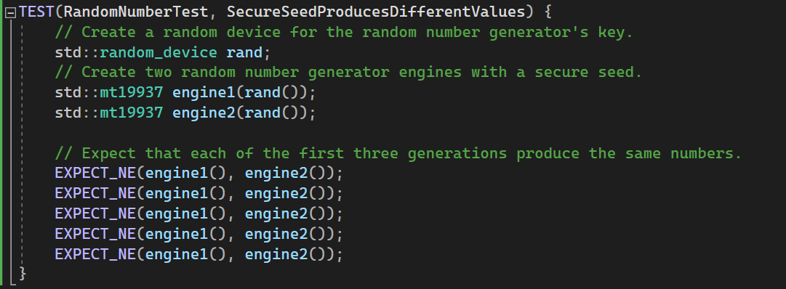
Unit Testing: MSC51-CPP
The following unit test expects that the first five values produced by two random number generator engines created using a secure, random key are not equal:

Slide 12
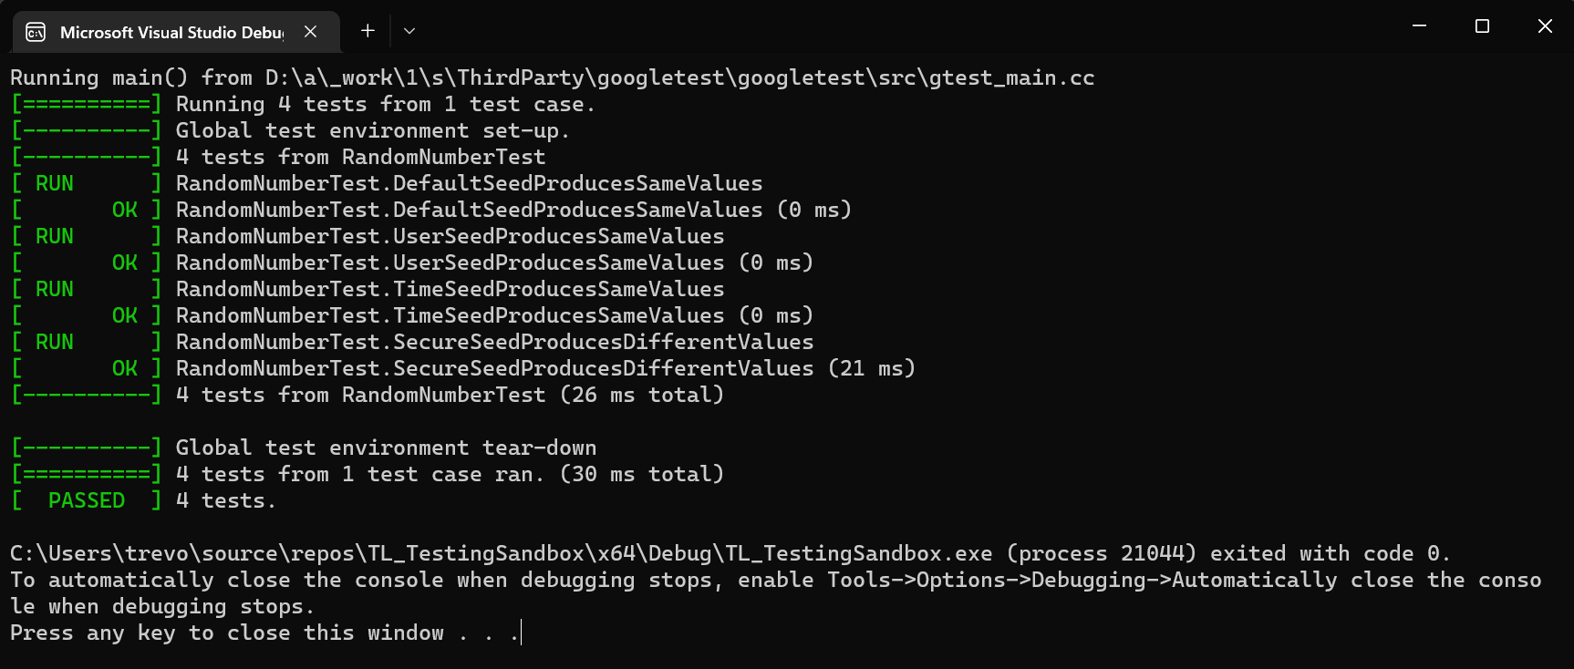
Unit Testing: MSC51-CPP

Slide 13

AUTOMATION SUMMARY

Slide 14
TOOLS
Assess and plan – This is the phase where the initial plans for the project are going to be determined and laid out.
Design – This phase lays out the framework of the project, and where appropriate secure coding recommendations can be used.
Build – The project is starting to be developed in the build phase. Unit testing should occur within the build phase.
Verify and test – In this phase, automation tools can be applied since there is code to test. Tools such as CppCheck can be implemented to detect security vulnerabilities.
Transition and health check – The project must be fully configured and tested before it is released. Penetration testing happens in this phase to ensure that the system’s parts are all working together.
Monitor and detect – When the project is deployed, it is important to monitor and log user activity for accountability. If a vulnerability has been found or exploited, it should be detected and alerted.
Respond – If an attack happens, it should be blocked.
Maintain and stabilize – After a product releases, it will need to be maintained based on customer wants and needs and as new vulnerabilities are found.

Slide 15
RISKS AND BENEFITS
The company needs to implement security policies before a vulnerability and/or data breach occurs.
Waiting until the end of development to implement security policies one strategy, but it will require a lot of code refactoring to ensure it still works with the rest of the program.
Employing DevSecOps will be overall faster than DevOps because vulnerabilities in code can be found with automation tools, remediated, and the project can continue development rather than needing to refactor later (Vijayan, 2017).

Slide 16
RECOMMENDATIONS
It is vital to secure an entire project front-to-back to ensure there are no gaps in security. The following recommendations are included to assist patching remaining holes in the security plan:
Physical security needs to be considered. For example, company data stored on physical hard drives or servers still needs to be properly protected from an attack.
The staff needs to be adequately trained on how to keep their (and, by extension, Green Pace’s data secure). For example, remote workers are required to connect to company resources only over a VPN connection. Remote workers should also keep company assets secure by ensuring other people cannot access or view the information or have access to their devices.
Additionally, employee and user passwords should follow the National Institute of Standards and Technology (NIST) guidelines for password creation: at least eight characters in length; not longer than 64 characters in length; a mixture of letters, numbers, and symbols; not in use on another account of the user; preferably generated and stored in a password manager; etc. (CISA, 2009).
Implement a “zero-trust” policy. No user should be trusted without verification.

Slide 17
CONCLUSIONS
Overall, a company’s cybersecurity is like a frame holding everything else together. Without considering cybersecurity, a company will lose any good reputation it has if the users cannot trust it. A few finishing tips to prevent any future security problems include:
Unit test and automate testing as it becomes available to test and automate.
The SEI CERT C/C++ Coding Standards are great references for developers coding in C/C++. Always ensure developers are following the language’s best practices when it comes to secure coding.
Ensure the perimeter of the company is secure by implementing AAA security (Authentication, Authorization, Accounting), and trust no user.
Encrypt important data such as important company documents, private user data (especially passwords); and make sure it stays encrypted throughout its lifecycle.

Slide 18
REFERENCES
Ballman, A. (2016). Sei Cert C Coding Standard (2016th ed.). Software Engineering Institute | Carnegie Mellon University.
Ballman, A. (2016). Sei Cert C++ Coding Standard (2016th ed.). Software Engineering Institute | Carnegie Mellon University.
Vijayan, J. (2017, December 13). 6 DevSecOps best practices: Automate early and often. TechBeacon. Retrieved December 17, 2022, from https://techbeacon.com/security/6-devsecops-best-practices-automate-early-often
CISA. (2009, May 21). Security tip (ST04-002). Security Tip (ST04-002) Choosing and Protecting Passwords. Retrieved December 17, 2022, from https://www.cisa.gov/uscert/ncas/tips/ST04-002

