Slide 1

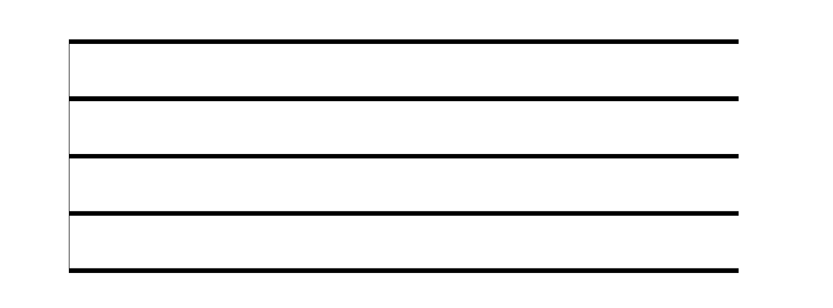
Staff
The staff is a series of 5 lines and 4 spaces where notes are placed.
© Jamie Kraft 2015

Slide 2

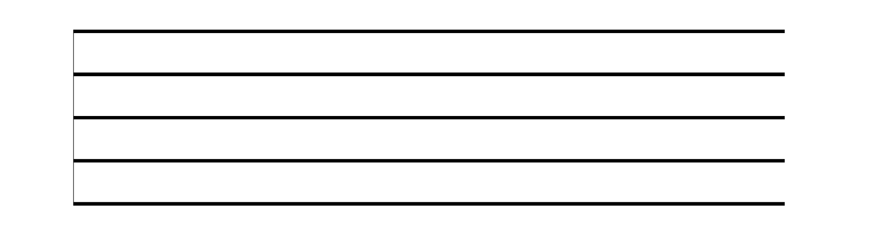
Pitch
*Pitch is represented by the placement of notes on the staff.
© Jamie Kraft 2015

Slide 3

Treble Clef
The treble clef indicates the higher pitches on a staff.
© Jamie Kraft 2015

Slide 4
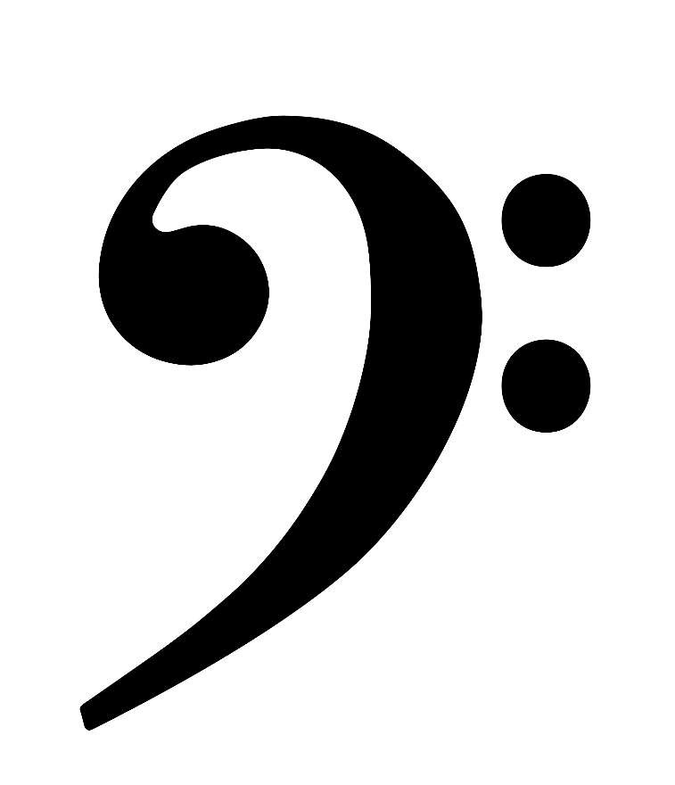
Bass Clef
The bass clef indicates the lower pitches on a staff.
© Jamie Kraft 2015

Slide 5
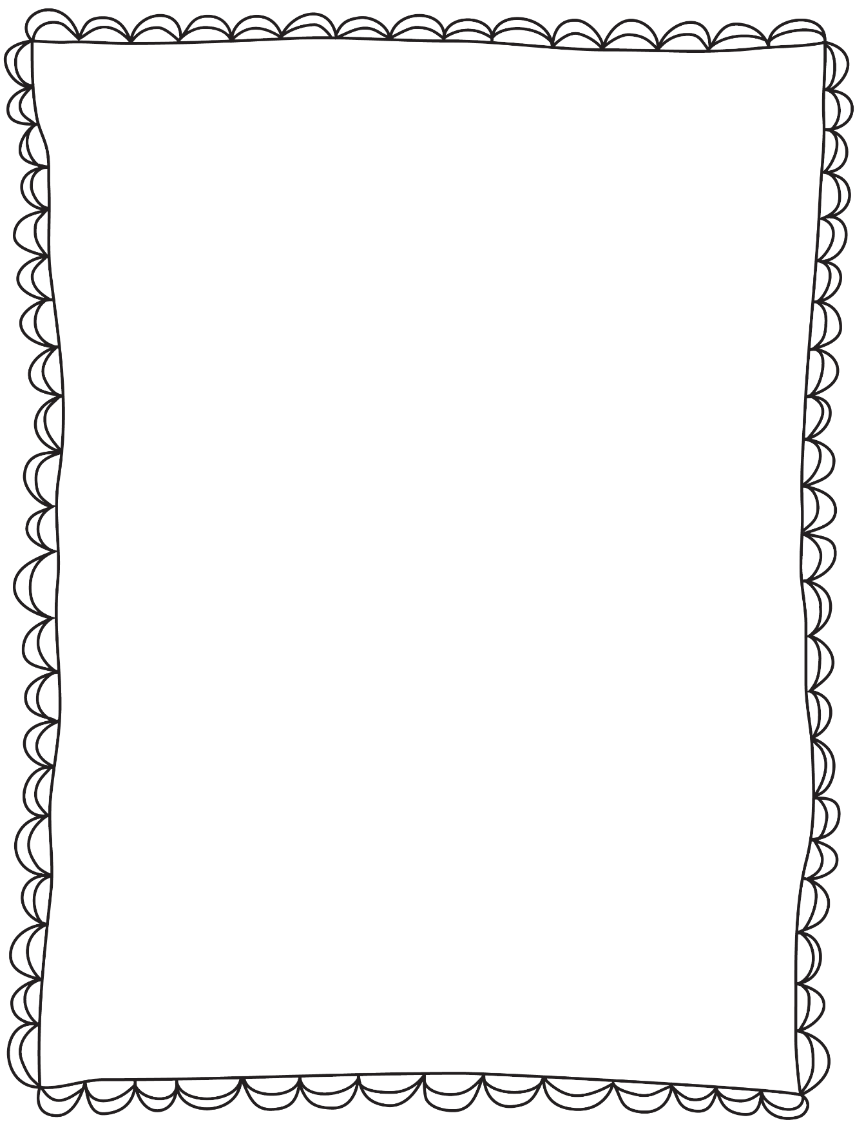
Lesson 2: Note Names
A B C D E F G
© Jamie Kraft 2015

Slide 6


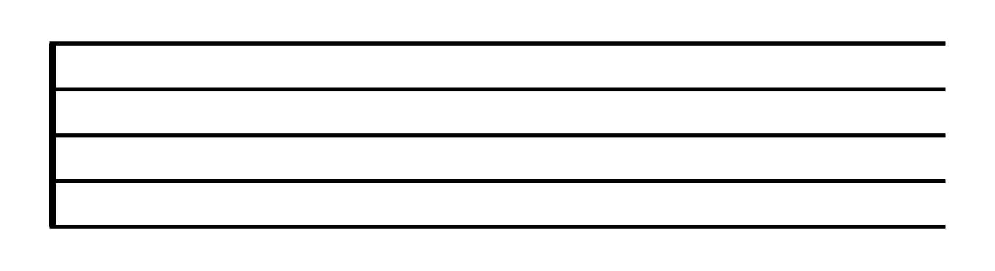
E
C
A
F
A way to remember the note names on the treble clef spaces is to use the rhyming words: SPACE-FACE
© Jamie Kraft 2015

Slide 7
F
D
B
G
E
A way to remember the note names on the treble clef lines is by using the saying: Every Good Boy Does Fine
© Jamie Kraft 2015

Slide 8
F
E
D
C
B
A
G
F
E
Each line and space on the treble clef has a letter name.
© Jamie Kraft 2015

Slide 9
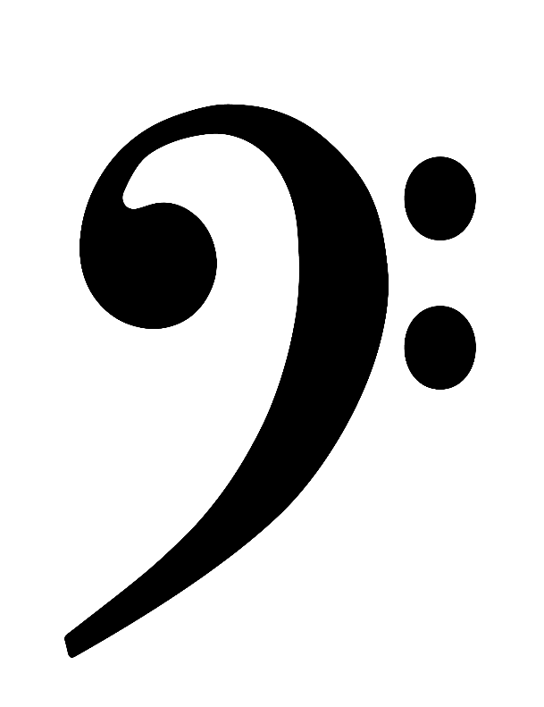
G
E
C
A
A way to remember the note names on the bass clef spaces is to use the saying: All Cows Eat Grass
© Jamie Kraft 2015

Slide 10
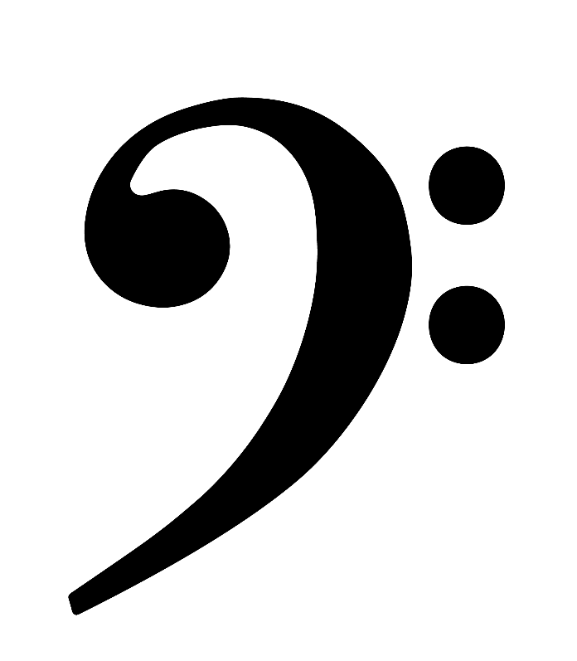
A
F
D
B
G
A way to remember the note names on the bass clef lines is by using the saying: Good Boys Do Fine Always
© Jamie Kraft 2015

Slide 11
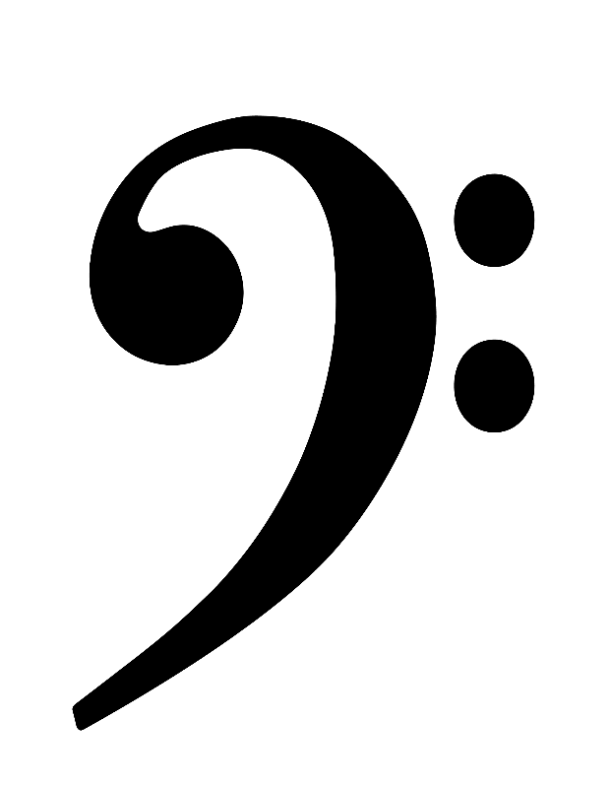
A
G
F
E
D
C
B
A
G
Each line and space on the bass clef has a letter name.
© Jamie Kraft 2015

Slide 12
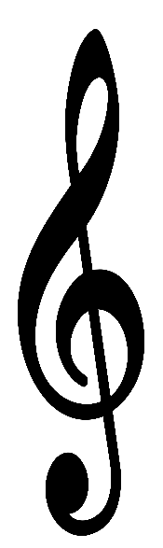
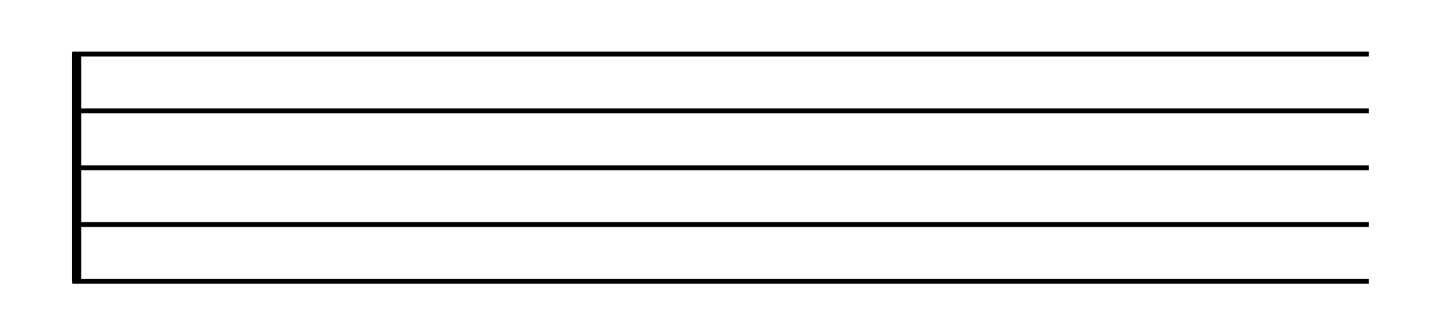

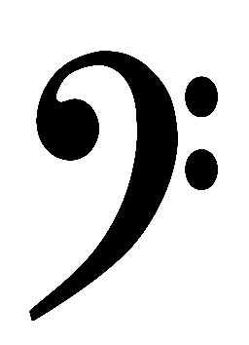
Together, the treble clef and bass clef create the
Grand Staff
© Jamie Kraft 2015

Slide 13



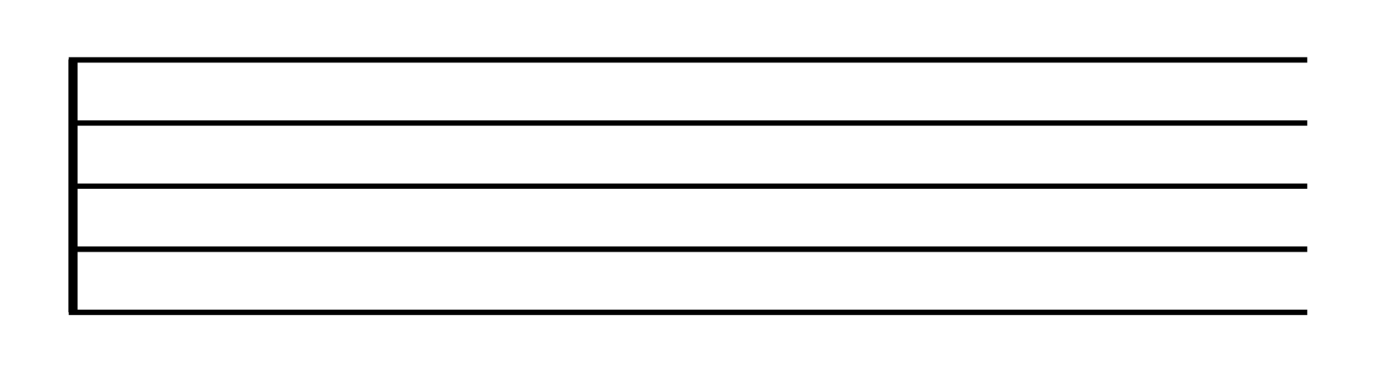

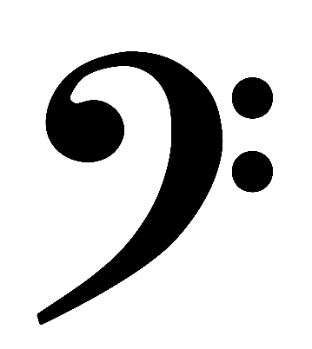
Pitches extending outside of the staff use ledger lines.
© Jamie Kraft 2015

