Slide 1
Musical Notes and Time Values
Musical Notes and Time Values
Objectives: To be able to identify the various musical notes and time values.
To know and understand the relationship between the musical notes.
To be able to write musical notes with stem on the staff in the right direction.

Slide 2
Objectives
To be able to identify the various musical notes and time values.
To know and understand the relationship between the musical notes.
To be able to write musical notes with stem on the staff in the right direction.

Slide 3
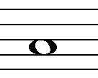
While the placement of notes on the staff indicates the pitch, the duration of the note (how long note is held) is determined by the note value.
A Semibreve or Whole note is drawn as an open round note.
Musical Notes and Time Values
Objectives: To be able to identify the various musical notes and time values.
To know and understand the relationship between the musical notes.
To be able to write musical notes with stem on the staff in the right direction.

Slide 4
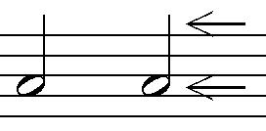
Stem
Two Minims or Half notes are equal to the duration of one semibreve or whole note.
Minims of Half notes
Notehead
Musical Notes and Time Values
Objectives: To be able to identify the various musical notes and time values.
To know and understand the relationship between the musical notes.
To be able to write musical notes with stem on the staff in the right direction.

Slide 5
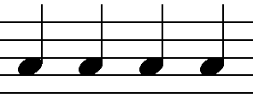
Four Crotchets or Quarter Notes equal the duration of one whole note.
Crotchets or Quarter Notes.
Musical Notes and Time Values
Objectives: To be able to identify the various musical notes and time values.
To know and understand the relationship between the musical notes.
To be able to write musical notes with stem on the staff in the right direction.

Slide 6
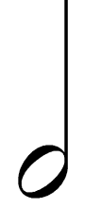



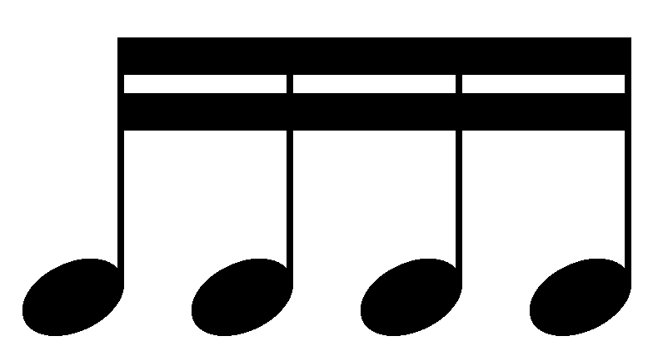
Note Values
=
=
1 Semibreve or Whole note
2 minims or half notes
4 Crotchets or Quarter notes
=
=
1 minim or half note
2 Crotchets or Quarter notes
4 Quavers or Eighth notes
8 Semiquavers or Sixteenth notes

Slide 7
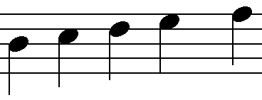
Stem directions for musical notes on the stave
Stems extend downward on the left side when the note appears on or above the 3rd line of the staff.
Musical Notes and Time Values
Objectives: To be able to identify the various musical notes and time values.
To know and understand the relationship between the musical notes.
To be able to write musical notes with stem on the staff in the right direction.

Slide 8
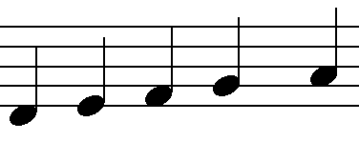
Stem directions for musical notes on the stave
Stems extend upward on the right side when the note appears on or below the 3rd line of the staff.
Musical Notes and Time Values
Objectives: To be able to identify the various musical notes and time values.
To know and understand the relationship between the musical notes.
To be able to write musical notes with stem on the staff in the right direction.

Slide 9
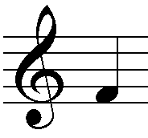
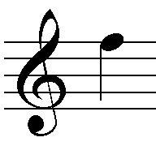
Stem extend to F above
Stem extend to F below
Musical Notes and Time Values
Objectives: To be able to identify the various musical notes and time values.
To know and understand the relationship between the musical notes.
To be able to write musical notes with stem on the staff in the right direction.

Slide 10
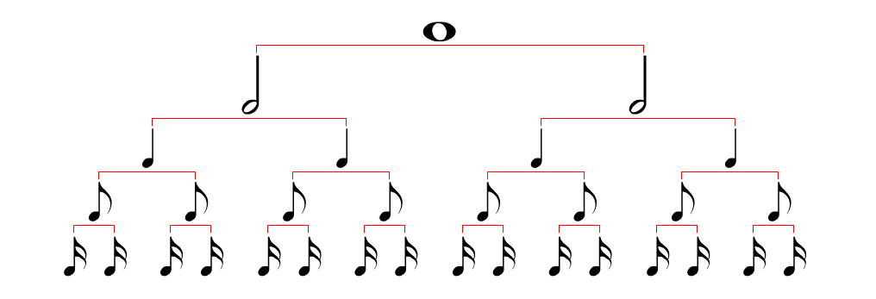
Relationship between the various Musical notes.
Musical Notes and Time Values
Objectives: To be able to identify the various musical notes and time values.
To know and understand the relationship between the musical notes.
To be able to write musical notes with stem on the staff in the right direction.

Slide 11
