Slide 1
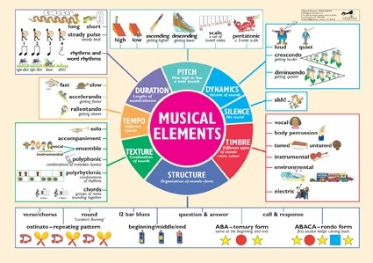
Musical terminology
Creative Musicianship

Slide 2
Time signatures
Time signatures are the numbers found on the left hand side of the stave or staff
The top number represents how many beats in the bar there are
The bottom number represents a “code” for what sort of beats they are, for example:
4 = crotchet beats
8 = quaver beats
2 = minim beats

Slide 3



Time signatures
4 crotchet beats in a bar; also represented by - common time
6 quaver beats in a bar
2 minim beats in a bar; also known as Alla Breve

Slide 4
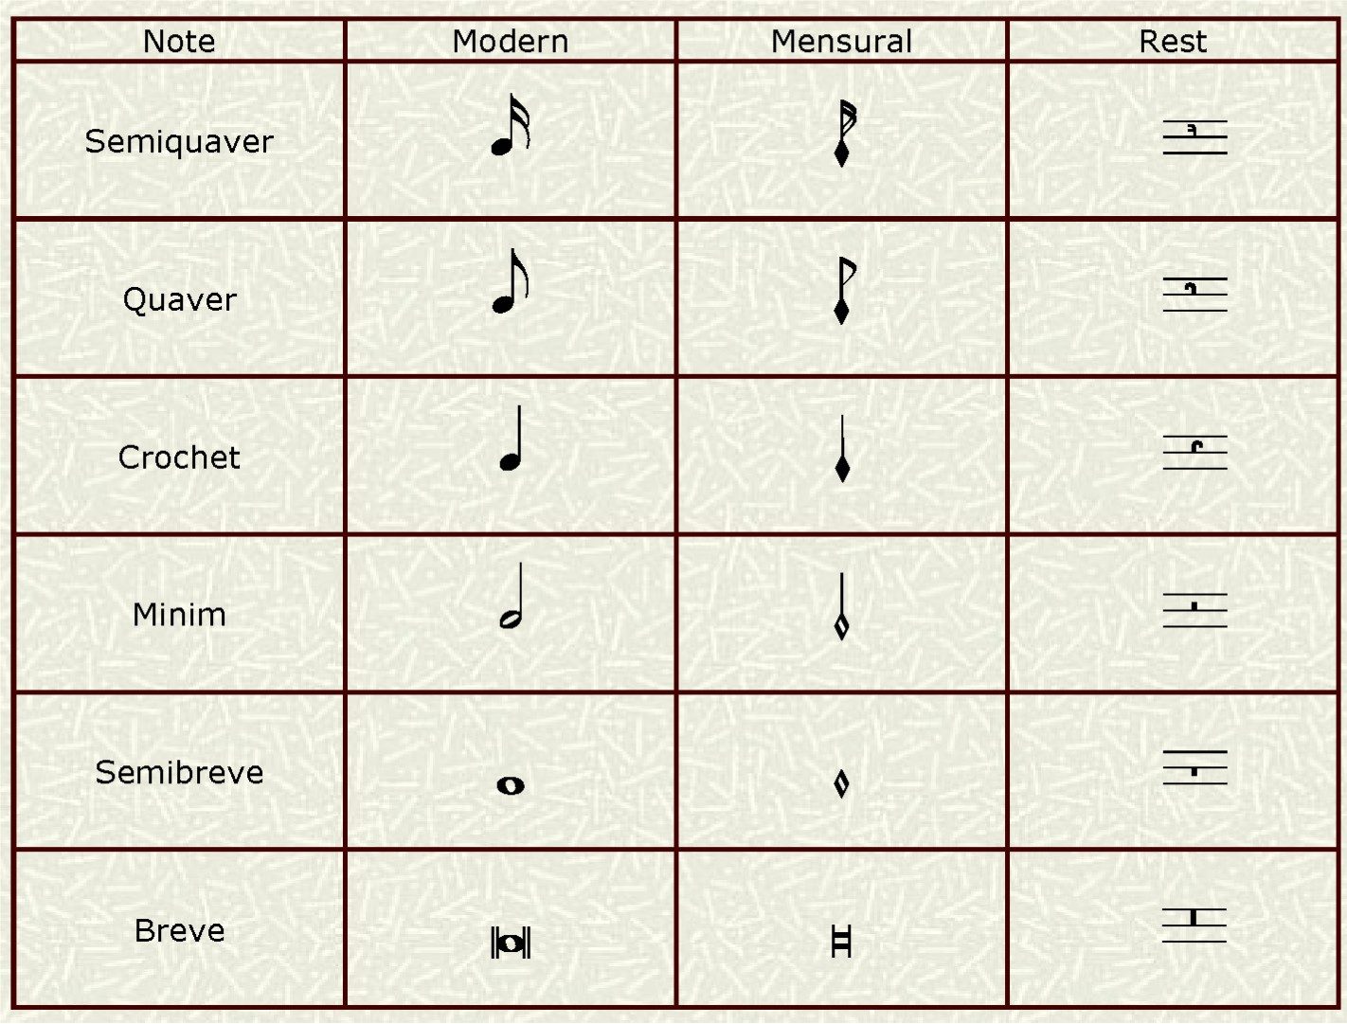
What do the notes look like?

Slide 5
British vs American terminology
Breve – a double whole note
Semi-breve – a whole note
Crotchet – a quarter note (often said to be representative of “one beat”)
Quaver – an 8th note
Minim – a half note
Semi-quaver – a 16th note

Slide 6
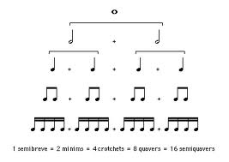
Note length

Slide 7
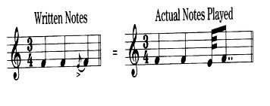
The stupid ones!
Demisemiquaver – 32nd note
Hemidemisemiquaver – 64th note
Semihemidemisemiquaver – 128th note
Acciaccatura; Appoggiatura – the only two types of Grace notes (musical ornament)

Slide 8
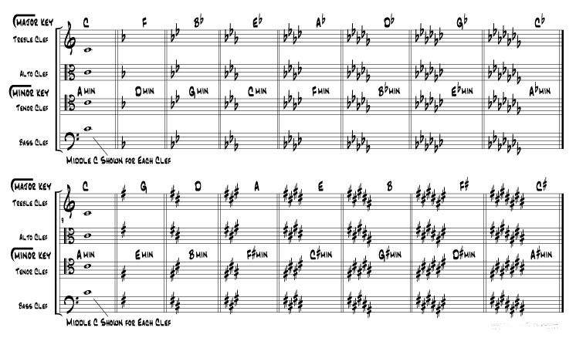
Key signatures, relative majors/minors

Slide 9
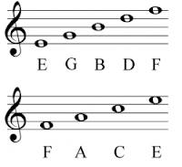
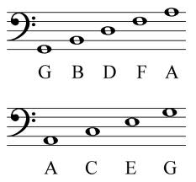
Note mnemonics
Treble clef mnemonics –
Every Good Boy Deserves
Food
FACE
Bass clef mnemonics –
Great Big Dogs Fight
Alsatians
All Cows Eat Grass

Slide 10
Definition of scale degrees - ascending
Tonic-the primary pitch of the key (root note)
Super tonic-the pitch above the tonic (second note)
Mediant- third note
Subdominant- fourth note
Dominant-the pitch a perfect fifth above tonic (fifth note)
Submediant- sixth note
Leading note - seventh note, leads to tonic

Slide 11
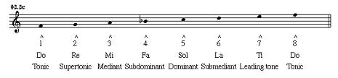
Image of scale degrees

Slide 12
scales
Major - always associated with positive emotions
Minor – always associated with negative emotions
Compositions that are based wholly on the white notes (based on piano keys), are called Diatonic (tonal)

Slide 13
scales
3 types of minor scales – natural (the one that matches the key signature)
Harmonic minor – I like to refer to this as the Eastern scale (play)
Melodic minor – ascending, its only the mediant (3rd note in scale) that’s played as a minor. Descending, this scale adopts the same process as the harmonic minor scale (play)

Slide 14
Other scales
Chromatic – use of all 12 notes (Schoenberg)
Pentatonic: this scale is best remembered as the black keys on the piano ascending from F sharp. It comprises five notes of the major scale (by scale degree number): 1-2-3-5-6. (Mahler)
Whole tone: the whole tone scale has no half steps. It has six pitches C-D-E-F sharp-G sharp-A sharp. There is an enharmonic whole step from A sharp to the C above, so the scale is complete. (Debussy)

Slide 15
Other scales
Octatonic scale: this is a special scale that has the following sequence of intervals: W-H-W-H-W-H-W-H, producing a scale like: C-D-E flat-F-G flat-A flat-A-B-C. Notice that there are eight different pitches within the octave, rather than the seven of a diatonic scale (Note: the scale may begin with a half step rather than a whole step: H-W-H-W-H-W-H-W, thus E-F-G-A flat-B flat-C flat-D flat-D-E.)
Stravinsky was famous for using this scale

Slide 16
intervals
An interval is the distance between two notes, not in time, but in musical space.
Intervals are classified two ways: a. the basic interval of the tonic (unisons), second, third, fourth, fifth, sixth, seventh, and octave, b. the type of basic interval (perfect, major, minor, augmented, diminished)
Many theorists by default refer to an interval's notes in ascending order. Therefore, an interval between C and E usually means that C is the lower note of the interval.

Slide 17
intervals
An interval can be inverted by placing the upper note under the lower note and vice versa. For example, the interval C-E can be inverted by placing the E below the C or the C above the E.
Intervals beyond an octave are usually referred to as compound intervals. This means that the interval of a ninth is equivalent to the interval of a second, displaced by an octave.
Intervals are measured according to the spelling of each pitch. This means that C-D sharp is some kind of second, even though the interval may not sound like a second, while the interval between the same actual keys on the keyboard, respelled C-E flat, is considered a third.
Key word: ENHARMONIC. Enharmonic means the same pitch used differently. Common usage: E flat is the enharmonic equivalent of D sharp.

Slide 18
intervals
Types of intervals: The basic interval types are major, minor, augmented (higher), diminished (lower) and perfect. The only basic intervals that can be perfect are unisons, fourths, fifths, and octaves (which actually are compound unisons). All intervals can be augmented. All intervals but the unison can be diminished. Only seconds, thirds, sixths, and sevenths can be major or minor.

Slide 19
cadences
A cadence is an ending “chord” played to provide a particular emotive response to a piece of music
In musical terms, there are a number of different versions.
Authentic cadence – comprised of a Perfect cadence and an imperfect cadence.

Slide 20
Perfect cadence
Harmonic progression of V - I (or the fifth and the first note, or the dominant and the tonic)
Both chords (e.g. left and right hand on piano) must be in root position
The Melody must end on the tonic pitch.
It’s the most final sounding of all the cadences

Slide 21
Imperfect cadence
Imperfect cadences are as structurally built around the dominant (Vth) and use it as the root note. An imperfect cadence denotes the song hasn’t finished yet and there’s more to come.
For example, if the key signature is C major, an imperfect cadence would be rooted from G

Slide 22
Interrupted cadence
An interrupted cadence occurs when you think you’re waiting for an ending, perfect cadence but you are presented with a minor chord instead.
For example, is the key signature is C major, an interrupted cadence would be rooted in A

Slide 23
Plagal cadence
A plagal cadence is best remembered as the Amen cadence as its predominantly used in hymns and Christian/Catholic pieces of music
The root (tonic) and the fourth (subdominant) notes are used for this cadence.

Slide 24
Tierce de Picardie or English cadence
This cadence is signified when a piece of music is played in a minor key and resolves on a major, usually perfect cadence.
It denotes a feeling of euphoria and whilst its origins are in Baroque music, it is widely used in dance music, from psi-trance, techno and hard house.

Slide 25
modulation
When a piece of music changes key it is said to modulate. It is most likely to modulate to a closely related key.
The three most closely related keys to the tonic are the dominant, the subdominant or the relative minor or major keys.

Slide 26
modes
A mode is a seven note scale
Modes work according to tuning and occur in authentic and plagal (taken from cadence terminology because modes use I and IV root note positions, or tonic and subdominant forms)
The first and fourth (I, IV, or tonic and subdominant) are shown in the examples)

Slide 27
Different types of modes
Dorian: D E F G A B C D
Hypodorian: A B C D E F G A
Phrygian: E F G A B C D E
Hypophrygian: B C D E F G A B
Lydian: F G A B C D E F
Hypolydian: C D E F G A B C
Mixolydian: G A B C D E F G
Hypomixolydian: D E F G A B C D
Aeolian: A B C D E F G
Hypoaeolian: E F G A B C D
Ionian: C D E F G A B C
Hypoionian: G A B C D E F G
Locrian: B C D E F G A B
Hypolocrian: F G A B C D E F

Slide 28
dynamics
Dynamics in music dictate to the performer how the composer wanted particular phrases or notes to be played; they are the musical equivalent to stage directions
Dynamics essentially means the emotions of a piece of music.
For example, Andante (walking speed), ff – fortissimo (very loudly)
Refer to hand out glossary of terms

