Slide 1

Music Theory
Grade 1
Based on the ABRSM Syllabus
Associated Board of the Royal School of Musicians

Slide 2

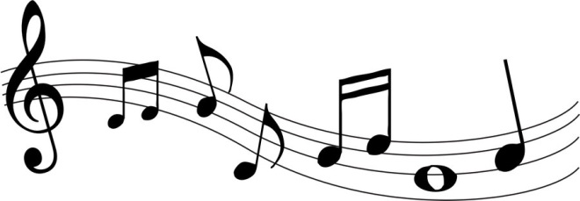

Syllabus
Note values
Dotted notes
Rest values
Tied notes
Time signatures
2 bar rhythms
Treble clef
Bass clef
Accidentals
Constructing major scales
C, G, D and F major scales
Tonic triads
Degrees of the scale & intervals
Vocabulary

Slide 3

Vocabulary
This is in the back of your booklet.
Most of these words are Italian and known as Italian terms.
This is for you to learn independently throughout the term.
Use it as an aid to describing music in lessons.
Plus you’re learning a new language!

Slide 4
Note Values
Draw the note | Name the note length | How many beats does it last?
 | Semibreve | 4 (or the whole bar)
 | Minim | 2
 | Crotchet | 1
 | Quaver | ½
 | Semi quaver | ¼
Notes:
Copy and fill in to booklet

Slide 5
Dotted Notes
A dot next to a note means that you add on half the notes original value for a new note length.
Mathematical formulae
n + ½ n = dotted note length
Note length + half the note length
e.g. How long is this note?
n | + | ½ n | = | length
4 | + | 2 | = | 6 beats
Notes:
Questions to answer in booklet

Slide 6
Homework
Answer the sums made up of different note lengths.
To be marked next lesson and scores recorded in the front of your booklet.

Slide 7
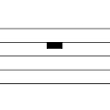
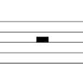

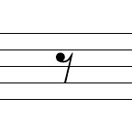
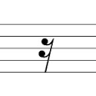
Note Rests
Draw the note | Name the note length | How many beats does it last? | Rest
 | Semibreve | 4 (or the whole bar)
 | Minim | 2
 | Crotchet | 1
 | Quaver | ½
 | Semi quaver | ¼

Slide 8
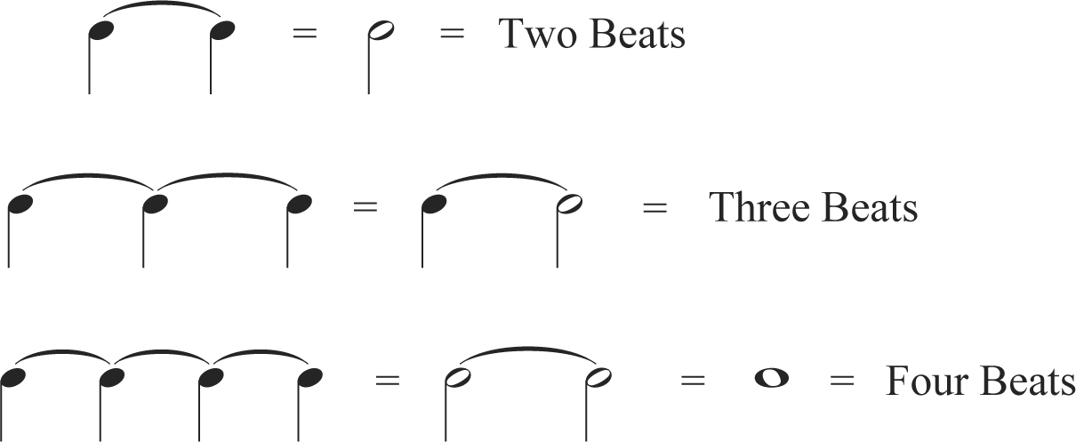
Tied Notes
Sometimes notes are tied together because they cross a bar line or you can’t make the note length you want by dotting it
You can only tie notes that are on the same line or space within the stave.
Notes:
Practice questions in booklet

Slide 9
Time Signatures
Time signatures tell you how many beats are in a bar.
4 4 crotchet beats in a bar. Also known as common 4 time.
3 3 crotchet beats in a bar. Also known as a waltz.
4
2 2 crotchet beats in a bar.
4

Slide 10
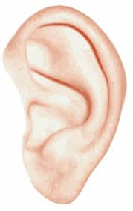
Time Signatures
Listen to me clap a beat.
I will be clapping either 2, 3 or 4 beats per bar.
The first beat of the bar is the strongest beat.
Join in when you can hear the time signature.
Time signatures explained:
The top number tells you how many beats are in a bar.
The bottom number tells you what type of beat it is. Having a 4 on the bottom represents a crotchet beat.
3 means 3 crotchet beats in a bar.
4
Notes:
Questions in booklet.

Slide 11
Composing a 2 bar rhythm
Advice for writing a 2 bar response.
Look at the time signature first.
Tap the written rhythm to yourself.
Tap a response that sounds good.
Make the rhythm interesting.
Use the existing rhythm and amend it to be an answer.
This will make it similar but different.
End on a longer note.
Notes:
Examples in workbook taken from grade 1 theory book

Slide 12

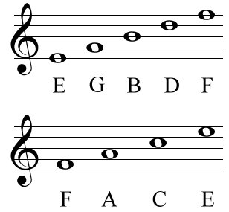
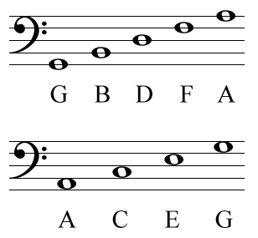
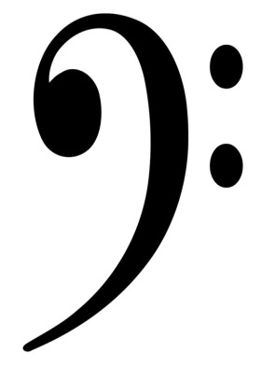
Notes on the stave
Treble Clef
Bass Clef
Notes:
Can play ‘Name that note’. Click on the treble or bass clef for hyperlink.
Write mnemonics in workbook.
Piano teachers resource kit notes worksheets.

Slide 13

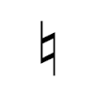
Accidentals
# is the symbol for sharp
This means that you raise the note by a semi tone.
A semi tone is the very next note.
So seeing C# means that you play the back note above C.
b is the symbol for flat
This means that you lower the note by a semi tone.
A semi tone is the very next note.
So seeing Ab means that you play the back note below A.
is the symbol for natural
This means that a # or b note returns to being ‘normal’.
Notes:
Workbook exercises of drawing accidentals, naming notes and identifying them on a piano keyboard.

Slide 14
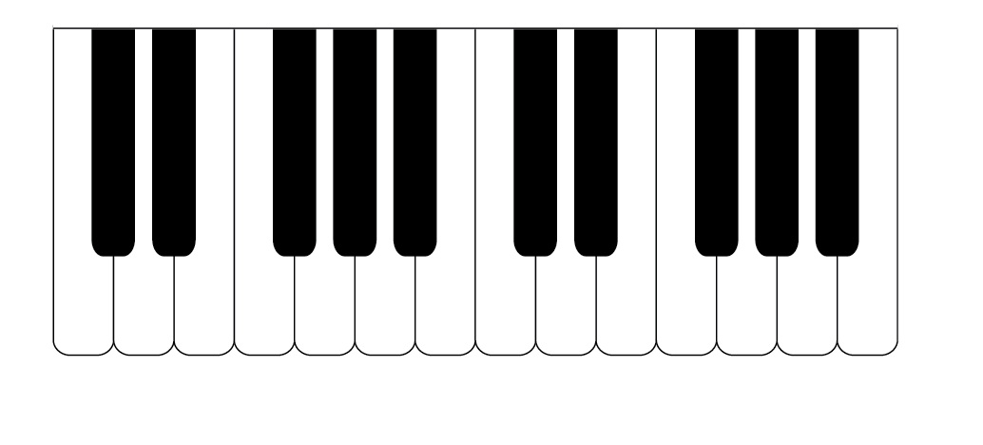
Accidentals
Notes:
Use smart board or pointer to ask questions on tones, semi tones, sharps, flats and naturals.

Slide 15
Constructing a Major Scale
Tones (T) and Semi tones (St)
T
T
St
T
T
T
St
Notes:
Students then use the pattern to do the G,D and F major scale in the booklet. Answers on next slide.

Slide 16



C, G, D and F major scales
C major has NO sharps # or flats b
G major has 1 sharp #
The 1 sharp is F#
D major has 2 sharps #
The 2 sharps are F# and C#
F major has 1 flat b
The 1 flat is Bb

Slide 17
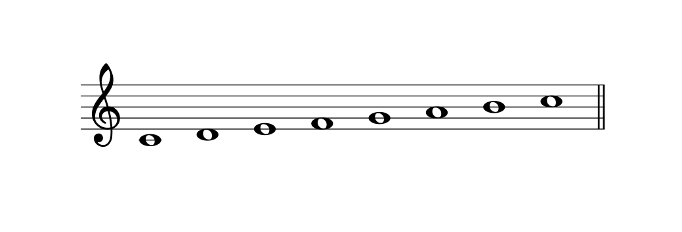
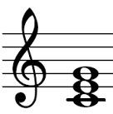
Tonic Triads
1 2 3 4 5 6 7 8
tonic octave
A triad is made of 3 notes; the tonic, 3rd and 5th.
So C major triad looks like this:
Draw your triads in your book.
Notes:
In both treble and bass clef in workbook.

Slide 18

Degrees of the Scale
Degrees of the scale are exactly what you did on p16 when you wrote the number underneath your scales! So you’ve already done it without realising it!
Here is an example of C major with roman numerals rather than numbers:
Notes:
Answer questions in workbook

Slide 19
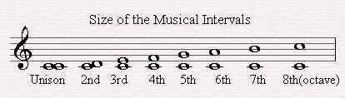
Intervals
The same note is called unison
An 8th is called an octave. They will be the same note but at different pitches. In this example, both notes are C.
A 2nd is the next note up.
Etc…
You count the bottom note and the note you end on when counting intervals.
Notes:
Piano teachers resource kit intervals worksheets

Slide 20
Grade 1 Theory Paper
Spend 10 mins doing last minute revision.
Choose the topics you did not do so well at.
Test conditions
30 mins to complete the paper. If you want longer please raise your hand to ask.
Answer every question.
66 = pass 80 = merit 90 = distinction
1 stamp 2 stamps 3 stamps

