Slide 1
Muxes
Presented By: Trevor Abel, Ryan Hinson, Samuel Manos, and Mark Neitzel

Slide 2
Why Are Muxes Important?
A multiplexer is a combinational circuit that has many data inputs and a single output that depends on control or select inputs.
Muxes are mainly used to increase the amount of data that can be sent over the network within a certain amount of time and bandwidth.
Multiplexers are used to select either a register operand (0) or a constant operand (1).
Notes:
Source: https://www.geeksforgeeks.org/multiplexers-in-digital-logic/

Slide 3
Instructions That Muxes Support
A multiplexer is a logic gates circuit used to fetch a bit of data from memory at a given memory address. A processor has several multiplexers (MUX) controlling the data and address buses.
Multiplexers are switches allowing the processor to select data from multiple data sources.
To select which data source should be used a multiplexer has one or more control lines (a.ka. Selectors).
The output of a multiplexer is the selected data.

Slide 4
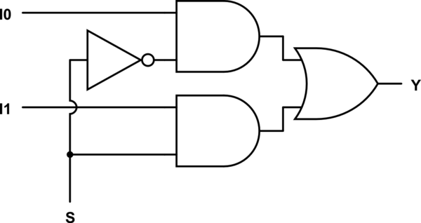
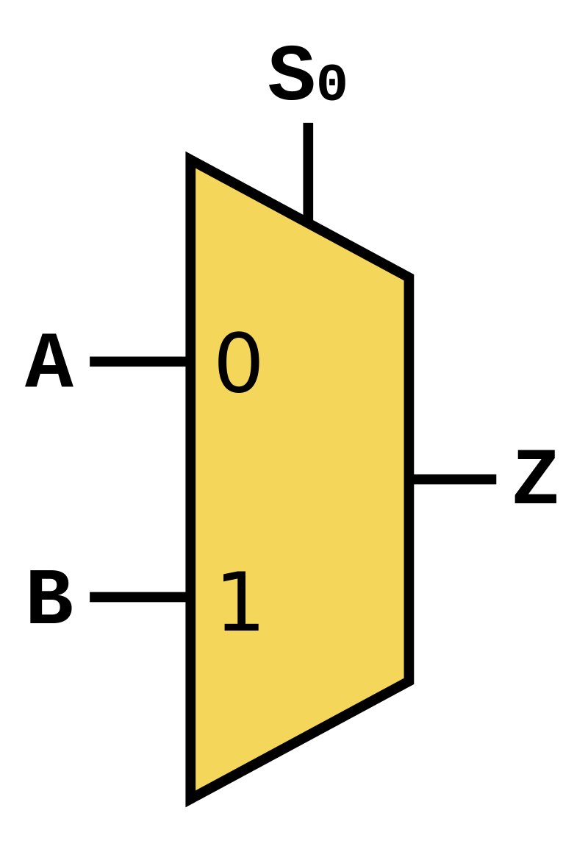
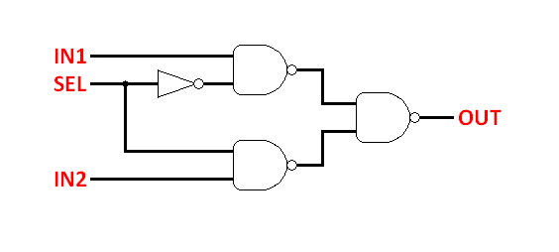
Overview aka how it do?

Slide 5
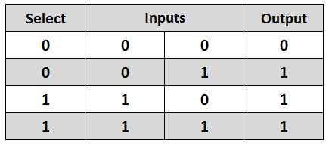
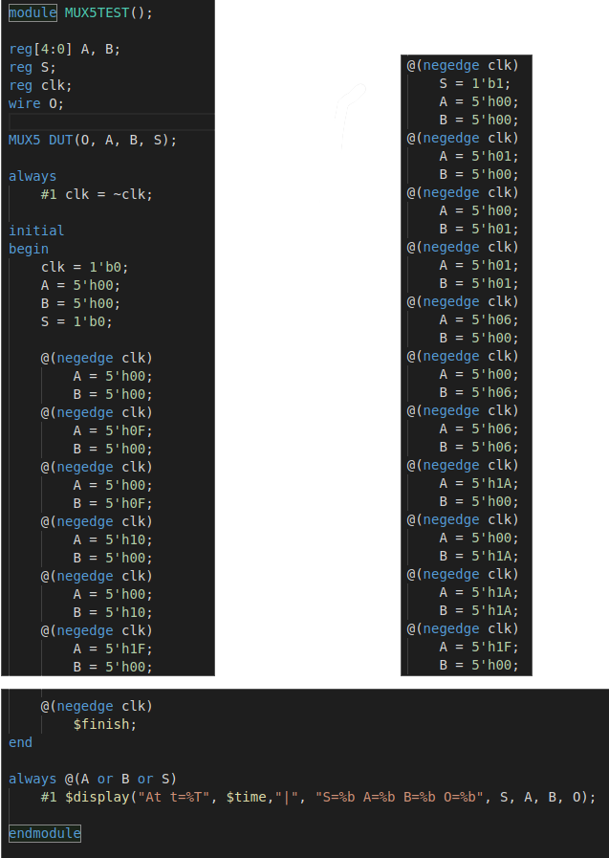
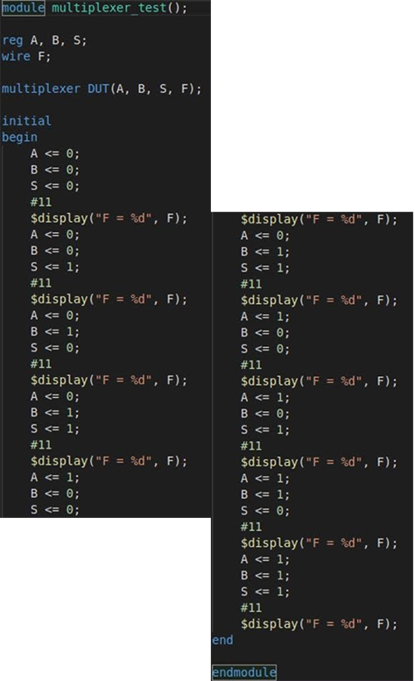
Test Cases

Slide 6
Issues with
Muxes Implementations
One of the most common implementation problems comes with moving a completed MUX into a full processor. When implementing a MUX into a full processor you can get an unexpected “x” value when it was working by itself.
Another issue is mislabeling a variable and not listing it as a register then it will produce an output that tells you that the register you are trying to use does not exist.
The other issues can either stem from misspelling or missing a line of code which would make your mux no longer work and integration into a single cycle processor impossible.

Slide 7
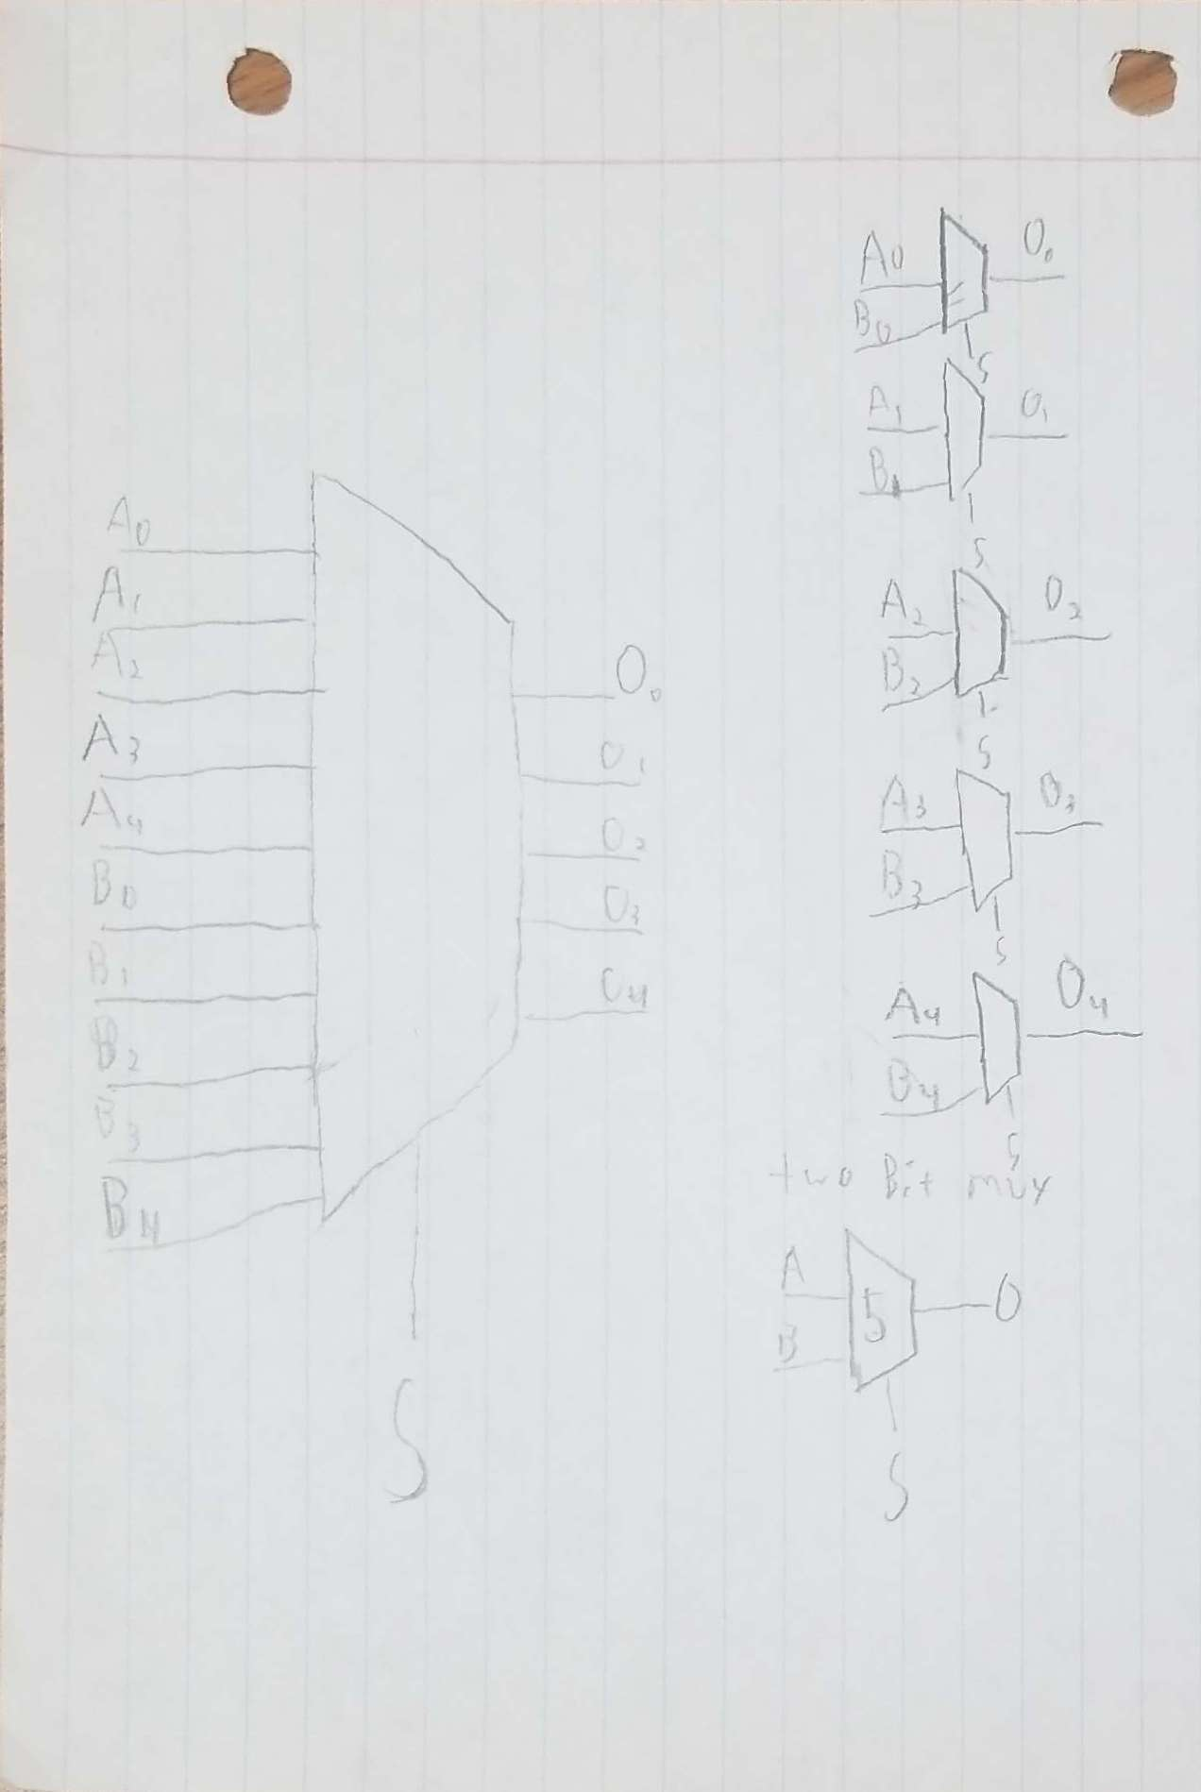
Gate Delay - 5 Bit Mux
Because of parallelism, muxes work all at the same time.
This means that the Gate delay is 5, like a 2 bit mux

Slide 8
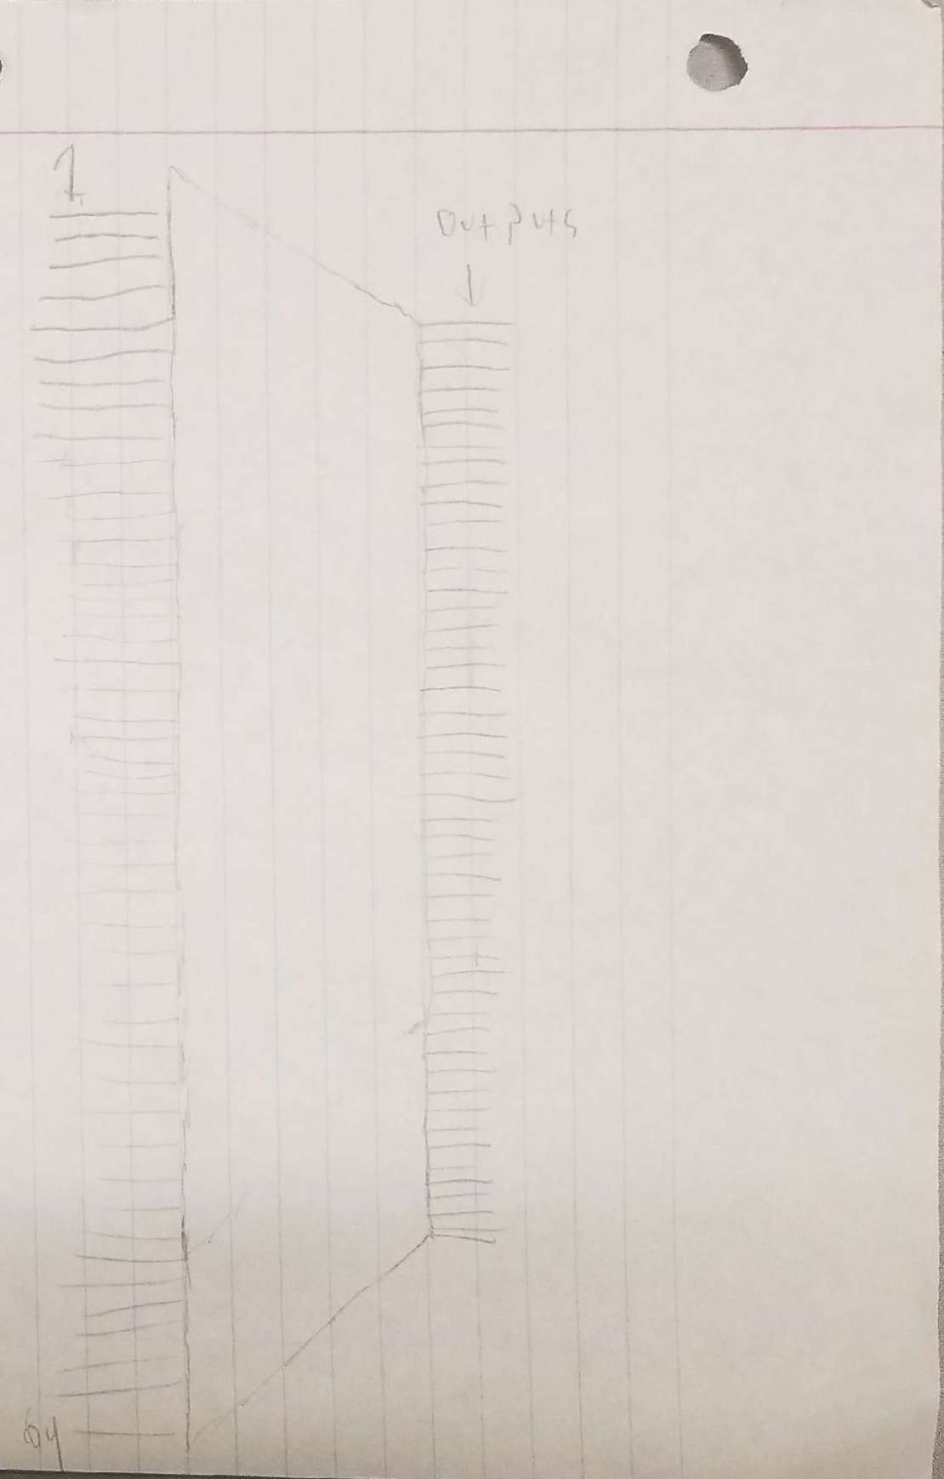
Gate delay 64 bit mux
The 64 bit mux is the same concept as the 5 bit.
Everything works in parallel, so the gate delay is 5.

