Slide 1
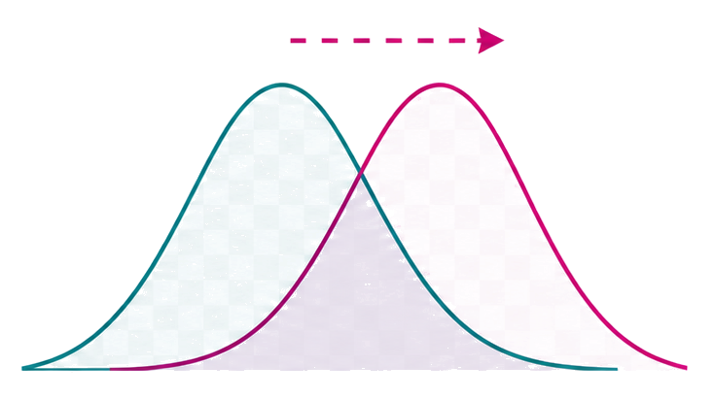

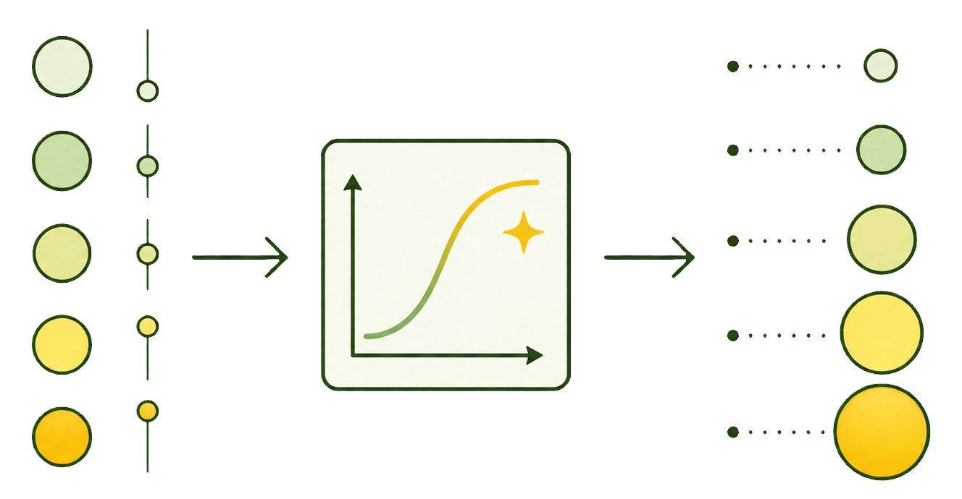
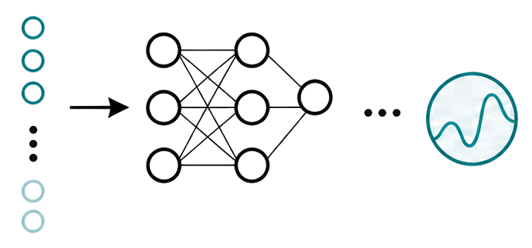

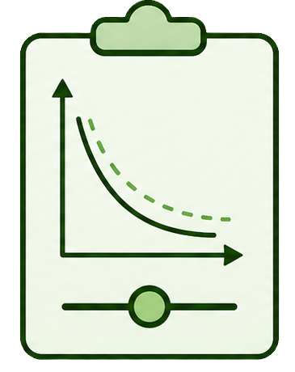




Step 1: Steered Generation
Step 2: Adaptation
Oracle
steer
Reward Shaping
$$r\left(x\right)→\hat{r}(x)$$
Reward $r(x)$
Generator $p_{θ}$
Learning
Objective
Regularization
Fine Tuning
$$θ←θ−η∇L(θ)$$

