Slide 1

Economic Excellence
Zuzanna Whitman, Leo Nelson, Trevor DeVries, Eric Johnson

Slide 2
Financial Survival Web App
Budgeting • Mortgage • Investment • Financial Health
Team Members: Zuzanna Whitman, Leo Nelson, Trevor DeVries, Eric Johnson
Technologies: Python, Flask, HTML, APIs

Slide 3

The Problem
Many people struggle with:
Managing monthly budgets
Understanding mortgage affordability
Knowing when to invest
Financial tools are often:
Too complex
Not personalized
Spread across multiple platforms

Slide 4
Our Solution
One centralized financial web application
Provides:
Budget analysis
Mortgage affordability estimation
Investment decision support
Financial health scoring
Simple, user-friendly interface

Slide 5

Key Features
Budget Analyzer
Mortgage Calculator
Investment Decision Tool
Financial Health Score

Slide 6
System Architecture
Frontend:
HTML user interface
Backend:
Flask (Python)
Modules:
Budget logic
Mortgage calculations
Investment engine
Score system
Data flow:
User input → Flask → Python logic → Results displayed

Slide 7
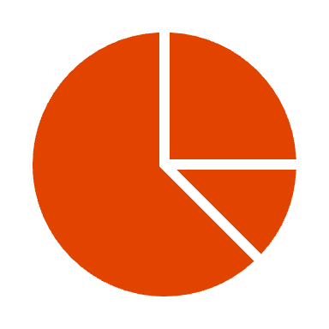
Budget Analyzer
Categorizes expenses:
Needs
Wants
Savings
Calculates:
Monthly income
Total expenses
Remaining balance
Determines:
Risk level (Low / Medium / High)
Includes:
Crisis mode for emergency budgeting

Slide 8
Budget Logic Highlights
Wants = remaining income after needs and savings
Automatically adjusts spending limits
Alerts user if:
Overspending occurs
No savings detected
Monthly loss occurs
Provides percentage breakdown of spending

Slide 9
Mortgage Calculator
Inputs:
Credit score
Income
Debt
Down payment
Calculates:
Interest rate based on credit score
Monthly mortgage payment
Property tax, insurance, PMI
Outputs:
Total monthly cost

Slide 10

Mortgage Intelligence
Applies real-world rules:
28% housing rule
36% total debt rule
Determines:
Whether a home is affordable
Calculates:
Maximum affordable home price
Uses realistic financial formulas

Slide 11

Investment Decision Tool
Uses real-time market data:
S&P 500 (SPY)
VIX (volatility index)
Interest rates
Unemployment rate
Analyzes market conditions
Generates a recommendation:
BUY / SELL / HOLD

Slide 12
Investment Logic
Scoring system based on:
Market trend (SPY vs 200-day average)
Volatility (VIX)
Interest rates
Economic strength
Produces:
Market regime (Risk-On / Risk-Off / Neutral)
Provides reasoning behind decisions

Slide 13
Financial Health Score
Calculates:
Monthly survival duration
Based on:
Income vs expenses
Outputs:
Score (0–100)
Helps users understand financial stability

Slide 14

Interest-Based Decision Model
Simple rule-based system:
High interest → Invest
Low interest → Wait
Demonstrates basic financial decision logic
Supports investment feature

Slide 15
Live Demonstration
Budget analysis example
Mortgage calculation example
Investment recommendation example
Real-time outputs from user input

Slide 16

Challenges
Integrating multiple features into one app
Connecting frontend and backend
Handling user input validation
Working with external APIs
Maintaining realistic financial logic

Slide 17
Future Improvements
User accounts and data storage
Improved UI/UX design
Mobile-friendly version
More financial tools (retirement, taxes, etc.)
Enhanced data visualization

Slide 18
Conclusion
All-in-one financial decision tool
Helps users:
Budget effectively
Buy homes responsibly
Invest wisely
Combines real-world financial logic with usability

Slide 19

Questions?
Thank you!

