Slide 1


Welcome to
BLAW 3100

Slide 2
Welcome to Business Law 3100!
Lectures: Catherine Ryan
Course Material: http://www.bcit.ca/learn/
Labs:
Financial Management – Catherine – Sets Fmgt 3G, 3H
Catherine_Ryan@bcit.ca
- Joao – Sets 3B, 3D, 3N, 3P
Joao_Molinari@bcit.ca
- Clayton – Set 3A
Clayton_Greenwood@bcit.ca
If we contact you via D2L email, please reply to the emails above.

Slide 3
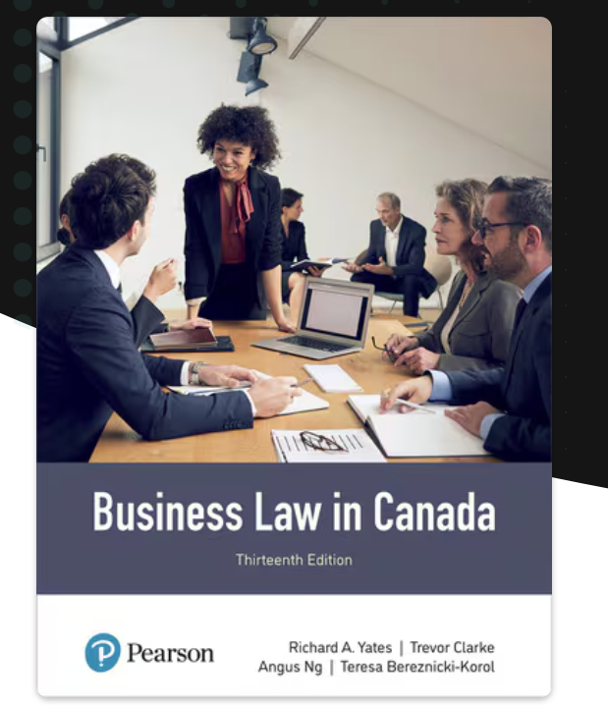
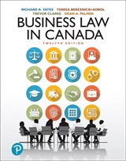
Textbook (Thirteenth or Twelfth Edition)

Slide 4
E-Textbook Information
You will choose EITHER option 1 OR option 2 below.
Option 1 (with digital learning tools, such as practice quizzes, flashcards):
Revel Business Law in Canada 13e Canada Version - Yates, Bereznicki-Korol, Clarke, Pearson
https://console.pearson.com/enrollment/mbhu3h
If you choose this option 1, you are required to register at the link above. You will then use Revel Application on your phone or computer to have access to the etextbook and to the digital learning tools, such as the practice intra- and end-of-chapter quizzes. These digital studying aid tools may help enhance your learning throughout the course. but in no way are required or a must-have to be successful in this course.
Option 2 (etextbook only):
Pearson eText for Business Law in Canada 13e Canadian Edition - Yates, Bereznicki-Korol, Clarke, Pearson
Available at BCIT Bookstore - https://www.bcit.ca/bookstore/

Slide 5
Textbook Tip!
There are summary sections for each lecture at the end of each textbook chapter

Slide 6
My CV in a nutshell
Burnaby Central High School, Science, Library Science and Law at UBC
BC Supreme Court Law Clerk, research for 5 Judges, articled and practised Insurance Defense litigation at Harper, Grey Easton
Ran the Library and taught legal research at Bull, Housser and Tupper
Taught Legal Writing and Legal Research at UBC Law School for 5 years while working downtown
Have taught here at BCIT since 1987 and was delighted to receive the Teaching Excellence Award in 2015 and again in 2024
Very excited to have this class together!

Slide 7
Course Outline:
Evaluation
Chapter Quizzes | 25% | -Weekly chapter quizzes done in lab
Presentation | 20% | Students in teams present a summary of a legal case to illustrate principles studied in the course.
Midterm Exam | 25% | Midterm covers specified chapters and any other material covered in lectures and labs.
Final Exam | 30% | Not cumulative. Only covers material after the midterm.
Total | 100%

Slide 8

Why Learn Business Law?

Slide 9
Why Learn Business Law?
To Avoid and Resolve Legal Disputes
To Avoid Legal Disputes
Take care when....
Criticising a product
Advising a client/customer
Selling to a minor
Reading and analyzing a contract
Buying property
To Resolve Legal Disputes
Be aware of...
The consequences of breaching a contract, infringing a copyright or trademark, making a false statement
Risks of litigation
Litigation procedures

Slide 10
Why don’t businesspeople hire lawyers whenever they have legal problems?
lawyers are expensive
so try to avoid legal problems in business
and if you cannot, then know when problems exist-identify legal issues
then decide if a lawyer is needed
knowing business law helps us develop these skills

Slide 11
Business Law in Canada
Chapter 2
Introduction to the Legal System
(Part a)

Slide 12
Definition of Law
Law is the body of rules
that can be enforced by the courts or government agencies

Slide 13
Categories of Law (1 of 2)
Substantive Law
  The rights and rules that govern behaviour and set limits on conduct
Procedural Law
  determines how substantive laws will be enforced

Slide 14
Categories of Law (2 of 2)
Public Law
  Includes Constitutional Law and determines how the country is governed and regulates our relationship with government
Private Law
  Governs personal, social and business relationships

Slide 15
Law is? Morality is…
Law is a set of enforceable rules
Broken rules are “legal wrongs”
A legal wrong is not necessarily a moral wrong
Moral rules guide judgements about behaviour
Broken rules are moral wrongs
A moral wrong is not necessarily a legal wrong
But frequently they intersect : theft is both a moral and a legal wrong

Slide 16
Classifications of Law
Systems: Common-Law
Civil-Law
Wrongs: Criminal Wrongs
Civil Wrongs
Types of Civil Wrongs

Slide 17
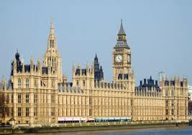
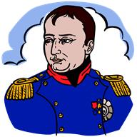
Systems: Common-Law and Civil-Law
Common-Law System
English Canada, England, Former British Colonies
Based on court cases
Follows precedent
“stare decisis”
Civil-Law System
Quebec, France, Germany, China, many other countries
Based on Civil Codes
Judges not bound by prior cases but may be influenced

Slide 18
“Civil Law” has two different meanings
“Civil-Law System” – the legal system used in Quebec or France etc.
that is different from the Common-law system of the rest of Canada
“Civil Law”($$ money compensation for harm)
that is different from “Criminal Law” (punishment and deterrence for crimes)
both Civil and Criminal laws make our Common Law

Slide 19


Wrongs: Criminal and Civil
Criminal Wrong
A wrong done by an individual against the state
A crime – like murder
Procedure: prosecution by Crown Prosecutor against Accused
Purpose: to punish, deter, rehabilitate
Civil Wrong
A wrong done by an individual against another individual
A “cause of action” – like wrongful dismissal
Procedure: lawsuit or legal action by plaintiff against defendant
Purpose: to compensate for harm $$

Slide 20

Types of Civil Wrongs
Tort – e.g. negligence, defamation, assault, trespass etc.
Breach of contract
Statutory wrong – e.g. breach Residential Tenancies Act etc.
Equitable wrong – the catch-all – e.g. fraud etc.

Slide 21
Consequences of a Civil Wrong
Creates a “cause of action”
  that entitles the wronged individual (plaintiff)
  to sue the bad guy (defendant)
Court grants a Judgment
  Plaintiff might win ($$)etc. or
  Plaintiff might lose (0), so defendant wins
Remedies: “Damages” ($ money compensation), injunction etc.

Slide 22
Legal History – Our Law Comes From…
Ancient Rome
Medieval Europe
Medieval Church Law
Traditional Commercial Law – “the Law Merchant” from the Guilds

Slide 23
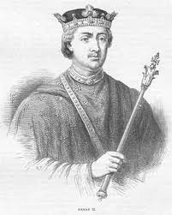
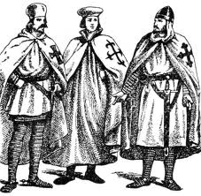
Features of the Common Law
King Henry II of England set up travelling courts to show his royal power
These “common-law” courts followed local customs and, where there were gaps in the law, borrowed from Roman Law, Church Law, and the Law Merchant (“medieval international commercial law”).
The medieval civil wrongs were based largely on what we now know as tort and contract.
There were no legal codes so judges followed decisions given in previous cases.
Stare decisis or following precedent thus developed
Stare decisis means to stand by what has already been decided
Prior decisions are binding if they come from a higher court in the same jurisdiction and if the facts are similar.
Lawyers argue by similarity “same facts” or by dissimilarity; they distinguish “different facts.”

Slide 24
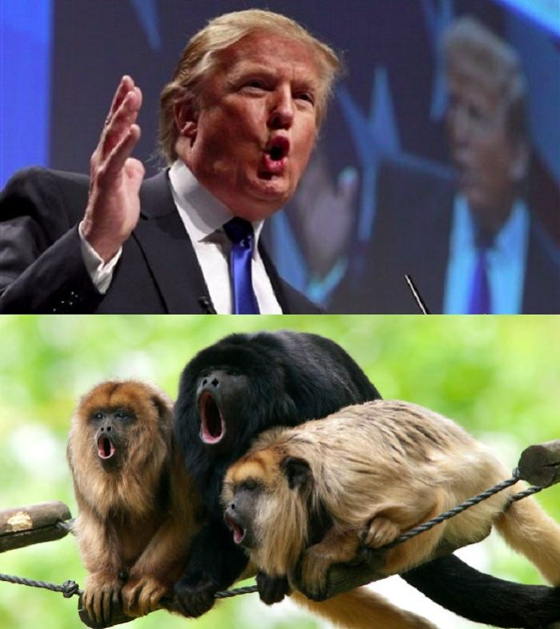
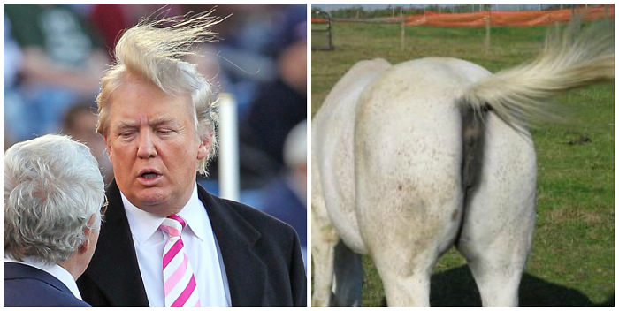
Following precedent (Stare Decisis)
Arguing by similarity
What is the same?
Arguing by dissimilarity
What is different?
Distinguish the facts

Slide 25

Example of “arguing by similarity”, versus “distinguishing” two cases on the facts
Mom Tom he cannot play outside after dark. Tom is 11 years old and Tom is mad.
Mom reminds him, “Your older brother Jack was not allowed to play outside after dark when he was 11. The world is a dangerous place, after dark.”
(Mom is arguing by similarity)
Tom replies, “But I am four inches taller and ten pounds heavier than Jack was at 11 and I have a green belt in Taekwondo.”
(Tom is distinguishing facts)

Slide 26
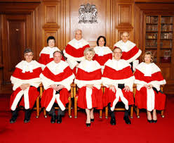
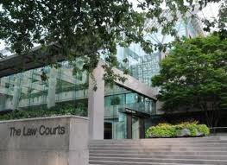
General Principles of Stare Decisis:
A decision of a court (first court) is binding on another court (the second court) when…
The facts in both cases are similar enough to justify it.
The first court is in the same jurisdiction (province) as the second court
The first court is at a higher level than the second court e.g. a decision of the BC Court of Appeal binds the Supreme Court of BC
The highest court is Supreme Court of Canada
Q: Why wouldn’t the Court of Appeal of Nova Scotia bind a lower court in B.C?

Slide 27
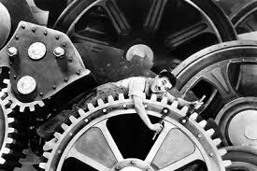
Why is the concept of Stare Decisis so critical to the smooth functioning of business and the economy?

Slide 28
Stare Decisis – Pros and Cons
more predictable and thus more stable.
You can know when to settle outside of going to court
And make better business decisions and personal choices with better outcomes.
But a system run on stare decisis has a disadvantage: it can sometimes be harsh and inflexible
Which is why “Equity” evolved

Slide 29
Equity
The common law evolved as an inflexible system, because it was based on precedent.
People who suffered injustice, that was not characterized as a breach of contract or tort, could not get a remedy.
So, in medieval times the Court of Equity or Chancery was set up to deal with other types of civil wrongs.
To decide on the basis of “fairness” or “equity” rather than according to the strict rules of the common law
In the 19th Century, the Courts of Equity and the Courts of Common Law were merged.
So today in Canada the same courts decide issues of common law and equity and can give both $ damages and equitable remedies.

Slide 30
The Canadian Constitution
(Part b)

Slide 31
Concept Review -- Sometimes True or False
The civil law system can be distinguished from the common law system by its use of a written body of rules known as the ______________
The doctrine of following precedent is known as _____________
A Supreme Court of Canada decision will not bind a lower court if parliament subsequently enacts a law that overturns that decision. T F
A judge of the Alberta Court of Appeal is free to ignore a Manitoba trial court’s decision. TF
Arguing by similarity means trying to persuade a court that the case you are arguing about is based on facts similar to a previous case whose decision you agree with. TF
Equity was a system of law that grew up in England to circumvent the rigidity of the common law. TF
The four classifications of Civil Wrong are ________________
A tort can also be a criminal wrong. TF
Equity was developed to circumvent the rigidity of the common law TF
Law is enforced by Parliament TF
Is the BC Court of Appeal bound by the decisions of the Supreme Court of Canada?
Criminal law is designed to compensate the victims of crime. TF
Libel is insulting your friend in a text message to him.TF
A “cause of action” means facts that enable someone to start a legal action. TF
The criminal law is designed to compensate victims injured by criminal acts. TF
If someone writes lies about you on Facebook you could have a cause of action for ___________?

Slide 32

One More Classification of Law:
Public Law and Private Law
Public Law
The rights and duties governing the individual’s relations with the state
e.g. criminal law, constitutional law, administrative law
(legal, or potential legal, conflict between the state and the individual)
Private Law
The rights and duties governing an individual’s relations with another individual:
e.g. civil wrongs: tort, breach of contract
(legal, or potential legal, conflict between two or more individuals)

Slide 33


What is Canadian Constitutional Law?
The law for interpreting and applying Constitution of Canada.
All laws of Canada, both provincial and federal, must conform to the Constitution.
If a law is challenged as inconsistent with the Constitution, the courts can declare that law is of no force or effect
  “strike it down”
  “it’s unconstitutional”

Slide 34
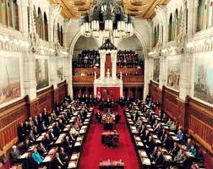
What is a constitution?
An organization's constitution defines its form, structure, activities, character, and fundamental rules
In government, a law that trumps other laws
A law to which other laws must conform
A law entrenching certain legal rights
A law that is very hard to change

Slide 35
A Hierarchy of Law
Constitution
Statute Law
(Laws passed by Parliament & Legislatures)
Judge-made law
(Common Law & Equity)

Slide 36
Hierarchy of Laws Explained
Statute Laws (Legislation) (Acts)
  both Federal and Provincial statutes
    will over-ride common law and equity court decisions on the same issue.
However, The Constitution trumps all.
It is the “Supreme Law of Canada”
  will over-ride Statute Laws, Acts etc. &
  will over-ride common law and equity court decisions on the same issue.

Slide 37
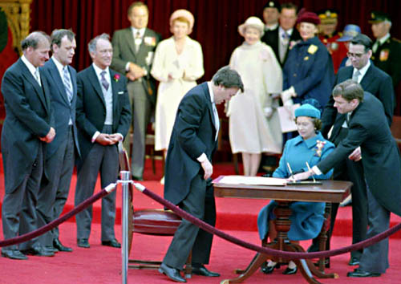
The Canadian Constitution
Constitution Act, 1867
Constitution Act (1982) which includes …
The Canadian Charter of Rights and Freedoms

Slide 38
Conventions
Canada inherited certain conventions or traditions from Britain which are written into the Constitution Act, 1867, which carries over into the Constitution Act, 1982
Including:
  Democratic parliamentary system
  The Supremacy of Parliament
  Rule of Law (although Parliament is supreme, government cannot act arbitrarily, must act in accordance with law; all are equal in the eyes of the law)
  Principles (e.g. such as the rule of law) established in the Magna Carta and the English Bill of Rights

Slide 39
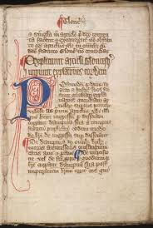
The Magna Carta of 1215 required King John of England to proclaim certain liberties, and accept that his will was not arbitrary, for example by explicitly accepting that
“no freeman (non-serf) could be punished except through the law of the land”, a right which is still in existence today.
Arguably, this is the very beginning of the Rule of Law.

Slide 40
The Rule of Law
Not the “Divine Right of Kings” or “Rule by Law”
  both of which place rulers above the law.
  the Rule of Law makes all people, King and officials included, subject to the same laws.
  A fundamental legal principle that provides that all decisions by officials or the government that affect peoples’ rights, are made by applying legal principles that are known/published, equally to all people.
In a rule-of-law system:
-- all people are equal under the law
-- government cannot act arbitrarily (e.g. no arbitrary arrest)
-- government action and laws can be reviewed by the courts
-- government cannot make law without the people’s consent
-- people have the right to elect their government
-- there is a constitution,
which is the supreme law to which other laws must conform, as interpreted by the courts

Slide 41

The “Rule of Law” Principle is embodied in s. 7, 9 of the Charter of Rights and Freedoms
“Protection of Legal Rights”
7. Everyone has the right to life, liberty and security of the person and the right not to be deprived thereof except in accordance with the principles of fundamental justice.
…
9. Everyone has the right not to be arbitrarily detained or imprisoned
…

Slide 42

Constitution Act (1867)
Was the British North America Act, 1867 (BNA Act)
Created the “Dominion of Canada”
It divides Government into 3 branches: Executive, Legislative and Judicial
Sections 91 and 92 divided powers to make laws between federal and provincial governments
Why was the BNA Act hard to change?

Slide 43


Constitution Act (1867)
S.91 allocates law-making powers to the Federal government
for crime, banking, railways, currency, military……
S. 92 allocates powers to the Provincial governments
for health care, education, administration of justice….
Federal government has P.O.G.G. – power to make laws for Peace, Order and Good Government…all areas not allocated.
If a Federal & Provincial law are in clear conflict, the Federal law prevails

Slide 44
Constitution and Division of Powers
Table 2.1 Division of Legislative Powers
Federal—Section 91 | Provincial—Section 92
Trade and commerce | Municipal institutions
Employment insurance | Hospitals (and health care)
Raising monies by any mode of taxation | Direct taxation within the province
Criminal law (although not its enforcement) | Administration of justice within the province
Banking, currency, postal service | Property and civil rights
Indians, and Lands reserved for the Indians. | Management and sale of public lands
Residual power under the “POGG” clause | Generally, matters of a local or private nature

Slide 45
Paramountcy
Powers of the federal and provincial governments can overlap considerably
  If overlap is incidental, both laws are valid and operative
Where laws truly conflict paramountcy may require that the federal legislation be operative and the provincial legislation no longer apply

Slide 46
Constitution and Division of Powers
“Peace, Order and Good Government” (POGG) clause
  Federal government has residual power to make law on things not included in Constitution Act
Divides law making power among three branches of government:
  legislative branch which creates legislation or statute law
  judicial branch which interprets legislation and makes case law
  Executive branch which implements the law

Slide 47
Sources of Law in Canada
Sources of Law in Canada
Branch of Government | Legislative | Executive | Judicial
Who fills these positions? | Federally: Parliament | Prime minister and cabinet ministers together with each department’s civil servants/ bureaucrats | Judges appointed by the various provinces and federally appointed justices
 | Provincially: Legislative Assemblies | Premier and the cabinet together with each department’s civil servants/bureaucrats
Type of law made | Statute law (legislation) | Subordinate legislation • regulations made by order-in-council or as authorized by legislation • bylaws made by municipal governments | Case law

Slide 48
Indigenous Rights and Self-Government
First Nation, Inuit, and Métis peoples see their right to self-determination and self-government as an inherent right
  pre-existing right rooted in occupation and government before European settlement
Royal Proclamation of 1763
  established the relationship between the Crown and First Nation communities as nation-to-nation
UN Declaration on Rights of Indigenous Peoples (UNDRIP)

Slide 49
Indigenous Rights and Self-Government
Businesses must respect Indigenous rights and title
  Failure to consult Indigenous peoples may be costly
Section 35 of the Constitution Act, 1982 recognizes and affirms existing Indigenous and treaty rights

Slide 50

Constitution Act (1982)
Lists the statutes that have “constitutional status”
Ends ties with British Government
Charter of Rights and Freedoms
Establishes amending formula for constitutional change that is complex and therefore hard to make happen
  the approval of the Senate and House of Commons
  and of the legislative assemblies of at least
  two thirds of the provinces
  with at least 50% of the population of all provinces.

Slide 51

Charter of Rights and Freedoms
Entrenches individual rights (see amending formula)
Protects individuals from infringement on their rights by governments or their agents or agencies acting in a governmental capacity
Empowers people to argue in court that legislation is contrary to the Charter
Trumps the principle of Parliamentary supremacy

Slide 52
Charter Guaranteed Fundamental Freedoms in Section 2
theoretically applying to everyone in Canada,
  regardless of whether they are a Canadian citizen, or an individual or corporation.
These freedoms can be held against actions of
  all levels of government and are enforceable by the courts.
2. Everyone has the following fundamental freedoms:
(a) freedom of conscience and religion;
(b) freedom of thought, belief, opinion and expression, including freedom of the press and other media of communication;
(c) freedom of peaceful assembly; and
(d) freedom of association.

Slide 53

Fundamental Rights
Democratic Rights [s.3-5] (s.33 cannot abrogate)
Mobility Rights[s.6](s.33 cannot abrogate)
Legal Rights[s.7-14]
Equality Rights [s.15]
Language Rights[s.16-23]

Slide 54
Charter of Rights and Freedoms
Limitations
  Section 1 – can interfere with a right if it can be justified in a free and democratic society
  Section 33 - legislatures can pass Acts that infringe on rights “notwithstanding” the Charter but legislation must be reviewed every 5 years
Only applies – to governments and their agents and to legislation passed by governments….

Slide 55
Ss. 24 and 52 – Enforcement of Guaranteed Rights and Freedoms
Section 24 allows parties to bring forward a claim to the courts when they feel their rights are being violated,
and
s. 52 states that the Constitution of Canada is the supreme law of the land, meaning that “any law that is inconsistent with the provisions of the Constitution is, to the extent of the inconsistency, of no force or effect

Slide 56
Human Rights Legislation
Traditionally common law cases and custom protected human rights and individual freedoms
Legislation now protects individuals against human rights violations in social and private relationships
Canadian Bill of Rights attempted to protect individuals from abuses by government but, ultimately, could not.

Slide 57
Human Rights Legislation
Federal | Provincial
Canadian Human Rights Act | BC Human Rights Code
protect private relationships
Use when problems exist between individuals and corporations
Must comply with Charter
Tribunals, like the Human Right Tribunal hear complaints
Courts may get involved in judicial review of Tribunal decision making process – if natural justice not followed.

Slide 58
Human Rights Legislation & the Charter
If an injured party’s human rights have been breached by another, (e.g. his employer) he can complain under human rights legislation.
If, however, an injured party’s rights have been breached by the operation of legislation, he can bring legal action and ask the court to declare that legislation contrary to the Charter or that the government action is invalid.
Under s.11 of the Charter people also have certain protected legal rights in relation to criminal charges brought against them
e.g. to be informed of the charge and right to a trial without unreasonable delay
e.g. not to be a witness against oneself
e.g. to be presumed innocent until proven guilty
e.g. once acquitted or convicted not to be tried again for the same crime (double jeopardy)

Slide 59
Charter Section11 Rights When Charged With a Criminal Offence
Under s.11 of the Charter people have certain protected legal rights if criminal charges are brought against them
- Right to be informed of the offence charged
- Right to a trial within a reasonable time
- Right not to be a witness against oneself
- Right to be presumed innocent until proven guilty
- Right not to be denied reasonable bail
- Right to a trial by jury if the penalty is 5 years jail or worse
Right not to be tried again
  once acquitted or convicted the right not to be tried again for the same crime.
    No “double jeopardy”

