Slide 1

Business Law in Canada
Chapter 3
The Resolution of Disputes

Slide 2
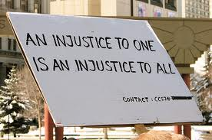
CIVIL WRONGS

Slide 3

Classification of Civil Wrongs
Tort – e.g. negligence, defamation, assault, trespass etc.
Breach of contract
Statutory wrong – e.g. breach Residential Tenancies Act etc.
Equitable wrong – the catch-all – e.g. fraud etc.

Slide 4


Statutory Wrong
e.g. Residential Tenancy Act
s. 9 If a landlord accepts a security deposit or a pet damage deposit that is greater than the amount permitted under subsection (1), the tenant may deduct the overpayment from rent or otherwise recover the overpayment.
e.g. Trade-marks Act
s.53.2 Where a court is satisfied... that any act has been done contrary to this Act, the court may make any order...including an order ... for...injunction and the recovery of damages or profits...

Slide 5

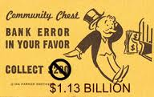
Equitable Wrong
(“the catchall”)
Bank mistakenly credits your account with money….it’s not “fair”…
What can the bank do?
Question of “trust”

Slide 6


Wrongs: Criminal and Civil
Criminal Wrong
A wrong done by an individual against the state
A crime – like murder
Procedure: prosecution by Crown Prosecutor against Accused
Purpose: to punish, deter, rehabilitate
Civil Wrong
A wrong done by an individual against another individual
A “cause of action” – like wrongful dismissal
Procedure: lawsuit or legal action by plaintiff against defendant
Purpose: to compensate for harm $$

Slide 7
How do you right civil wrongs?
Alternative Dispute Resolution “ADR”
Litigation
“Go to Court”

Slide 8
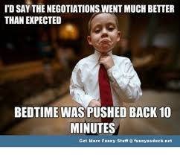
Alternative Dispute Resolution
Process for resolving disputes outside of the courts
3 Options:
  Negotiation
  Mediation
  Arbitration

Slide 9

Negotiation
“Self help”
Parties discuss the problem together and try to find a solution – decision making is left in the hands of the disputing parties to work out for themselves
Involves cooperation and compromise
Goes better with good communication skills
Effective negotiators use argument by similarity
Parties may use representatives
Process may make the relationship better
But…the solution agreement may not be legally binding

Slide 10
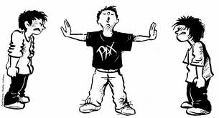
Mediation
Neutral outsider helps parties settle the dispute by coming to a resolution on their own
Communication and agreement facilitated by mediator
  Finds common ground
  Encourages concessions
Mediator does not make decision
Mediation sometimes required before court will hear case
Court may affirm mediated agreement

Slide 11
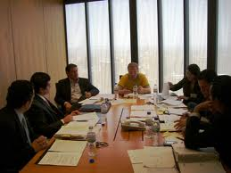
Arbitration
Parties agree on an independent third party outsider to make a decision that will be binding on the parties in the matter under dispute
A solution is imposed on the parties
Often required in contract
Arbitrators are often specialists in the matter under dispute

Slide 12
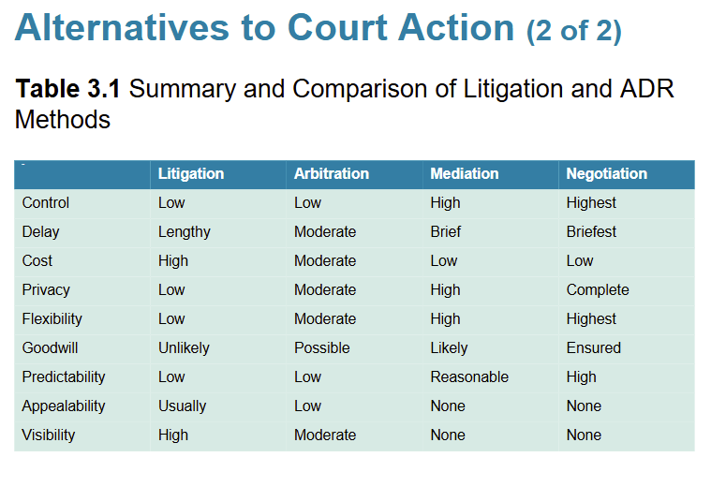

Slide 13
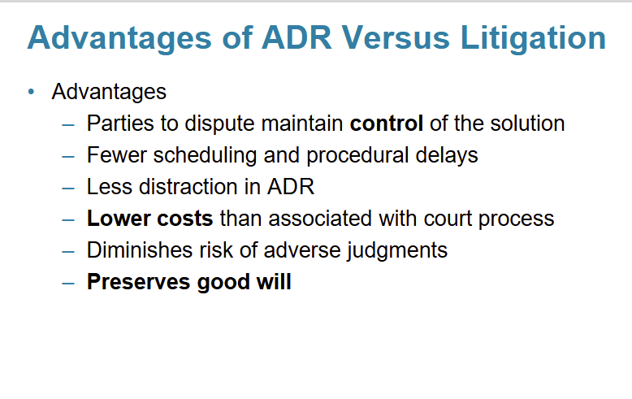

Slide 14
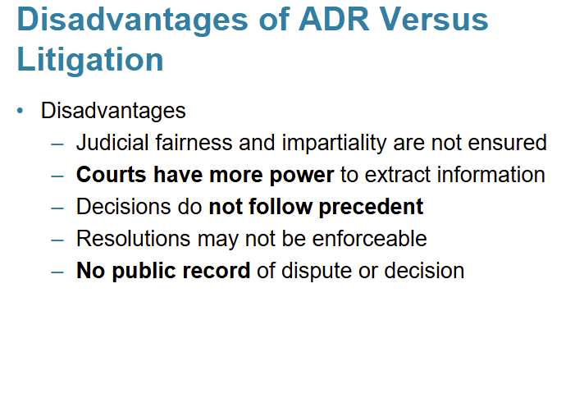

Slide 15
Arbitration
Decision of arbitrator is binding on the parties
Decision cannot be appealed to the courts (because of Provincial arbitration statutes)
  although procedures followed may be reviewed by the courts
      was there “due process”??
Advantages: process is private, faster, less costly than litigation,
but more formal and more adversarial than mediation

Slide 16
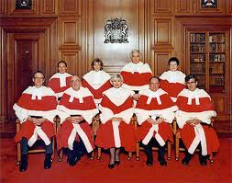
The Court System – for Litigation

Slide 17


Courts Hierarchy
Supreme Court of Canada
Federal Court of Appeal | Court of Appeal of BC
Federal Trial Court | Supreme Court of BC
 | Provincial Courts

Slide 18
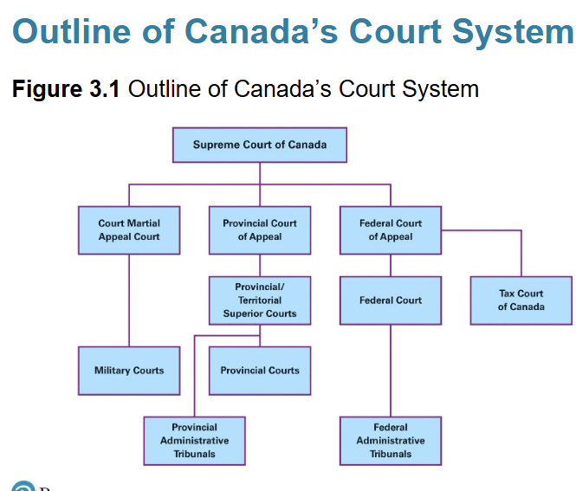

Slide 19
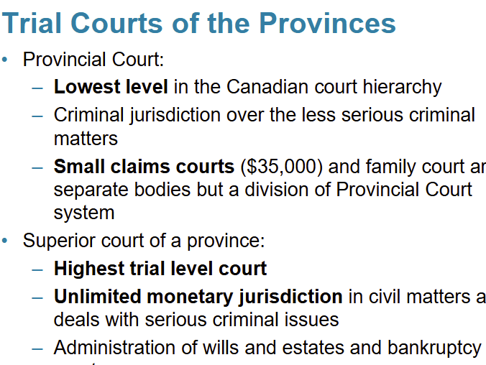

Slide 20
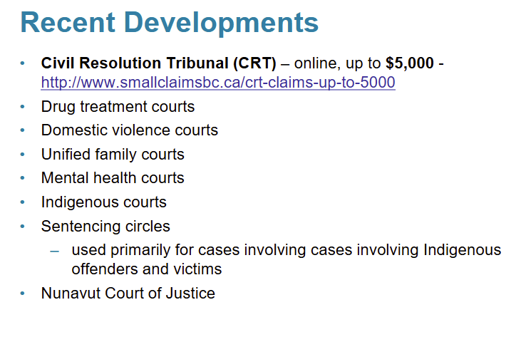

Slide 21
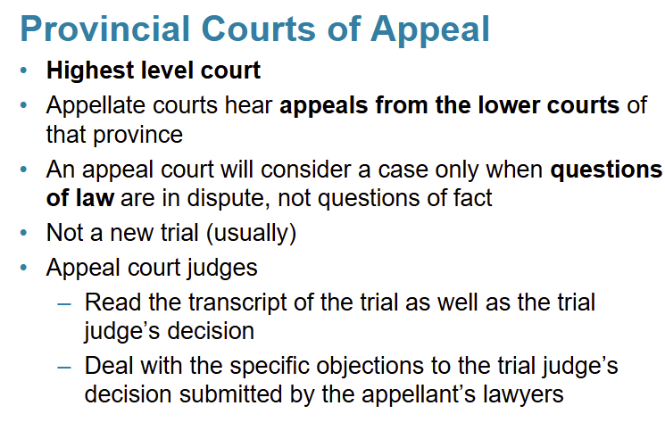

Slide 22
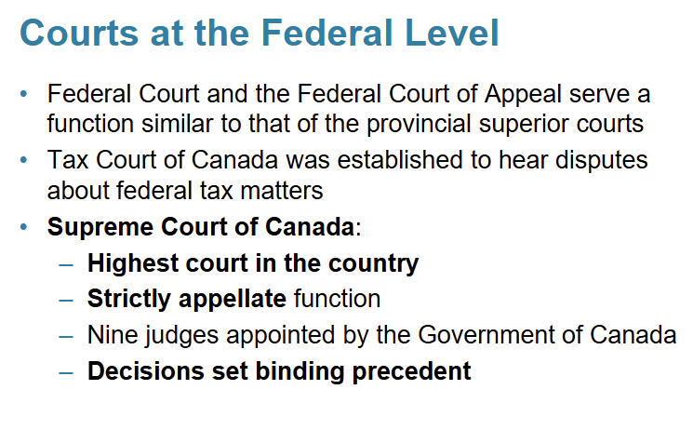

Slide 23
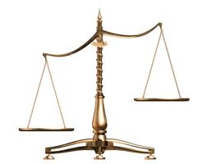
Court’s Criminal Function (public law)
R. v. Accused
In criminal cases, the Crown (state) prosecutes the Accused who is convicted only when state proves the case beyond a reasonable doubt
Victims of crime are merely witnesses at the trial
The court assesses and enforces penalties
Victims are not usually compensated $ for their injuries

Slide 24
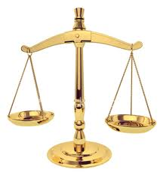
Court’s Civil Function (private law)
Plaintiff v. Defendant
Private individuals ask the court for remedies for civil wrongs or to reject claims for civil wrongs.
Court's decision is based on balance of probabilities
Court assesses liability, finds fault, holds one party responsible and gives a judgment.
  and can enforce judgment too.
Plaintiff can win $$ compensation from defendant, or Plaintiff can lose so claim is rejected or dismissed.

Slide 25
Civil & Criminal Standards of Proof
Civil standard of proof
On a balance of probabilities
B.O.P.
Criminal standard of proof
Beyond a reasonable doubt – B.A.R.D.

Slide 26
How to Enforce Your Rights
You may wish to go to court and get help from a judge.
If a civil wrong has been done to you, what procedures will you use to start a lawsuit?

Slide 27
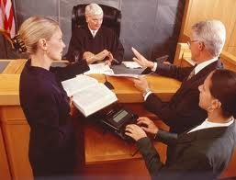
Lawsuit Procedure (Pre-trial)
Are you allowed to sue?
  Check the Limitation periods and deadlines
      You might be too late!
Jurisdiction? – Where do you sue?
  - Where the Defendant resides or where the harm occurred a “real and substantial connection” with factors that link the litigation to the court
  Which Court? - How much money is at stake?
    - Provincial Court - Small Claims Court for up to $35,000 maximum
    - Supreme Court of BC for unlimited $$
Try “self help” Negotiation

Slide 28
Pre-Trial Procedure With Help From Lawyer
Send a Demand letter to Defendant
  “You harmed the Plaintiff…..we demand you pay….”
File Pleadings in Court Registry
  Notice of Civil Claim – Plaintiff’s side
  Response to Civil Claim – Defendant’s side
  Counterclaim – Defendant says “right back at you!!”
Chambers Applications
Discovery
  Of documents
  Examination for discovery of parties – under oath
  Payment into court

Slide 29
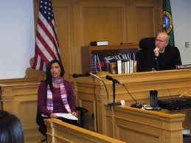
Lawsuit Procedure (Trial)
Plaintiff presents case
  Direct examination of witnesses
  Cross examination by Defendant
Defendant presents case
  Direct examination of witnesses
  Cross examination by Plaintiff
Rules of Evidence used
(e.g. general rule against hearsay)

Slide 30
Lawsuit Procedure (Judgment)
Judge makes findings of fact and applies the relevant law: cases and statutes
Reaches his or her decision, gives reasons and gives a judgment.
If the Plaintiff wins, the remedies awarded can be:
Damages $$ (monetary compensation)
    General Damages are for pain & suffering, wage loss
    Special Damages reimburse expenses caused
    Punitive damages are to ‘punish’ high handed conduct
An Accounting, an injunction, specific performance
Costs – a contribution towards the winner’s legal fees.

Slide 31
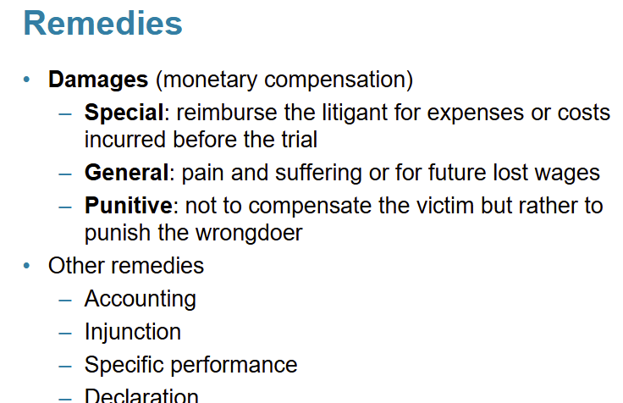

Slide 32
Lawsuit Procedure (After-Trial)
Examination in aid of execution
  To find out about assets to get
Seizure of property – take stuff
Garnishment– get $ from wages
Injunction – an order to stop…

Slide 33
The Start of a Lawsuit
Plaintiff Files a
Notice of Civil Claim
(next four slides)

Slide 34
FORM 1
(RULE 3-1 (1))
No. 78658/Yr+1
Vancouver (Robson Square) Registry
In the Supreme Court of British Columbia
Between
YAKIMA IMPORTS LTD., Plaintiff
and
BRIAN BELSTEAD
Defendant
NOTICE OF CIVIL CLAIM
[Rule 22-3 of the Supreme Court Civil Rules applies to all forms.]
This action has been started by the plaintiff(s) for the relief set out in Part 2 below.
If you intend to respond to this action, you or your lawyer must
(a) file a response to civil claim in Form 2 in the above-named registry of this court within the time for
response to civil claim described below, and
(b) serve a copy of the filed response to civil claim on the plaintiff.
If you intend to make a counterclaim, you or your lawyer must
(a) file a response to civil claim in Form 2 and a counterclaim in Form 3 in the above-named registry of
this court within the time for response to civil claim described below, and
(b) serve a copy of the filed response to civil claim and counterclaim on the plaintiff and on any new
parties named in the counterclaim.

Slide 35
JUDGMENT MAY BE PRONOUNCED AGAINST YOU IF YOU FAIL to file the response to civil claim within the time for response to civil claim described below.
Time for response to civil claim
A response to civil claim must be filed and served on the plaintiff(s),
(a) if you were served with the notice of civil claim anywhere in Canada, within 21 days after that service,
(b) if you were served with the notice of civil claim anywhere in the United States of America, within 35 days after that service,
(c) if you were served with the notice of civil claim anywhere else, within 49 days after that service, or
(d) if the time for response to civil claim has been set by order of the court, within that time.

Slide 36
CLAIM OF THE PLAINTIFF(S)
Part 1: STATEMENT OF FACTS
1. The Plaintiff, Yakima Imports Ltd. is a company incorporated in the State of Washington whose registered office is 4673 Alabama Road, Bellingham, Washington, 96532.
2. The Defendant, Brian Belstead is a businessman who resides at 2137 West 4th Avenue, Vancouver, British Columbia, V4N 6T3.
3. The Plaintiff and the Defendant entered into a written contract on or about September 6, Yr0 in Vancouver, British Columbia ("the contract") the terms of which, inter alia, provided that the Plaintiff would sell and the Defendant would purchase USD$65,000 worth of aluminum cookware manufactured in Indonesia ("the cookware") to be delivered to the Defendant on or before December 12, Yr0.
4. On November 27, Yr0, the Plaintiff through its agent in Vancouver notified the Defendant by telephone that the cookware had arrived from Indonesia and was ready for delivery to the Defendant.
5. Immediately on notification, the Defendant informed the Plaintiff's agent that he would not take delivery of the cookware and would not pay for the cookware.
6.The Plaintiff's agent notified the Defendant to the same effect by telephone and email and sent to the Defendant a similar notification by double-registered post on December 2, Yr0. The Defendant has never replied.
7. The Plaintiff elected to terminate the contract on December 6, Yr0 but despite its best efforts has been unable to resell the cookware to another buyer.
Part 2: RELIEF SOUGHT
1. Damages for breach of contract;
2. Interest;
3. Costs.
Part 3: LEGAL BASIS
1. The Plaintiff says that, as a result of the above, the Plaintiff has breached or is in anticipatory breach of the contract.
2. As such, the Plaintiff has suffered damages in the amount of USD$65,000 plus the costs of warehousing the cookware less any amount it may have, but has not yet, received by way of mitigation when it resells the cookware.

Slide 37
(1) The plaintiff’s ADDRESS FOR SERVICE is: 201-700 Hornby Street, Vancouver, BC V6Z 2E1 (2) Fax number for delivery (if any): 604-263-7854
(3) The name and office address of the plaintiff’s solicitor is: Baldry and Beaudoin, 201-700 Hornby Street Vancouver, B.C. (4) Place of Trial: Vancouver, British Columbia (5) The address of the registry is: 800 Smithe Street, Vancouver, BC V6Z 2E1 May 19, Yr+1 Michelle Beaudoin, Plaintiff’s Solicitor Rule 7-1 (1) of the Supreme Court Civil Rules states: (1) Unless all parties of record consent or the court otherwise orders, each party of record to an action must, within 35 days after the end of the pleading period, (a) prepare a list of documents in Form 22 that lists (i) all documents that are or have been in the party’s possession or control and that could, if available, be used by any party at trial to prove or disprove a material fact, and (ii) all other documents to which the party intends to refer at trial, and (b) serve the list on all parties of record.

Slide 38
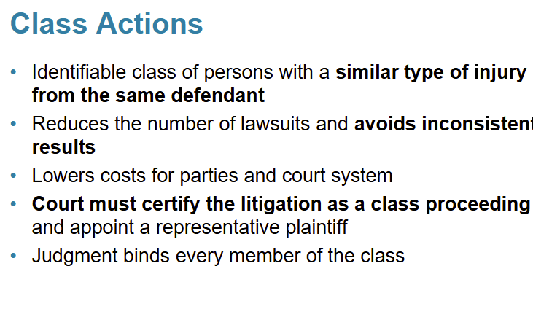

Slide 39
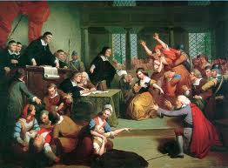
Administrative Law (public law)
The rights of people facing an administrative tribunal are covered by administrative law
An administrative tribunal is created by statute.
Along with an entire regulatory system or body of rules
e.g. the Workers Compensation system and the Workers Compensation Board that is set up under the Workers Compensation Act
    If a worker is injured on the job in BC, it is a no-fault system that takes away the worker’s right to sue the employer.
    And replaces it with compensation under WCB.

Slide 40
Regulatory Role of Government
Executive branch of government is responsible for these regulatory bodies set up by legislation or statutes or Acts.
Government officials must rely on legislation to authorize their acts (the rule of law).
They cannot infringe a person’s rights by virtue of their position.

Slide 41
Resolving Complaints Against Regulatory Agencies
Complaints against the actions of regulatory agencies are usually heard by administrative tribunals.
Decision-making panels with specific expertise
More discretion than judges
More efficient, quicker and cheaper
Administrative tribunals (e.g. Workers Compensation Board) must function according to the rules of natural justice
-

Slide 42
Rules of Natural Justice
Claimant is entitled to a Fair hearing
-- complainant must have reasonable notice of the
hearing
-- opportunity to see and respond to all evidence
-- opportunity to be heard (produce evidence, witnesses)
Heard by decision maker - the people making the decision must be the same ones hearing the evidence
Impartiality - no bias on part of decision makers
(Rules of evidence and procedure used in court need not be adhered to; sometimes depends on rules of the tribunal or the particular circumstances)
If complainant can show she did not get a fair hearing she can apply for “Judicial Review” by the courts

