Slide 1
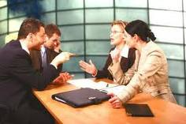
Concept Review (Ch.3) Dispute Resolution
Three categories of ADR?
Criminal standard of proof - BARD
Civil standard of proof - BOP
Lawsuit procedure
(time limits, jurisdiction, notice of civil claim, response & counterclaim, default judgment, examination for discovery, discovery of documents)
Post-trial execution of judgments
(registration against land, garnishing order, examination in aid of execution, asset seizure)
Administrative Law
(private citizen versus government body; rules of natural justice)

Slide 2
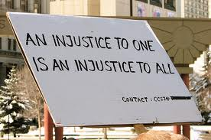
CIVIL WRONGS

Slide 3
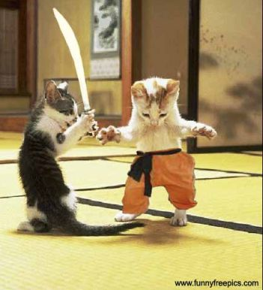
Classification of Civil Wrongs
Tort – e.g. negligence, defamation, assault, trespass etc.
Breach of contract
Statutory wrong – e.g. breach Residential Tenancies Act etc.
Equitable wrong – the catch-all – e.g. fraud etc.

Slide 4
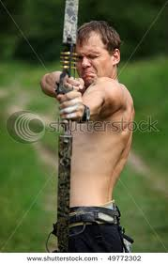
Business Law in Canada
Chapter 4
Intentional Torts

Slide 5

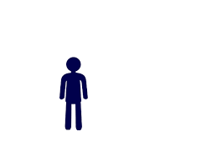
What Is a Tort?
A civil wrong
An action that causes harm to another
  Can be deliberate, intentional action, or
  Can be accidental, careless, un-intentional action
While a crime is a wrong and an affront to society
as a whole, a tort is a wrong to an individual
Some acts may be both crimes & torts

Slide 6
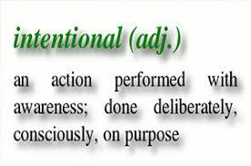
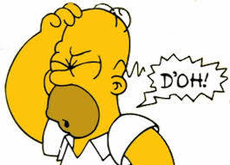
Classifications of Tort
Intentional
  deliberate acts that
  cause injury or loss
Un-intentional
  Careless or accidental acts
  that cause injury or loss
    “negligence”

Slide 7
Intentional Torts
Some Examples
  Trespass to Person = Assault and Battery
  Trespass to Land
  False Imprisonment
  Private Nuisance
  Defamation
  Product Defamation = Injurious Falsehood
Courts may sometimes award punitive damages $$$ in addition to general $$ & special $ damages
Vicarious liability – liability without personal fault
  an employer can be held liable for employee’s torts committed in the course of employment

Slide 8

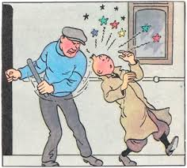
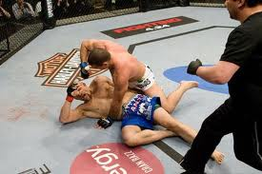
Trespass to Person: Assault & Battery
Intentional physical interference with another person
Assault and Battery
  Assault - where there is fear of imminent contact
    Protects our right to ‘peace of mind’ & includes threats
  Battery – deliberate physical contact without consent
    Protects our body integrity
    Our right to refuse consent to contact
  Does not have to be harmful contact
We have the right to refuse medical
  Treatment – ‘informed consent’
Defences
  1. Accidental contact – no intention – not deliberate
  2. Consent (informed) – to contact – so then it’s okay…
  3. Self-defence (reasonable force) is okay….

Slide 9

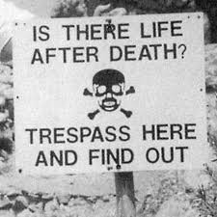
Trespass to Land
Deliberately going onto someone’s land without the owner’s permission or lawful right to go there.
Do not have to prove harm
  Merely “bruising one’s grass” is enough
  ‘Actionable without proof of damage’
  Do not have to prove he intended to trespass
    Ignorance of the property line is no excuse!
Sometimes permission or authority is implied
  a business impliedly authorizes customers to enter
  by virtue of one’s job (e.g. postman, meter reader) authority is implied
Occupier owes only minimal duty to trespasser
unless trespasser is a minor (under 19 yrs. Old)
  Lack of control is a defense for the parents!

Slide 10
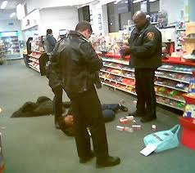
False Imprisonment
The unlawful and intentional restraint of a person against their will
The person doing the restraining has no lawful justification or authority to do so.
Restraint can be physical or even psychological
Restraint may only be lawfully justified if the person has done something they can be arrested for.
  Like shoplifting…
- Citizen’s arrest s. 494 Criminal Code

Slide 11
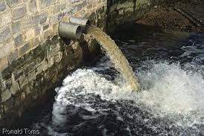
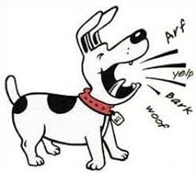
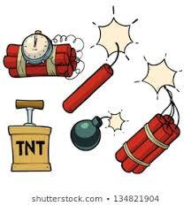
Nuisance
Public nuisance affects public in general usually public land. Usually gov’t brings action
Private nuisance occurs when a person uses their property in a way that interferes with another person’s use and enjoyment of their property
Usually it is with next-door neighbours
“Strict Liability” for inherently dangerous situations or products

Slide 12
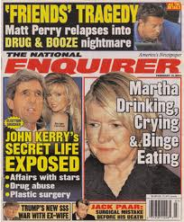

Defamation
A published false statement about someone that is to his or her detriment
  A lie that damages someone’s reputation
must be published or broadcast – communicated to 3rd party
Spoken defamation = Slander
Written defamation = Libel
Of special concern in cyberspace

Slide 13
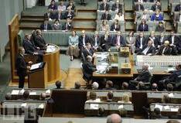
Defamation – How to Get Out of Trouble
Defences
  1. Truth – works every time!
  2. Absolute Privilege – statements made in Court or in Legislature – politicians’ debates
  3. Qualified Privilege – job duties
  4. Fair Comment – public criticism
  5. Responsible communication
  on “matters of public
  importance”

Slide 14
Other Business Torts
Inducing breach of contract
  “head-hunting” enticing employee to quit…
Interference with economic relations
  e.g. $$ kickbacks to staff to get them to use a new supplier instead of the existing one, bribery
Conspiracy
e.g. when two or more people act together to do the above
Intimidation
  e.g. threat of violence or illegal strike…
Intentional infliction of mental suffering
  e.g. harassment associated with wrongful dismissal action
Deceit (civil fraud) – fraudulent & intentionally misleading of another person, causing damage

Slide 15
Other Business Torts continued
Trespass to chattels
  - deliberate damage to stuff
  - kick the door of my car
  Conversion
  - deliberate appropriating goods of another; wrongful taking
  - borrow my lawn-mower & sell it – includes theft
  Detinue
  - wrongful keeping
  - borrow my lawn-mower with permission but then refuse to return it.
Injurious falsehood
-product defamation;
- telling lies maliciously and without just cause about a product or a business that cause harm
- the “chocolate milk tort”….
Passing off action improper use of trademark ….@ C/L

Slide 16

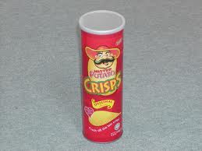
Passing off

Slide 17
Privacy – “Intrusion Upon Seclusion”…
not yet firmly established
Privacy protection provided by statute law
Invasion of a person’s privacy can be physical intrusion, surveillance, misuse of a name or image
Can also be access to information
Personal Information Protection and Electronic Documents Act (federal)
Regulates collection and use of private information
Provides a model code
Personal Information Protection Act (Provincial)
Privacy Act (BC) s3: cannot use someone’s portrait for commercial purposes

Slide 18
A Note about Tort & Loss
Tort law is designed to provide $$$ compensation for injury or damages suffered.
As of 2026 the maximum amount for pain and suffering in Canada is approximately $470,000.
In rare exceptions such as with the tort of trespass to land, or defamation, or battery, the plaintiff does have, in theory, a cause of action, even when no loss or damage has occurred.

