Slide 1
Senior Project
Trevor Engstrom

Slide 2
Overview
Project is a web app for a commercial truck dealer in Fort Myers Florida

Slide 3
Client
Todd Allan Motors
Clients Requirements:
Easy to use / Hard to mess up
Cheap to maintain
Makes the dealership look professional
Solution:
Website
Display’s inventory
Allows client to maintain inventory
Allows client to upload and display information on inventory
store and display photos
Able to contact the dealership from website

Slide 4
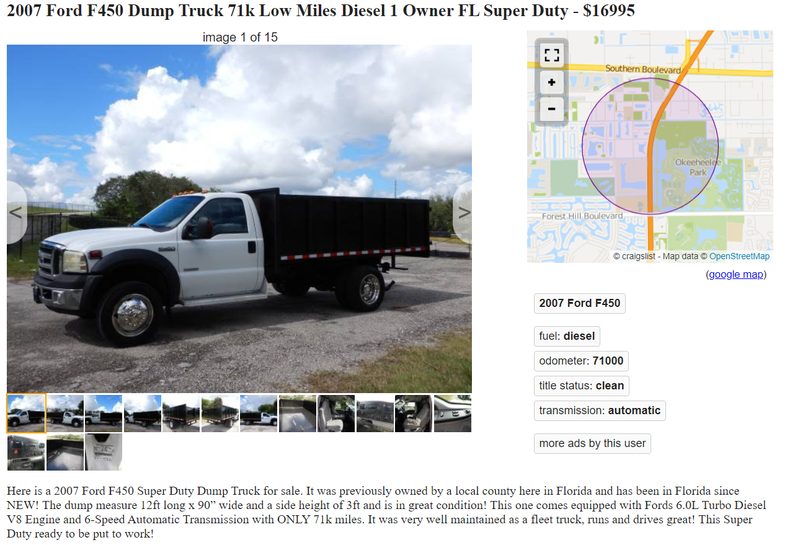
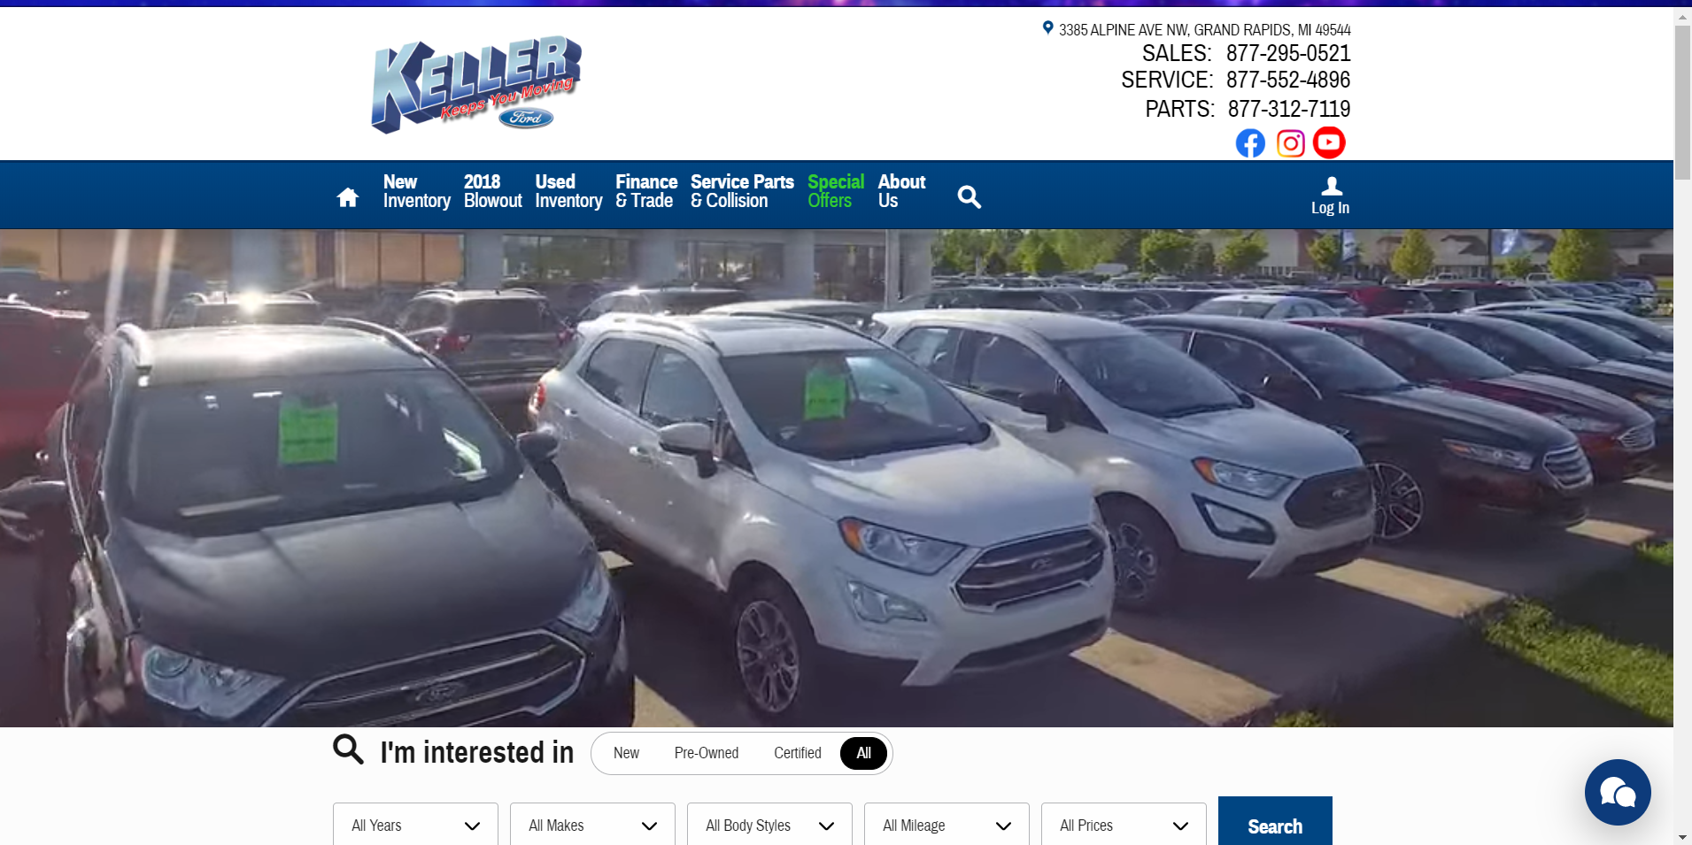
Main Objectives

Slide 5
Methodology
ASP.NET Model View Controller
Visual Studio / C#
Javascript
Vanilla JS Framework
Ajax / JSON
Datatables
JQuery
Dropzone.JS
HTML / CSS
Bootstrap
SQL Server
Entity Framework 6
Linq

Slide 6
Timeline
Complete Log in / Roles / Access (Early November)
Complete database design (Early November)
Complete Dashboard CRUD (Mid November)
Complete Inventory Detail Page (Late November)
Complete Front End Design (Late November / Early December)
Testing / Server Tests (Early December)
Full Launch ( Mid December)

Slide 7
Definition of Done
Front End Design
Views created
Styling
Functioning Javascript
Contact page
Roles
Login system
Registration system
Show/Hide (permissions)
Dashboard
Inventory CRUD
Photo CRUD
Database Design
Inventory Table
Photo Lookup Table
Photo storage
Back End
Entity Framework
Hosting
Server
Domain Registration

Slide 8
Lessons learned
Time allotment / management / projection
Updated support
“Definition of Done”
Client communication / setting expectations

Slide 9
Skills Learned
ASP.NET
Model View Controller
Repository Pattern
Unit of Work
Identity
Roles & Authentication
Visual Studio
Entity Framework
LINQ
Javascript
Vanilla JS / Jquery
Frameworks (Vue / Angular)
Nuget / Plugins
SQL Database
File Storage
Server Deployment
API
AJAX
Datatables
Bootstrap

Slide 10
What's Next
Look ‘n Feel
Testing
Selenium
Role authorization on views & controllers
Database Population
Write copy
About Us
Contact
Financing
Deployment
March 2020

Slide 11
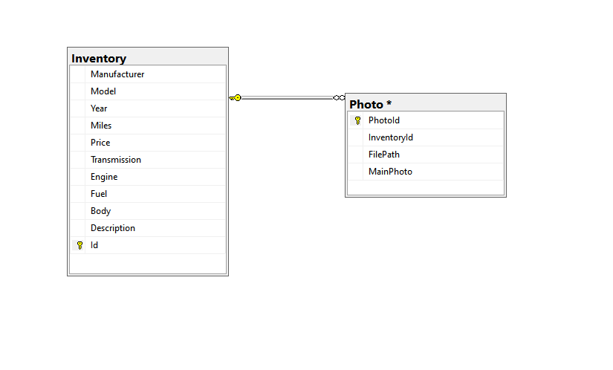
Demo
Questions?

