Slide 1
Senior Project
Trevor Engstrom

Slide 2
Overview
Project will be a central hub for Soldiers to submit unclassified training files (Powerpoints, Papers, video (links), audio, Etc...)
Soldiers in other units/duty stations can log into the system and search/browse the training by title, keywords, or MOS/topic.
Users can rate/download/comment on the training and submit their own versions of the training.
Users will create profiles in order to vote/download/track progress.

Slide 3
Client
SFC Jason O. Eck
111th Military Intelligence Brigade, Fort Huachuca AZ
The client is in charge of Field Training Exercises (FTX) for incoming intelligence Soldiers. The client has almost 20 years of experience in the military and is in tune with the wants and needs of today’s warfighters.

Slide 4
Client Needs
The Client will serve as a liaison to the military and as a sounding board and mentor.
The website will not be built specifically for the client, but the client will have major say in what features are useful and mandatory.

Slide 5
Main Objectives
Create website skeleton / design
Find Server
Create profile system
Create voting system
Create database to host content
Create link allowing users to submit content
Allow viewing/previewing of content online before downloading content
Security!!!
Find cooperating veteran-run sponsors to help advertise site and garner interest.
Content

Slide 6
Main Objective Progress
Create website skeleton / design
Create basic HTML/CSS templates. Focus on design after functionality is established
Find Server
Must be cheap and offer enough storage to handle many PPT presentations
Create profile system
Likely use CRM Software (Still need to learn)
Create voting system
Likely Javascript/PHP (add values then divide; store in DB; Output “star” rating)
Content
Begin soliciting content from old colleagues

Slide 7
Main Objectives Progress
Create database to host content
MySQL
Need to learn about storing different file types
Create link allowing users to submit content
PHP forms with security and limitations
View PPTs before downloading
Allow viewing/previewing of content online before downloading content
Security!!!
OWASP top 10
NO injections
Handling user information / passwords

Slide 8
Main Objectives
Yet to Send
Sent / Waiting
Confirmed
Denied
Find cooperating veteran-run sponsors to help advertise site and garner interest.
Prepare pitch email
Black Rifle Coffee Company | De Espresso Liber | FOB Brewing
Blue Angel Coffee Co | Lock N Load Coffee | Alpha Coffee
GI Joe Coffee | Java Jarhead | Bomb Coffee
Victory Coffee | 11b Coffee | Invader Coffee
Nine Line Apparel | Grunt Style | Ranger Up
Article 15 Clothing | Combat Iron Apparel | Valhalla Wear

Slide 9
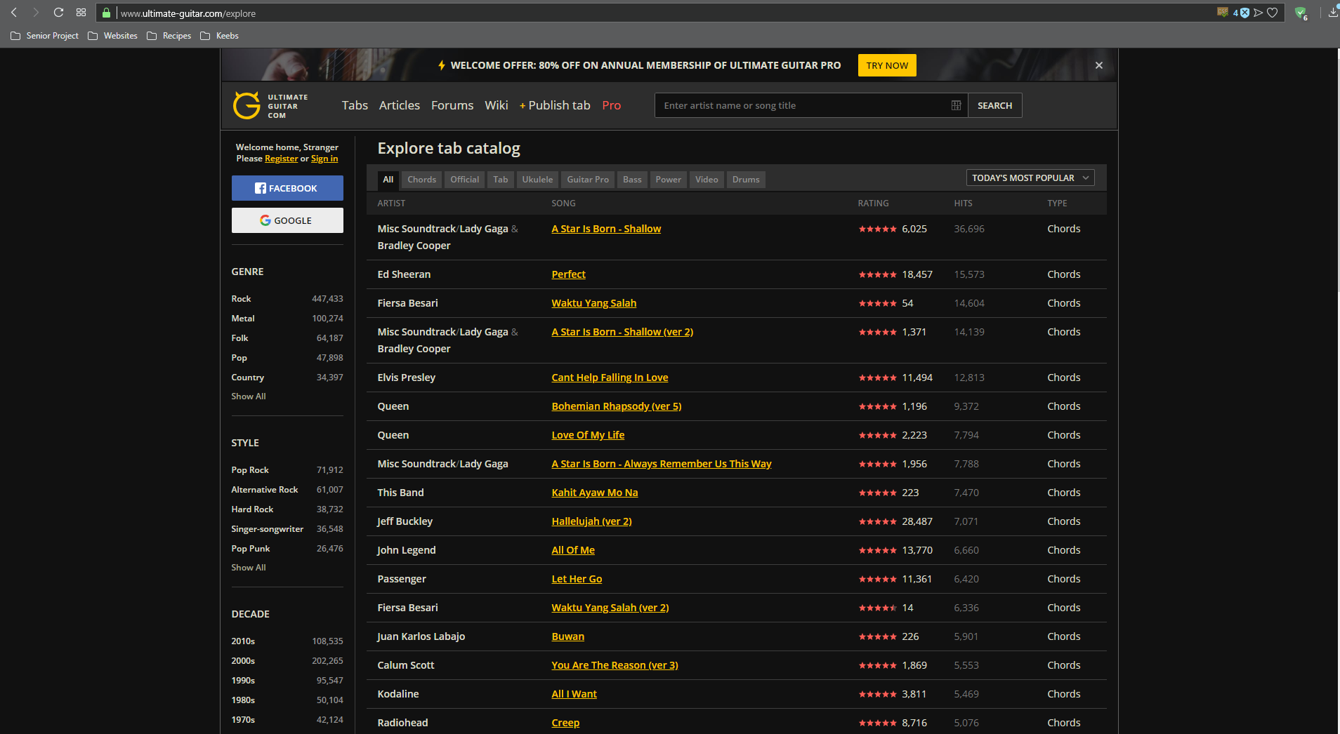
Inspiration / Visualization

Slide 10
Mockup
Search
Browse
Branch:
Topic:
MOS:
Top Trainings
Recent Trainings
News / Announcements

Slide 11
Timeline
Complete web design (Early September)
Complete database design (Early October)
Complete functionality and interaction between app and database (Early October)
Complete security tasks (Mid November)
Launch web app on server (Mid-Late November)
Testing (Early December)
Full launch (Early December)

Slide 12
Skill Learning
HTML
CSS
Javascript
PHP
MySQL
CRM
Security

Slide 13
Questions?

