Slide 1
A guide to okay figures from an idiot
Why this is bad
and this is okay

Slide 2
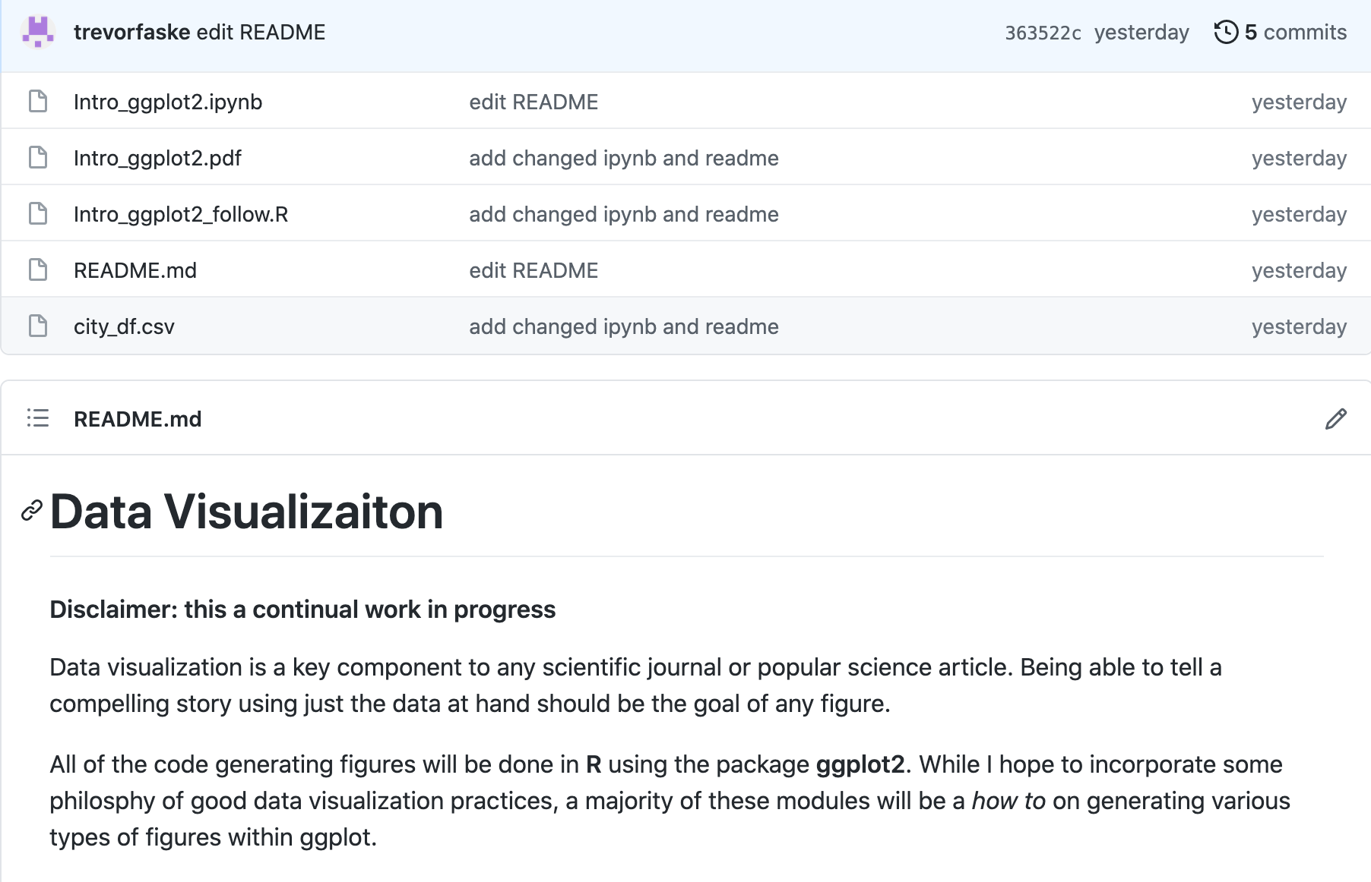
https://github.com/trevorfaske/DataVisualization

Slide 3
Resources
Rougier, N. P., Droettboom, M., & Bourne, P. E. (2014). Ten Simple Rules for Better Figures. PLoS Computational Biology, 10(9), 1–7. https://doi.org/10.1371/journal.pcbi.1003833
https://robjhyndman.com/hyndsight/graphics/
Nature collections: Visual strategies for biological data (pdf)
https://clauswilke.com/dataviz/

Slide 4
General figure tips

Slide 5
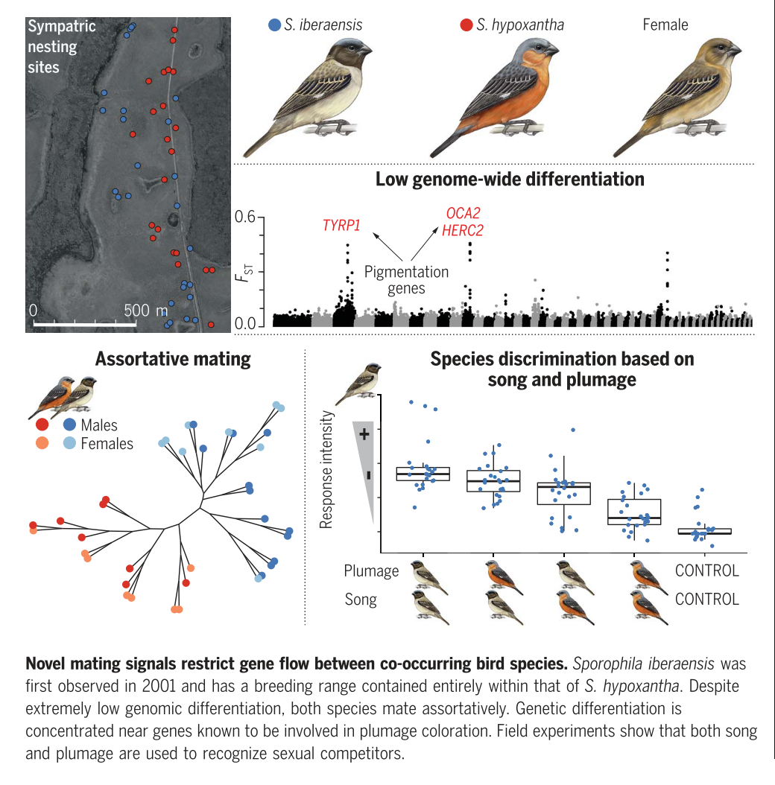
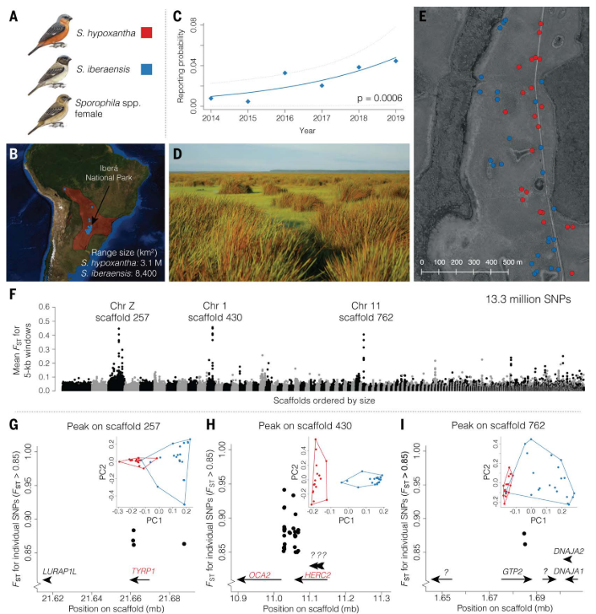
Know your audience
Turbek et al. (2021) Science
Broad
Specific

Slide 6
Know your medium
Talk figures are different from paper figures

Slide 7
Talk figures are different from paper figures
Paper
Complicated
Multi-panel
Can be aided by caption
Reader has prolonged time to process info
Turbek et al. (2021) Science

Slide 8
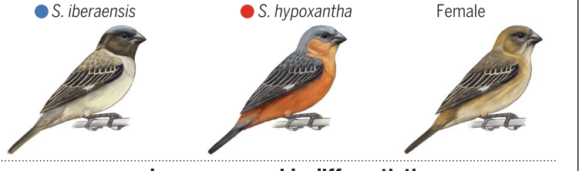
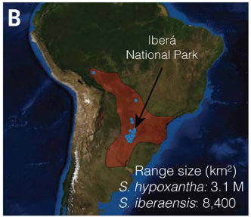
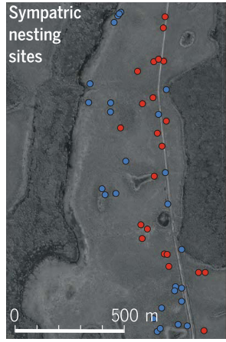
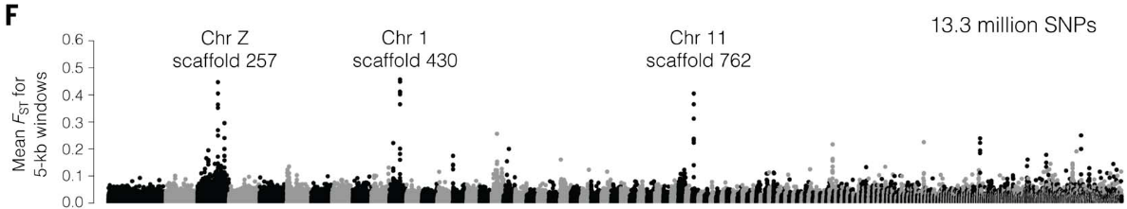
Talk figures are different from paper figures
Talk
Simple
Reader has seconds to understand info
Can be aided by animation (arrows, boxes, text)
No space/color limit
Multiple slides
Only highlighting parts of interest
Slide 1
Descriptive text blah blah
Slide 2
Slide 3
Turbek et al. (2021) Science

Slide 9
Can a reader understand what’s happening without reading the paper
Turbek et al. (2021) Science

Slide 10
Identify your message
What is it you want to show?
Make sure comparing the right thing
Don’t use unnecessary or redundant figures
Ask: Does this add to the story or add confusion
When in doubt, SUPPLEMENT (figure/table)

Slide 11
Comparison between states
Least populous
Comparison between
city populous size
Population:
Least
Most
Most populous

Slide 12
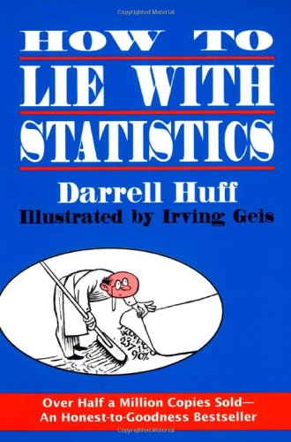
Don’t be misleading

Slide 13
Why is this misleading?
Least populous cities
Most populous cities

Slide 14

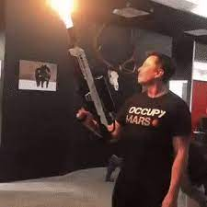
Look at me, I’m a nice guy who cares about the environment
JUST KIDDING, I want to cultivate Mars and back a coup in Boliva for battery juice

Slide 15
Common ways to be misleading
Scales
Leaving out data/outliers
Not stating what stats are in figure (mean, median, sd, 95% ci, etc.)
Jittering points
Sample sizes
Summarizing data is lying, do it with caution

Slide 16
Misleading continued: Show the data!
Bar chart

Slide 17
Misleading continued: Show the data!
Bar chart
Wasting space
Makes hard to compare

Slide 18
Misleading continued: Show the data!
Bar chart
Point and error
Wasting space
Makes hard to compare

Slide 19
This is the exact same data…..

Slide 20
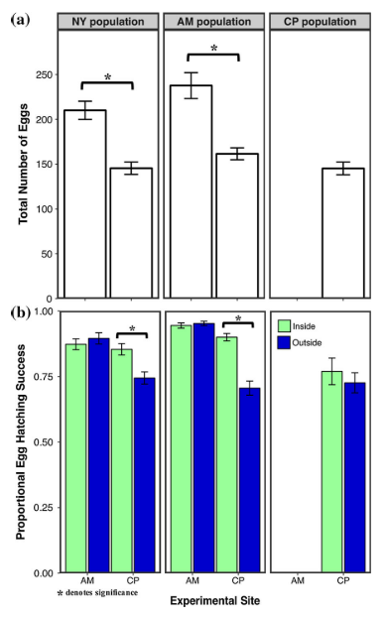
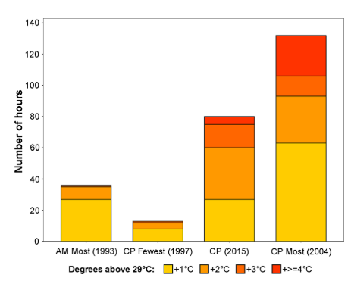
Don’t feel bad about past / current figures!
Faske et al. (2019) obviously not Science

Slide 21
More specific tips

Slide 22
Colors
Color blind-friendly (https://colororacle.org/)
Ask: Can this be black and white? ($$$)
Have colors make sense (Temp: hot = red, cold = blue)
CONSISTANCY!!!
If species A is a blue square in Figure 1, species A should be a blue square in Figure 6

Slide 23
Color palettes
Just a few, not an exhaustive list:
ggsci (https://cran.r-project.org/web/packages/ggsci/vignettes/ggsci.html)
Wes Anderson (https://github.com/karthik/wesanderson)
National Parks (https://github.com/katiejolly/nationalparkcolors)
ColorBrewer2 (https://colorbrewer2.org/)
Viridis (https://cran.r-project.org/web/packages/viridis/vignettes/intro-to-viridis.html)
Paletton (https://paletton.com/)

Slide 24
Make text/labels/points annoyingly big
r = -0.851
P < 0.001
r = -0.851
P < 0.001

Slide 25
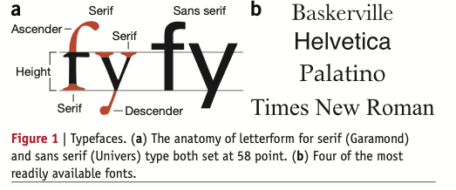
Typography/font: serif not ADA approved
Everything in this talk has been in Arial
Also, default font in ggplot2
Nature collections: Visual strategies for biological data (pdf)

Slide 26
Consolidate axes
Least populace
Most populace

Slide 27
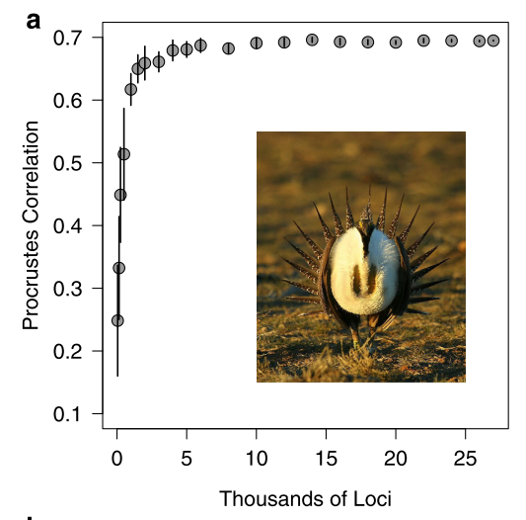
Lastly, from the wisdom of Josh Jahner… Add a photo of your study organism!!!
If you study sage-grouse and you don’t put a picture, what is even the point of science!
Also, helps with negative space
Jahner et al. (2016) should be Science

