Slide 1
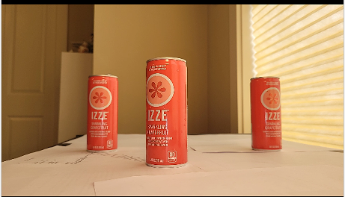
Image Width (px) = 640
targetCenterX
Image Center
targetCenterX – imageCenterX (px)

Slide 2

Image Width (px) = 640
tan(60) = opposite/adjacent
Tan(60) = 320px / focalLength * 2
focalLength = 320 / tan(60) * 2
Image Width / 2 = 320
focalLength
60 °
60 °
HorizontalFOV = 120°

Slide 3
tan(Θ) = targetCenterx – imageCenterX / focallength
Θ = Arctan ((targetCenterx – imageCenterX) / focal Length)
targetCenterX – imageCenterX (px)
focalLength

Slide 4
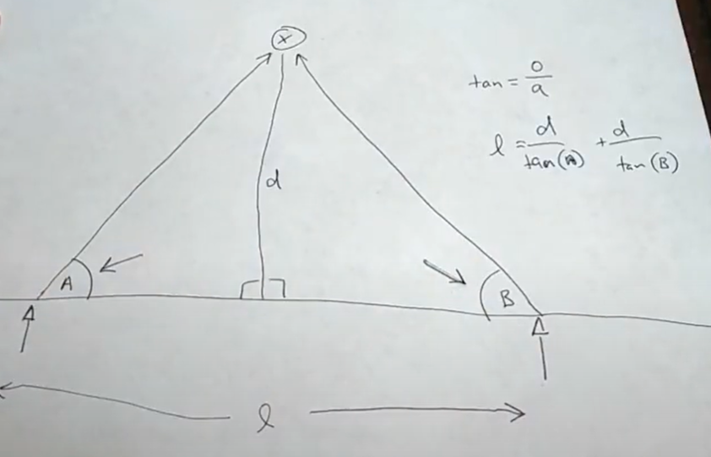
Bonus! How Steroscopic Vision Works

