Slide 1
Penalized Casebase in Survival Analysis
Trevor Kwan

Slide 2
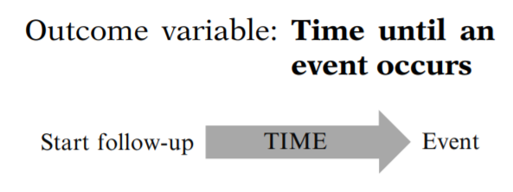
What is Survival Analysis?
Kleinbaum and Klein (2005), Survival Analysis: A Self Learning Text, Third Edition.

Slide 3
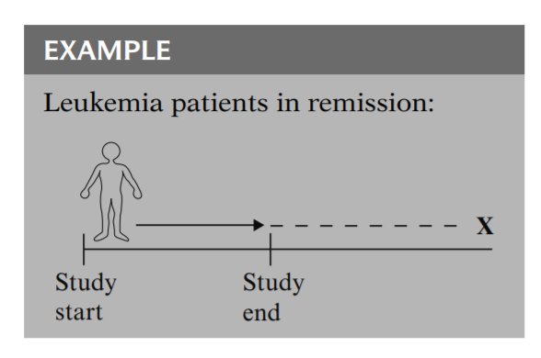
Censorship
Kleinbaum and Klein (2005), Survival Analysis: A Self Learning Text, Third Edition.

Slide 4
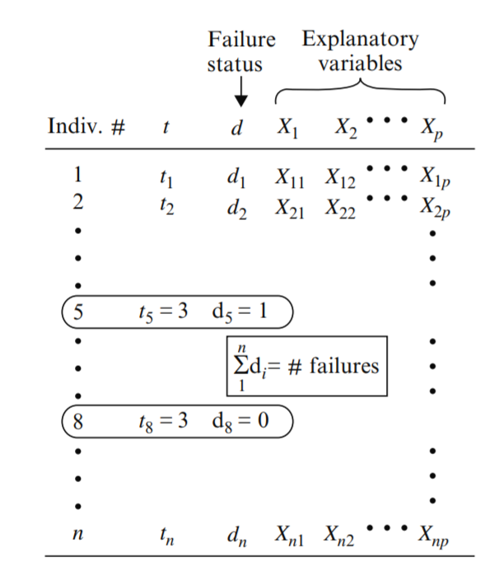
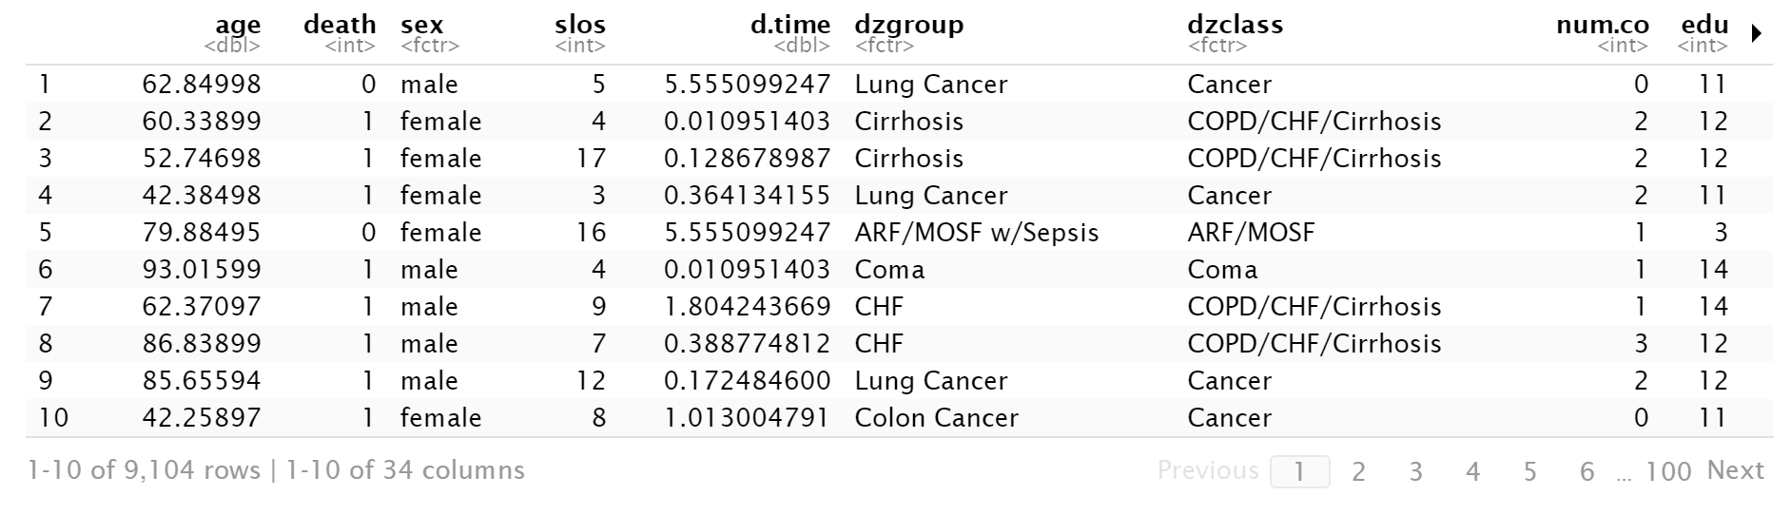
Example Data Tables
Kleinbaum and Klein (2005), Survival Analysis: A Self Learning Text, Third Edition.
Bhatnagar et al. (2020), casebase: An Alternative Framework For Survival Analysis and Comparison of Event Rates.

Slide 5
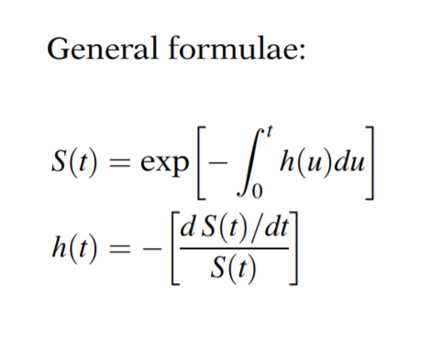
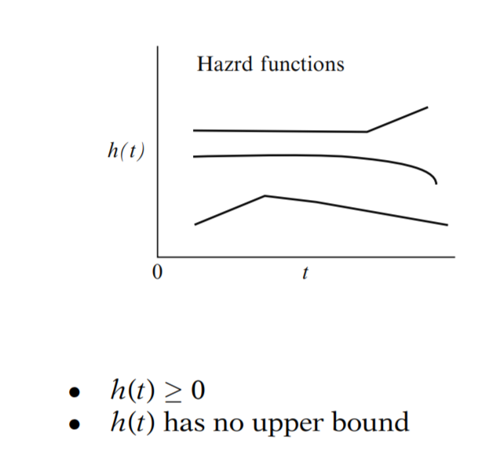
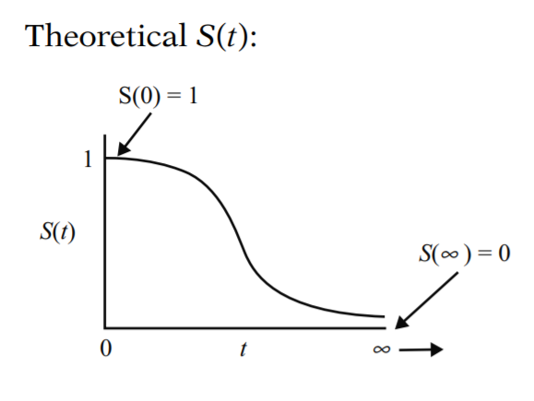
Survival and Hazard Functions
Kleinbaum and Klein (2005), Survival Analysis: A Self Learning Text, Third Edition.

Slide 6
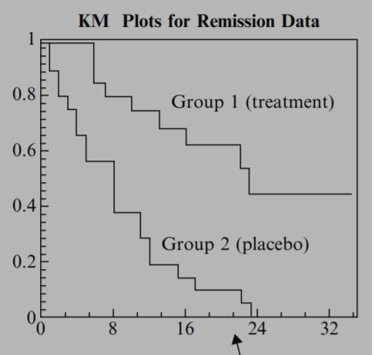
Basic Goals of Survival Analysis
Estimate and interpret survivor/hazard functions from survival data
Compare survivor/hazard functions between groups (e.g. Kaplan Meier)
Assess the relationship of explanatory variables to survival time (e.g. Cox Regression)
Kleinbaum and Klein (2005), Survival Analysis: A Self Learning Text, Third Edition.

Slide 7
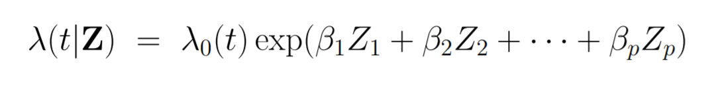
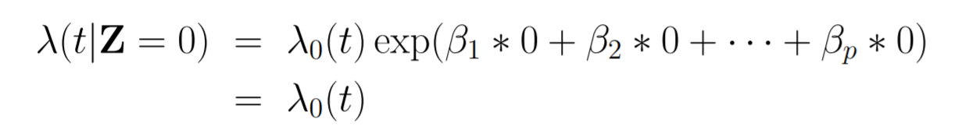
Cox Proportional Hazards Regression Model
Z is a vector of covariates of interest, which may include:
Continuous factors (e.g. age, blood pressure)
Discrete factors (e.g. gender, marital status)
Possible interactions (e.g. age by sex interaction)
λ₀(t) is the baseline hazard function (the hazard when all Z covariates are = 0)
https://mathweb.ucsd.edu/~rxu/math284/slect5.pdf

Slide 8
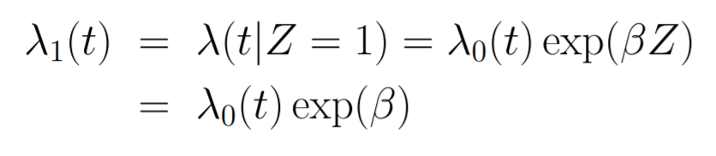
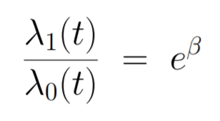
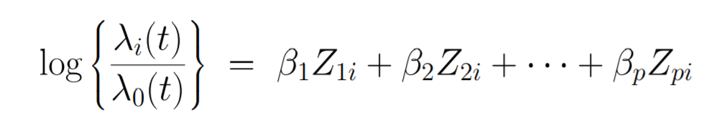
Cox Proportional Hazards Regression Model
Why is it called proportional hazards?
Example: Leukemia data, where Z = 1 for treated and Z = 0 for control. Then if we think of λ₁(t) as the hazard rate for the treated group, and λ₀(t) as the hazard rate for control, then we can write:
The ratio of the hazards is a constant e^β which does not depend on time. The hazards of the two groups remain proportional over time.
This means we can write the log of the hazard ratio for the i-th individual as:
The Cox PH Model is a linear model for the log of the hazard ratio.
https://mathweb.ucsd.edu/~rxu/math284/slect5.pdf

Slide 9
Cox Proportional Hazards Regression Model
There are 3 approaches to fitting survival models:
Parametric approach: assume a specific functional form for the baseline hazard (e.g. Weibull, gamma)
Semi-parametric approach: make mild assumptions about the baseline hazard (e.g. sub-divide time into small intervals and assume baseline hazard is constant within each interval, leading to a piece-wise exponential model)
Non-parametric approach: focuses on estimating β regression coefficients, leaving the baseline hazard unspecified
https://data.princeton.edu/wws509/notes/c7s3

Slide 10
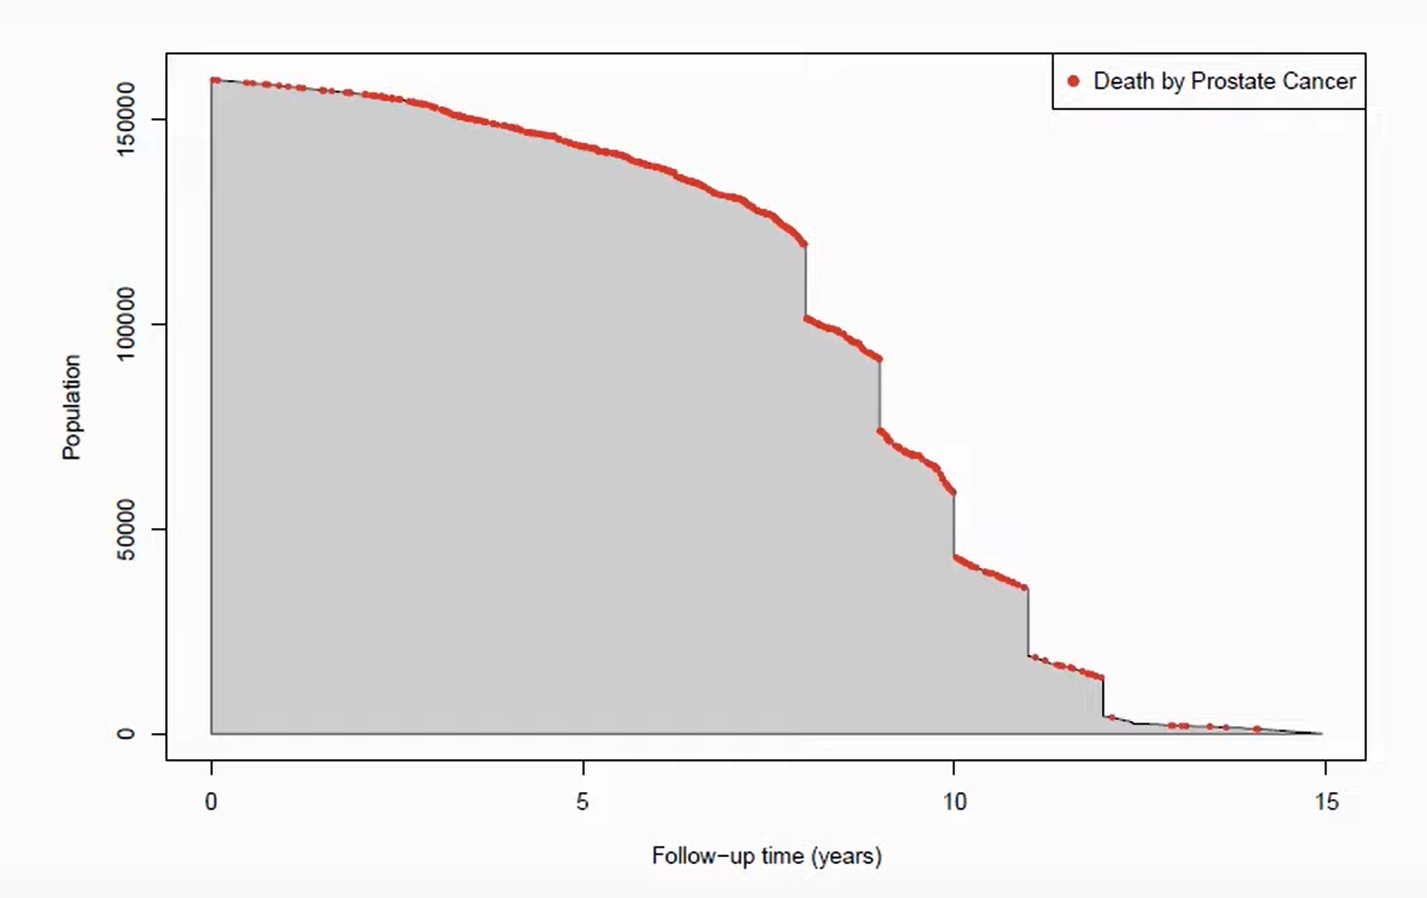
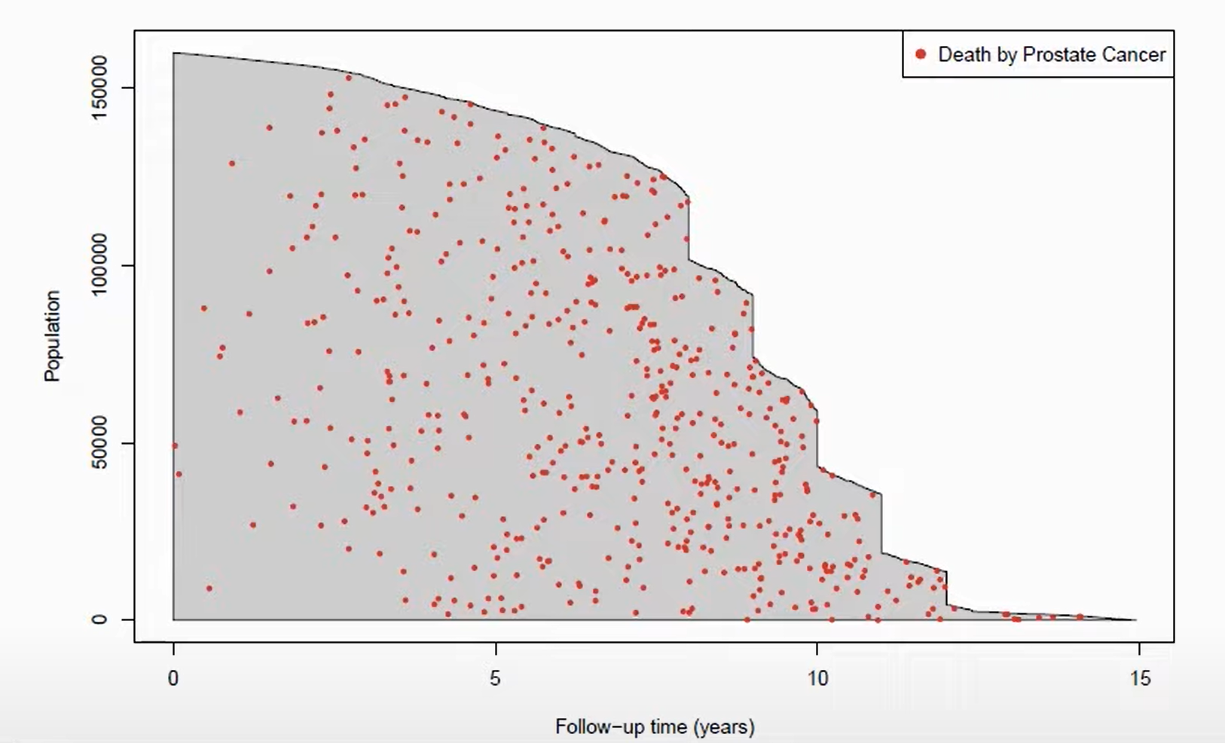
Casebase Framework
Estimates fully parametric hazard models through logistic regression.
Comparing person-moments when the event of interest occurred with person-moments when patients were at risk.
Logistic regression also allows us to perform variable selection within the casebase framework (lasso, elastic net, etc.)
Bhatnagar et al. (2020), casebase: An Alternative Framework For Survival Analysis and Comparison of Event Rates.

Slide 11
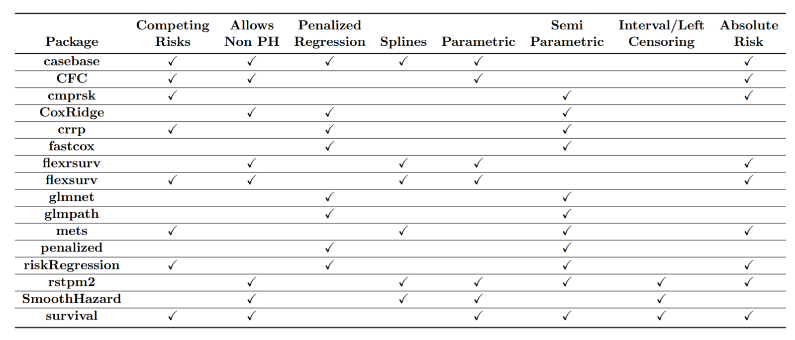
Comparison of R Packages for Survival Analysis
Bhatnagar et al. (2020), casebase: An Alternative Framework For Survival Analysis and Comparison of Event Rates.

Slide 12
Variable Selection in Survival Analysis
Gui and Li (2005), Penalized Cox regression analysis in the high-dimensional and low-sample size settings, with applications to microarray gene expression data.
Androulakis, Koukouvinos, Mylona, and Vonta (2008), A real survival analysis application via variable selection methods for Cox’s proportional hazards model.
Goeman (2010), L₁ Penalized Estimation in the Cox Proportional Hazards Model.
Wu (2012), Elastic Net for Cox’s Proportional Hazards Model with a Solution Path Algorithm.
Chai, Liang, and Liu (2014), The L₁ and L₂ regularization approach for survival analysis in the accelerated failure time model.

Slide 13
Casebase
Casebase improves on these limitations by being able to:
Provide smooth cumulative incidence estimations
Perform variable selection
But, there has been no simulation study to compare penalized estimators.
Bhatnagar et al. (2020), casebase: An Alternative Framework For Survival Analysis and Comparison of Event Rates.

Slide 14
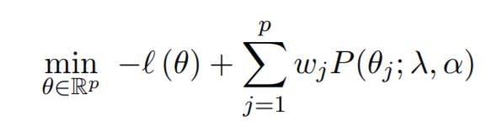
Casebase Case Study
Goal: show that casebase can also be used for variable selection
SUPPORT dataset tracks death in 5 American hospitals within individuals who are considered seriously ill.
Bhatnagar et al. (2020), casebase: An Alternative Framework For Survival Analysis and Comparison of Event Rates.

Slide 15
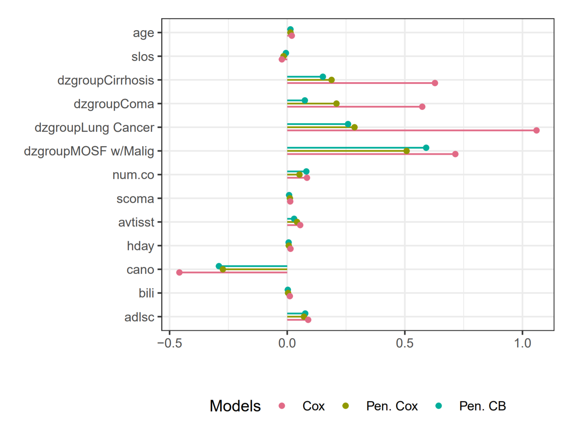
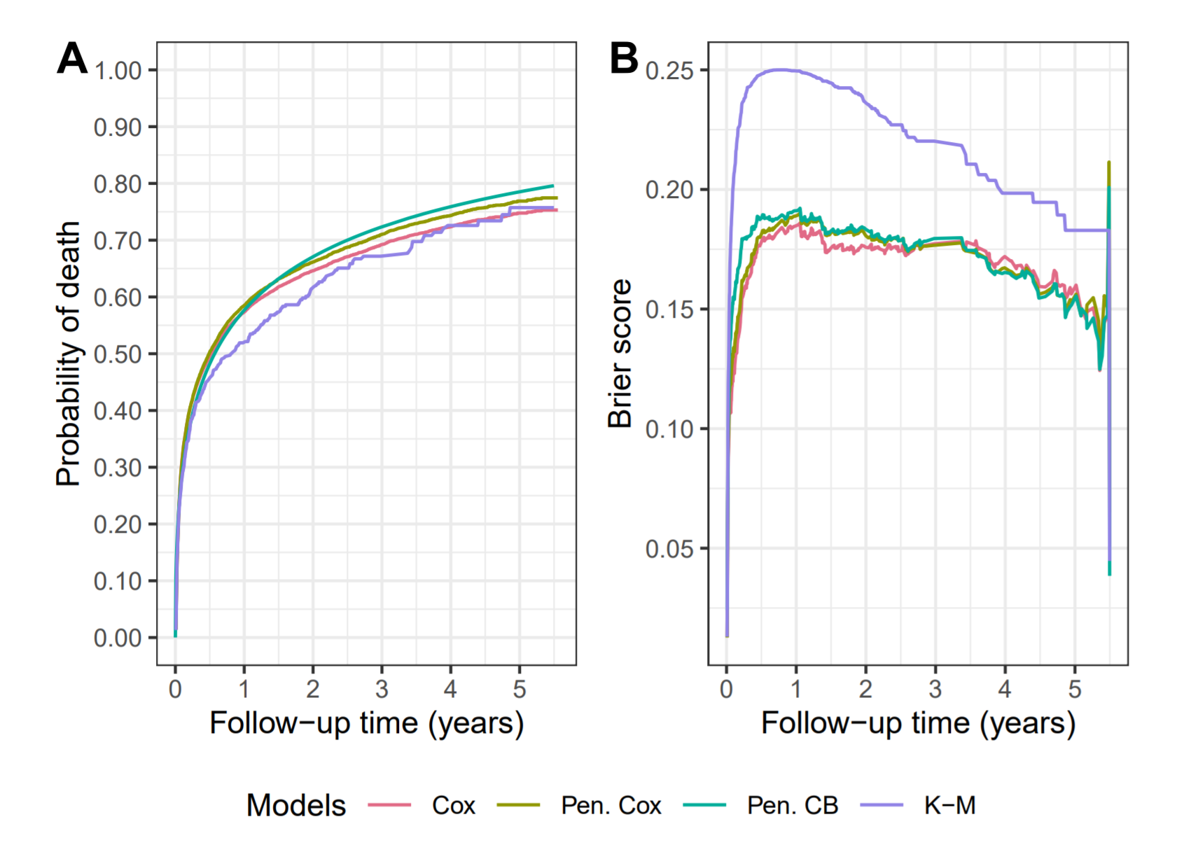
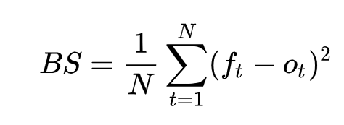
Casebase Case Study: Comparing Estimators
Bhatnagar et al. (2020), casebase: An Alternative Framework For Survival Analysis and Comparison of Event Rates.

Slide 16
My Project Goals
Integrating survival analysis, logistic regression, and penalization
Simulation Study
Incorporate other penalization methods (e.g. LARS-Cox, SCAD):
Wu (2012), Elastic Net for Cox’s Proportional Hazards Model with a Solution Path Algorithm.
Lian, Li, and Tang (2013), SCAD-penalized regression in additive partially linear proportional hazards models with an ultra-high-dimensional linear part.
Gui and Li (2005), Penalized Cox regression analysis in the high-dimensional and low-sample size settings, with applications to microarray gene expression data.
Explore simulation settings in:
Bair and Tibshirani (2004), Semi-Supervised Methods to Predict Patient Survival from Gene Expression Data.
Zou and Hastie (2005), Regularization and Variable Selection via the Elastic Net.

