Slide 1
Customer segmentation
Trevor Maxwell
2024-04-07

Slide 2
contents
Introduction to Customer Segmentation
Dataset Used
Exploratory Data Analysis
K-Means Clustering Model Deployment
Results
Conclusion and Next Steps
Ethical Considerations

Slide 3
Introduction to Customer Segmentation
Customer Segmentation:
A way to uncover insights into the customer base
Achieve action items from a seemingly random pool of customers
Product improvement
Customer retention
Marketing strategies
Increase revenue
History:
Companies have large amounts of data on customer attributes and behavior
This vast amount of data getting created, processed, and stored by organizations is derived from the development of information technology
The problem with large volumes of customer data is the difficulty of understanding the customer base in its entirety, and this is solvable with customer segmentation

Slide 4
Dataset Used
Dataset includes 53,501 observations and 20 features.
Personal attributes include:
Transactional attributes include:
Geographical attributes include:
Age
Gender
Marital Status
Education
Occupation
Income
Purchase history
Policy type
Interactions with customer service
Insurance products owned
Coverage amount
Premium amount
Location/Market

Slide 5
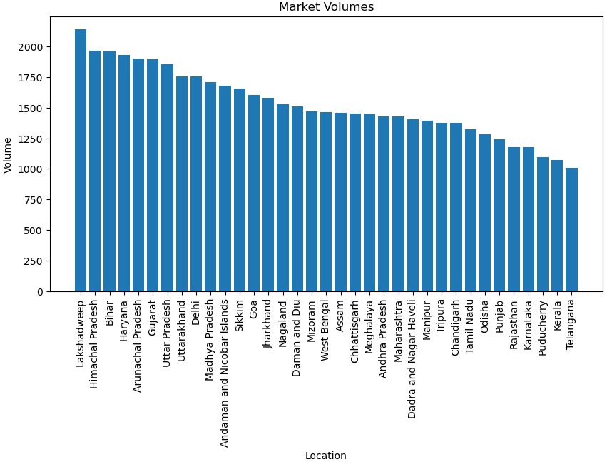
Exploratory Data analysis (eda)
Market with the highest volume:
Lakshadweep
Volume: 2,140 customers
This market will be the focus of the customer segmentation.

Slide 6
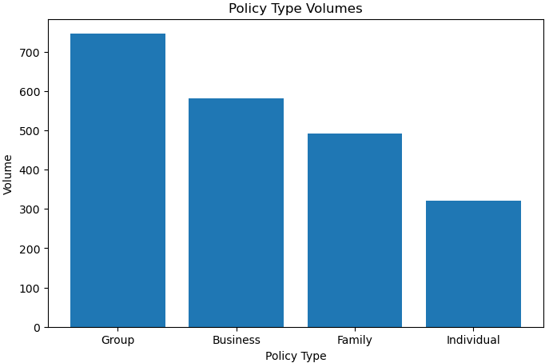
Exploratory Data analysis (continued)
Policy Type with the highest volume:
Group
Volume: 746 customers
This policy type will be another focus of the customer segmentation.
Volumes reflected are in the Lakshadweep market.

Slide 7
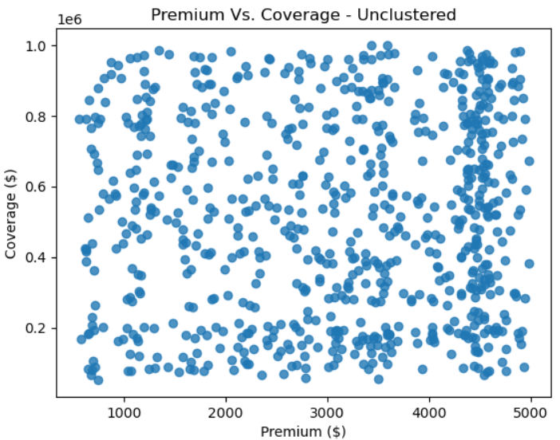
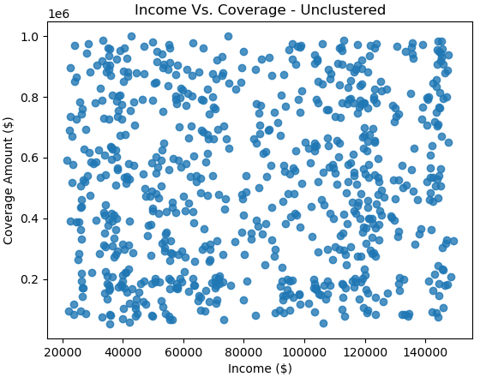
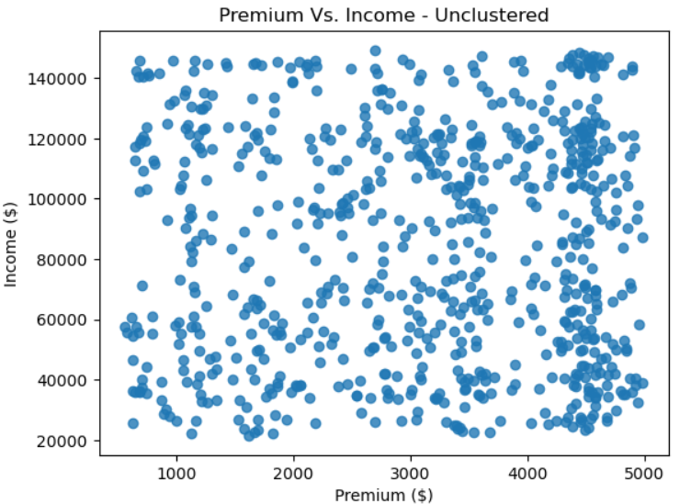
Exploratory Data analysis (continued)
Scatter plots:
Premium and Coverage amounts
Income and Coverage amounts
Premium and Income amounts
Initial scatter plots seem random and do not uncover any actionable insights.

Slide 8
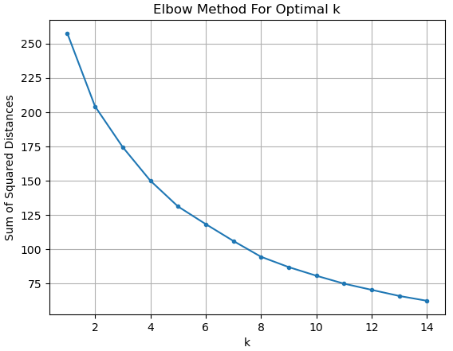
K-Means Clustering Model Deployment
Calculate sum of squared distance for each k value.
Determine optimal number of clusters based on the elbow plot.
Optimal number of clusters: 3

Slide 9
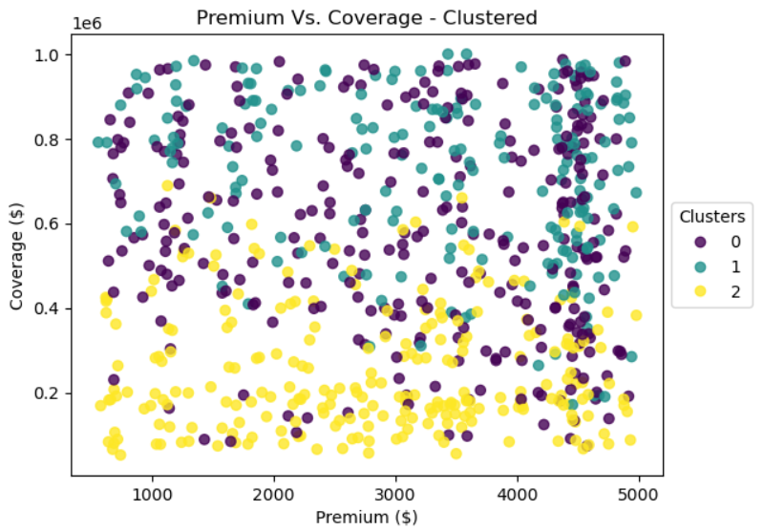
Results

Slide 10
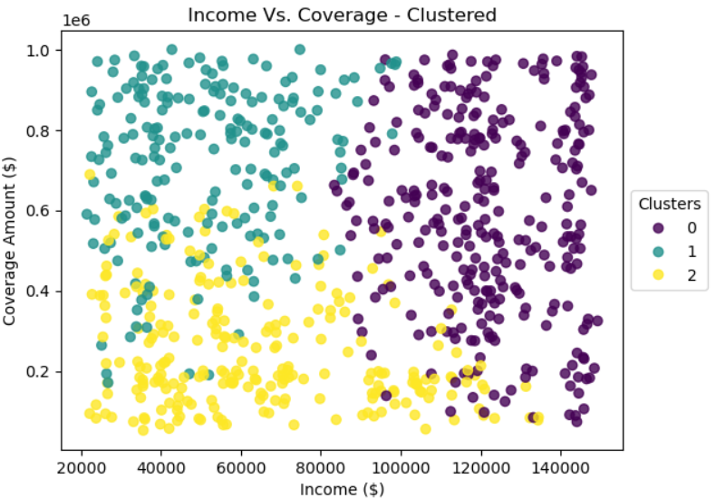
Results (continued)

Slide 11
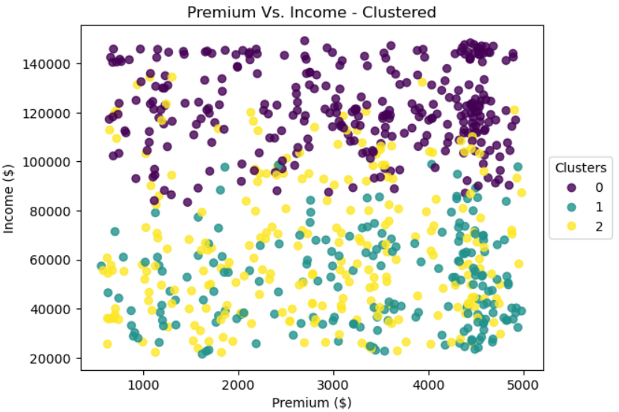
Results (continued)

Slide 12
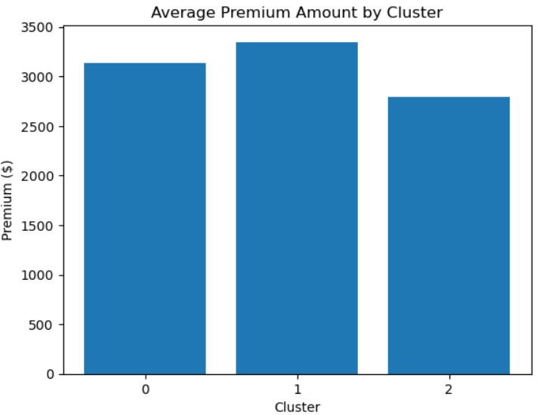
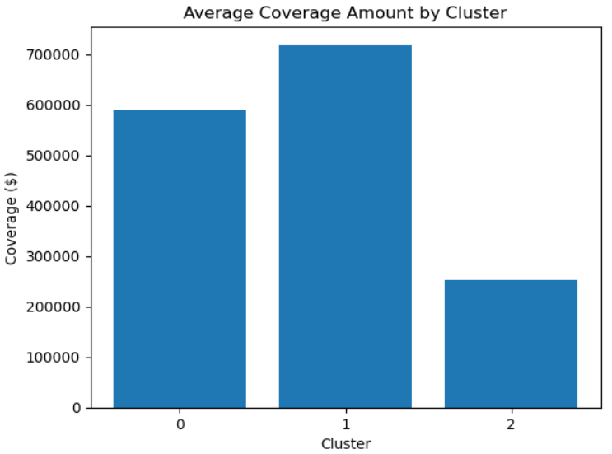
Results (continued)
Group 2 is the ideal group for the business.
Premium amounts are comparable the other groups
Coverage amount is significantly less than the other groups

Slide 13
Conclusion and next steps
This customer segmentation analysis is a method to generate more revenue for the company, improve current policies, and generate new policies
The company could market to current customers to switch into the more cost-effective policies that the customers in Group 2 are in.
Another option is to market the policies in the most cost-effective group to prospective customers
The company adopt principles from the policies in the most cost-effective cluster to the policies in the other two clusters.

Slide 14
Ethical implications
Ethical considerations arise during the recommendations suggested to the company based on the clusters.
Removing perks from policies in the less cost-effective clusters to be more like the policies in the most cost-effective cluster could result in customers losing their needs for the policy.
Increasing premiums to become more cost-effective would affect the customers with lower income more than the customers with higher income.
Decreasing the coverage amount overall which could lead to more out-of-pocket costs for the customers should they submit claims and reach the coverage amount quicker due to the decrease.

Slide 15
references

