Slide 1
Marketing Offer Acceptance Prediction
Trevor Maxwell
2024-05-05

Slide 2
contents
Introduction to Analytics in Marketing Strategy
Dataset Used
Exploratory Data Analysis
Models Deployed
Results
Conclusion and Next Steps
Ethical Considerations

Slide 3
Introduction to Analytics in Marketing strategy
Marketing Strategy:
A company’s plan to reach an audience or showcase products/services
Can be aimed towards new or existing customers
Can showcase new or existing products/services
Machine learning techniques can strengthen the effectiveness of the marketing strategy
Develop different campaigns for different markets
Develop different campaigns in the same market to determine which campaign yields best results
Determine which customers are more likely to buy company products/services based on the marketing campaign
Better marketing campaigns can engage with more customers, increase the number of services and products offered, increase revenue, and achieve faster growth for the company

Slide 4
Dataset Used
Dataset includes 2,240 observations and 29 features.
Purchasing attributes include:
Target attribute:
Personal attributes include:
Year of birth
Income
Number of kids in home
Number of teens in home
Education
Marital status
Sales for each product type (wines, meats, fruit, etc.,)
When the customer enrolled with the company
How many days since the last purchase
If the purchase came through in-store, catalog, or the web
If the customer accepted a marketing offer by the sixth marketing campaign

Slide 5
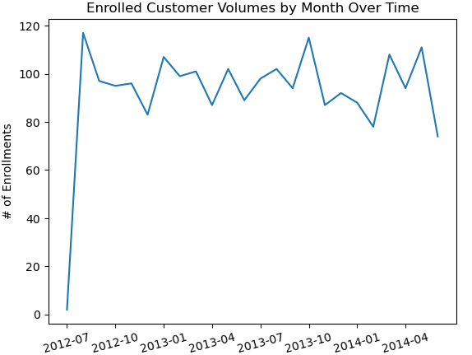
Exploratory Data analysis (eda)
Enrollments over time have been quite steady
Can track enrollments after marketing campaign deployment as a performance indicator
Do not have sale date, therefore cannot use sales over time as a performance indicator

Slide 6
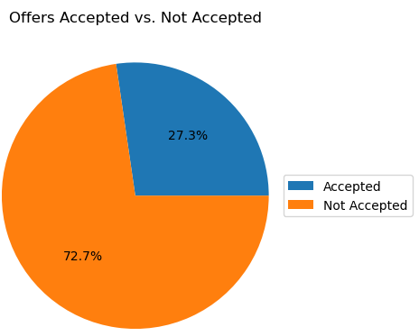
Exploratory Data analysis (continued)
Majority of customers did not accept the marketing offer.
Offers accepted: 27.3%
Offers not accepted: 72.7%

Slide 7
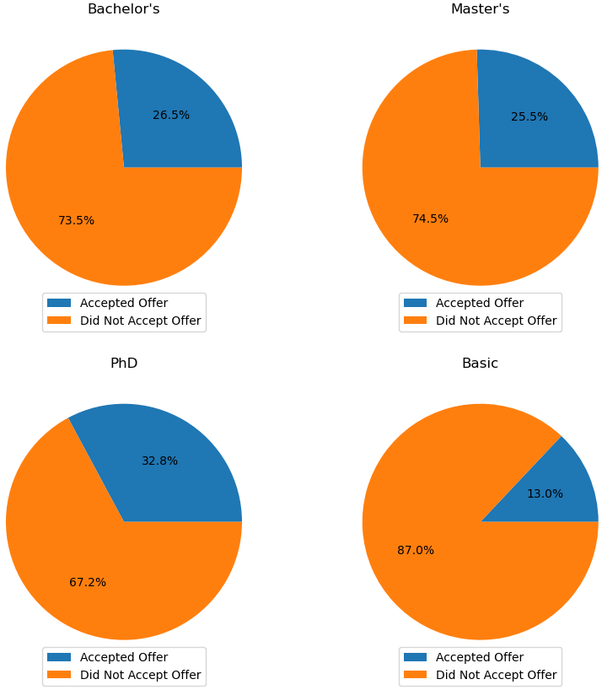
Exploratory Data analysis (continued)
It is important to understand customer demographic
Pie Plots:
Did or did not accept marketing offer per education level
The PhD education level had the highest percentage of offer acceptance compared to the other 3 education levels
the basic education level had a significantly smaller percentage of offer acceptance compared to the other 3 levels

Slide 8
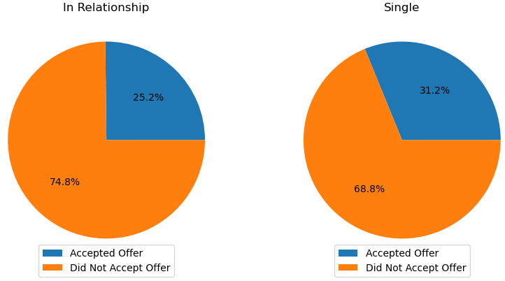
Exploratory Data analysis (continued)
Pie Plots:
Did or did not accept marketing offer per marital status
Customers with a Single marital status had a higher offer acceptance by 6% compared to those with an In Relationship marital status

Slide 9
Models deployed
Logistic Regression
Accuracy: 79.64%
Precision: 69.62%
Recall: 45.45%
F1 Score: 55.00%
KNN Classifier
Accuracy: 78.28%
Precision: 72.73%
Recall: 33.06%
F1 Score: 45.45%
Random Forest
Accuracy: 83.26%
Precision: 79.75%
Recall: 52.07%
F1 Score: 63.00%

Slide 10
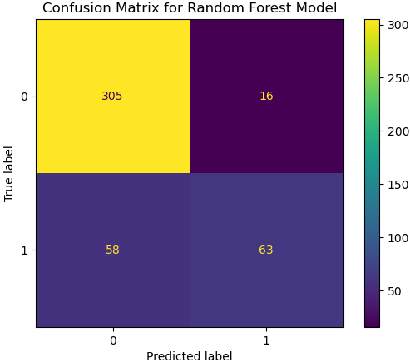
Results
Random Forest Model Confusion Matrix
True Positives: 63
False Positives: 16
True Negatives: 305
False Negatives: 58
Precision score is very important due to the nature of the analysis
79.75%

Slide 11
Conclusion and next steps
Random Forest Classifier was the best model for the purpose of this project
Based on accuracy and precision scores
Use cases of the model
Send marketing campaign materials to customers who were predicted to accept offer
OR
Send fewer marketing materials to customers who were predicted to not accept offer

Slide 12
Ethical implications
This dataset contained 6 marketing campaigns for each customer, which can be aggressive to some customers. The number of times a customer receives marketing materials should be considered.
Campaigns should be truthful about the product/service.

Slide 13
references
Alexandra, Jennifer, and Kristina Pestaria Sinaga. “Machine learning approaches for marketing campaign in portuguese banks.” 2021 3rd International Conference on Cybernetics and Intelligent System (ICORIS), 25 Oct. 2021, https://doi.org/10.1109/icoris52787.2021.9649623.
Wang, Tong, et al. “Evaluating the effectiveness of marketing campaigns for malls using a novel Interpretable Machine Learning Model.” Information Systems Research, vol. 33, no. 2, 21 Dec. 2021, https://doi.org/10.1287/isre.2021.1078.

