Slide 1
Time Series Forecasting for national sales
Trevor Maxwell
2024-05-30

Slide 2
contents
Introduction to Forecasting and Analytics
Dataset Used
Exploratory Data Analysis
Models Deployed
Results
Conclusion and Next Steps
Ethical Considerations

Slide 3
Introduction to Forecasting and analytics
Forecasting:
Using historical data and trends to make predictions in the future.
Can be performed in several business functions:
Sales
Supply chain
Finance
Marketing
Machine learning algorithms can supplement and enhance forecasting for businesses.
Strategic planning
Create sales initiatives and KPIs
Anticipate changes
Make informed decisions

Slide 4
Dataset Used
Dataset includes 9,800 observations and 18 features.
Order attributes include:
Target attribute:
Customer attributes include:
Customer ID
Name
Shipping address
City
State
Zip
Region
Postal code
Order date
Ship date
Product name
Product category and sub-category
Sales
The sale amount of the item
Will become summed by month-year at modeling phase

Slide 5
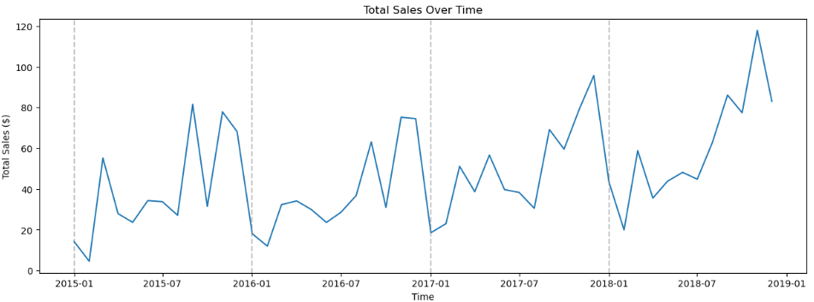
Exploratory Data analysis (eda)
Sales data from 2015 through 2018 appears seasonal every 12 months.
Appears to increase during 2017 and 2018.

Slide 6
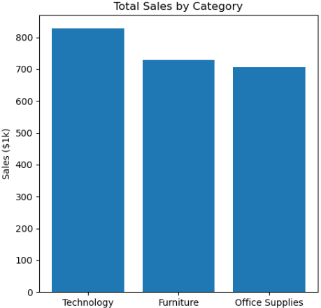
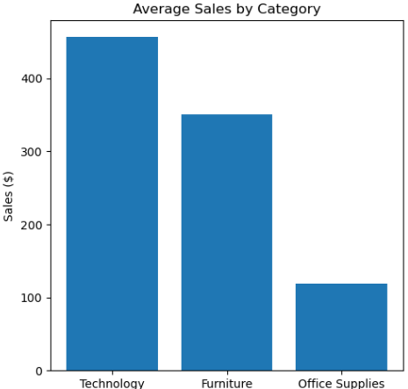
Exploratory Data analysis (continued)
Top performing category:
Technology
Average sale for Office Supplies is significantly lower than the other two.
However, the total sales is only slightly less than Furniture.

Slide 7
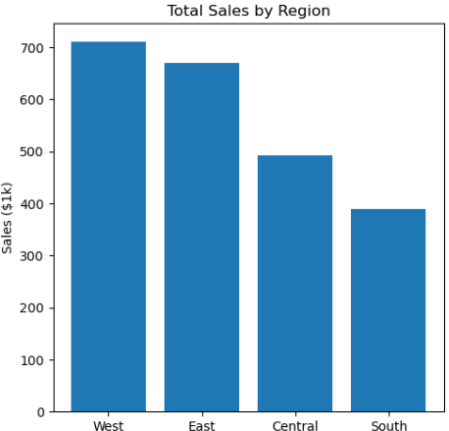
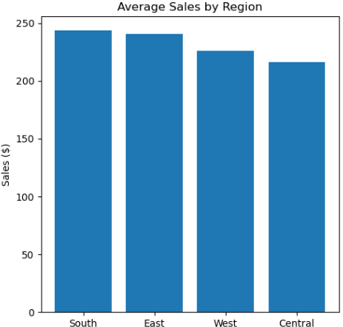
Exploratory Data analysis (continued)
Top performing regions:
East
West
South region has the lowest total sales and highest average
Worst performing region

Slide 8
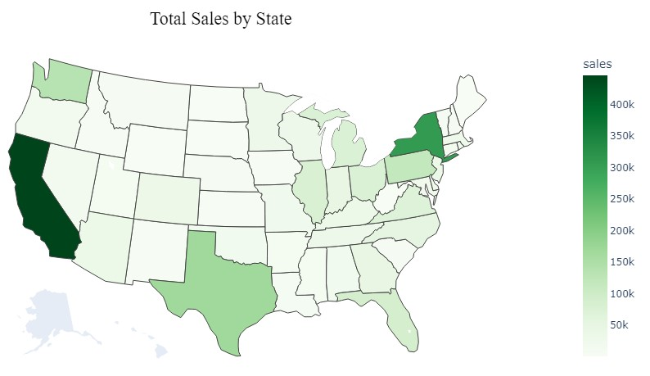
Exploratory Data analysis (continued)
Top performing states:
California – $446.3k
New York – $306.4k
Texas – $186.6k
Washington – $135.2k
Pennsylvania – $116.3k

Slide 9
Models deployed
Root Mean Square Error (RMSE)
Average difference between predicted value and the true value
Estimation of how well the model predicts the target value
ARIMA
RMSE:
$31,268.55
SARIMA
RMSE:
$19,670.13
XGBOOST
RMSE:
$18,575.05

Slide 10
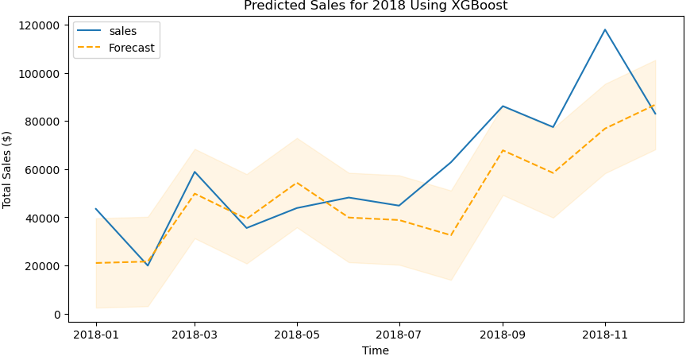
Results
XGBoost Model
Training Data: 2015 – 2017
Test data: 2018
RMSE: $18,575.05

Slide 11
Conclusion and next steps
XGBoost model was the best model for time series forecasting of national sales
Based on RMSE
Use cases of the model:
Set sales targets
Trend markets
Set inventory levels
Allocate resources
Manage cashflow

Slide 12
Ethical implications
If the forecast is not accurate enough, the organization could deploy inaccurate planning for its operations and hinder the business.
It is also important to be transparent and state the margins of error predicted in the forecast.

Slide 13
references
Fildes, Robert, and Paul Goodwin. “Against your better judgment? how organizations can improve their use of management judgment in forecasting.” Interfaces, vol. 37, no. 6, 1 Dec. 2007, pp. 570–576, https://doi.org/10.1287/inte.1070.0309.
Prevedere. “3 Real-World Market Demand Forecasting Success Stories.” Prevedere, 20 Dec. 2022, prevedere.com/3-real-world-market-demand-forecasting-stories/.

