Slide 1
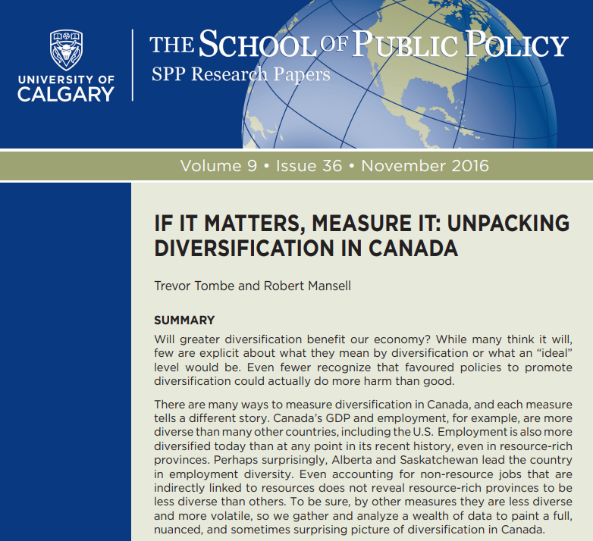
Economic Diversification in Alberta: Model or Mischief
Trevor Tombe Associate Professor, Department of Economics
Research Fellow, The School of Public Policy
May 21, 2020 Webinar

Slide 2
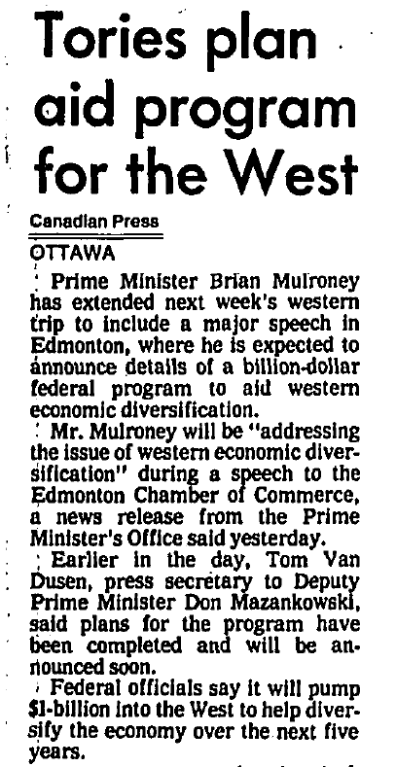
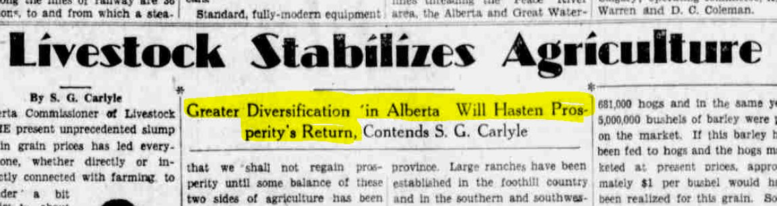

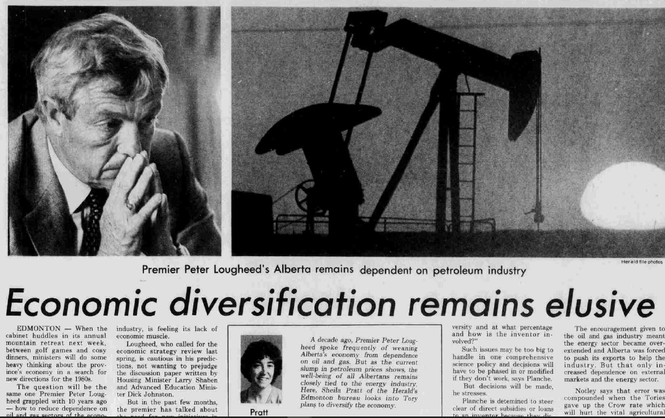
Calgary Herald, October 15, 1930
Calgary Herald, September 20, 1983
The Globe and Mail, July 29, 1987

Slide 3
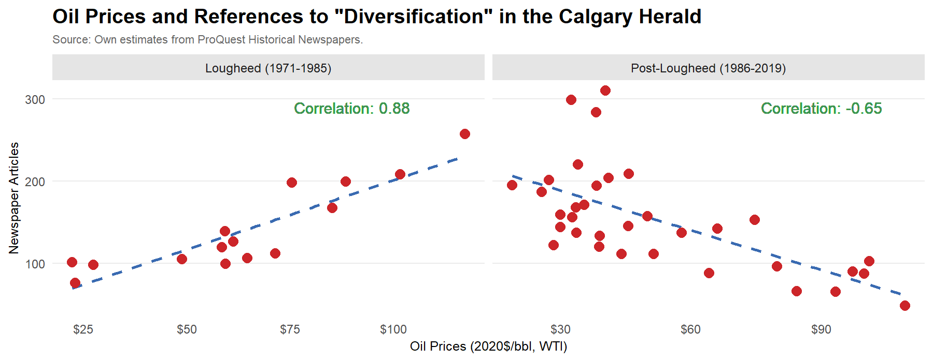
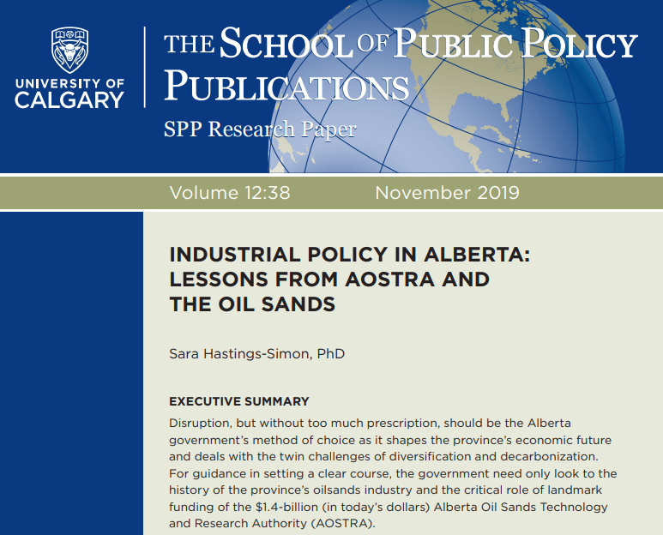
Common Topic When Times are Tough

Slide 4
In This Webinar, We Will Cover…
Measuring Diversification
Economic Volatility
Policy Options and Trade-offs

Slide 5
Rank of the Largest Employers in Canada
 | Canada | BC | Alberta | Ontario | Quebec
Health and Social | 1 | 1 | 1 | 1 | 1
Retail | 2 | 3 | 2 | 2 | 2
Education | 3 | 4 | 5 | 3 | 3
Accommodation/Food | 4 | 2 | 4 | 4 | 5
Public Admin. | 5 | 7 | 7 | 5 | 5
Construction | 6 | 5 | 3 | 9 | 7
Prof., Technical Serv. | 7 | 6 | 6 | 6 | 6
Finance/Insurance | 9 | 10 | 12 | 7 | 11
Mining/Oil/Gas | 21 | 21 | 8 | 24 | 22
At the two-digit NAICS level

Slide 6
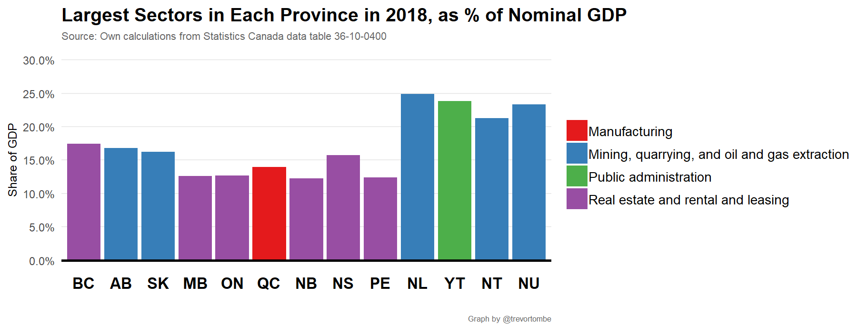
How Diverse Is Provincial Income/GDP?

Slide 7
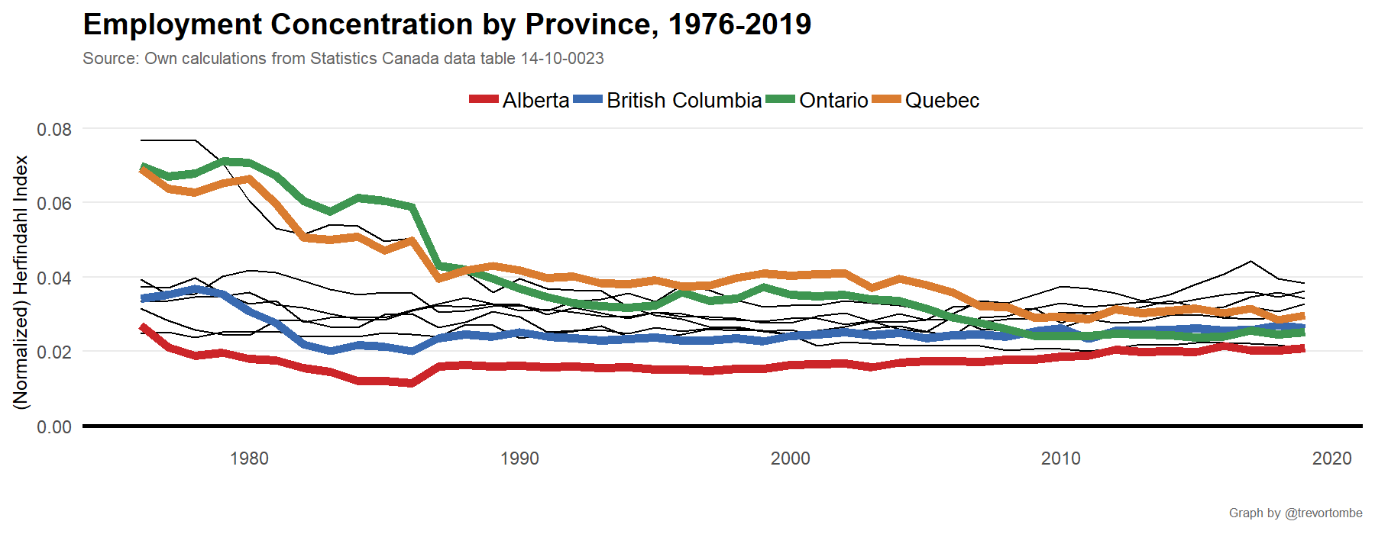
How Concentrated Is Provincial Employment?

Slide 8
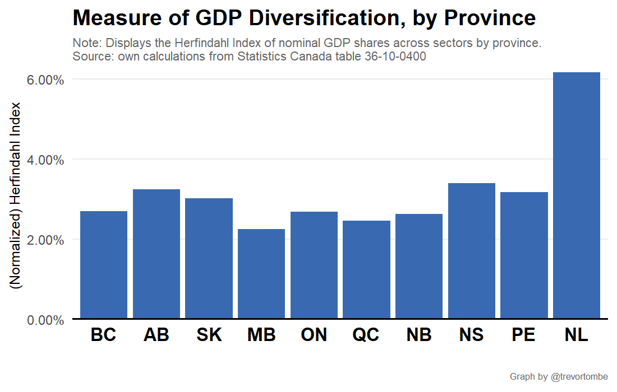
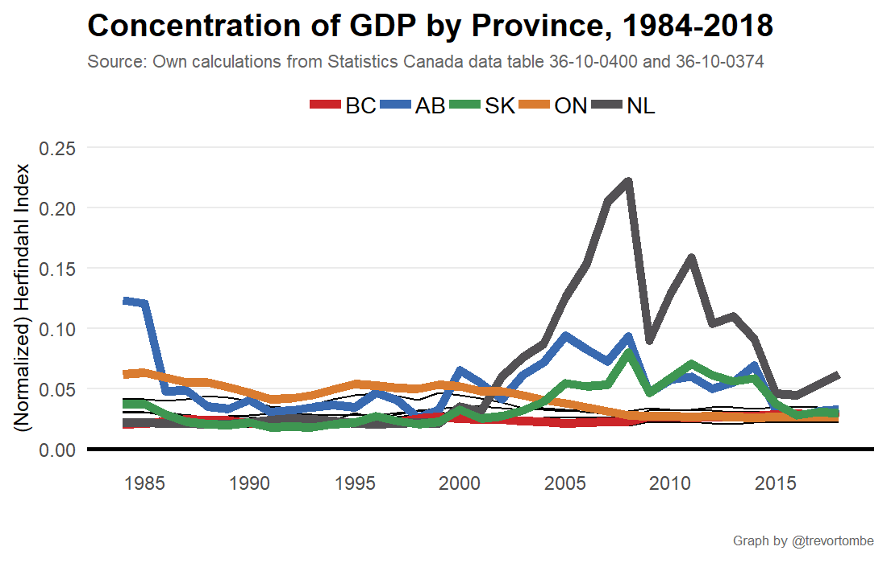
How Concentrated Is Provincial Income/GDP?

Slide 9
Volatility of Provincial Economies
Comparing the magnitude of business cycles

Slide 10
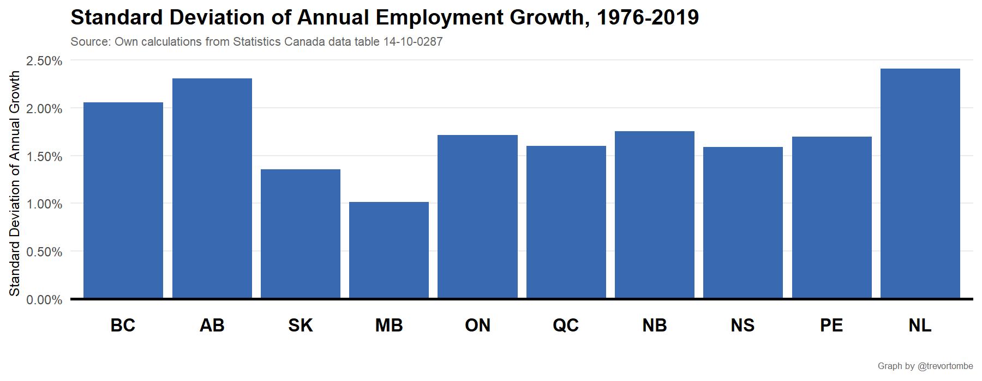
How Volatile Is Provincial Employment?

Slide 11
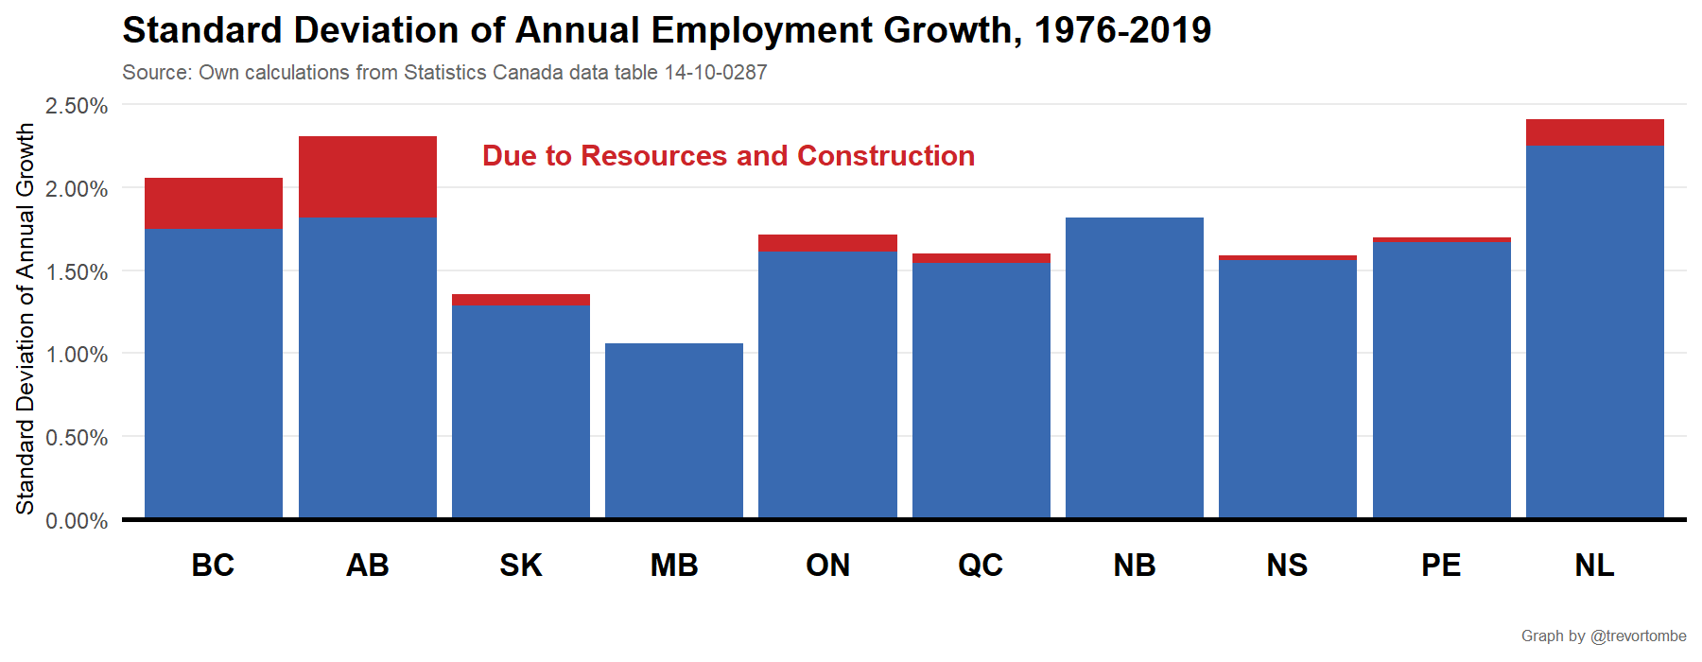
How Volatile Is Provincial Employment?

Slide 12
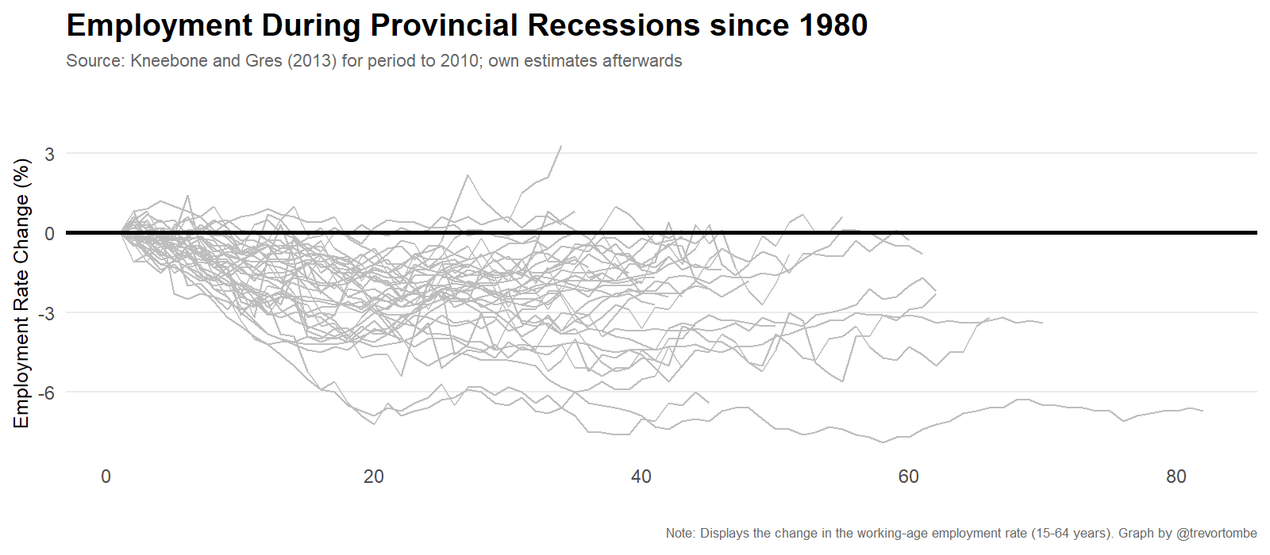
Are Alberta Recessions Deeper?

Slide 13
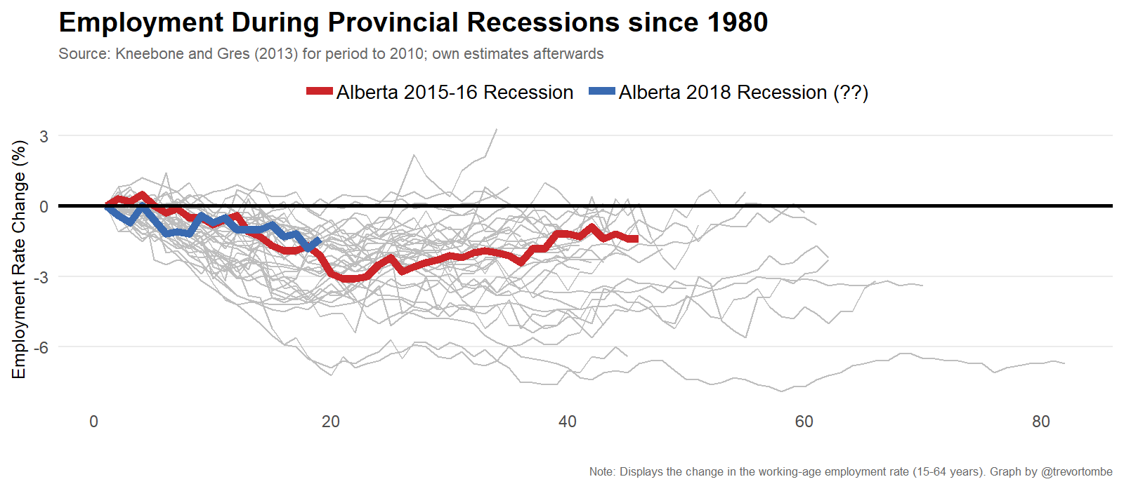
Are Alberta Recessions Deeper?

Slide 14
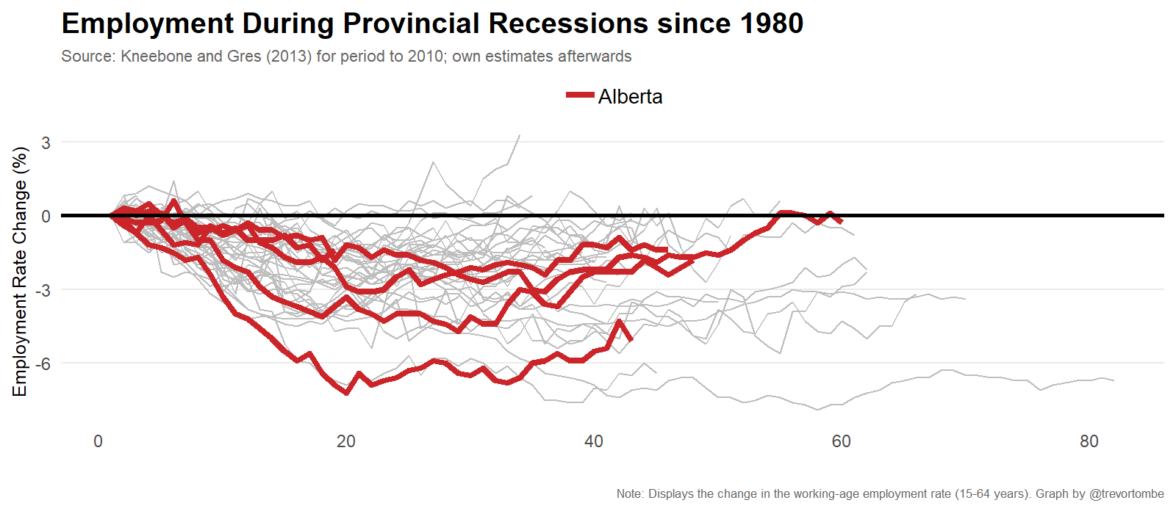
Are Alberta Recessions Deeper?

Slide 15
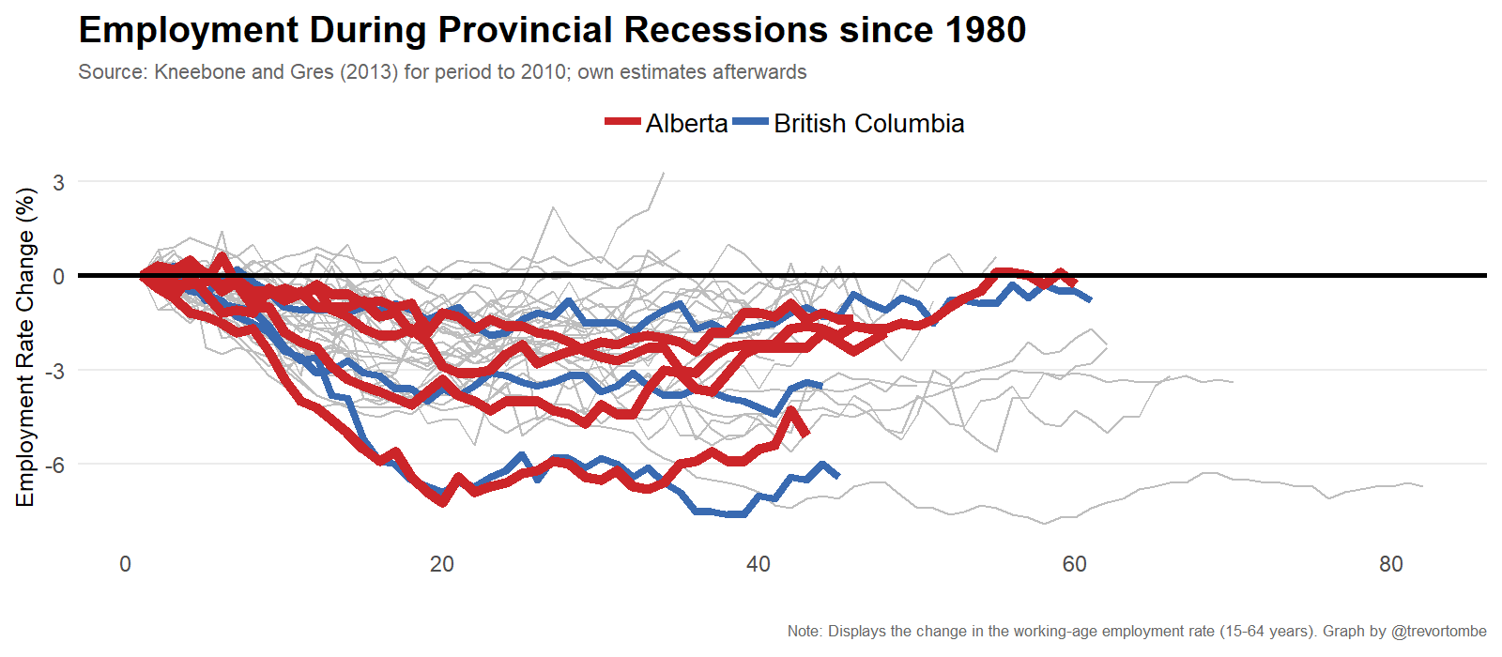
Are Alberta Recessions Deeper?

Slide 16
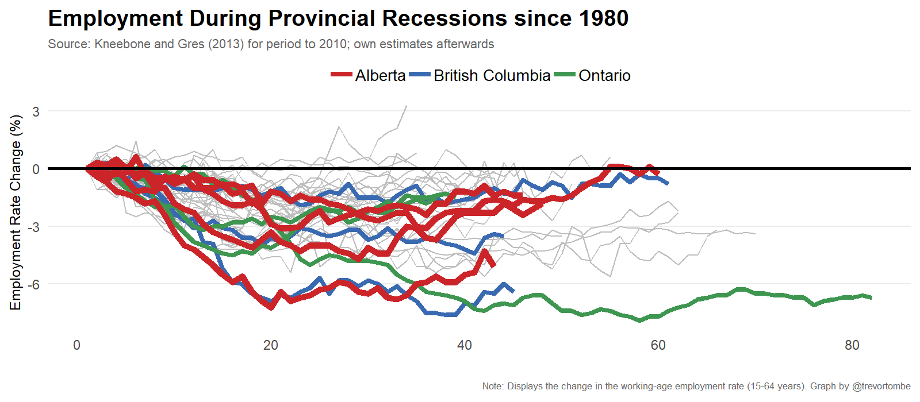
Are Alberta Recessions Deeper?

Slide 17
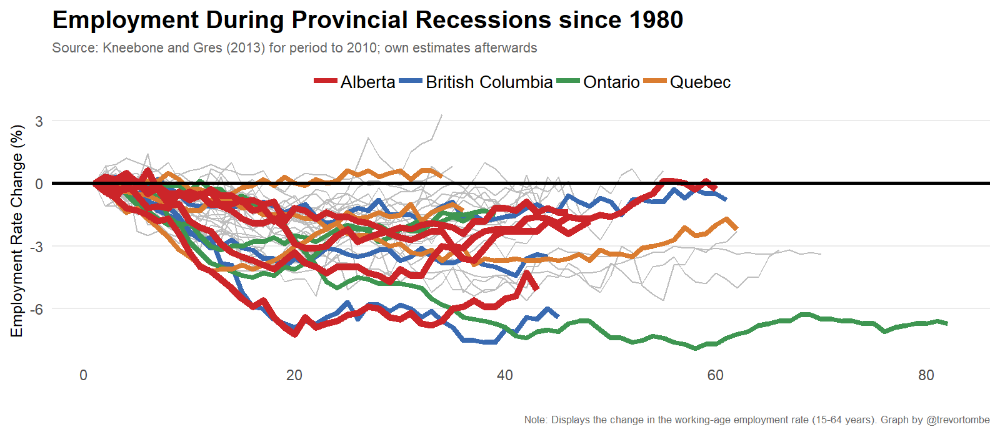
Are Alberta Recessions Deeper?

Slide 18
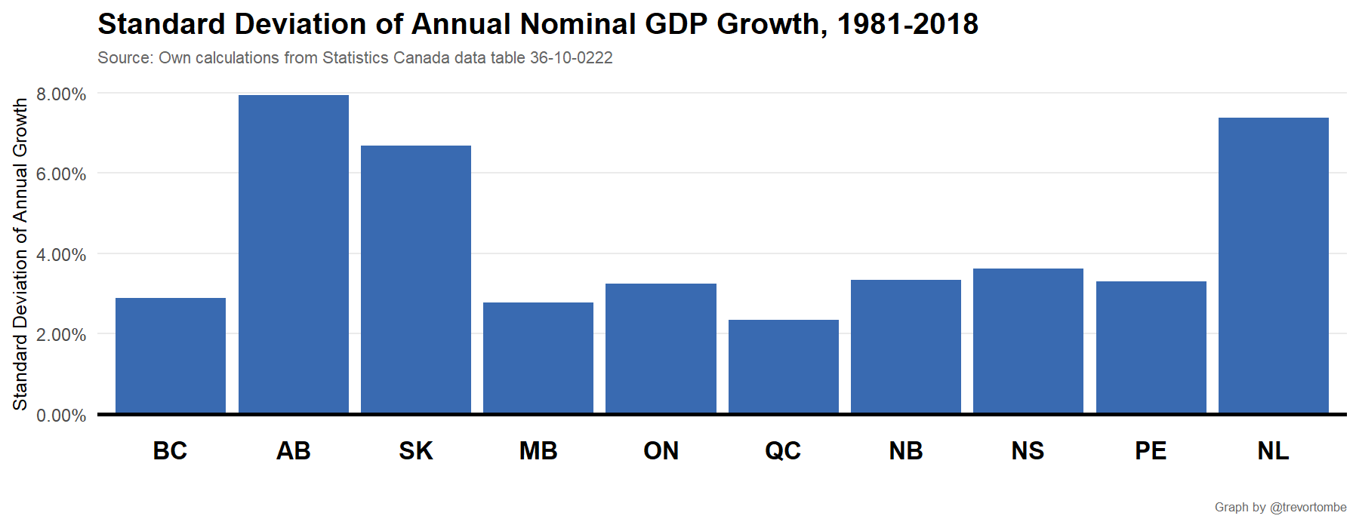
How Volatile Is Provincial Income/GDP?

Slide 19
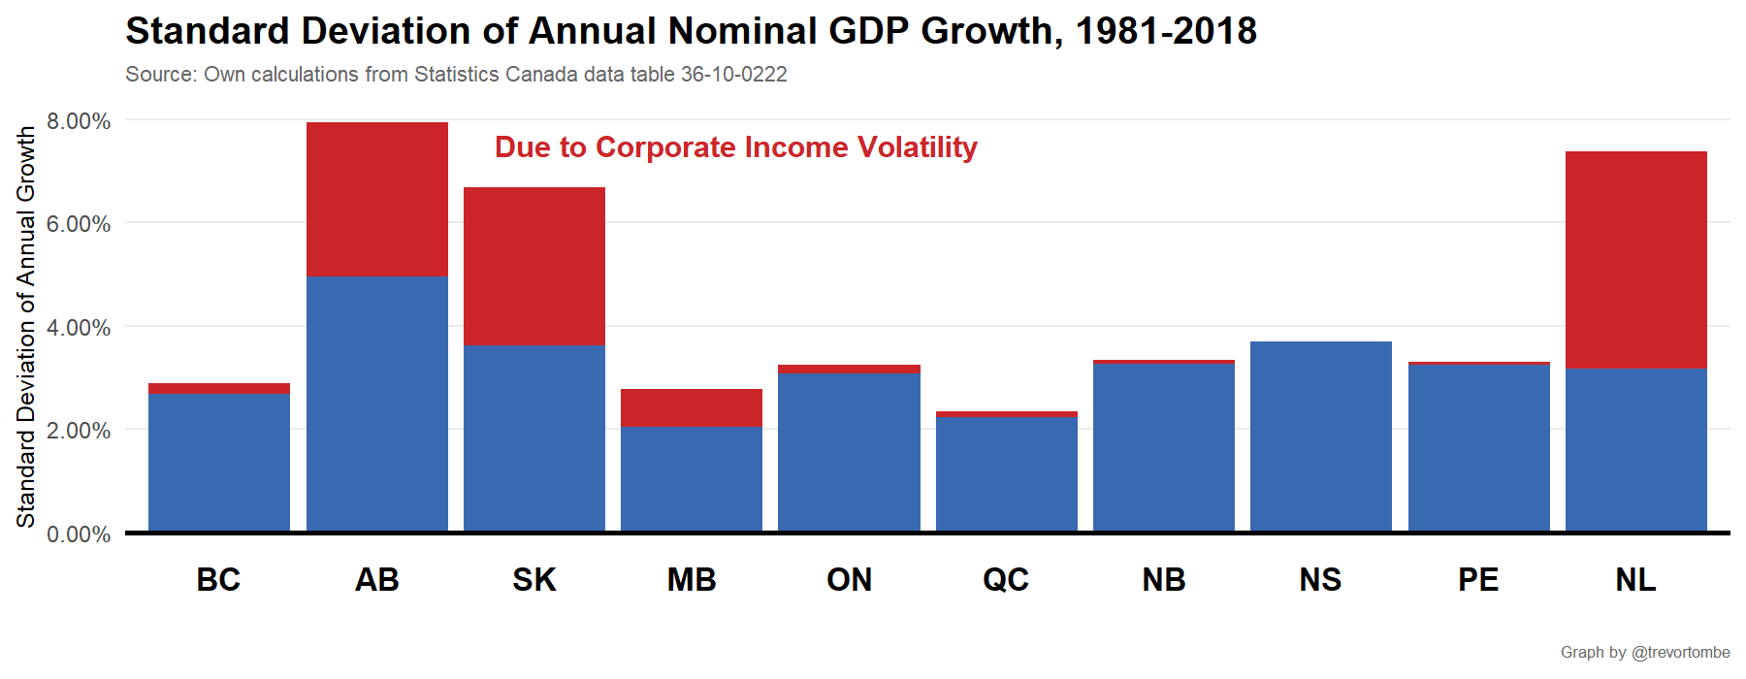
How Volatile Is Provincial Income/GDP?

Slide 20
Policy Options and Trade-Offs
Briefly primer on important considerations

Slide 21
Policy Options
Top-Down
Bottom-Up
Subsidies or tax breaks to certain sectors or activities that you would like to grow
Taxes or regulatory costs on sectors that you would like to shrink
Marketing and promotional campaigns (think Amazon HQ2 efforts)
Support for workers and/or businesses through the ups and down
Improved business environment to promote investment broadly
Create new sources of comparative advantage (through education, for example)

Slide 22
Diversification Policy may come with a Trade-offs
Lower Volatility
Lower Productivity
Higher Taxes or Lower Program Spending

