Slide 1
https://drive.google.com/file/d/1kXdq-cBlybVMBoqo1cDoGA80Zsxd5KG1/view?usp=sharing

Slide 2
ARCHITECTURAL
ENHANCEMENT
For ScummVM and SCI Engine
Trevor White (Group Leader, Alternatives for Implementation, Use Cases)
Sophia Pagazani (Presenter, SEI SAAM analysis)
Aniss Hamouda (Presenter, Use Cases, Effect on NFRs)
Claire Whelan (Abstract, Introduction, Potential Risks, Testing Plan)
Nicole Hernandez (Alternatives for Implementation, Lessons Learned)
Nasreen Mir (Current State, Enhancement, Motivation, Value, and Benefit)

Slide 3
TABLE OF CONTENTS
01
02
03
04
05
06
Enhancement Intro
Implementations
SEI SAAM Analysis
Current state of the system, and our proposed enhancement
Our two considerations on how to implement our enhancement
Our enhancement and its considerations on stakeholders and NFRs
Use Cases
Continued Analysis
Conclusions
A description of how the system would act in specific scenarios
Testing plans, risks and effect of certain NFRs will be discussed
Wrapping everything up, and our lessons learned

Slide 4
ENHANCEMENT INTRODUCTION

Slide 5
Current State
ScummVM is an open-source software that runs classic point-and-click games across a variety of platforms
Has a layered style
Recreates other game engines to run in it
Maintained by the community
Includes features such as
Save states
Remapping controls
Fast-forward functionality
Does not have an explicit speedrunning tool…

Slide 6
Enhancement
Proposed Idea: A Speedrunning toolset
Track best time
Rewind to previous checkpoints
A timer that can be started manually or automatically
Tracks current progress
Has a practice mode
Have its own UI

Slide 7
Motivation, Value, and Benefit
Why?
Speedrunning has become a popular and competitive activity
Encourage new categories + games to be competed in
Proven market for speedrunning already exists
Value?
Empower current players by making speedrunning accessible
Enable new ways to interact with old games, creating community
Provides tools for players who want to master games
Non-intrusive for casual players

Slide 8
IMPLEMENTATION 1: ENGINE-INDEPENDENT

Slide 9
SUMMARY OF ALTERNATIVE 1
ScummVM Layer: Most components are added in a new layer of ScummVM, making it work without the SCI engine
Idea: To implement the speedrun functionality in ScummVM, making it easy to port into other engines.
Changed Components: Interpreter, User Interface
New Components: Checkpoint Manager, Speedrun Launcher, Timer, Speedrun Database

Slide 10
SUMMARY OF ALTERNATIVE 1
Impact on Architecture:
New layer added to ScummVM
This new layer works in conjunction with the other layers
This minimizes the dependence on the engine
Doing everything in a new layer minimizes impact on other layers

Slide 11
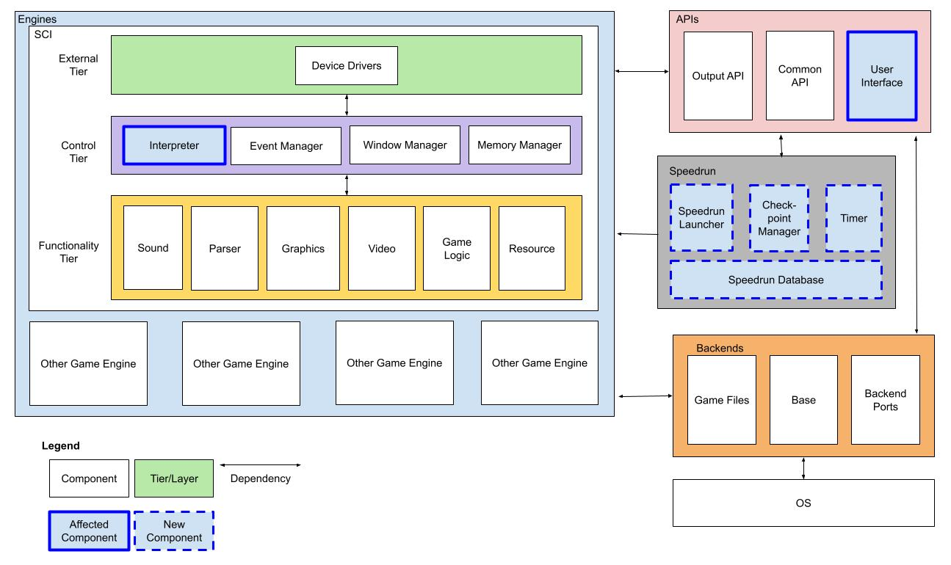
Engine-Independent

Slide 12
IMPLEMENTATION 2: ENGINE-INTEGRATED

Slide 13
SUMMARY OF ALTERNATIVE 2
Engine-Integrated: Most components are changed or added within the SCI system/architecture, making it highly dependent on it.
Idea: To leverage existing components that perform similar tasks to extend functionality for our enhancement
Changed Components: Interpreter, Event Manager, Parser, Resource, User Interface
New Components: Speedrun Manager, Speedrun Launcher

Slide 14
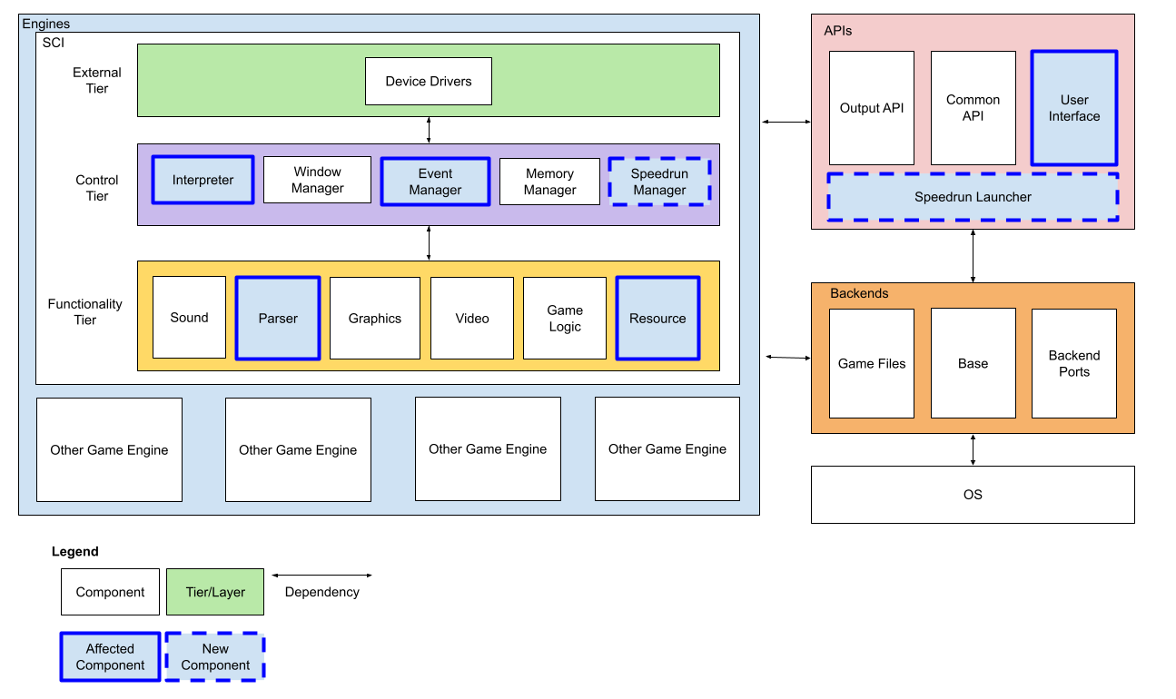
Engine-Integrated

Slide 15
SEI SAAM ANALYSIS

Slide 16
IDENTIFIED STAKEHOLDERS
Speedrunners:
Players that attempt to complete games with the fastest time within a certain category with specific objectives
Professional OR just for fun
Casual Players:
Players have little interest in using the speedrunning features but wish to ensure that their gameplay experience is not changed
Contributors
…to the development of ScummVM and the SCI engine
new avenue for them to contribute, by creating speedrunning configurations for game engines supported by ScummVM

Slide 17
ASSOCIATED NFRs
Speedrunners
Accuracy
Usability
Performance
Scalability
Casual Players
Performance
Usability
Portability
Contributors
Modifiability

Slide 18
IMPACTS ON NFRs (1)
STAKEHOLDER | ENGINE-INDEPENDENT
Speedrunner | Accuracy ✔ - timer is independent and flexible
 | Usability 〰 - consistent UI, but inconsistent measures
 | Performance 〰 - lots of communication outside SCI
 | Scalability 〰 - same as performance
Casual Player | Performance ✔ - remains as it did before enhancement
 | Portability ✔ - same as performance
 | Usability ✔ - easy to disable before launching a game
Contributor | Modifiability 〰 - open to change because in ScummVM

Slide 19
IMPACTS ON NFRs (2)
STAKEHOLDER | ENGINE-INTEGRATED
Speedrunner | Accuracy 〰 - relies on internal timer, fast response time
 | Usability ✗ - have to launch engine to view tools
 | Performance 〰 - slow response times, quick reload
 | Scalability ✗ - increased load on the interpreter
Casual Player | Performance ✗ - memory space held when not in use
 | Portability ✔ - same as before enhancement
 | Usability 〰 - variable for what engines a player is using
Contributor | Modifiability ✗ - hard to replicate for other engines

Slide 20
FINAL IMPLEMENTATION METHOD
We are going with a Engine-Independent method for implementation because it is:
Easier to adapt
Net positive overall
Performance is maintained and other NFRs are improved
Aligns wholly with stakeholders interests

Slide 21
USE
CASES

Slide 22
RELOADING CHECKPOINT STATE
When the player selects to load a checkpoint, the User Interface will pass this to the Checkpoint Manager
The Checkpoint Manager will:
Get desired game state from Speedrun Database
Rollback Timer
Instruct Interpreter to rollback all components to previous state
Once everything has rolled back, Checkpoint Manager will update User Interface, and then the player will regain control

Slide 23
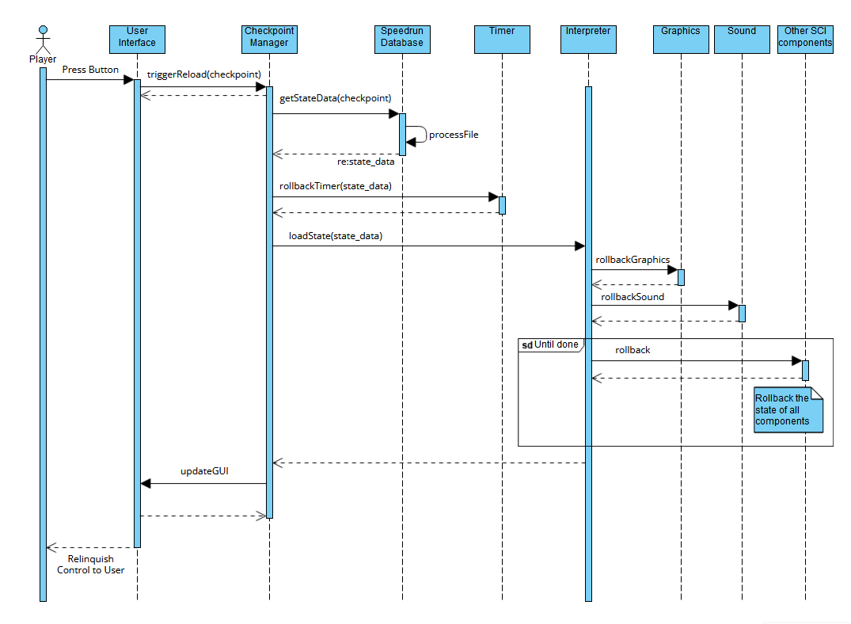
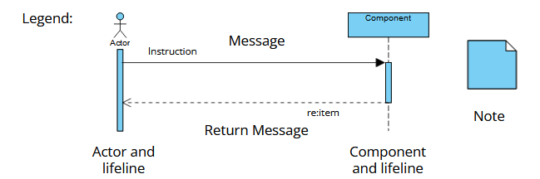
….

Slide 24
STARTING A RUN
User must enable speedrun mode:
Select speedrun in User Interface
Selection is passed to Checkpoint Manager, which retrieves file from Speedrun Database
When user starts game:
Interpreter does usual boot sequence
When done,Speedrun Launcher starts the Timer, and game starts
Checkpoint manager monitors game state through Interpreter
Gets time and records to Speedrun Database

Slide 25
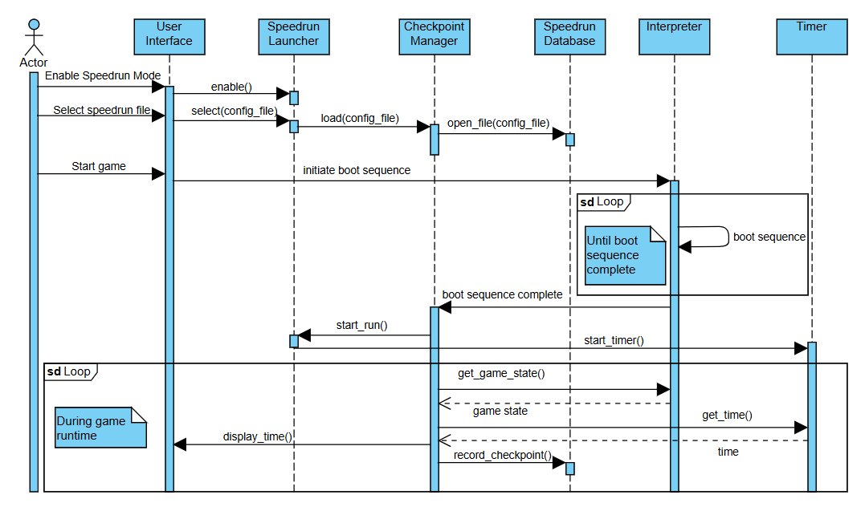
…

Slide 26
POTENTIAL RISKS AND LIMITATIONS
While our enhancement mainly relies on ScummVM, it still relies on the engine’s Interpreter and specific config files
Those must be implemented on a case-by-base basis
Different implementations of engines could cause times to be recorded differently, or might not work at all
The new components might increase system latency

Slide 27
PLAN FOR TESTING
Tests will be needed for each engine implementation
A list of use cases will be needed, tests made for each of them
Using the practice mode would help to test. It would be necessary to test that all checkpoints can be loaded correctly when they are saved. It would also help to confirm the system can handle all the checkpoints

Slide 28
MAINTAINABILITY, EVOLVABILITY, TESTABILITY, AND PERFORMANCE
Maintainability:
Maintenance will take longer, but not much
Testability:
Testability will take longer, but not much
Evolvability:
Harder to add new features that work with the speedrun mode
Performance:
Increased latency, may be negligible on newer machines

Slide 29
CONCLUSION
.
We considered many different enhancements but settled on speedrunning tools.
There were 2 implementation methods, one in the engine and one in ScummVM.
Doing it in ScummVM satisfied most stakeholders, and was cleaner to implement
This method still has issues:
Inconsistencies between different engines
Potential latency or failures
We think that overall it would benefit the system
This experience helped us shape our understanding of software architecture

Slide 30
LESSONS LEARNED
How hard it is to design new features for software.
Importance of brainstorming as a team.
Box and line diagrams are very helpful to understand a system.

