Slide 1
https://drive.google.com/file/d/1lB1F-s53sEy7AYgfC4dbu62wrzjpFZP5/view?usp=sharing

Slide 2
CONCEPTUAL ARCHITECTURE
For ScummVM and SCI Engine
Trevor White (Group Leader, Conclusions, SCI Components, Use Cases)
Sophia Pagazani (Presenter, SCI Components, Architectural Style)
Aniss Hamouda (Presenter, ScummVM Components, Use Cases)
Claire Whelan (Introduction, External Interface)
Nicole Hernandez (ScummVM Components, System Evolution)
Nasreen Mir (Derivation Process, External Interface)

Slide 3
TABLE OF CONTENTS
01
02
03
04
05
06
Derivation Process
Architectural Overview
External Interface
Our methods for researching the system
Our understanding of the components and style of the system
You can describe the topic of the section here
Use Cases
Evolution of the System
Lessons Learned
A description of how the system would act in specific scenarios
How the system changes over time
What we learned throughout this project

Slide 4
INTRODUCTION
ScummVM:
Script Creation Utility for Maniac Mansion Virtual Machine
Allows users to run classic adventure games on foreign systems
Focused on addressing portability by expanding support for more engines
Game engines are rewritten to run in a platform non-specific environment with ScummVM being the intermediary
SCI:
Script Code Interpreter/Sierra's Creative Interpreter
Game engine ScummVM supports
Mainly for adventure and text-based games
This Presentation:
An architectural overview view of both systems and their interactions
And how we got there!
Use cases for the systems
Conclusions and what we got out of this
And more!

Slide 5
DERIVATION PROCESS
Process:
Consulted various documentations for each system
Split the team into two groups: one for ScummVM and one for SCI
We settled on Layered Style for ScummVM and Layered & Interpreter Style for SCI
More detail in Architectural Overview!
Alternatives:
We considered that ScummVM might also use the interpreter style, but we decided that it makes more sense for just the SCI engine

Slide 6
ARCHITECTURAL
OVERVIEW

Slide 7
SCUMMVM
User Interface
Game Database
Bridge between User and ScummVM
Stores game files and save files
Common API
Output API
Backends
APIs that support many other components
APIs that process/pass graphics and audio
Allow ScummVM to run on many platforms

Slide 8
SCI
Graphics Subsystem
Sound Subsystem
Handles all visual displays for a game in SCI
Manages all music and sound for a game in SCI
Window Manager
Device Drivers
Heap and Hunk
Invisible but holds all other windows and ports
Takes input and produces events, then given to event handler
Used for memory allocation within the engine

Slide 9
SCI
Event Manager
Parser
Receives events and activates the related subsystems
Takes all user-entered text and compares it to a vocab list
Animation Subsystem
Game Code
Interpreter
Has a mover and a cycler that executes animations
All scripts and objects that make up a game in SCI
Uses all subsystems to allow game code to be executed

Slide 10
ARCHITECTURAL STYLE
ScummVM has a Layered architectural style:
Backend Tier: backends/ports, database for game files
Lowest level, communicates with the middleware tier
Middleware Tier: Output API, Common API
Middle level, communicates with both backend tier and frontend tier
Intermediary for the two other tiers
Frontend Tier: User Interface, Game Engines (like SCI)
Highest level, communicates with the middleware tier
Focused on rendering and extending middleware APIs

Slide 11
ARCHITECTURAL STYLE
SCI while be in one of ScummVM’s tier, has its own distinct architectural styles. The first being also Layered style:
Functionality Tier: Window Manager, Parser, Graphics Subsystem, Sound Subsystem, Animation subsystem
Lowest level, communicates with control tier
Concerned with all visual parts of a game and actually running it
Control Tier: Interpreter, Event Manager
Middle level, communicates with both functionality tier and data tier
Most important, how everything is allowed to run
Data Tier: Device Drivers, Game Code, Heap and Hunk
Highest level, communicates with control code
All resources required for game to run

Slide 12
ARCHITECTURAL STYLE
SCI also has an Interpreter style architecture:
Has two Domain Specific Languages (DSLs) to extend the program
Four Components to make up the style:
“The execution engine” = the main game loop
“Current state of the execution engine” = communicated to the interpreter by the timer component
“The program being interpreted” = any of the games created for the engine (i.e., King’s Quest IV)
“Current state of the program being interpreted” = the current game state

Slide 13
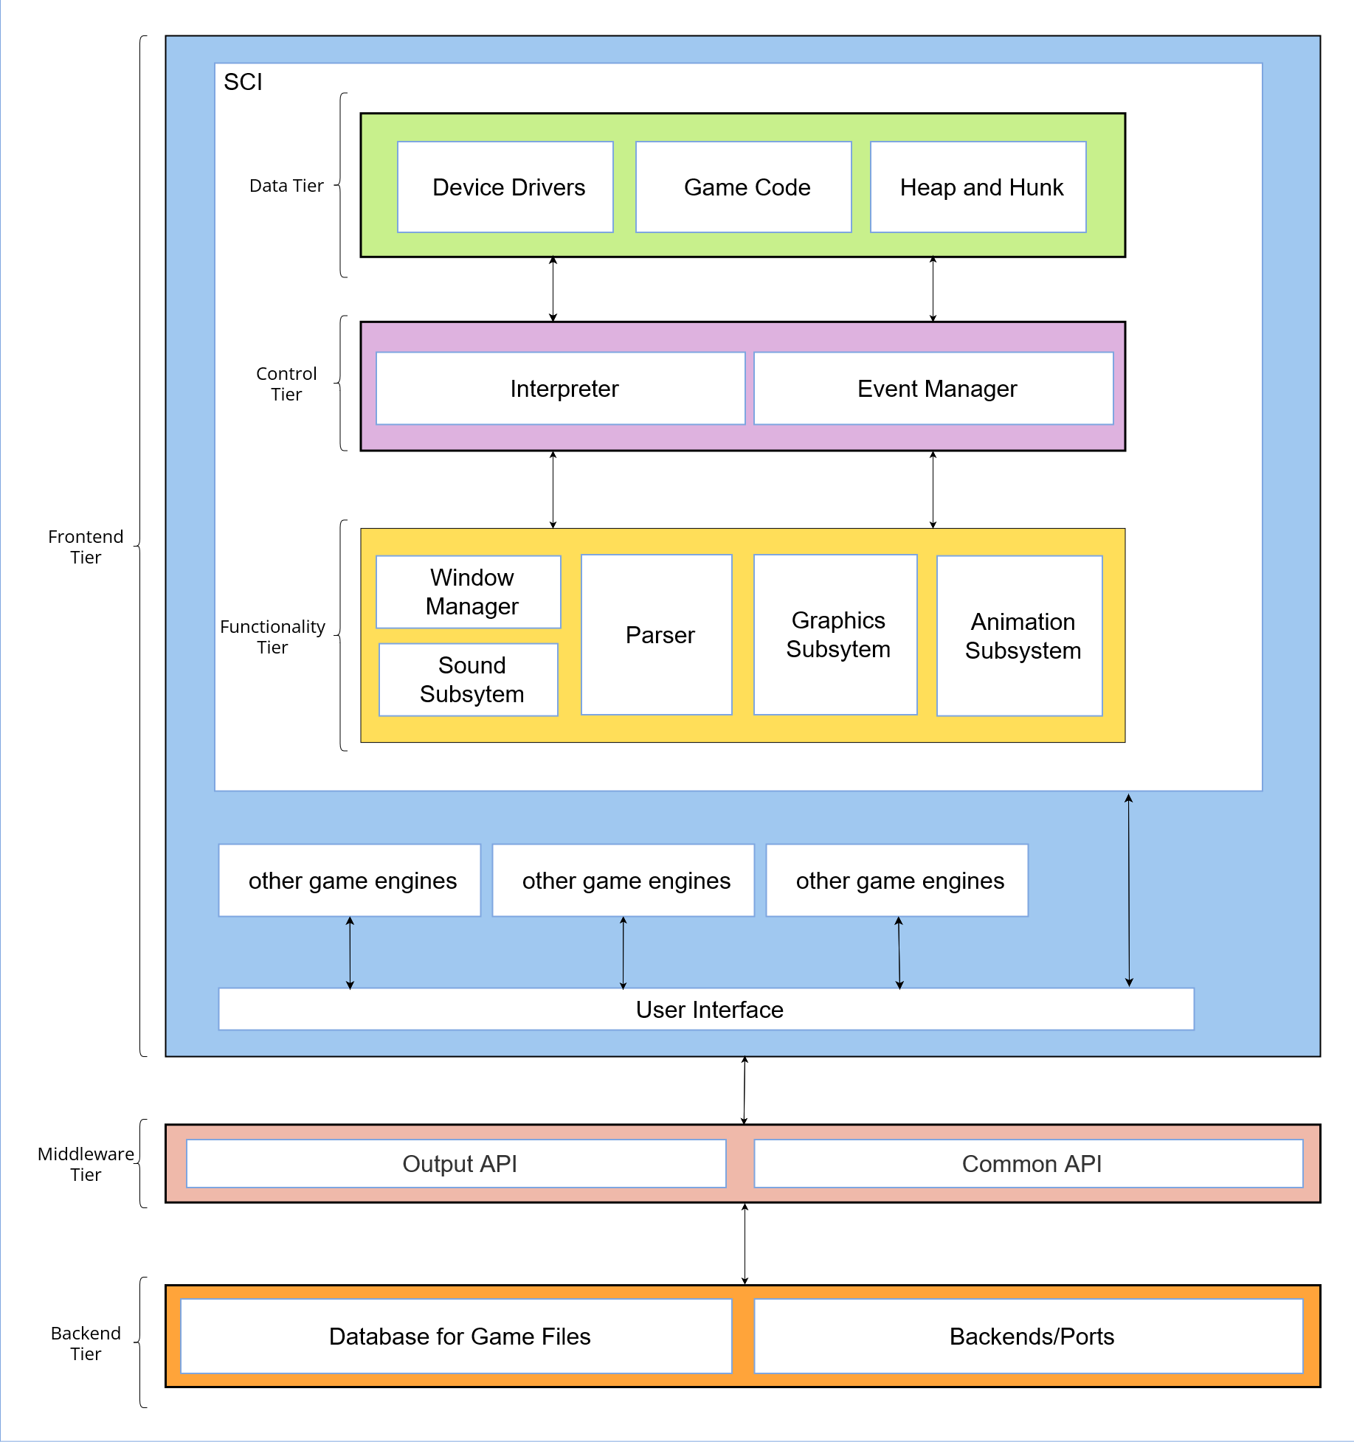
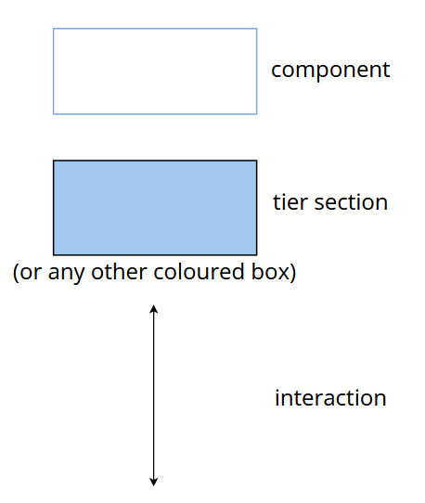
System Architecture
Box and Line Diagram

Slide 14
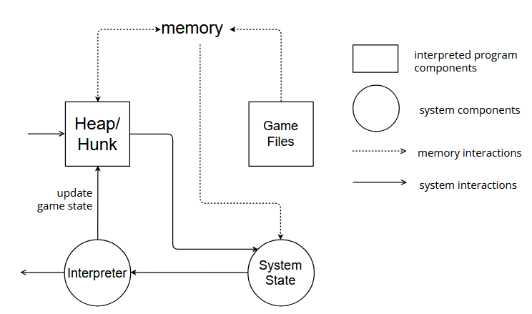
Interpreter Flow Diagram

Slide 15
EXTERNAL INTERFACE
ScummVM acts to transmit information between the engine and the system it is running on
It transmits information using APIs related to:
Event handling
Audio and Visual Output
The file system
The engine also receives information from the GUI, namely:
User Input
Display Updates
State Changes
Internally, the engine transmits game files relating to:
Graphics
Sounds
User Interaction.
ScummVM also has its own files like:
Configuration Files
Plugins
Translation Files
Save Directory

Slide 16
USE
CASES

Slide 17
LAUNCHING A GAME
Once the player launches the game, ScummVM passes this to the SCI Interpreter.
The Interpreter will:
Initialize all components
Parse Config Files and load drivers
Allocate space on heap
Run Game
The interpreter is always active and acts as the main controller for the engine

Slide 18
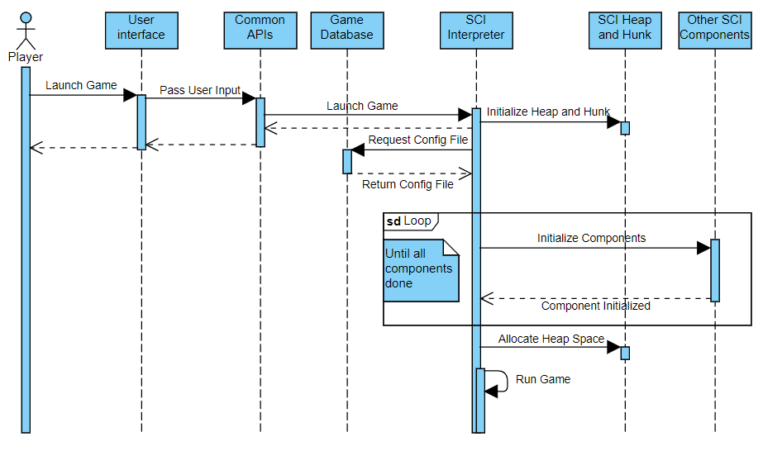
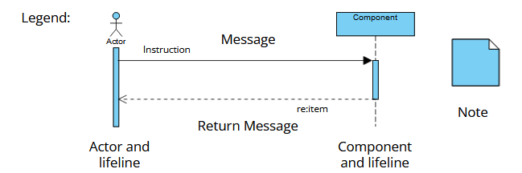
Launching a Game

Slide 19
USING A TEXT BASED COMMAND
When the user inputs a string:
String passed to event manager
String passed to parser
Parser generates event, returns it
Interpreter requests event
Interpreter will then:
Request view from game code
Dispatch to animation subsystem.
Animation subsystem will loop cycler, mover and Output APIs

Slide 20
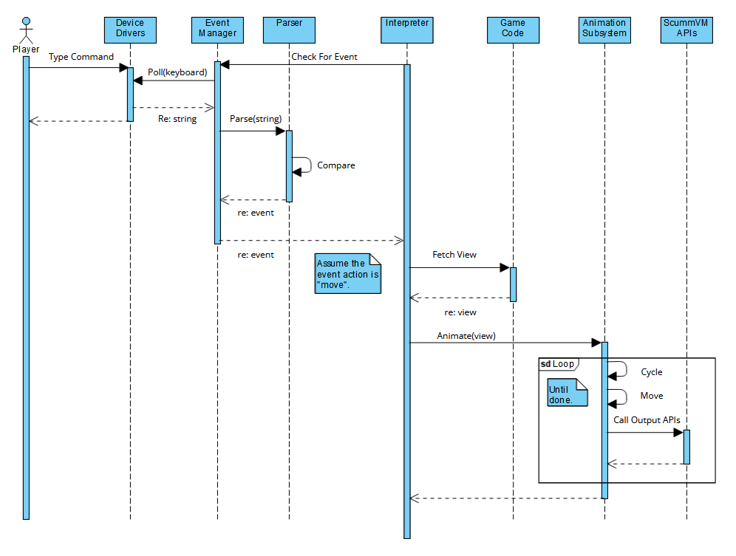
Text Based Command

Slide 21
EVOLUTION OF THE SYSTEM
ScummVM is an open source project, so anyone can contribute to it as long as they align with the coding conventions. All the source code can be found in the Github repository. In order to do so you must:
Code in C++ (exceptions being dev tools, Apple backends, android backends)
Fork the repository
Go through the Pull request system
Have the ScummVM team review your changes for two weeks
If the ScummVM team has no objections, your additions will be merged with the existing code, and you must document the changes you made.

Slide 22
LESSONS LEARNED
Learning how Open Source Projects are built and maintained
Learning about APIs and how they work
Our biggest mistake was treating ScummVM and the SCI engine as 2 separate subsystems, instead of one unified system
Understanding architectural styles, especially Interpreter style

Slide 23
CONCLUSION
ScummVM allows game engines to run on non natives system using a layered architecture, comprised of:
UI elements and game files, allowing the user to launch and save games
Many APIs, that facilitate communication between the engines and the system running it
The SCI engine is a layered system. It also has an interpreter style architecture, having a component that:
Directs the other components
Tracks the state of execution
These findings are all conceptual, as they are derived from documentation. The next step is to look at the source code to determine a concrete architecture.

Slide 24


