Slide 1
https://drive.google.com/file/d/10vyVWKhZQuWoTSg6qtGpZEr9Pc0lDDvm/view?usp=sharing

Slide 2
CONCRETE
ARCHITECTURE
For ScummVM and SCI Engine
Trevor White (Group Leader, Concrete Architecture, Use Cases)
Sophia Pagazani (Presenter, SCI Reflexion Analysis)
Aniss Hamouda (Presenter, Use Cases, Conclusions)
Claire Whelan (Abstract, High-Level Reflexion Analysis)
Nicole Hernandez (Derivation Process, Lessons Learned)
Nasreen Mir (Introduction, Review of Conceptual Architecture)

Slide 3
TABLE OF CONTENTS
01
02
03
04
05
06
Introduction
Reflexion Analysis
Concrete Architecture
Brief overview of presentation and a review of our conceptual architecture
Comparison between our conceptual and concrete architecture
Our new architecture based on our findings
Use Cases
Conclusions
Lessons Learned
A description of how the system would act in specific scenarios
Wrapping everything up, and what our final thoughts are
What we learned throughout this project

Slide 4
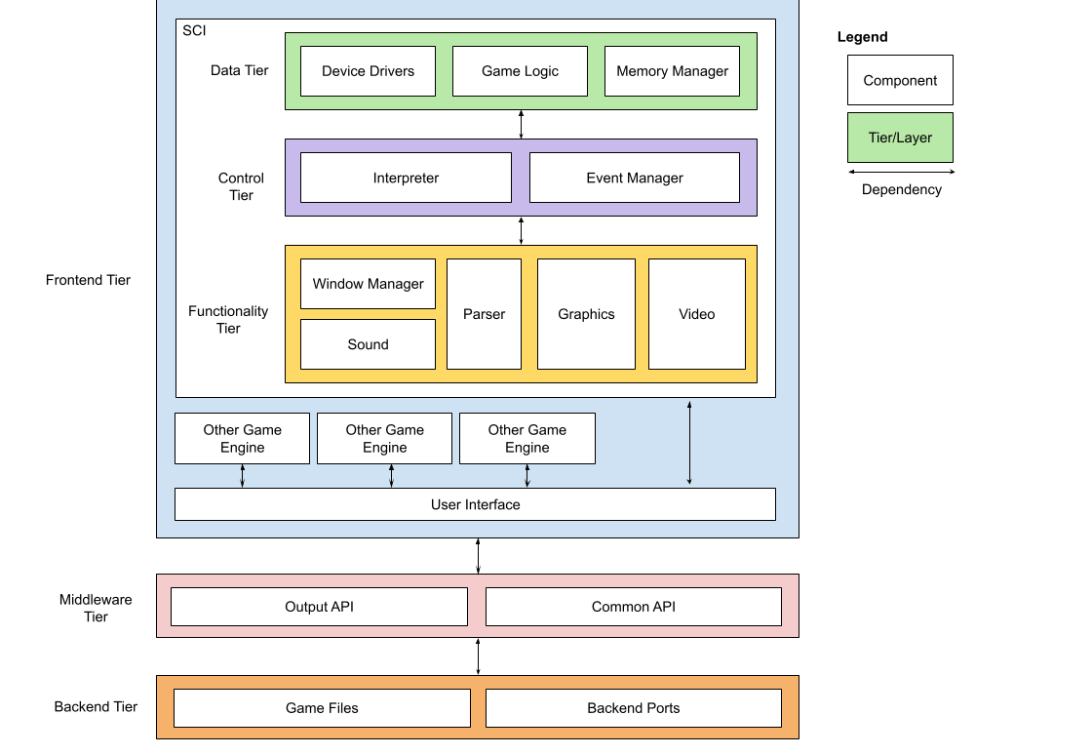
Review of Conceptual Architecture

Slide 5
DERIVATION PROCESS
Each member loaded files into Understand
With our conceptual architecture as a base, mapped code to components
Discussed placements as a group, renamed/added components as needed
Conducted a reflexion analysis and identified divergences
Derived a concrete architecture based on our findings

Slide 6
REFLEXION
ANALYSIS

Slide 7
TOP-LEVEL
Interpreter
Backend Ports
Base
Interpreter
Memory Manager
Backend Ports
Backend Ports
Sound
Window Manager
Base

Slide 8
WITHIN SCI
Resource
Video,
Graphics,
Sound
Memory Manager
Parser
Resource
Parser
Memory Manager
Video, Graphics,
Sound

Slide 9
WITHIN SCI
Game Logic
Graphics,
Sound
Game Logic
Parser
Window Manager
Game Logic
Window Manager
Memory
Manager
Window Manager
Resource

Slide 10
CONCRETE
ARCHITECTURE

Slide 11
DERIVED ARCHITECTURE
Problems:
Divergent dependencies violated original layering
Component gaps became evident
Misappropriated components also discovered
Solutions:
Added Base and Resource
Renamed:
Animation → Video
Game Code → Game Logic
Heap/Hunk → Memory Manager
Redefined tiers
Restructured layers
Observations:
Maintains both architectural styles
Pub-Sub for SCI as well
Maintains our initial findings and conclusions

Slide 12
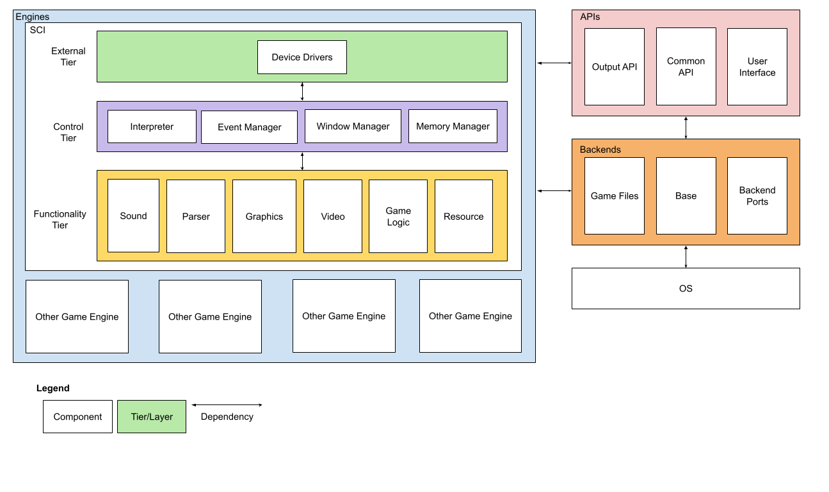
Concrete Architecture

Slide 13
USE
CASES

Slide 14
LAUNCHING A GAME
When the player opens ScummVM, the Base component creates an instance of the User Interface, where the user can select a game.
Once the player launches the game, ScummVM passes this to the SCI Interpreter.
The Interpreter will:
Parse Config Files
Initialize all components
Allocate space on heap
Run Game
The interpreter is always active and acts as the main controller for the engine

Slide 15
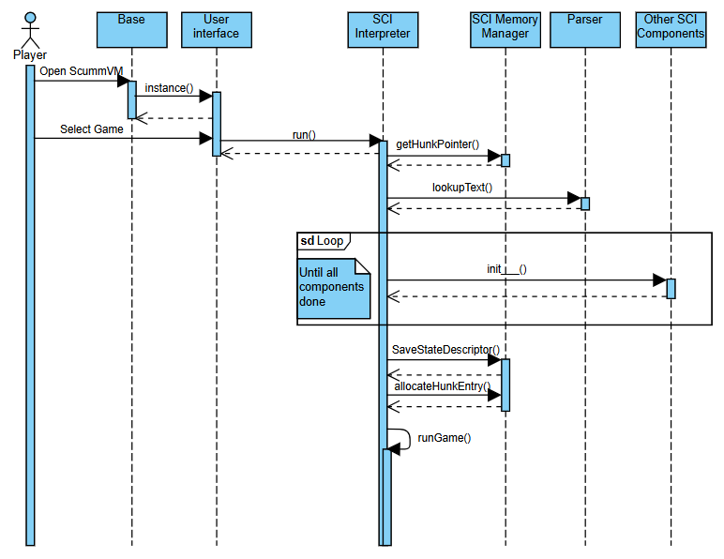
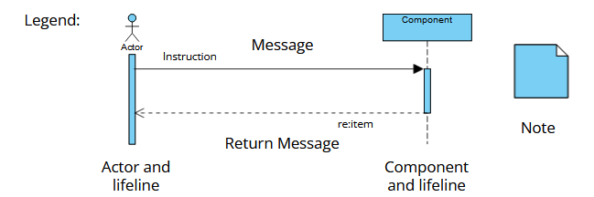
Launching a Game

Slide 16
USING A TEXT BASED COMMAND
When the user inputs a string:
Interpreter queries Event Manager
Event Manager passes string to Parser
Parser generates event, returns it
Event manager passes to Interpreter
Interpreter will then:
Call Game Logic to determine path and game object
Call Graphics to render movement on screen
Graphics will get view space from window manager
Graphics will loop, calling Output API

Slide 17
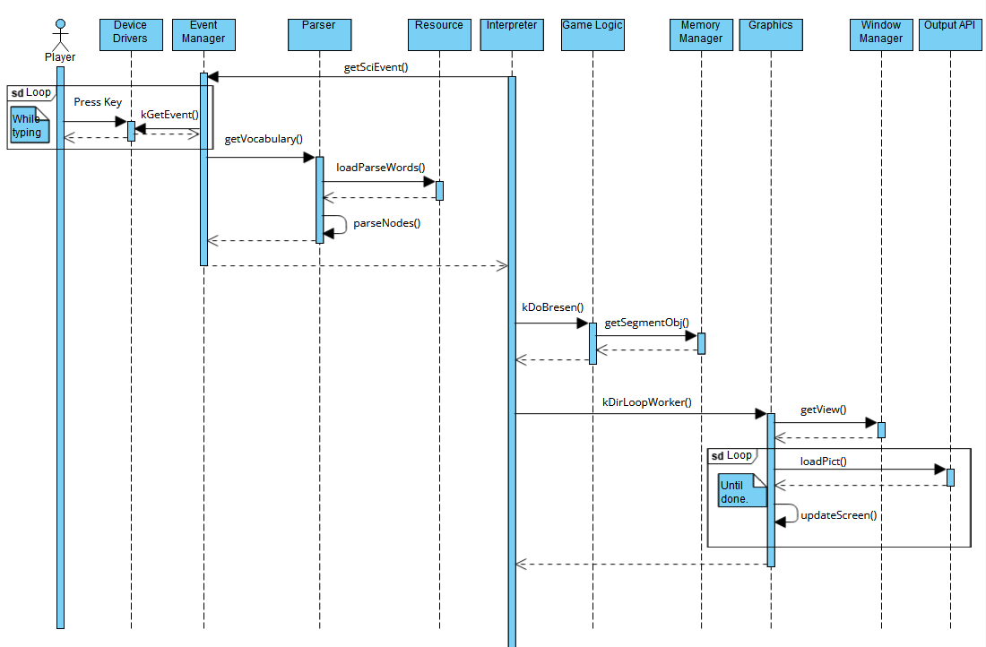
Text Based Command

Slide 18
CONCLUSION
Using Understand, we were able to develop a concrete architecture for the system. This was fairly similar to the conceptual architecture
Divergences:
New Resource and Base components
Tier changes
Frontend -> Engine
Middleware -> API
User interface moved to API tier
API and Backend work side by side instead of in hierarchy
By analyzing source code, we got a better understanding of the system.
We can use this to suggest improvements to the system.

Slide 19
LESSONS LEARNED
Teamwork:
We did not split up the system and all worked together
Documentation:
It was a challenge to understand code with minimal documentation
Proper Tools:
Using Understand helped find the dependencies

