Slide 1
Trip Generation Rates of Land Uses in a Developing Country City
Bharga Narayan Tarafder
ID: 0424042423

Slide 2
Objective
Determine trip generation rates for six land use categories along Mirpur Road, Dhaka, Bangladesh.
Explore modal share and vehicular trip rates using passenger car equivalents (PCE).
Provide insights for urban transportation planning and policymaking.

Slide 3
Data
Study Area
a section of Mirpur Road was selected, 7.4km in length(from “Azimpur” intersection to “Technical” intersection)

Slide 4
Data
Data Collection Method
Person Count Surveys:
Manual counting was conducted.
Persons entering and leaving were recorded
Counting was performed at each entry and exit point.
Counts were recorded every 30 minutes for most land uses.
For garment the it was 15 minutes for high trip volumes
Intercept Surveys:
50%-60% of trip makers for non-residential establishments intercepted.
92% of trip makers for residential establishments intercepted.
Respondents surveyed on primary mode of travel and trip details.

Slide 5
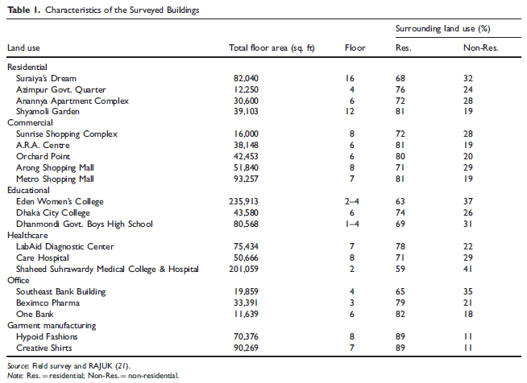
Data
Characteristics of the Surveyed Buildings
Source of data GIS data from RAJUK’s Detailed Area Plan (1995–2015).

Slide 6
Method Used for Analysis
- Person Trip Rate: Weighted average using gross floor area and building floors.
- Modal Share: Categorized into motorized and non-motorized modes.
- Vehicle Trip Rate: Converted from person trips using PCE values and vehicle occupancy rates.

Slide 7
Result
Results (Person Trip Rate)
Garment manufacturing and educational land uses had the highest average rates.
Residential land use recorded the lowest rate.
Peak-hour variations observed based on land use functions
Results (Modal Share)
Key Modes: Bus, walking, rickshaw dominate across all land uses.
Residential and healthcare: High car usage.
Garment manufacturing: Predominantly walking trips (87%).

Slide 8
Result (con.)
Results (Vehicle Trip Rate)
Healthcare had the highest peak-hour vehicular trip rate.
ITE manual underestimates total trip rates for Dhaka's mixed-use urban environment.
Commercial land use: Highest impact on vehicular traffic.

Slide 9
Limitations
It focus on single land uses excludes internal trips in mixed-use areas.
Other influencing factors, such as parking capacity, are not integrated.

Slide 10
Suggesting a better approach for attaining the objective
recommend improvements to the study’s methodology, such as:
adding a variety of land use categories because they provide a more authentic urban environment.
To increase the accuracy of the trip generation estimates, include variables like parking capacity, pedestrian infrastructure, or accessibility to public transportation.
Using updated PCE values, given changes in vehicle technology and urban conditions.
To determine how changes in socioeconomic factors affect trip rates, sensitivity analysis is being conducted.

Slide 11


