Slide 1
The impact of shared mobility on trip generation behavior in the US: Findings from the 2017 National Household Travel Survey
Authors: Junfeng Jiao, Chris Bischak, Sarah Hyden
Presented by
Tanmoy Nath Ananda
Graduate Student
Department of Civil Engineering
BUET, Dhaka

Slide 2



Shared mobility is a transportation system where travelers share a vehicle either simultaneously as a group or over time as personal rental, and in the process share the cost of the journey.
Shared Mobility
Car Sharing
Bike Sharing
Ride Hailing

Slide 3

Objectives
Modeling the trip generation associated with the shared mobility services
Determining the significance of shared mobility services on the trip generation behavior

Slide 4
Data
Data Source:
Secondary Source- National Household Travel Survey (2017) by Federal Highway Administration
Collection Method:
129,696 randomly selected US households were asked to keep travel diary of all trips made in a randomly assigned single travel day

Slide 5
Data
Note:
Four strata
urban area of 1 million plus with heavy rail
urban area of 1 million plus with no heavy rail
urban areas of less than 1 million
non-urban areas
Data on Household, Person and Trip were taken for the study

Slide 6
Data
Number of data points:
After dataset cleaning information on number of
trips of 180,605 persons were in the final dataset
Dataset Cleaning:
Any incomplete records
Ride-hailing users under 18 years age
Zero trips on the travel day

Slide 7
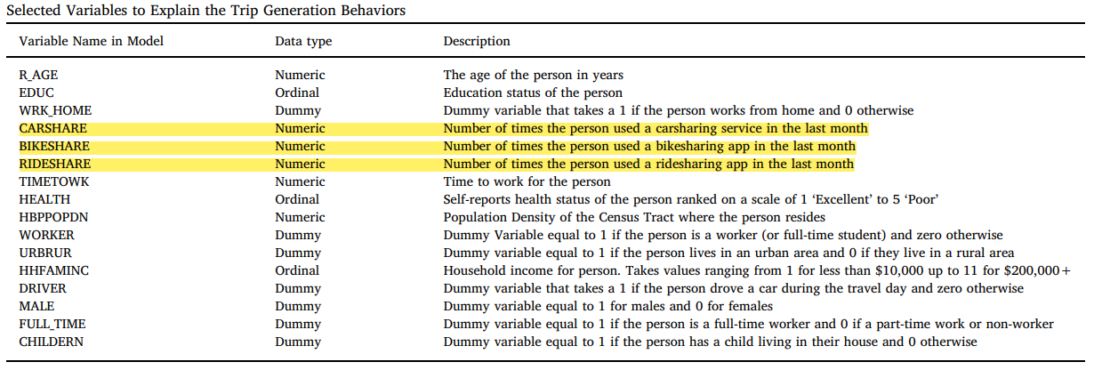
Variables (Independent)

Slide 8
Method used for analysis
Negative Binomial Regression (NBR) to model the count data and ANOVA test to assess the significance of the shared mobility variables (CARSHARE, BIKESHARE and RIDESHARE)
NBR Model equation:
log(y) = a + b_{i} * x_{i}
where,
y = dependent variable (trip count)
x_{i} = independent variable (carshare, bikeshare, rideshare etc)
a = intercept
b_{i} = model parameters

Slide 9
NBR is a better approach
Non-negative trip count is ensured using the following equation: | Accounts for overdispersion by adding dispersion parameter α:
y = exp(a +bi * xi) | Var(Y) = μ+α*μ²

Slide 10
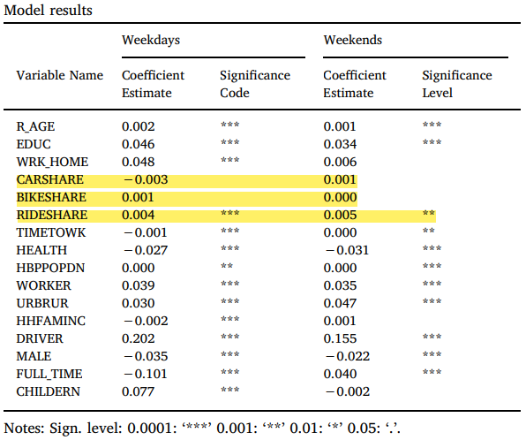

Result

Slide 11
Key Findings
None of the variables are strong predictor of trip generation behavior
Positive coefficient of work from home indicates that these workers are more likely to make recreational trips
Ride-hailing services may be causing more trips than other two services

Slide 12
Discussion
Carsharing services are substitute for other forms of car usage
Bikesharing services are substituting walk trips or short bus trips
Comfort and convenience of ride-hailing services are increasing trips specially social or recreational trips which might not be made otherwise.
Frequent use of ride-hailing services might reflect the absence of adequate transportation services in certain areas
Ride-hailing is putting strain and inducing pollution by increasing the number of trips in urban areas.

Slide 13
Thank You

