Slide 1
Linking Mode Choice with Travel Behavior by Using Logit Model Based on Utility Function
Authors: Wissam Qassim Al-Salih and Domokos Esztergár-Kiss
Presented By:
Parvez Anowar
Student ID: 0424042428

Slide 2
🎯 Study Objectives
📊 Data Collection
📚 Research Methodology
📈 Results and Discussions
🌟 Major Findings
💬 Comparison with the Class Lecture
Presentation Outline
2

Slide 3
Study Objectives
Objective # 1
Examine the relationships between the mode choice and travel behavior by using a multinomial logit model (MNL) and nested logit (NL) model
Objective # 2
Identify which of the variables has the greatest effect on transport mode choice
Objective # 3
Determine the utility functions formulated from an individual, household characteristics and daily activity behavior to define the most suitable mode choice.
3

Slide 4
Data Collection
Source of Data:
Case study in Budapest, Hungary
The data collection was conducted by the Hungarian Census Bureau in 2014
Data Collection Method:
Household survey process
Data Points:
A total of 1889 trips were identified
4

Slide 5
Data Collection
Variables Categories:
1. Household Characteristics
Variables | Description | Measure
HSIZE | Household size | Scale
HINCOME | Average household monthly income (1 if between 75K Ft and 50K Ft, 2 if between 100K Ft and 75K Ft, 3 if between 125K Ft and 100K Ft, 4 if between 150K Ft and 125K Ft, 5 if no answer) | Ordinal
VEHOWNER | Vehicle ownership (vehicles per household) (Private car) (1 if No and 2 if Yes) | Scale
2. Individual Characteristics
Variables | Description | Measure
AGE | Age of individual | Scale
GENDER | Gender (1 if male and 2 if female) | Scale
Employment | Employment (1 if full time, 2 if entrepreneur, 3 if unemployed, 4 if retired, and 5 if housewife) | Ordinal
EDUCATION | Education level (1 if primary schools, 2 if vocational training, 3 if high school, 4 if college and university, and 5 if without education and no answer) | Ordinal
5

Slide 6
Data Collection
Variables Categories:
3. Trip Characteristics
Variables | Description | Measure
ACP | Activity purpose (1 if W, 2 if E, 3 if S, 4 if L, and 5 if O) | Nominal
DISTANCE | Average distance of each mode | Scale
TIME | Average time of each mode | Scale
COST | Average cost of each mode | Scale
TRANSFER | Transfer number | Scale
TRMO | Transport mode (walk, private car as driver, and public transport) | Nominal
6

Slide 7
Methodology
Identification of the individuals, household, and travel characteristics
Analyze the mode choice based on the selected variables by using MNL and NL
Investigate the mode choice behavior based on the utility function
7

Slide 8
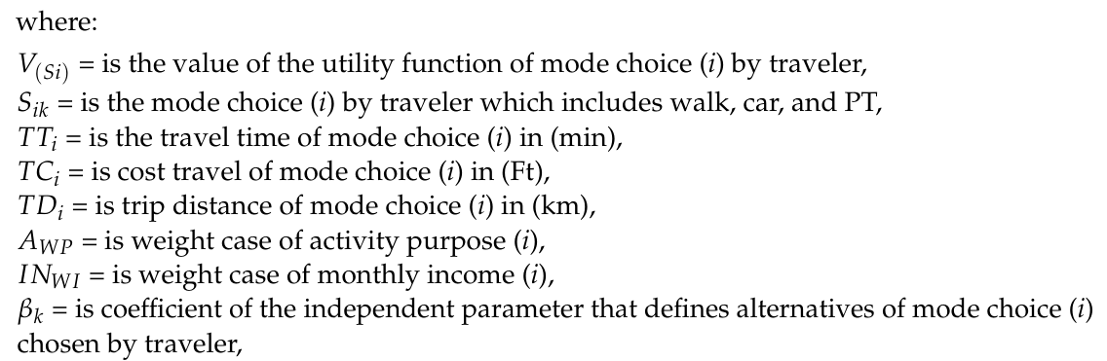

Methodology
Utility Theory Associated with Alternatives
The general utility function is:
$V_{(Si)}=β_{1}+{β_{2i}∗TT}_{i}$ $+ {β_{3i}∗TD}_{i}$ $+{{ β}_{4i}∗TC}_{i}$ $+ {β_{5i}∗A}_{WP}$ $+ {β_{6i}∗IN}_{Wi}$
8

Slide 9
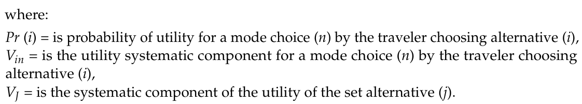

Methodology
Multinomial Logit Model
Overview:
MNL identifies how the independent variables are related to the dependent variable
Expressed in terms of utility
Probability of choosing one mode over another does not depends on other modes
$${Pr}_{(i)}= \frac{e^{V_{in}}}{\sum_{i=1}^{J}{e^{V_{in}}}}$$
9

Slide 10


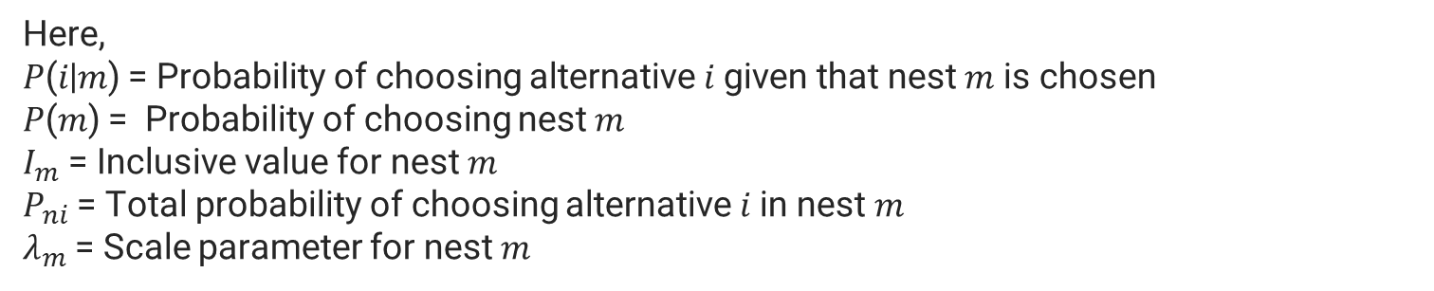


Methodology
Nested Logit Model
Overview:
Estimate the relationship between socio demographic characteristics and mode choice
Partial relaxation of the independence of irrelevant alternatives property by allowing correlation among similar alternatives
$$P(i|m)= \frac{e^{\frac{V_{ni}}{λ_{m}}}}{\sum{e^{\frac{V_{nj}}{λ_{m}}}}}$$
$$P(m)= \frac{e^{I_{m}}}{\sum{e^{I_{m}}}}$$
$$I_{m}=ln⁡\left(\sum{e^{\frac{V_{nj}}{λ_{m}}}}\right)$$
$$P_{ni}= P_{(m)}∗P_{(i|m)}$$
Here,
𝑃(𝑖|𝑚) = Probability of choosing alternative 𝑖 given that nest 𝑚 is chosen
𝑃(𝑚) = Probability of choosing nest 𝑚
$I_{m}$= Inclusive value for nest 𝑚
$P_{ni}$= Total probability of choosing alternative 𝑖 in nest 𝑚
$λ_{m}$= Scale parameter for nest 𝑚
10

Slide 11
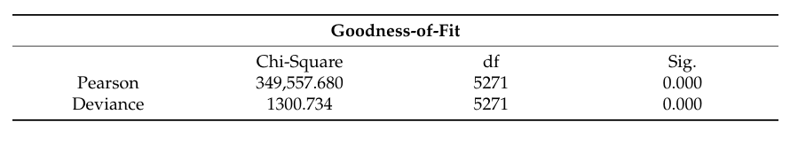

Results and Discussions
Goodness-of-Fit Measures:
Pseudo R-square:
Used for model involving categorical dependent variables
11

Slide 12
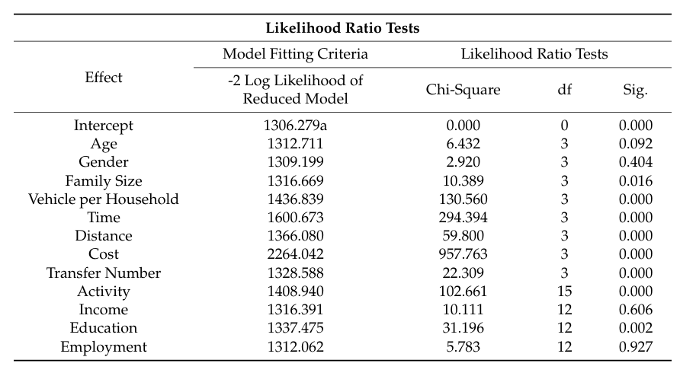
Results and Discussions
Likelihood Ratio Test:
Assess the significance of individual variables in a statistical model
12

Slide 13
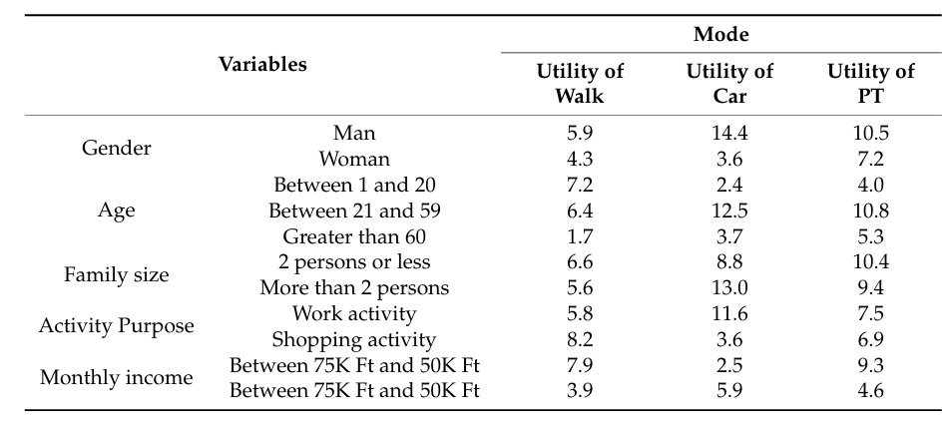
Results and Discussions
Estimation of Utility:
13

Slide 14
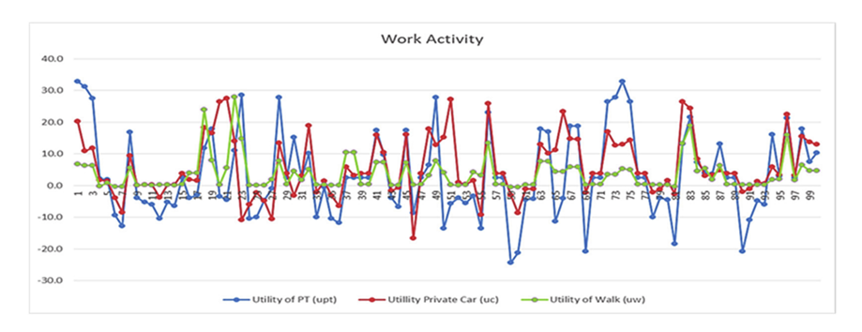
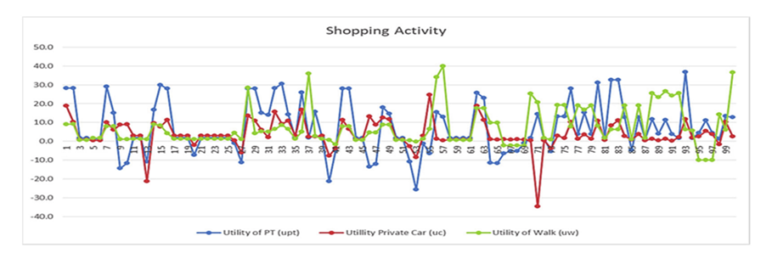
Results and Discussions
Utility value of dependent variable based on activity purpose:
13

Slide 15
Major Findings
All considered variables were significant, but the effects and contribution of each variable were not the same.
Identified order of the significance of the variables: trip distance, travel time, activity purpose, income, travel cost, vehicle per household, number of transfers, family size, age, gender, employment, and finally education.
Formulated utility functions based on individual, household, and activity characteristics and enabled effective mode choice decisions by maximizing personal utility.
15

Slide 16
Thank You…
16

