Slide 1
Incorporating the Influence of Latent Modal Preferences on Travel Mode Choice Behavior
Presented By: Fahim Shahrer Ziko
Student ID: 0424042440

Slide 2
Introduction
Objective
Understanding Travel Mode Choice: Quantify and operationalised modality style into traditional mode choice models.
Incorporation of psychological factors: Goes beyond travel time and cost to include cultural, lifestyle elements
Enhancing decision making models: Integrates measurable and non-measurable factors for accuracy.

Slide 3



Dataset Overview
MOBIDRIVE Project Survey
Survey location and method
Data collected from Karlsruhe and Halle using face to face and self administrated survey
Participants Demographic
139 households, 317 individuals aged 6+ participated over six week
Travel Mode Studied
Data on auto, bus, bike and walk for work and non-work tour

Slide 4
Key Insights From Datasets
Patterns and Observations
High Consistency in Mode Choice: One-third of the participant use same mode over 80% of trip.
Multimodal Behaviour Insights: Multimodal use always doesn’t imply optimal decision making.
Focus on Work and Non-work Trips: Analysed 1445 work tour and 3359 non-work tour.

Slide 5

Model Framework (LCCMs)
Latent Class Choice Models
Class Membership Models
Classify individual based on observed characteristics like demographic.
Class-Specific Choice Models
Analysed travel mode choice influenced by situational factors.
Capturing Heterogeneity
Accounts for diverse behavioural patterns in travel choice.

Slide 6
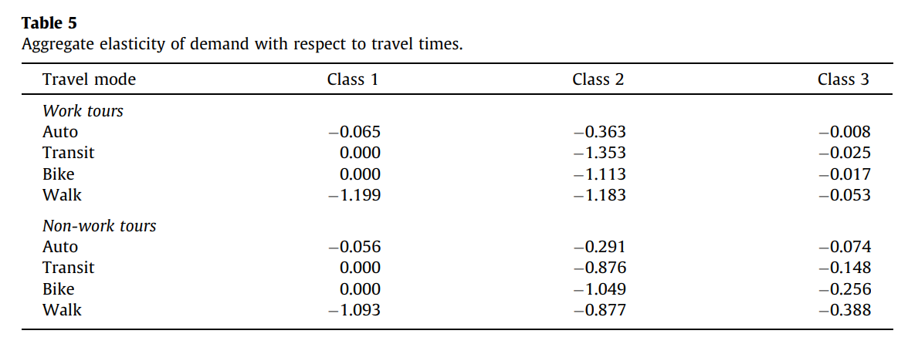
Results and Findings
Three Class LCCM results: Classes Identified habitual drivers, time sensitive multimodal, time insensitive multimodal.
Elasticity Insights: Negative elasticity for travel time indicates reduce probability of mode choice.

Slide 7
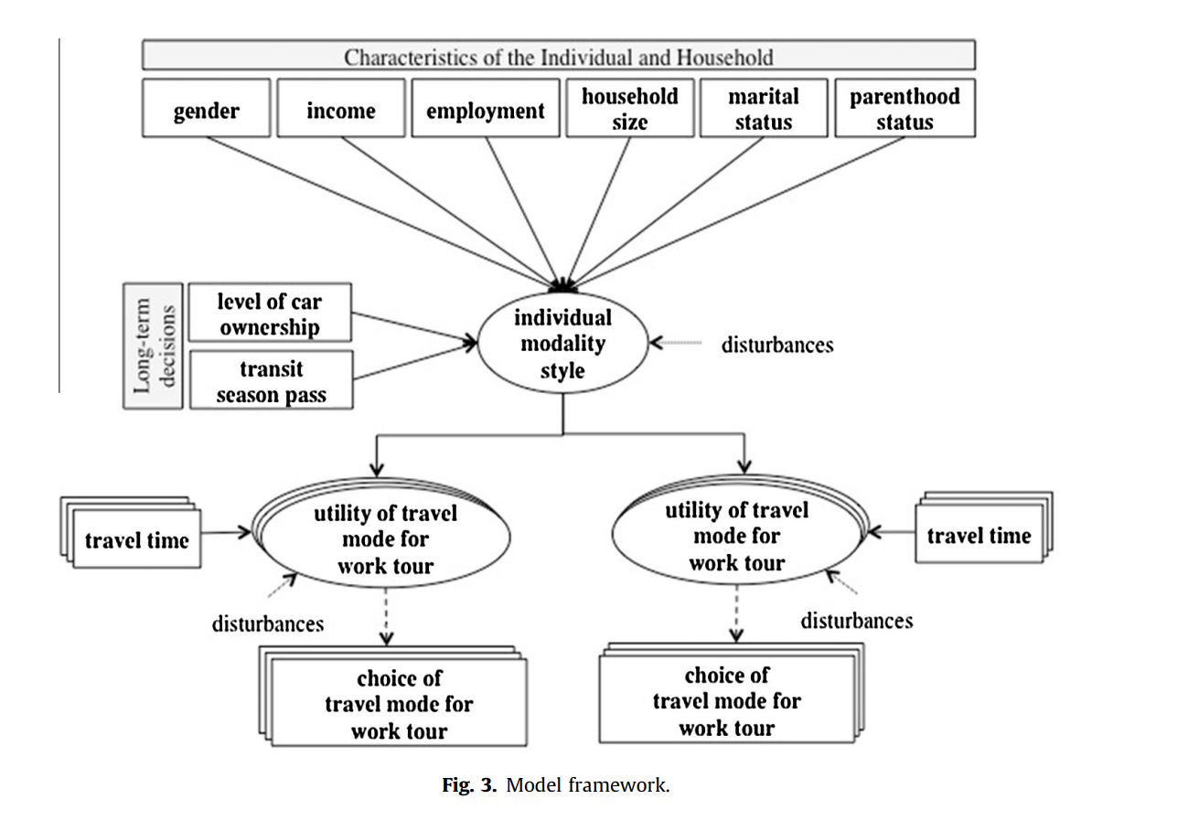
Comparison
Logit Model
LCCMs
Explanatory Variables
Disturbance
Utility
Choice

Slide 8
Conclusion
For Capturing heterogeneity of data LCCMs is used because Logit model considered only homogeneous data
Future Research area: Integrate cost data and expand study scope beyond selected city

