Slide 1
Dexcom Blood Glucose Monitor Investigation
Group E

Slide 2
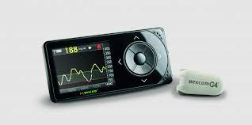
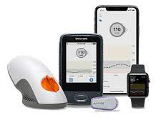
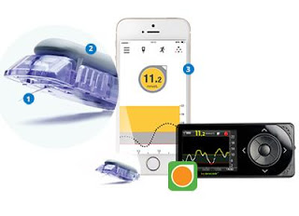
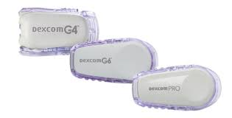
Data Description
Dexcom blood glucose monitor reports between 2016-2021
Three models: G4, G5, G6

Slide 3
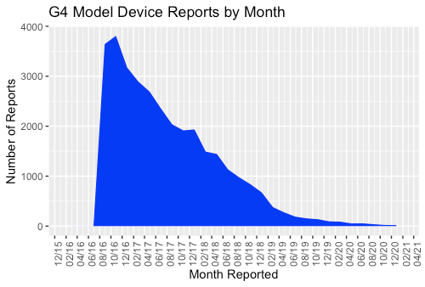
Exploratory Data Analysis G4
Notes:
Mention Outliers at beginning. The sharp decline is due to other models being introduced into the market.

Slide 4
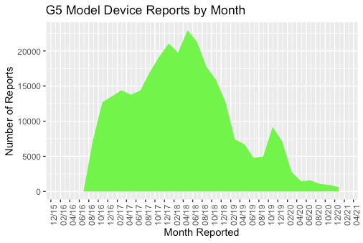
Exploratory Data Analysis G5
Notes:
Dexcom Stopped selling g4 and g5 devices in june 2020

Slide 5
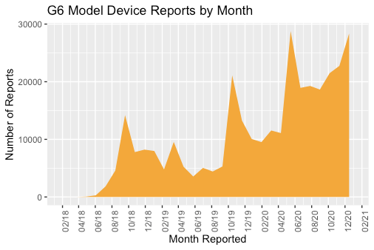
Exploratory Data Analysis G6
Notes:
Peaks in autumnal months may be due to seasonal incidence of diabetes.

Slide 6
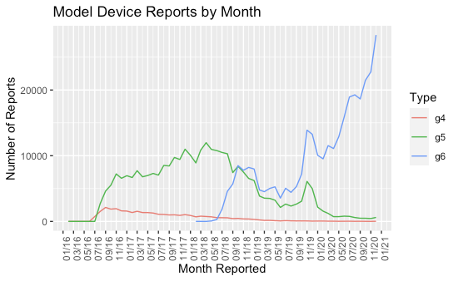
Combined Device Reports

Slide 7
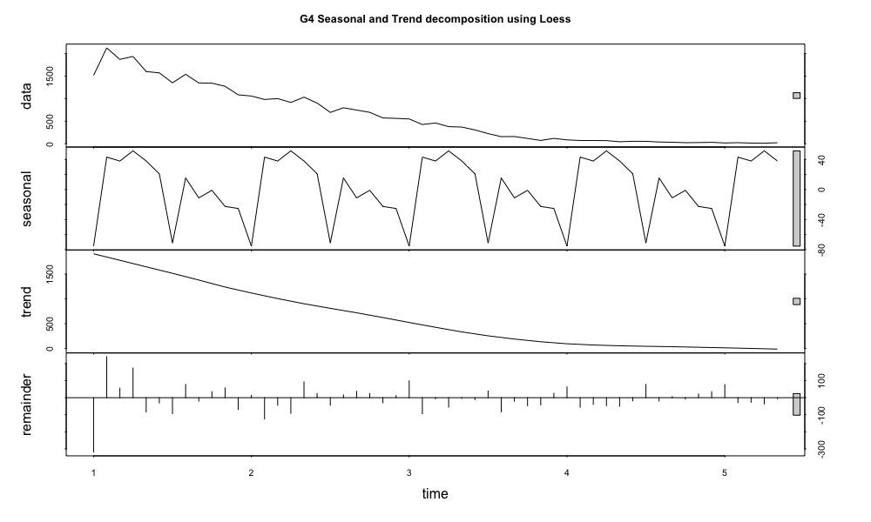
Time Series Analysis

Slide 8
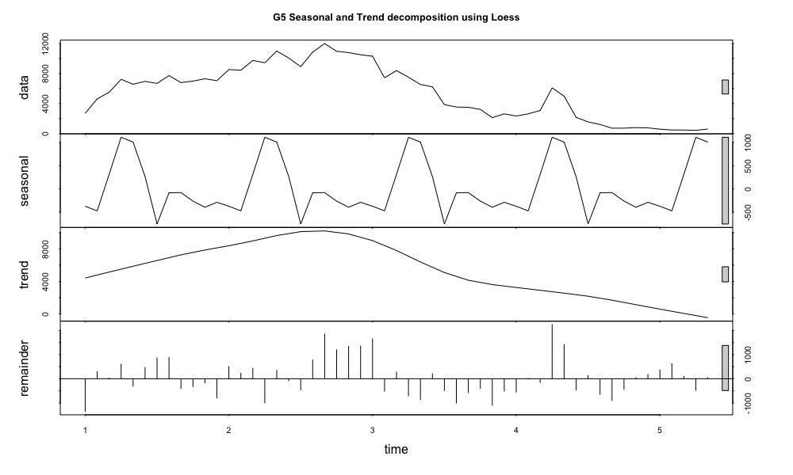
Time Series Analysis

Slide 9
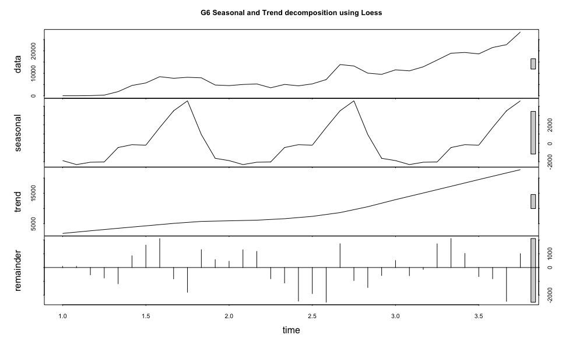
Time Series Analysis

Slide 10
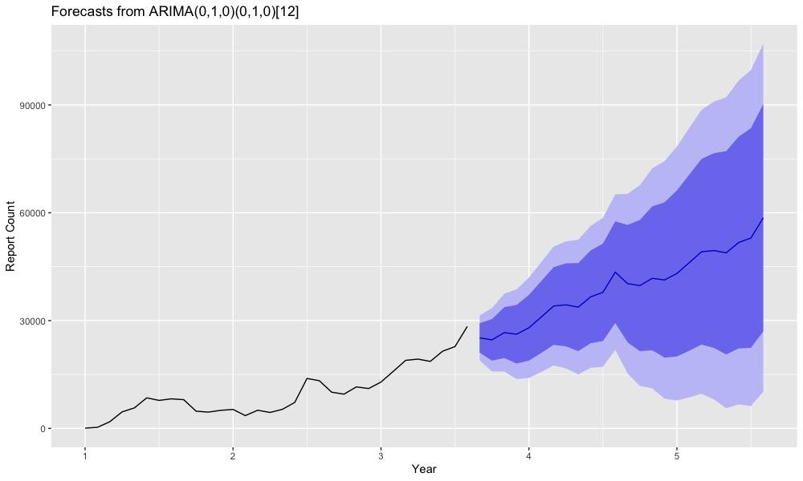
Time Series Analysis

Slide 11
Topic Modeling

Slide 12
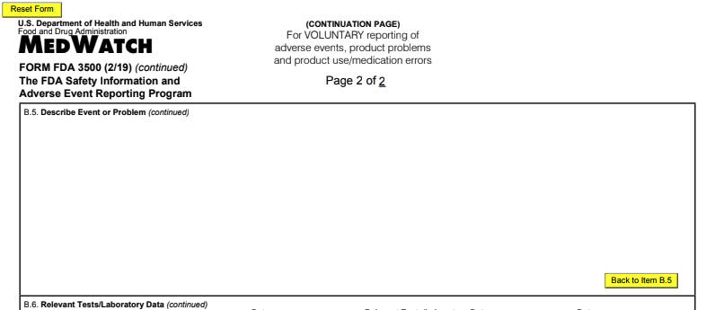
Text Extraction

Slide 13
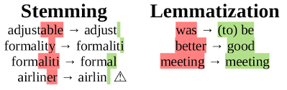
Preprocessing
Remove regular expressions (ex. ‘()-$@...’)
Remove stopwords
Lemmatization
TF-IDF
Image Link: https://www.quora.com/What-is-difference-between-stemming-and-lemmatization

Slide 14
Methods
Latent Semantic Analysis (LSA)
Latent Dirichlet Allocation (LDA)
Non-Negative Matrix Factorization (NMF)

Slide 15
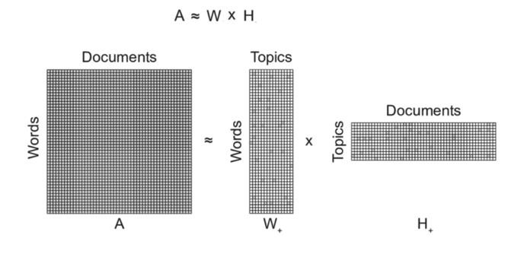
Non-Negative Matrix Factorization
Image Link: https://www.researchgate.net/figure/Conceptual-illustration-of-non-negative-matrix-factorization-NMF-decomposition-of-a_fig1_312157184

Slide 16
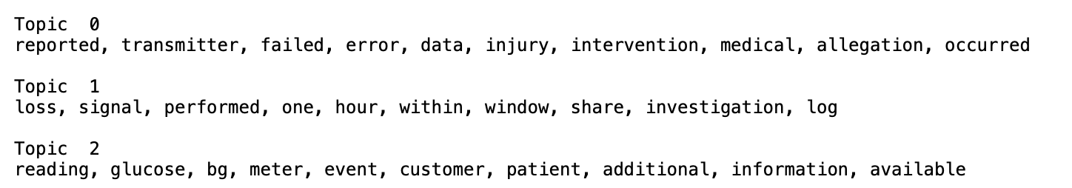
Topic Formulation

Slide 17
Final Topics
0. Cases relating to the transmitter
1. Cases relating to the connection of the device
2. Cases relating to events involving glucose level readings

