Slide 1
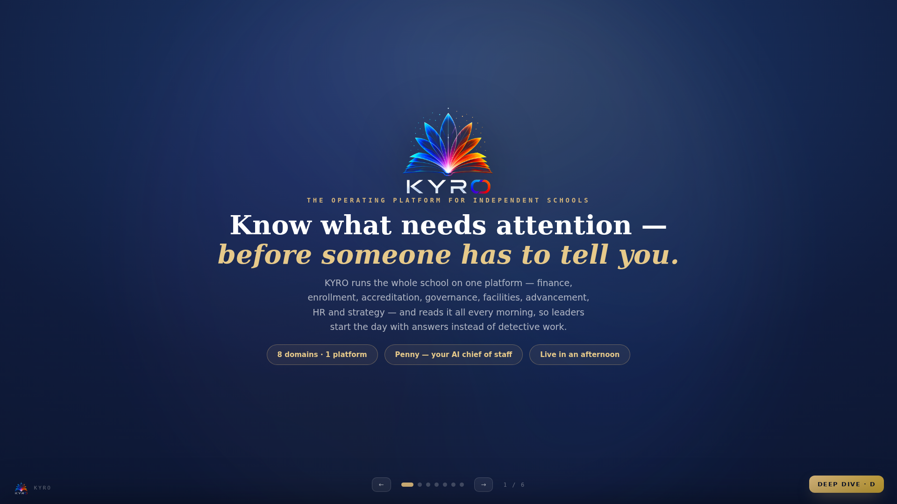
Notes:
Welcome
== SAY IT LIKE THIS — THE 30-SECOND SCRIPT ==
“This is KYRO — the operating platform for independent schools. One platform that runs finance, enrollment, accreditation, governance, facilities, advancement, HR and strategy — and reads all of it every morning, so you know what needs attention before someone has to tell you. In the next few minutes I’ll show you the problem it ends, and how little it takes to switch it on.” [advance]
== THE 10-SECOND VERSION ==
• "KYRO is the operating platform for independent schools — finance, enrollment, accreditation and five more domains on one platform, read every morning by an AI chief of staff named Penny."
== THE 30-SECOND VERSION ==
• Add: "Connect QuickBooks or drop the trial balance your bookkeeper already makes, load your roster from a CSV or your SIS — and the statements, forecasts, analytics and board packet build themselves. Schools go live in an afternoon, not a semester."
== THE EIGHT DOMAINS ==
• Finance — statements, budget vs actual, cash forecast, analytics, board report
• Enrollment — roster intelligence, demographics, SIS sync
• Accreditation — multi-framework engine, evidence, projected index
• Governance · Facilities · Advancement · HR · Strategy — registers, signals and briefing coverage for each
== WHO BUYS AND WHY ==
• Head of school / business manager: gets weekends back; board-ready in a click.
• Superintendent / diocese: every school on one screen, exceptions first.
• Board: professional packet, defensible numbers, benchmarks.

Slide 2
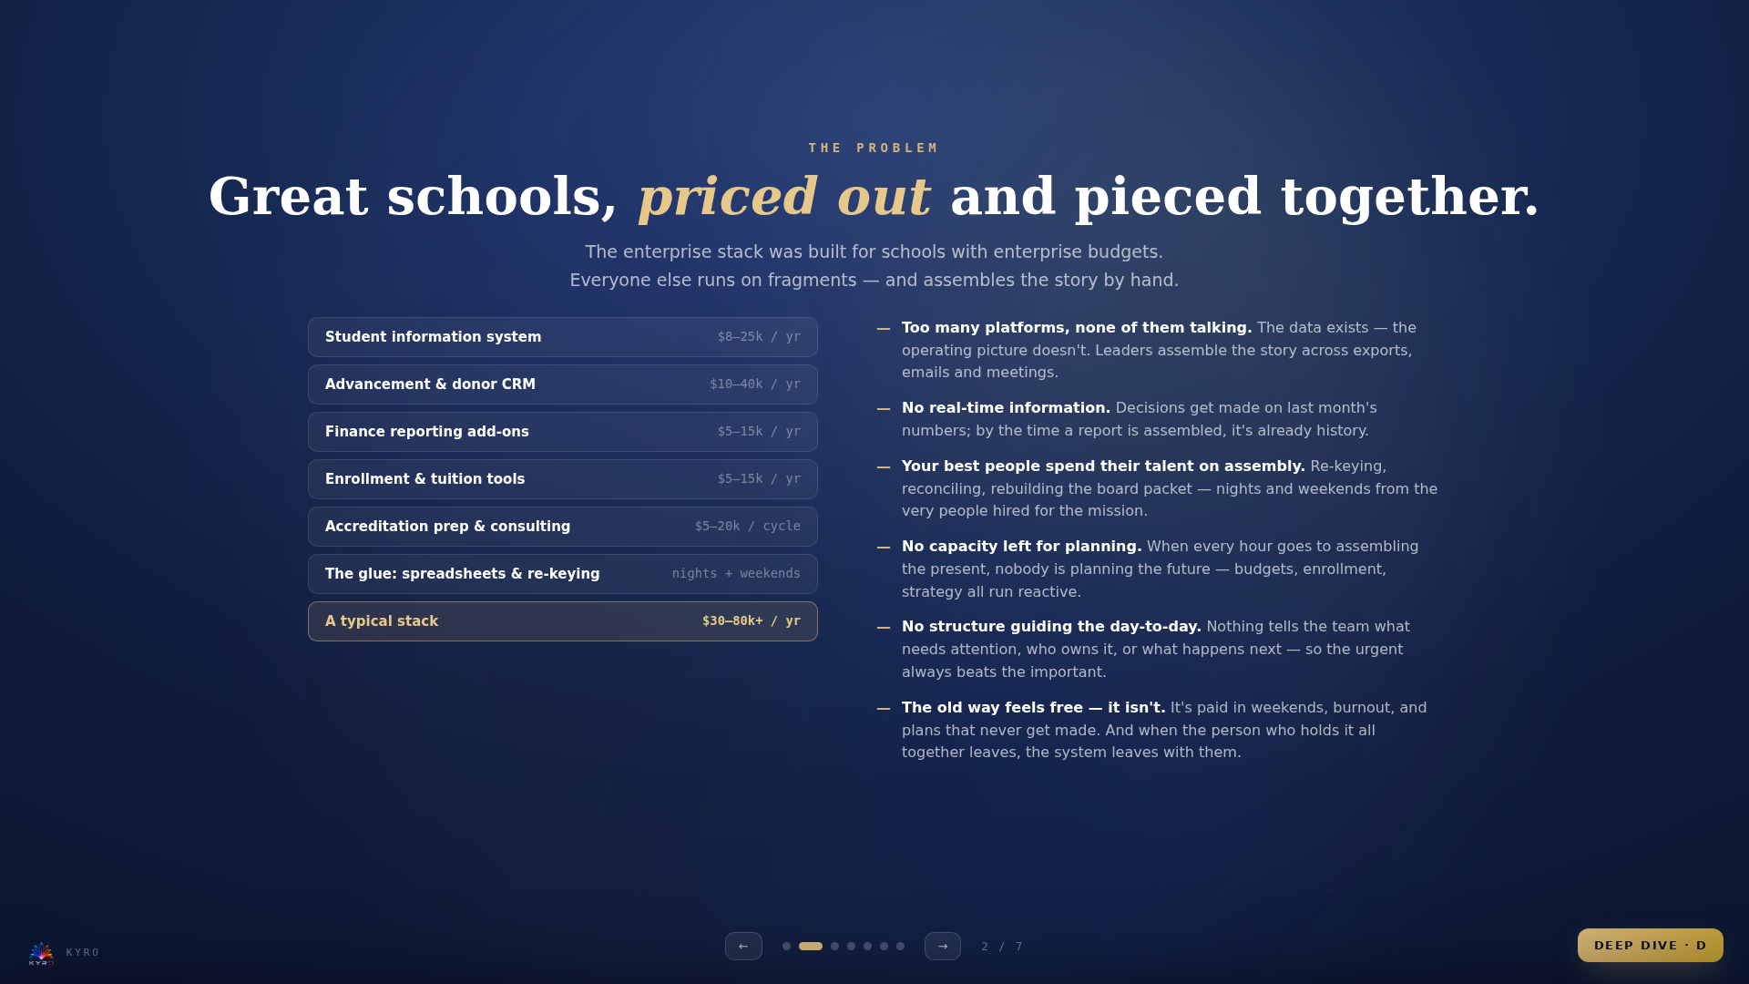
Notes:
The Problem
== SAY IT LIKE THIS — THE 30-SECOND SCRIPT ==
“Here’s what running a school looks like today. The left side is the software bill — a student system here, a donor CRM there, tools for tuition, reporting, accreditation. Thirty to eighty thousand a year, before anyone has answered a single strategic question. And the right side is what that money still doesn’t buy: the systems don’t talk, the picture is never current, and your best people give up nights and weekends stitching it together by hand. The old way feels free because a person quietly absorbs the cost. [beat] It isn’t free.”
== WALKING THE BILL PILE ==
• These are typical mid-market quotes; big-name SIS + advancement CRM contracts alone routinely clear $30k/yr before support and add-ons.
• The last line is the one to land: the glue is a person — someone re-keys the same numbers into three systems, on hours nobody planned for.
• Punchline: "The stack costs more than a teacher — and it still can't answer Monday's questions."
== WHEN THEY DON'T SEE A PROBLEM ==
• Expect it — the pain is invisible because a dedicated person quietly absorbs it. Name that with respect: "It works because someone MAKES it work."
• Then the turn: "Heroics aren't a system. When that person is out for a week — or retires — the school's operating picture goes with them. KYRO makes their knowledge institutional."
• The why, in one line: "Your people were hired for the mission — students, families, formation. Every hour the platform absorbs is an hour that goes back to what only a person can do."
• Never sell hours as savings on people — sell them as capacity returned to the mission. This lands in Catholic and independent schools alike.
== THE FIVE PROBLEMS, AS TALK TRACKS ==
• Platform sprawl: "Count your logins. Every one is a bill, a password, and a silo."
• No real-time picture: "When the board asks about cash, is the answer from today — or from the last time someone built a report?"
• Talent on assembly: "What does your business manager's weekend before a board meeting look like? You hired that person for their judgment — and the stack spends them on copy-paste."
• No planning capacity: "Assembly work crowds out the forward work — the budget, the enrollment plan, the strategy. Reactive becomes the culture."
• No day-to-day structure: "Who decides what gets attention on an ordinary Tuesday? In most schools: whoever shouts loudest."
== THE FIVE QUESTIONS THAT EXPOSE THE GAP ==
• Which school needs my attention today?
• What changed since last week?
• Where is risk building?
• What's driving the problem?
• Who owns the next action?
• Ask the room: "How long would it take you to answer these right now?" Then pause. That silence is the pitch.
== WHY SMALL SCHOOLS FEEL IT WORST ==
• Most independent and parochial schools enroll a few hundred students; one business manager wears every hat.
• Enterprise vendors sell per-module, per-student, with implementation fees — the model breaks under 400 students.
• Result: the schools with the least slack get the least tooling. That's the injustice KYRO was built against.

Slide 3
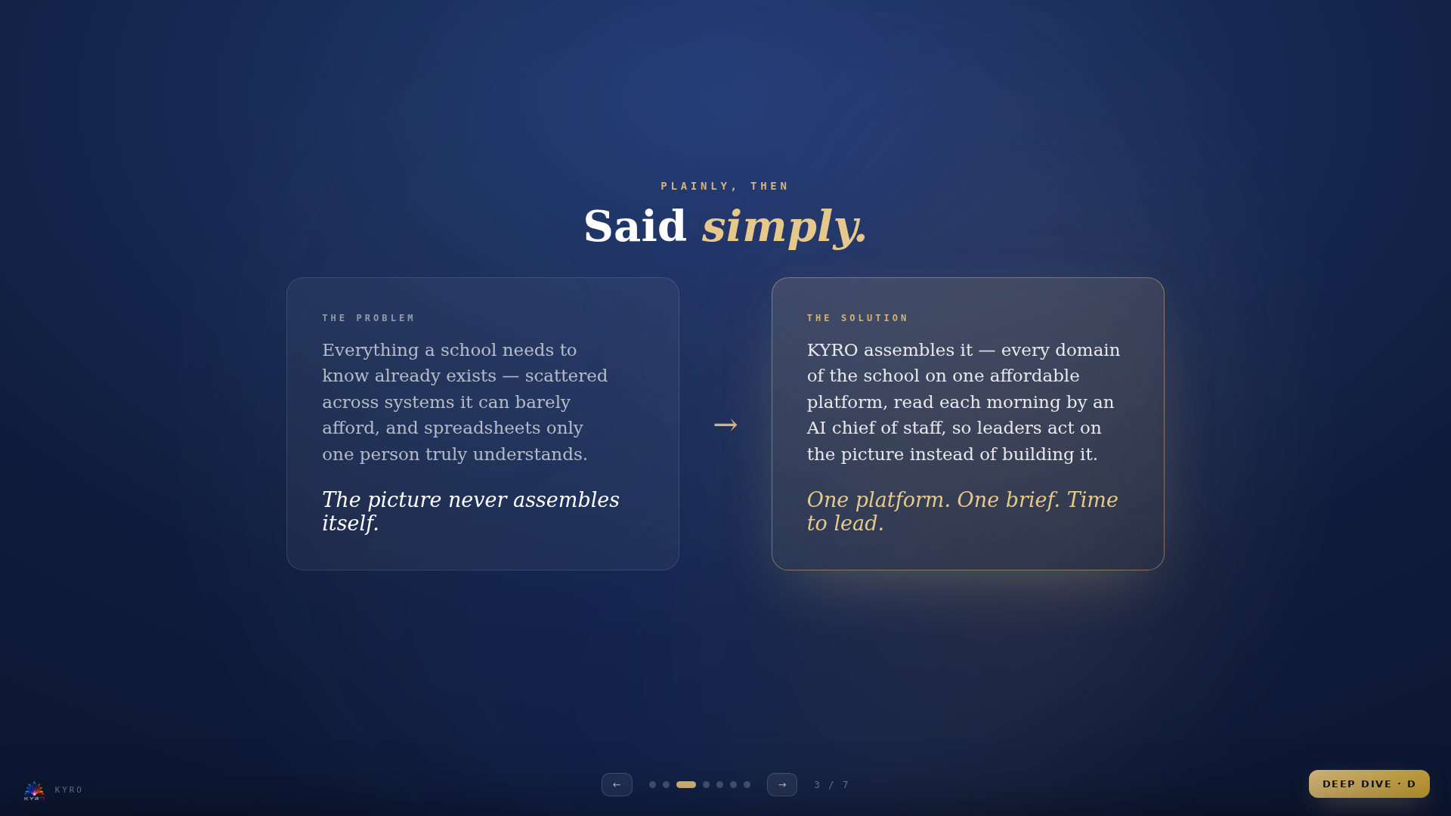
Notes:
Problem & Solution
== SAY IT LIKE THIS — THE 30-SECOND SCRIPT ==
“Let me say the whole thing simply. Everything your school needs to know already exists — it’s just scattered across systems you can barely afford, and spreadsheets one person truly understands. The picture never assembles itself. [pause — two full beats] KYRO assembles it. Every domain, one affordable platform, read every morning by an AI chief of staff. One platform. One brief. Time to lead.”
== DELIVERING THE COUPLET ==
• Slow down here — this is the slide you say almost word for word, then stop talking.
• Read the problem card, pause two beats on "The picture never assembles itself." Let it sit.
• Then the turn, softer: "KYRO assembles it." The whole pitch is those three words.
== TUNING IT TO THE LISTENER ==
• Head of school: "…so you act on the picture instead of building it — and your evenings go back to the school, not the spreadsheet."
• Superintendent: "…and for a network, the picture assembles across every school at once — exceptions first."
• Board chair: "…so the board reads one defensible picture, not a different story from every binder."
== IF THEY PUSH BACK HERE ==
• "Sounds too simple." — "The hard part isn't the idea, it's the plumbing: statements that tie out, forecasts from live books, privacy-safe AI. That's what the demo shows."
• Resist feature-listing on this slide — the couplet is the product of the whole deck; features live two slides ahead.

Slide 4
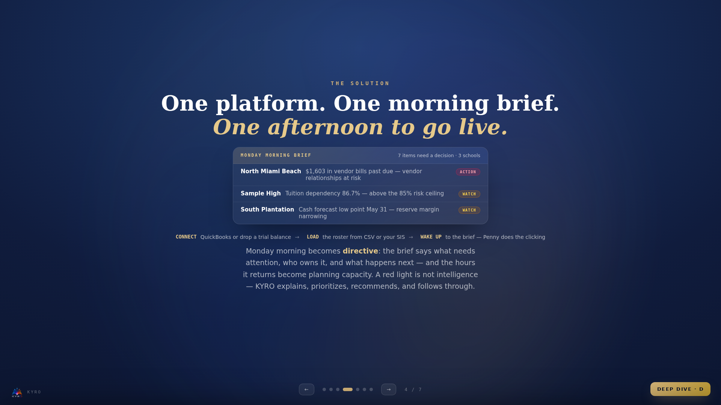
Notes:
The Solution
== SAY IT LIKE THIS — THE 30-SECOND SCRIPT ==
“Here’s what Monday looks like instead. One brief, across every school: seven items need a decision — each one explained, prioritized, and owned. And getting there takes an afternoon: connect QuickBooks, or drop the trial balance your bookkeeper already makes; load the roster from a CSV or your student system — and the next morning the brief is waiting. A red light is not intelligence. KYRO tells you what changed, why it matters, and what to do about it.”
== DEMO FLOW (3–5 MIN, MIRRORS THE VIDEO) ==
• 1 · Open the morning brief — read one item aloud.
• 2 · Click into the flagged school; show the signal's evidence.
• 3 · Show statements building from the TB / QuickBooks.
• 4 · Cash forecast: press Build — the low point appears with the why.
• 5 · Board report wizard: Confirm financials → Draft with AI → Generate.
• Close the loop: "That was one afternoon of setup."
== SIGNAL → ACTION CHAIN (SAY IT AS A STORY) ==
• Signal: enrollment pacing 8% below plan.
• Explain: retention loss concentrated in grades 6–8.
• Impact: projected $310K revenue gap.
• Action: retention review + revised forecast.
• Owner: principal + finance lead, due Friday.
• "A red light is not intelligence. Knowing what to do next is."
== MONDAY MORNING, DIRECTIVE ==
• The brief converts leadership from investigative to directive: items arrive prioritized, explained, and owned.
• Tasks give the day-to-day a spine — Penny creates them, assigns owners, and follows through; nothing lives in someone's memory.
• The hours the platform returns are the planning capacity the school never had — that's the line that lands with heads of school.
== WHAT "EASY" ACTUALLY MEANS ==
• No IT staff required — it's a website; nothing to install.
• Data in three ways: QuickBooks connection, a trial-balance file, or a roster CSV. All formats the school already produces.
• Penny performs tasks on request — files documents, creates records, drafts reports — and asks permission before every change.

Slide 5
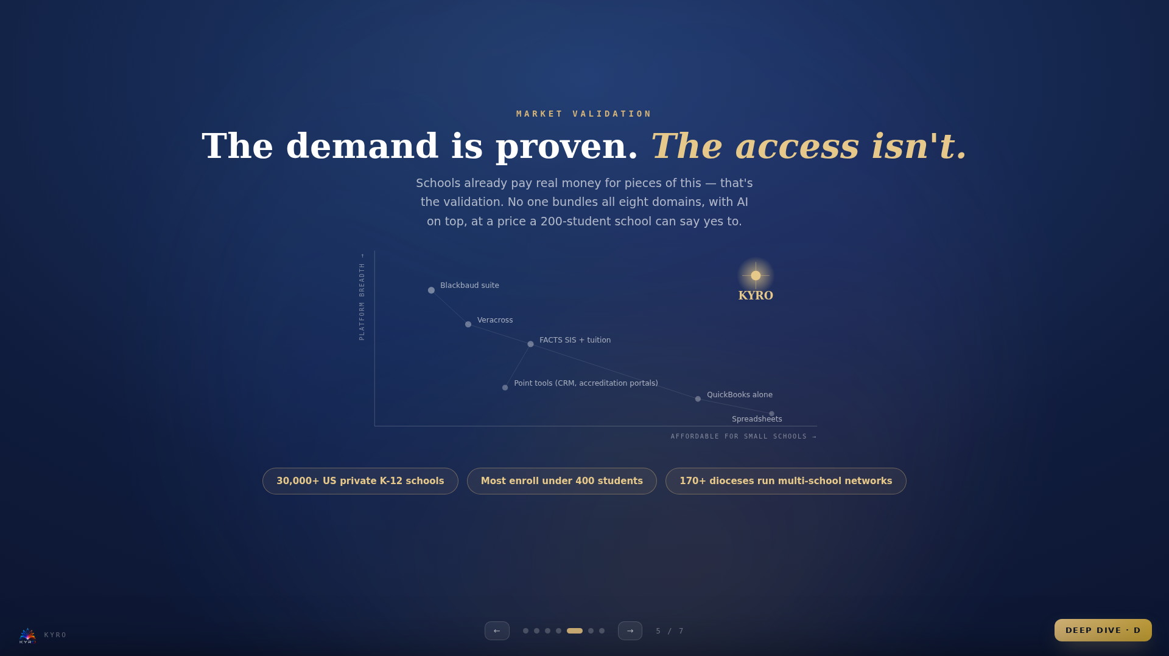
Notes:
Market Validation
== SAY IT LIKE THIS — THE 30-SECOND SCRIPT ==
“Fair question: is anyone else doing this? Pieces of it — yes. And honestly, that’s the proof. Schools already pay real money for every dim star on this map. What doesn’t exist is the whole picture, in one place, at a price a two-hundred-student school can say yes to. There are thirty thousand private schools in this country, most under four hundred students, and a hundred and seventy dioceses running networks. [gesture at the gold star] That corner was empty. We built KYRO to live there.”
== HONEST POSITIONING (USE THESE WORDS) ==
• "Are others doing this? Pieces of it, yes — and that's the proof schools pay for it. Nobody does all of it, in one place, at small-school pricing."
• Never trash competitors — respect them into a corner: each is excellent at its slice and priced for schools three times our buyer's size.
== PER-COMPETITOR READ ==
• Blackbaud: gold standard for advancement at big schools; famously expensive, module-by-module, long implementations.
• Veracross / FACTS: strong SIS cores; finance intelligence, accreditation and multi-school roll-ups are thin or absent.
• QuickBooks alone: where most small schools live today — bookkeeping, not intelligence. KYRO doesn't replace it; it reads it.
• Point tools: each adds a login, a bill, and another silo.
== MARKET SIZE TO CITE ==
• 30,000+ private K-12 schools in the US; the long tail is small schools.
• ~6,000 Catholic schools across 170+ dioceses — networks that need the superintendent view, which almost nobody serves.
• Buying trigger moments: accreditation cycles, new head of school, board pressure after a deficit surprise.

Slide 6
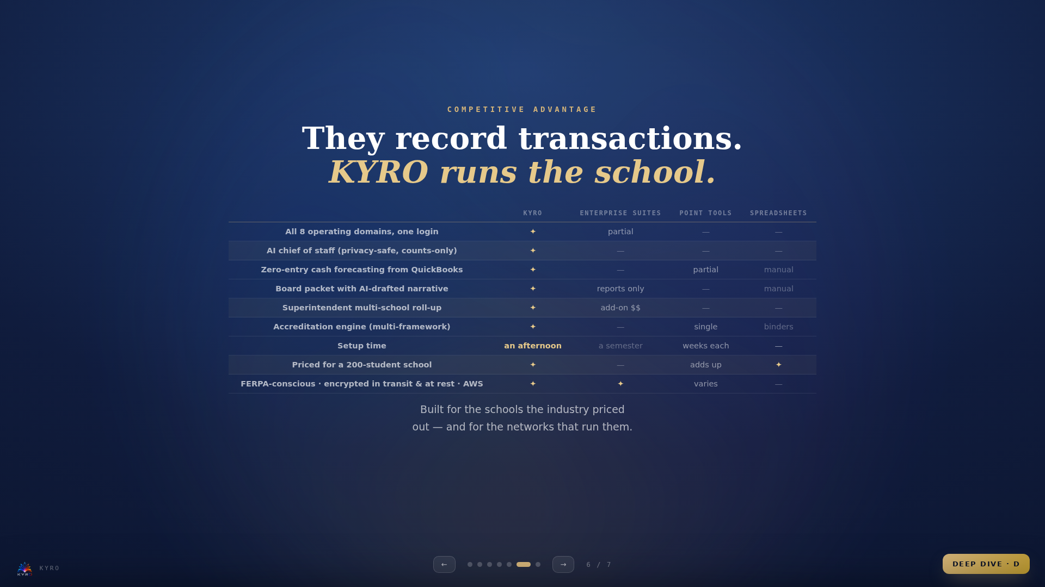
Notes:
Competitive Advantage
== SAY IT LIKE THIS — THE 30-SECOND SCRIPT ==
“So what’s actually different? Everything in gold. The whole school in one login. An AI chief of staff that’s privacy-safe by construction — it works from counts, and it cannot name a student. Cash forecasting straight from QuickBooks with zero typing. A board packet that drafts its own narrative. And the superintendent roll-up that, at this level, nobody else offers at all. Setup is an afternoon. And the price was designed for exactly the schools everyone else priced out.”
== OBJECTION HANDLING ==
Q: "We already have Blackbaud / FACTS."
A: "Keep what works — KYRO reads your books and roster rather than replacing them. The question is who assembles the operating picture. Today that's a person. With KYRO it's every morning, automatically."
Q: "We don't see a problem — we have someone who handles all that."
A: "And they're clearly excellent — that's exactly why it works today. It's also a single point of failure. KYRO doesn't replace that person; it gives them their weekends back, makes their knowledge part of the school instead of their memory, and frees them for the judgment work you actually hired them for."
Q: "Spreadsheets are fine."
A: "They are — until the person who built them leaves, or the board asks a question mid-meeting. KYRO gives you the same numbers, tied out, with history and an audit trail."
Q: "Is our data safe?"
A: "Encrypted in transit and at rest on AWS with customer-managed keys; FERPA-conscious by design — the AI works from counts only and can never name a student. Role-based access is enforced in the platform itself."
== THE DIFFERENTIATORS THAT DON'T COPY EASILY ==
• Penny is structural, not a chatbot bolt-on — she proposes changes, asks permission, logs and can undo every action.
• The counts-only privacy guard is enforced in code — the AI physically cannot fetch a student's name. Auditable, provable.
• The superintendent roll-up — consolidated statements, org KPIs, exceptions-first portfolio. Enterprise vendors charge five figures for less.
• Afternoon onboarding — because inputs are things schools already have.
== PRICING CONVERSATION ==
• Anchor against the bill pile: "a fraction of one line item of the current stack."
• Modules are licensable per school — start with finance, add domains as trust builds.
• For dioceses: per-school network pricing with the org console included — the thing they literally cannot buy elsewhere.

Slide 7
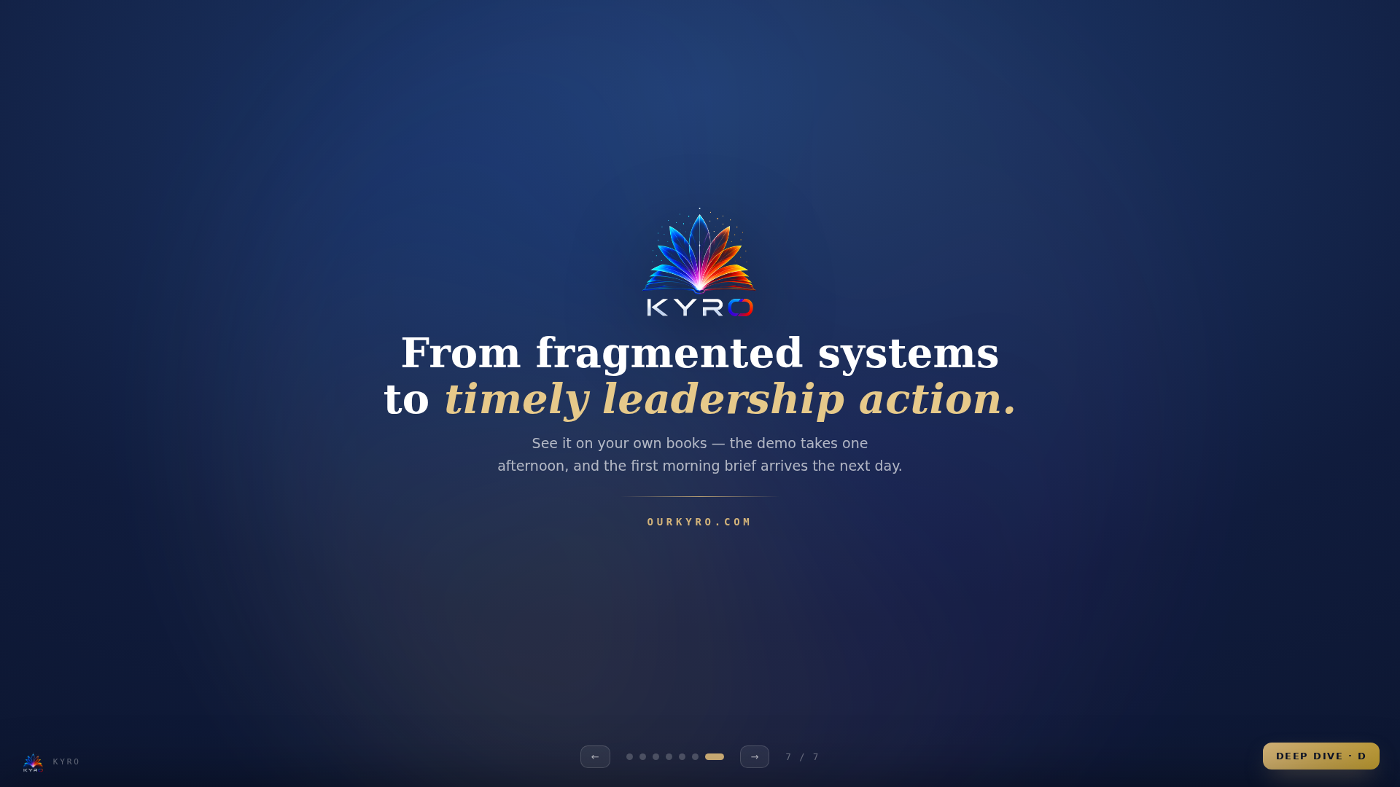
Notes:
Close
== SAY IT LIKE THIS — THE 30-SECOND SCRIPT ==
“So here’s the ask — and it’s small. Give me one afternoon with your books; last June’s trial balance is enough. I’ll hand you back your own board packet and your first morning brief. From fragmented systems to timely leadership action — in a day. [beat] That’s KYRO.”
== LANDING THE CLOSE ==
• Ask for the smallest yes: "Send me last June's trial balance and I'll show you your own board packet this week."
• Or: "Give me one afternoon with your bookkeeper — the first morning brief arrives tomorrow."
• Leave-behind: the 5-minute demo video + this deck's handout print.
== FOLLOW-UP CADENCE ==
• Same day: thank-you + video link + one specific observation about THEIR school.
• Day 3: the sample board packet built from their data (if provided).
• Day 7: offer a superintendent/board viewing session — decision-makers see the brief live.

