Slide 1

Marathon Project
A Black Butterflies Production
Joshua Rio-Ross

Slide 2
Fastest Times

Slide 3
Slowest Times

Slide 4
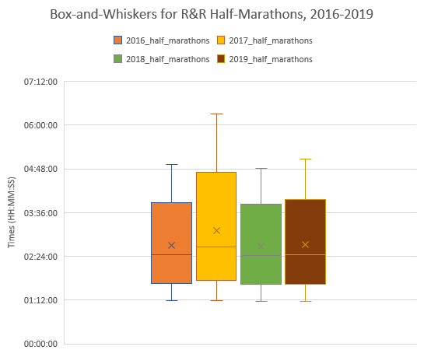
Burnt Out
 | 2016 half marathons | 2017 half marathons | 2018 half marathons | 2019 half marathons
Slowest | 04:54:41 | 06:18:24 | 04:48:06 | 05:03:35
Q1 | 02:50:11 | 03:05:10 | 02:51:16 | 02:51:30
Median | 02:26:18 | 02:39:34 | 02:25:32 | 02:26:07
Q3 | 02:08:18 | 02:18:17 | 02:07:21 | 02:07:04
Fastest | 01:11:15 | 01:10:58 | 01:09:25 | 01:10:03

Slide 5
The Oprah Standard

Slide 6
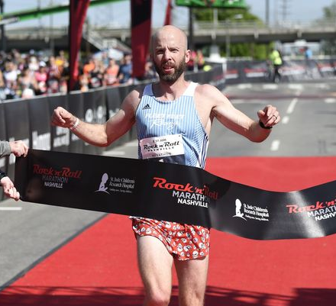
Great Scott!

Slide 7
Great Scott!
 | 2016 Marathon |  | 2017 Marathon |  | 2018 Marathon |  | 2019 Marathon
Rank | Name | Time | Name | Time | Name | Time | Name | Time
1 | Scott Wietecha | 02:25:42 | Scott Wietecha | 02:40:25 | Scott Wietecha | 02:28:16 | Scott Wietecha | 02:34:59
2 | Brian Shelton | 02:34:43 | Ryan Regnier | 02:56:28 | Garang Madut | 02:29:52 | Jordan Wilson | 02:35:24
3 | Christopher Capps | 02:38:43 | Daniel Everett | 03:00:55 | Kevin Fink | 02:38:59 | Steelton Flynn | 02:39:59

Slide 8
Great Scott!
=VLOOKUP($A16,_2016_marathons[#All],4, FALSE)
 | 2016 Marathon |  | 2017 Marathon |  | 2018 Marathon |  | 2019 Marathon
Rank | Name | Time | Name | Time | Name | Time | Name | Time
1 | Scott Wietecha | 02:25:42 | Scott Wietecha | 02:40:25 | Scott Wietecha | 02:28:16 | Scott Wietecha | 02:34:59
2 | Brian Shelton | 02:34:43 | Ryan Regnier | 02:56:28 | Garang Madut | 02:29:52 | Jordan Wilson | 02:35:24
3 | Christopher Capps | 02:38:43 | Daniel Everett | 03:00:55 | Kevin Fink | 02:38:59 | Steelton Flynn | 02:39:59

Slide 9
Great Scott!
=VLOOKUP($A16,_2016_marathons[#All],5, FALSE)
 | 2016 Marathon |  | 2017 Marathon |  | 2018 Marathon |  | 2019 Marathon
Rank | Name | Time | Name | Time | Name | Time | Name | Time
1 | Scott Wietecha | 02:25:42 | Scott Wietecha | 02:40:25 | Scott Wietecha | 02:28:16 | Scott Wietecha | 02:34:59
2 | Brian Shelton | 02:34:43 | Ryan Regnier | 02:56:28 | Garang Madut | 02:29:52 | Jordan Wilson | 02:35:24
3 | Christopher Capps | 02:38:43 | Daniel Everett | 03:00:55 | Kevin Fink | 02:38:59 | Steelton Flynn | 02:39:59

Slide 10
Demoralized
Name of Top-3 Finisher | Number of Top-3 Finishes
Brian Shelton | 1
Christopher Capps | 1
Daniel Everett | 1
Garang Madut | 1
Jordan Wilson | 1
Kevin Fink | 1
Ryan Regnier | 1
Scott Wietecha | 4
Steelton Flynn | 1
Grand Total | 12
Top-3 Finishers | 2017 Time | 2018 Time | 2019 Time | 2020 Time
Brian Shelton | 02:34:43 | #N/A | #N/A | #N/A
Christopher Capps | 02:38:43 | #N/A | #N/A | #N/A
Daniel Everett | #N/A | 03:00:55 | #N/A | #N/A
Garang Madut | #N/A | #N/A | 02:29:52 | #N/A
Jordan Wilson | #N/A | #N/A | #N/A | 02:35:24
Kevin Fink | #N/A | #N/A | 02:38:59 | #N/A
Ryan Regnier | #N/A | 02:56:28 | #N/A | #N/A
Scott Wietecha | 02:25:42 | 02:40:25 | 02:28:16 | 02:34:59
Steelton Flynn | #N/A | #N/A | #N/A | 02:39:59

Slide 11
Demoralized
=VLOOKUP($A37, _2016_marathons[[Name]:[Time]],2,FALSE)
Name of Top-3 Finisher | Number of Top-3 Finishes
Brian Shelton | 1
Christopher Capps | 1
Daniel Everett | 1
Garang Madut | 1
Jordan Wilson | 1
Kevin Fink | 1
Ryan Regnier | 1
Scott Wietecha | 4
Steelton Flynn | 1
Grand Total | 12
Top-3 Finishers | 2017 Time | 2018 Time | 2019 Time | 2020 Time
Brian Shelton | 02:34:43 | #N/A | #N/A | #N/A
Christopher Capps | 02:38:43 | #N/A | #N/A | #N/A
Daniel Everett | #N/A | 03:00:55 | #N/A | #N/A
Garang Madut | #N/A | #N/A | 02:29:52 | #N/A
Jordan Wilson | #N/A | #N/A | #N/A | 02:35:24
Kevin Fink | #N/A | #N/A | 02:38:59 | #N/A
Ryan Regnier | #N/A | 02:56:28 | #N/A | #N/A
Scott Wietecha | 02:25:42 | 02:40:25 | 02:28:16 | 02:34:59
Steelton Flynn | #N/A | #N/A | #N/A | 02:39:59

Slide 12
Scott vs. Himself
 | 2016 Marathon | 2017 Marathon | 2018 Marathon | 2019 Marathon
Scott Wietecha’s Time | 02:25:42 | 02:40:25 | 02:28:16 | 02:34:59
Difference From Previous Year |  | 00:14:43 | 00:12:09 | 00:06:43
Difference From Best Time |  | 00:14:43 | 00:02:34 | 00:09:17

