Slide 1
Coral Bleaching: A Brief History and Overview of Catalysts and Effects

Slide 2
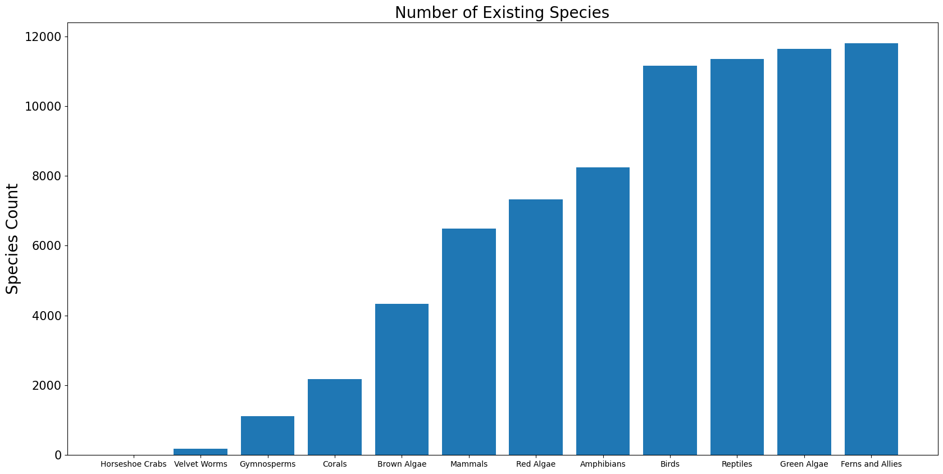

Slide 3
