Slide 1
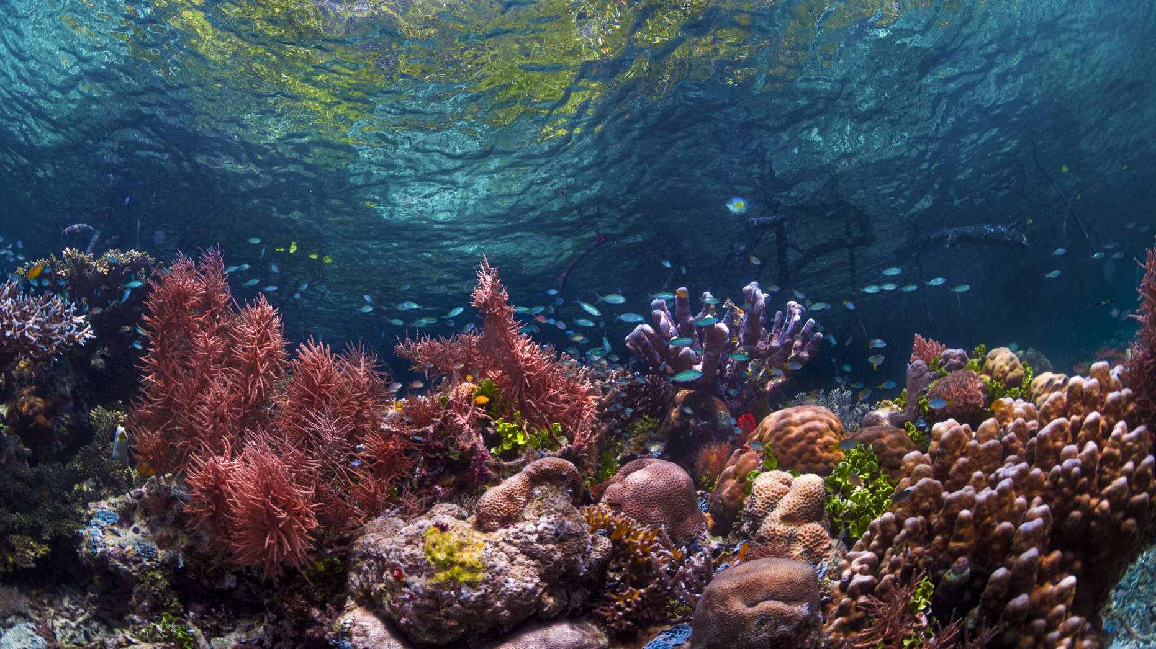
Coral Bleaching: A Brief History and Overview of Catalysts and Effects

Slide 2
What is coral bleaching?
When corals are stressed by changes in conditions such as temperature, light, or nutrients, they expel the symbiotic algae living in their tissues, causing them to turn completely white.

Slide 3
What are the main driving forces that cause coral bleaching to occur?
Global Warming
Weather Events
Changing Water Temperatures
Ocean Acidification
Pollution

Slide 4
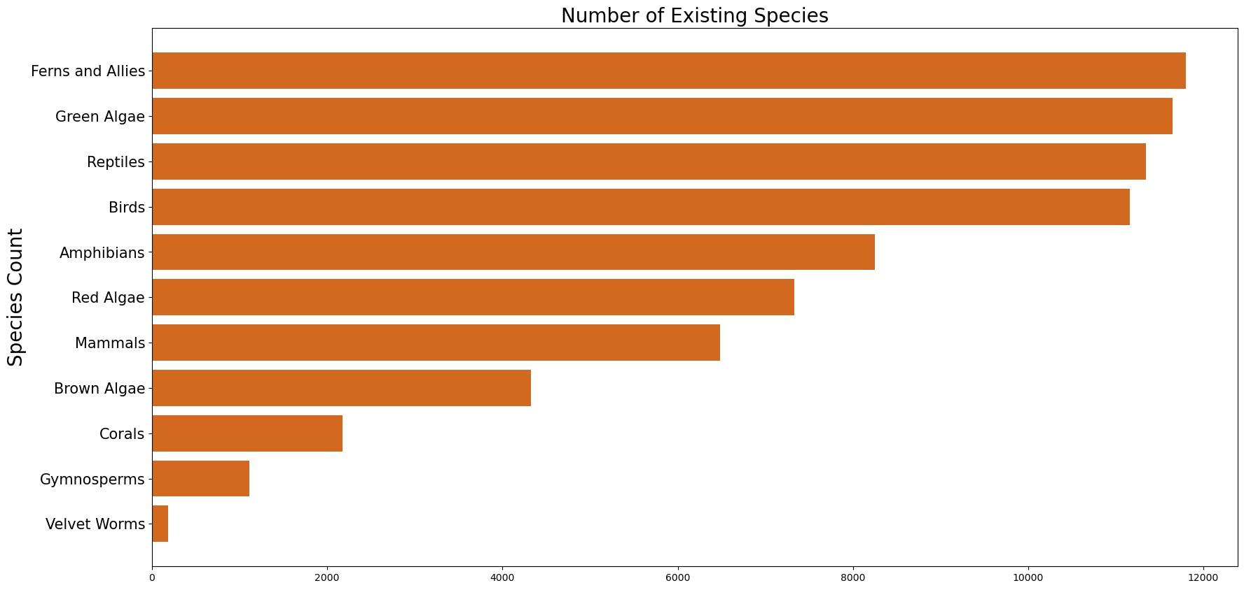
How relevant is coral to other species?

Slide 5
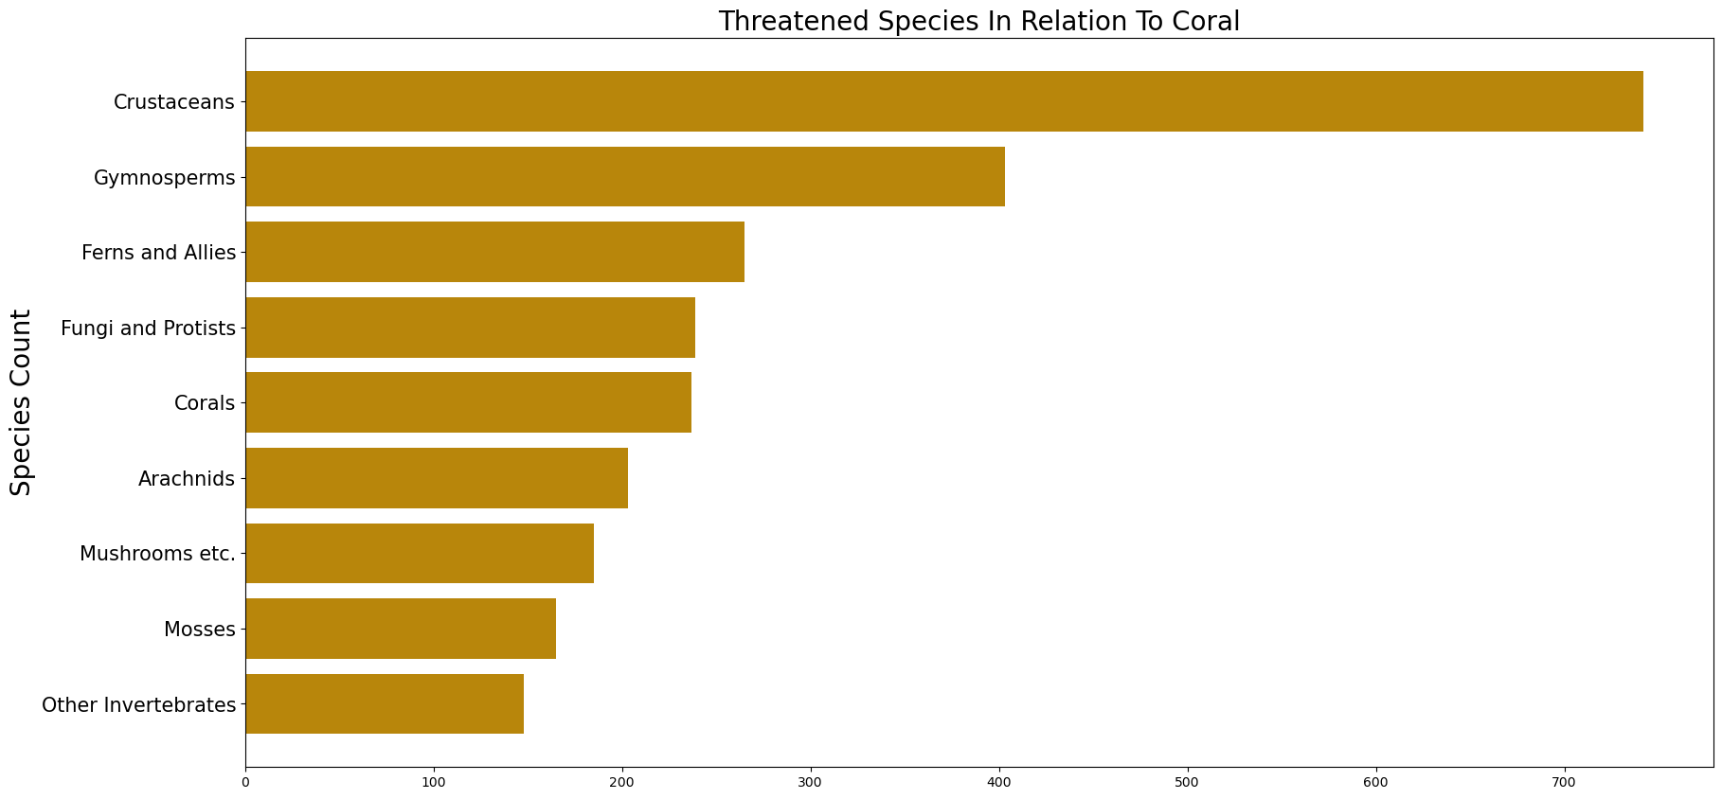
Coral threat levels

Slide 6
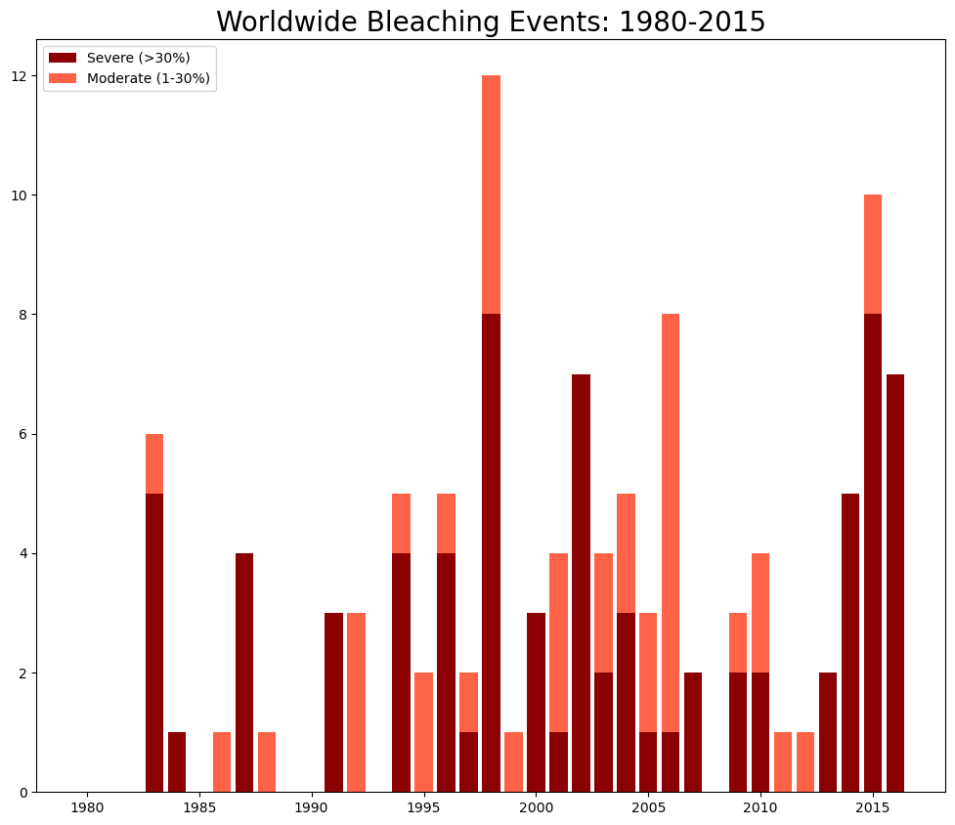

Slide 7
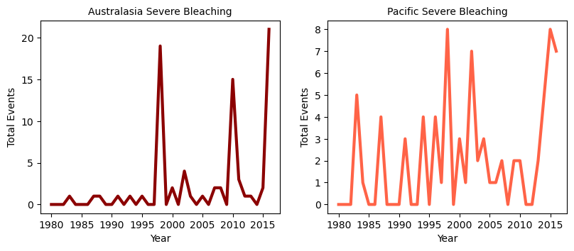
Australasia & Pacific

Slide 8
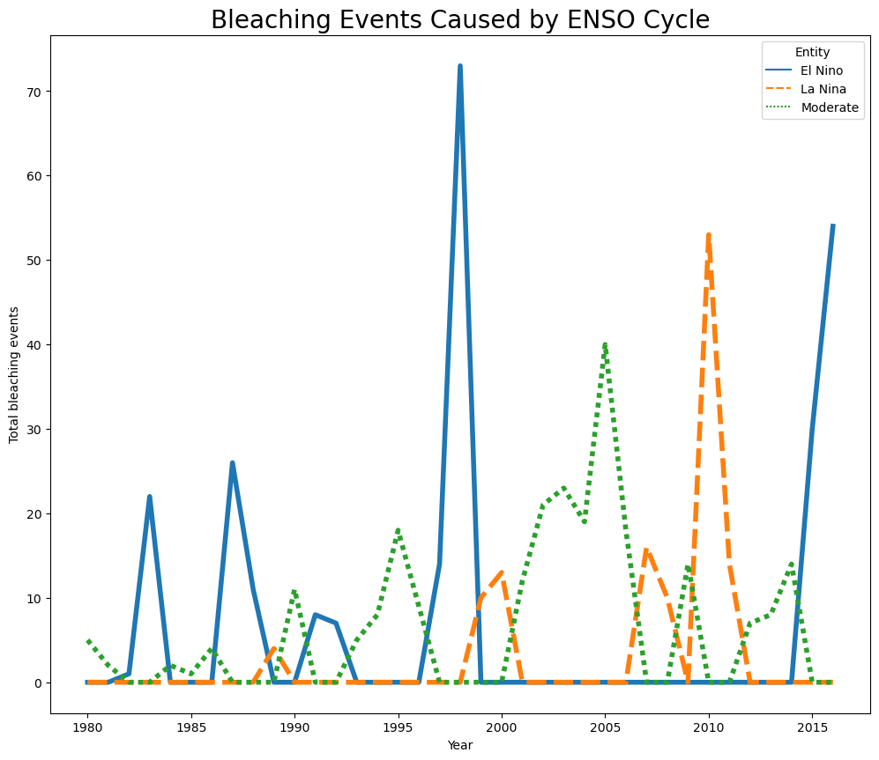
Weather Events

Slide 9
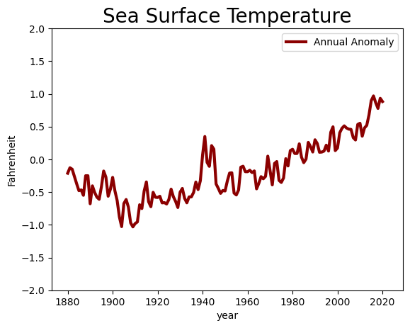
Changing Water Temperatures

Slide 10
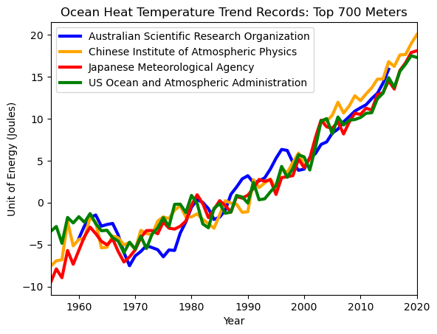

Slide 11
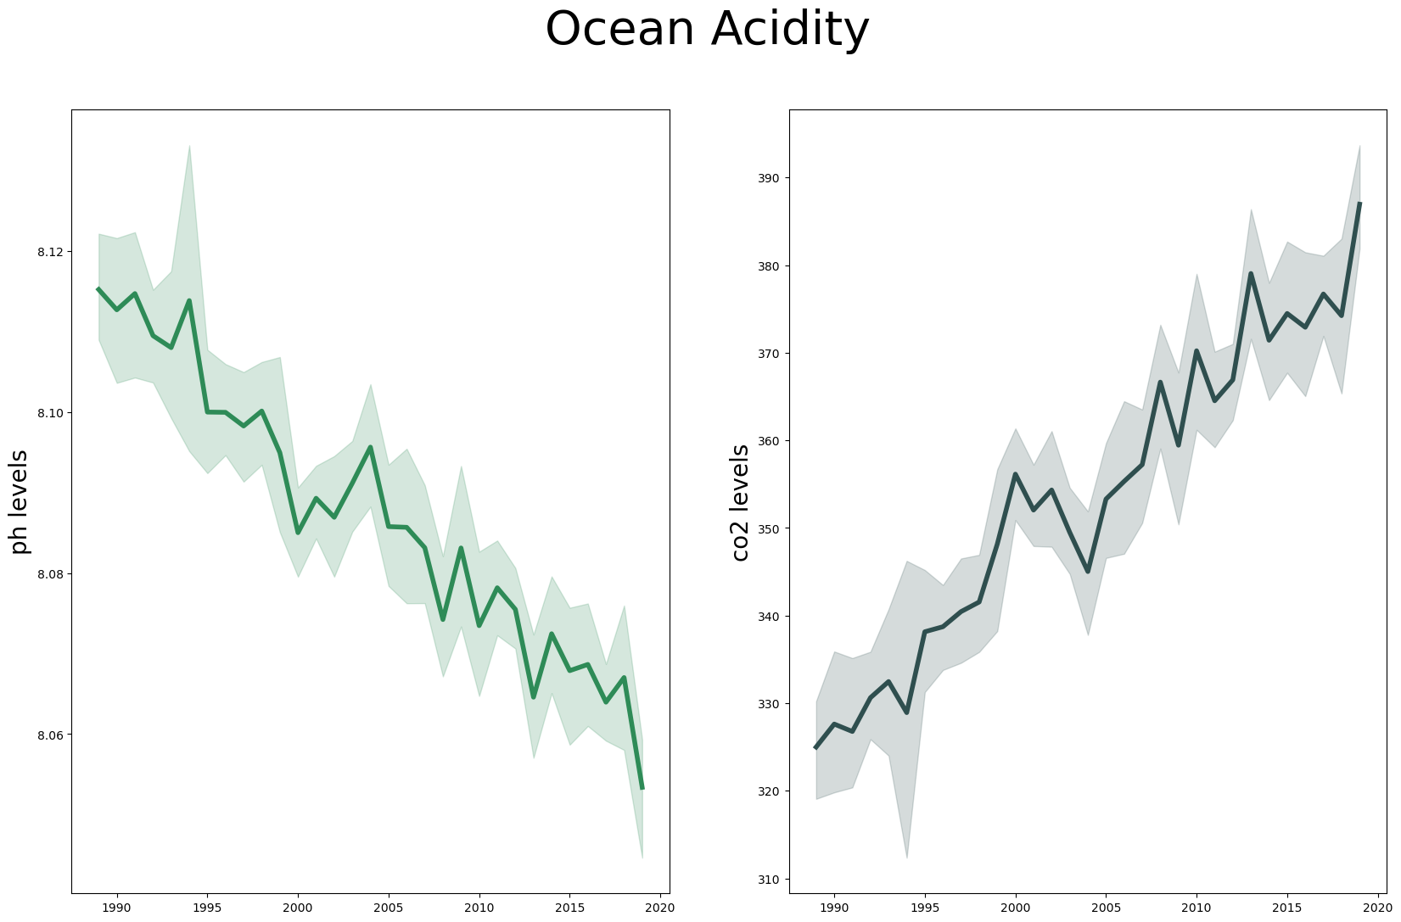

Slide 12
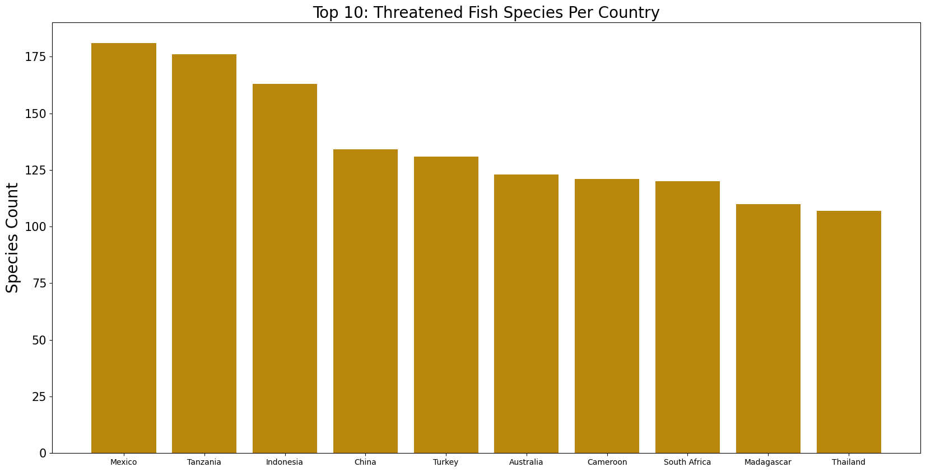

Slide 13
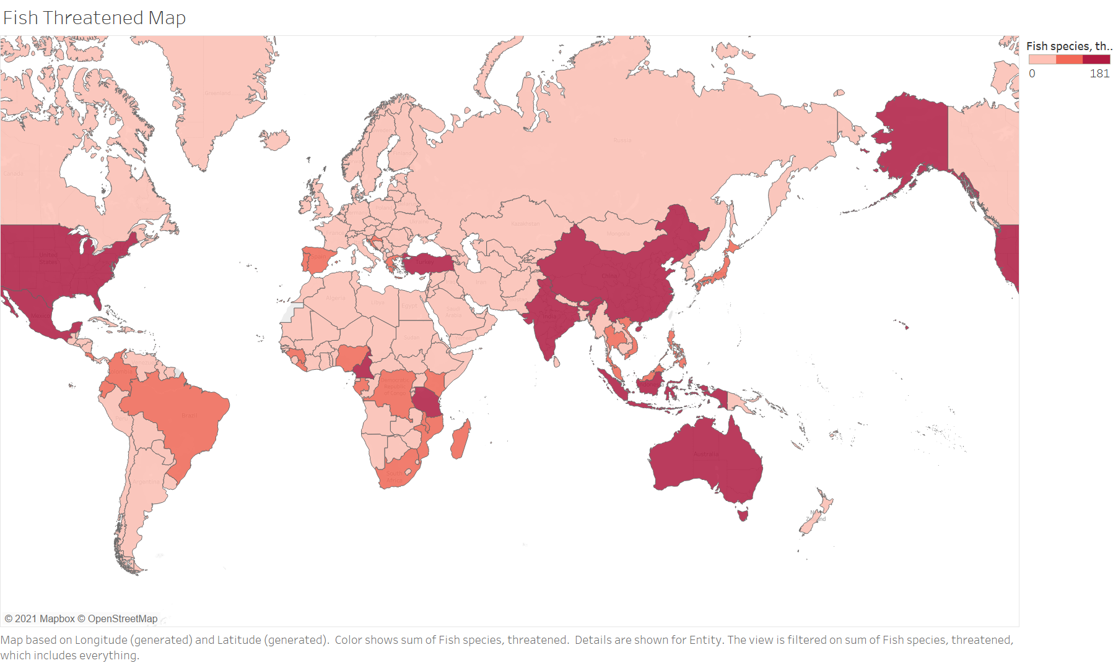

Slide 14
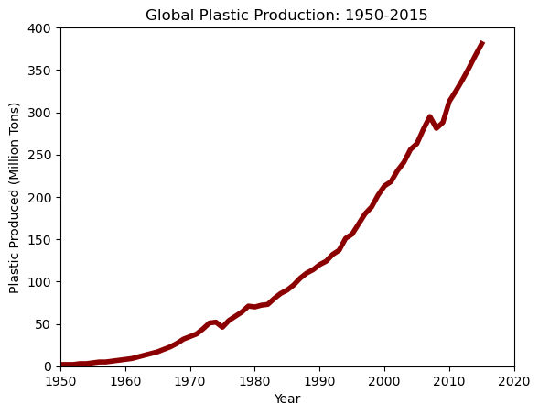
Pollution

Slide 15
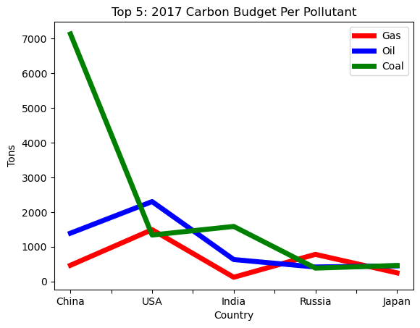
C02 Emissions Budget

Slide 16
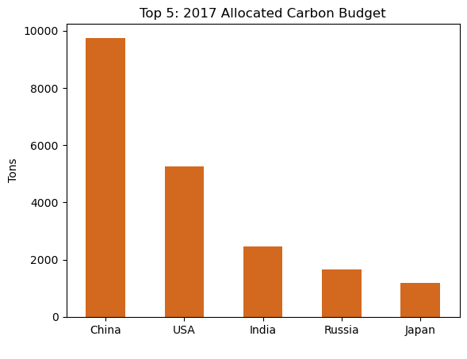
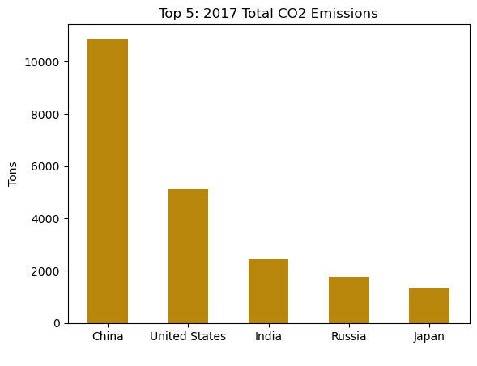

Slide 17
References
Coral Reefs - Our World in Data
Fish - Our World in Data
Extinctions - Our World in Data
Climate Change Indicators: Sea Surface Temperature | Climate Change Indicators in the United States | US EPA
Climate Change Indicators: Ocean Heat | Climate Change Indicators in the United States | US EPA
Climate Change Indicators: Ocean Acidity | Climate Change Indicators in the United States | US EPA
List of countries by carbon dioxide emissions – Wikipedia
What is coral bleaching? (noaa.gov)
Carbon Budget (globalcarbonproject.org)
Coral Bleaching - Great Barrier Reef Foundation

