Slide 1
Hospital
Inventory Management
Jaime Alvarez
Santhya Selvakularanjan
Trey Hunold

Slide 2
Overview
Using smart contracts we can safely and securely move inventory products down the intra-organizational supply chain of the hospital from when it is delivered by the distributor to the product being used on patients.
Once the inventory is received at the docking station, an employee will input each item. From there it goes to the onsite storage facility for their inventory to the department that needs it, to the pharmacy within that department, to the nurse and then to the patient. With our smart contract all you will need to do is updated the item id’s location each time the inventory is transferred.
Once the item is used it will be updated to reflect that is is no longer active.

Slide 3
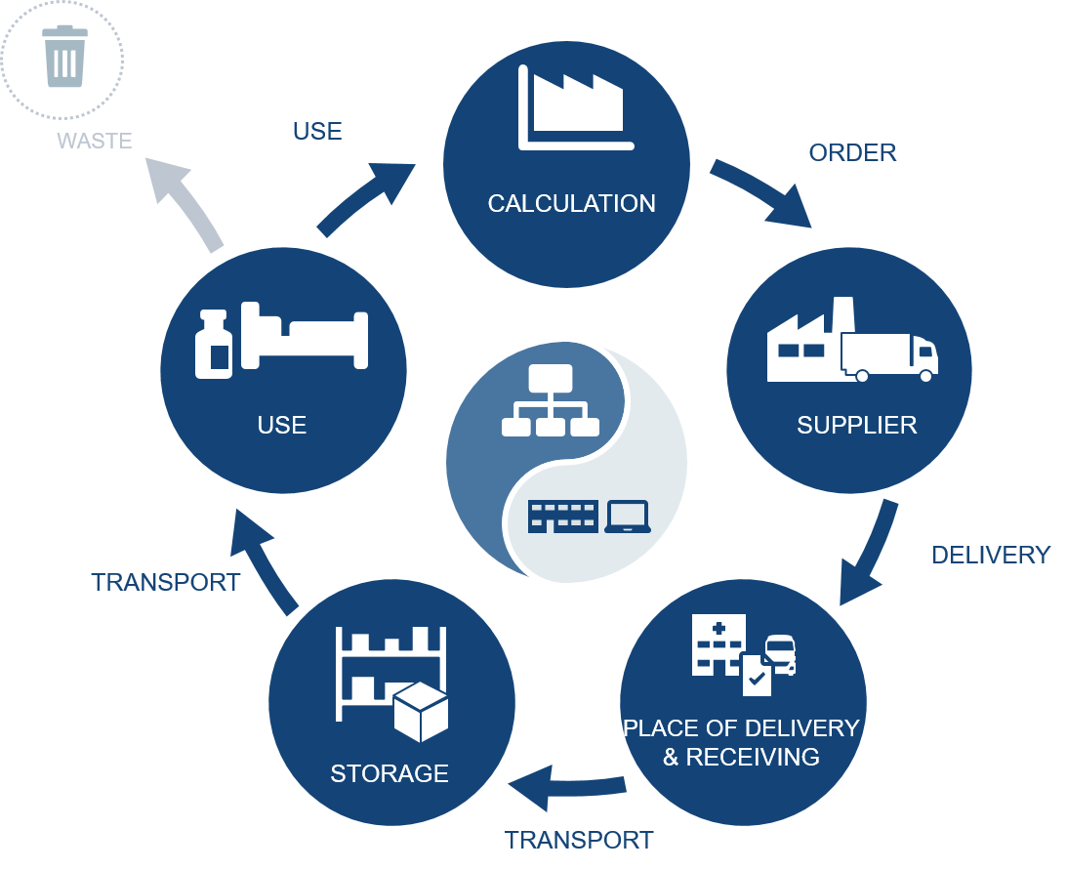
Hospital Logistics

Slide 4
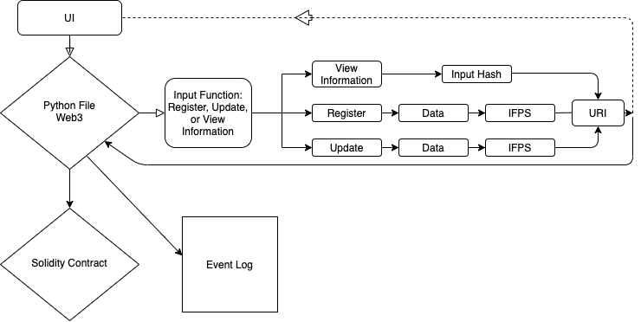
Flow Diagram
Interactions at the UI
Use Web3 through python file to add data to the IPFS
Pull information from IFPS by using URI

Slide 5
Demonstration
Now we will demonstrate adding a new item, new product, new employee and a new location.
We will then demonstrate updating an item and exporting the metadata to show the information that has been stored.
Lastly, we will update the item to show inactive.

Slide 6
Next Steps
Incorporating QR codes for items to be easily scanned in.
Creating a dApp to use as the interface for our contract.
Create a way to add batch items to improve efficiency when importing items.
Adding a function to show the inventory count for reconciling inventory.
Add access levels for who can update/create new employees, items, products and locations.
Who can deactivate products

