Slide 1

SIMPLE MARKET STRATEGIES
TREY HUNOLD
JORDAN PATTON
TRAVIS SMITH

Slide 2
Motivation and Summary
What’s everyone’s motivation?
MAKE MONEY
BUT HOW?

Slide 3
Hypothesis
Is there a market/ product where a simple trading strategy will work?
Many participants
Large market movements
Some sophisticated and some not as sophisticated
Need a market where some participants are willing to give up monetary value for another value proposition

Slide 4
Forex Markets
Forex markets trade 5 days a week for 24 hrs/day
Currencies are finite and trade in different parts of the world
Banks and individuals trade
Largest liquid market in the world
Trades more than $5 trillion/ day*
90% of forex trading is speculative*
41% of trading takes place in the UK*
Because the Market is 24 hours, there is overlap between the time that markets are open
British workday opens at towards end of Tokyo workday
American workday opens towards end of British workday
*information from: https://www.orbex.com/blog/en/2018/04/ten-fun-facts-about-the-forex-industry

Slide 5
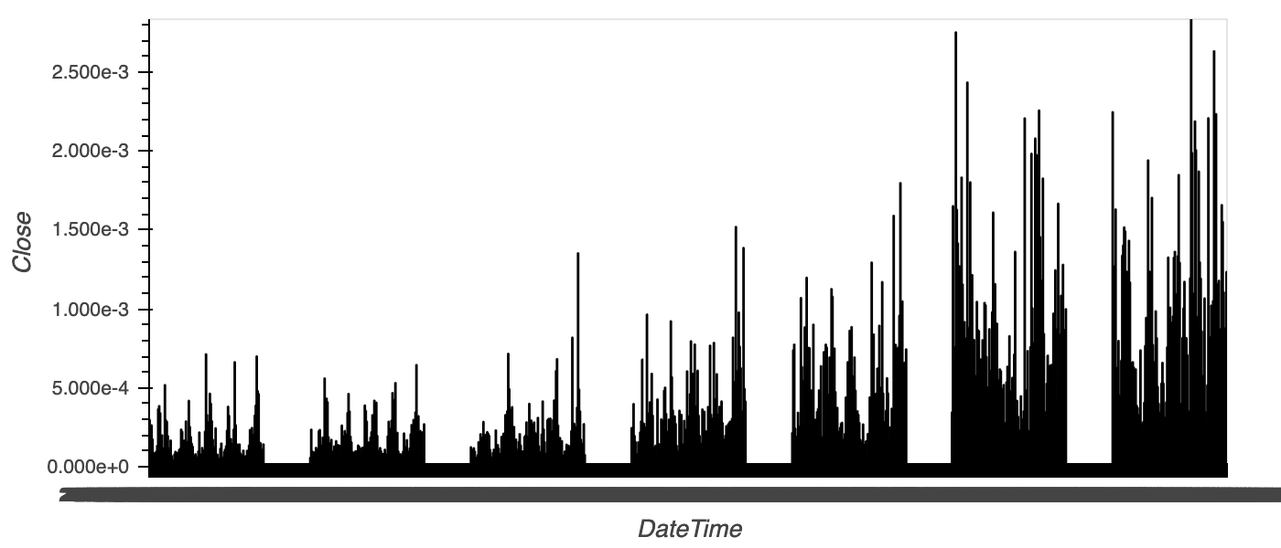
Searching for optimal

Slide 6
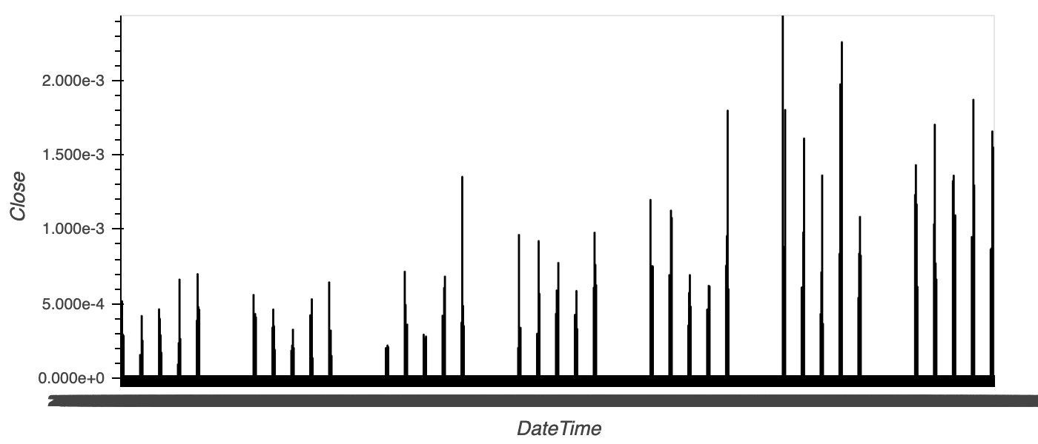
Searching for optimal

Slide 7
Exploration of Algorithms
We examined 2 basic algorithms for our hypothesis:
Crossover strategy
Using a 60/240 window
Bollinger bands
Using a 20 period

Slide 8
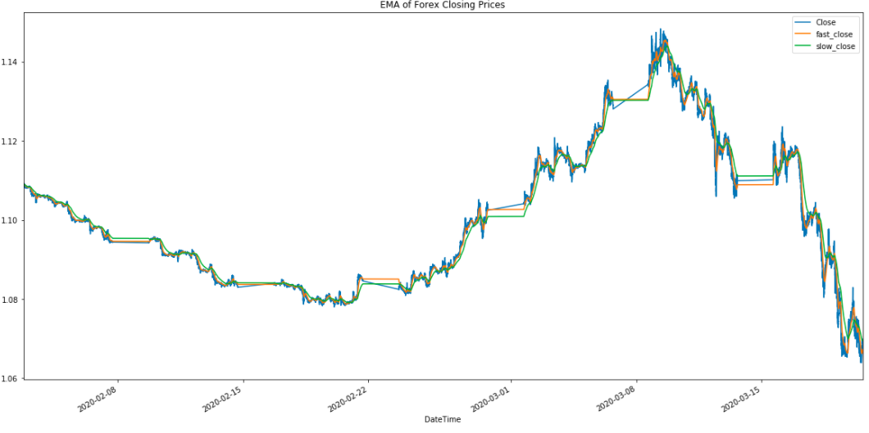
Crossover strategy

Slide 9
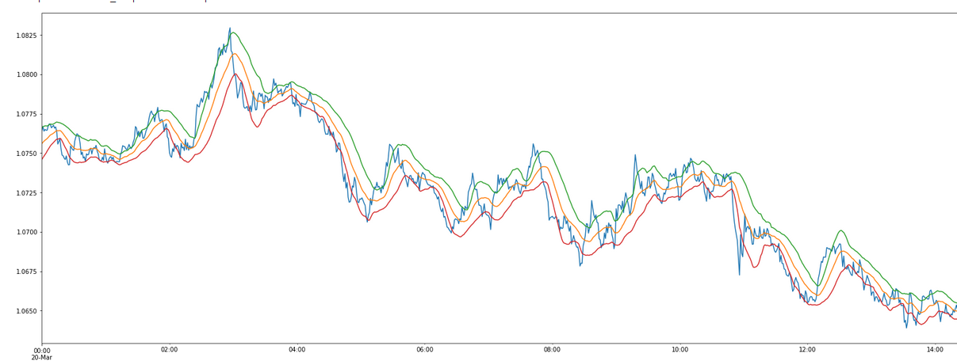
Bollinger bands

Slide 10
Random Forest Model
PROS
Random Forest produces a highly accurate classifier.
Runs efficiently on large databases
Can handle multiple input variables without variable deletion.
Generates an internal unbiased estimate of the generalization error as the forest building progresses.
CONS
Can have a tendency to overfit some datasets with noisy classification/regression tasks

Slide 11
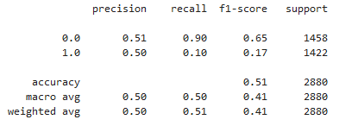
Validating the model

Slide 12
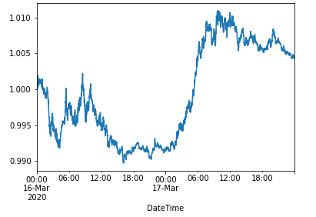
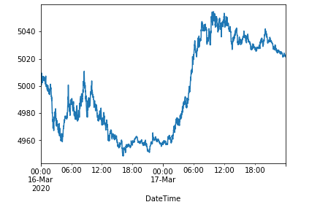
Validating the model

Slide 13
Findings
Satisfied that we were able to validate that the maximum volume trade window exists between 8am and 12pm Eastern time
Based on data that we examined we determined that a simple strategy would have been profitable

Slide 14
Difficulties
Random Forest model
Found difficulty selecting our train/ test split
Originally tried to bring in too many inputs which caused the model to never select to enter a position
Incomplete data
Were unable to find volume data for trade
Validation of optimal trade data based on volatility rather than trade volume
Needed more time

Slide 15
Further Questions
The time period we studied included periods influenced by the corona virus
Would need more time to validate over longer periods
Would like to spend more time testing other algorithms for fit
Volatility based
Back-testing
have a model that has satisfactory fit and profitability, but need to tweak in order to maximize/ optimize performance

Slide 16
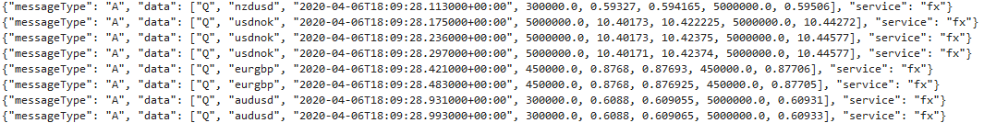
Next Steps
Further testing/ validation of a trade strategy
Testing using real-time data
Web socket
Proof of concept

