Slide 1
WebCL
Trey Spears

Slide 2
OpenCL
Goals
Utilize highly parallel devices to accelerate parallelized work
Portable code that works across wildly different devices
Notes:
Leverage different devices to accelerate parallel computing.
Devices: CPUs, GPUs, other processors ( i.e. Cell), and DSPs (digital signal processors)
Accelerating parallel computations, not sequential.
Both task-parallel and data-parallel

Slide 3
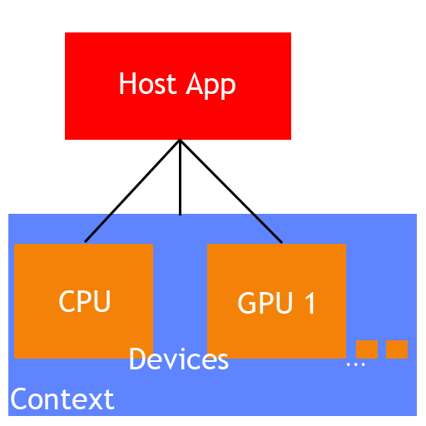
OpenCL

Slide 4
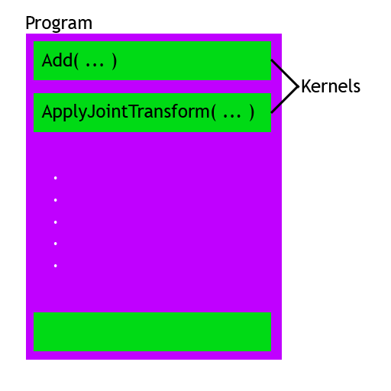
OpenCL

Slide 5
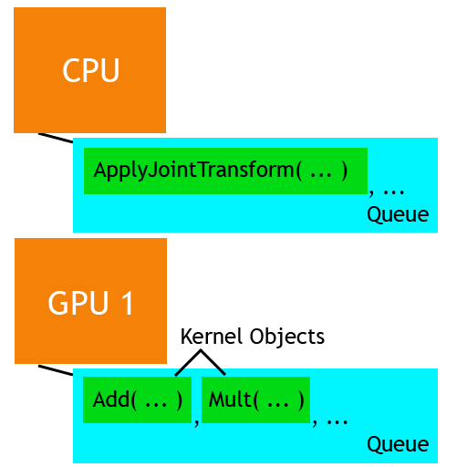
OpenCL

Slide 6
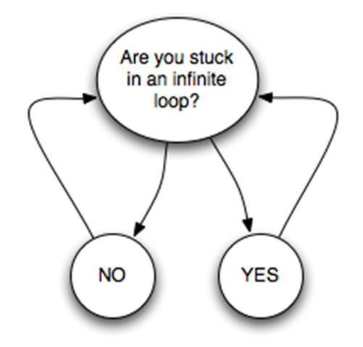
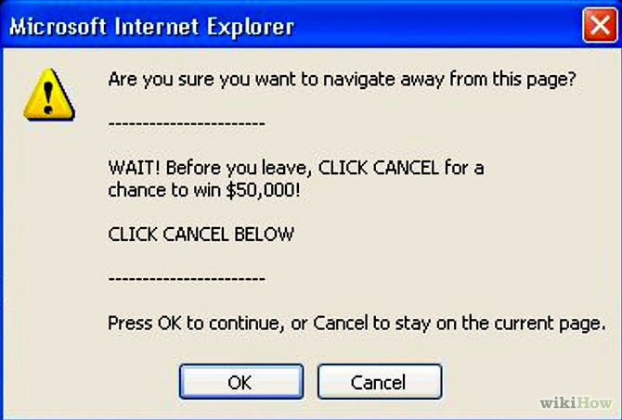

WebCL
The one and only!
Why hasn’t it caught on?
Notes:
Compute Shaders: GLSL instead of OpenCL C. Convenience functions. Restricted to GPU.

Slide 7
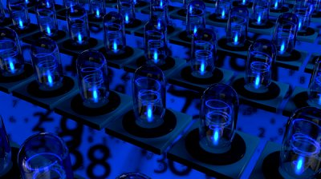
WebCL
What can we do with it?
Map reduce
Spatial partitions
Physics simulation
Image processing
Many more (big data)
Notes:
Map-Reduce – each process runs completely independent from one another
Spatial - partition
Physics – Bullet GPU OpenCL rigid body pipeline

Slide 8
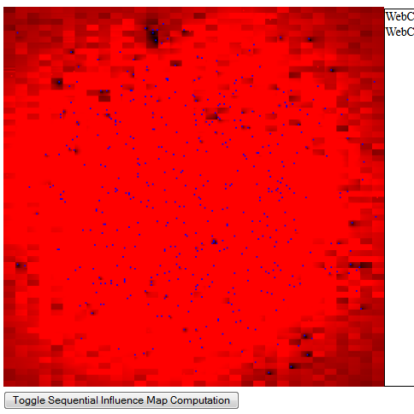

WebCL

Slide 9
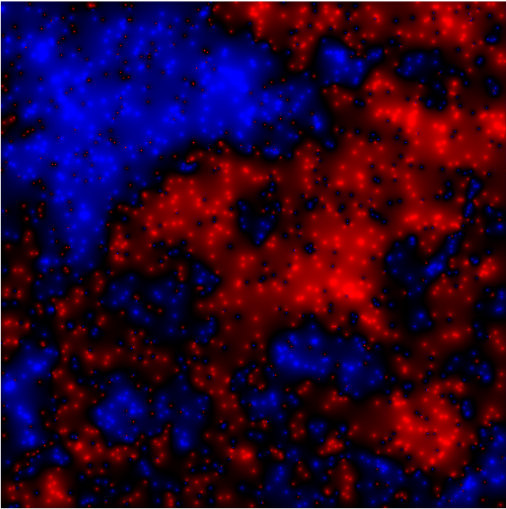
WebCL
Demo:
Simple Influence map
Performance gains
Discoveries
Notes:
Influence map:
Idea – provide useful information about the world
Situation summary – who’s in control of what at what point
Historical stats – can remember what happened for a period of time. Was this area being assaulted?
Future predictions – can use map in combo with terrain data to predict where attacks will happen
Help with Ais threat analysis

