Slide 1
OpenCL
Trey Spears

Slide 2
OpenCL
Leverage different devices to accelerate parallel computing.
Devices: CPUs, GPUs, other processors ( i.e. Cell), and DSPs (digital signal processors)
Accelerating parallel computations, not sequential.
Both task-parallel and data-parallel
Goals
Utilize highly parallel devices to accelerate parallelized work
Portable code that works across wildly different devices
Notes:
Opencl is a framework for writing programs that execute across heterogeneous platforms.

Slide 3
OpenCL
Has it’s own language, called OpenCL C, which is based on C99
Kernels – individual functions
Programs – collection of kernels you can call into, similar to DLL
Queue kernels for work
In order insertion
Kernels execute in order or out of order

Slide 4
OpenCL
Basic sequential function
Void add( const float *arg1, const float *arg2, float *result, int size )
{
for( int i = 0; i < size; ++ i )
{
result[ i ] = arg1[ i ] + arg2[ i ];
}
}

Slide 5
OpenCL
OpenCL version, data-parallel
Kernel void add( global const float *arg1, global const float *arg2, global float *result )
{
int i = get_global_id( 0 );
result[ i ] = arg1[ i ] + arg2[ i ];
}

Slide 6
OpenCL
get_global_id( 0 );
The parameter refers to the index in the specific dimension for this particular work-item
OpenCL supports (1, 2, and 3)-dimensional computation domains
Dimensions examples
1D – global_dim[3] = { 256, 1, 1 }
2D – global_dim[3] = { 16, 16, 1 }
3D – global_dim[3] = { 4, 4, 4 }

Slide 7
OpenCL
Each element in the domain is called a work item
Command is processed on all work items in parallel
Global and local workgroups
Global isn’t really a workgroup, but defines the whole range of the computation
Local workgroups consists of adjacent work items have their own local dimensions
Synchronization at the local level, but not at the global level
A kernel is executed on one device so that its work items can share local memory and remain synchronized

Slide 8
OpenCL
Cannot synchronize at a global level. Have to adjust algorithms to work in a way where global synchronization isn’t needed.
If that’s not possible, break algorithm up into multi pass algorithm

Slide 9
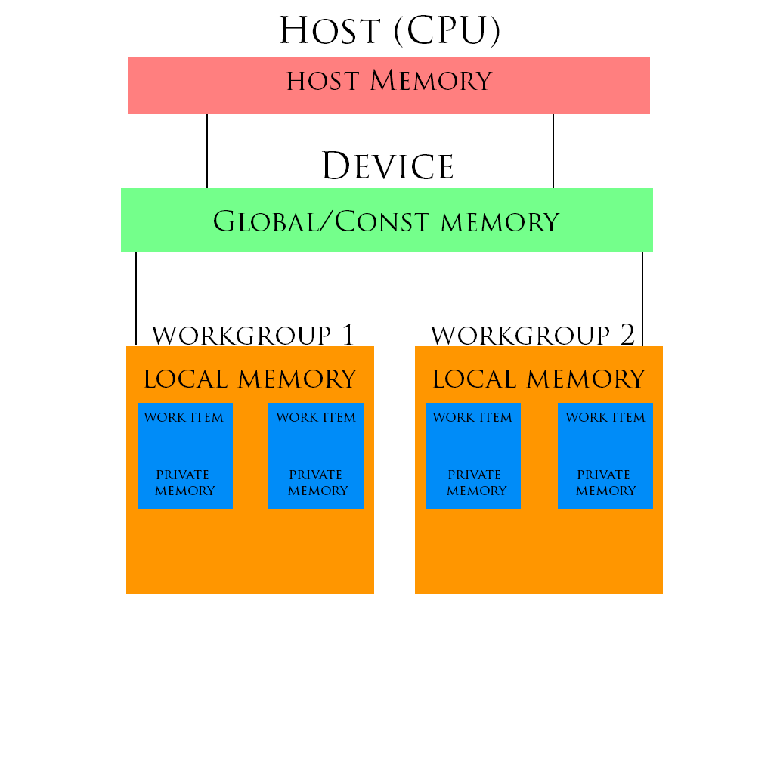
OpenCL
Memory Model
Global – not synched
Local – can be synched

Slide 10
OpenCL
Getting started
Get devices ( CPU, GPU, etc. )
Create a context with those devices
Create a queue for each device in the context

Slide 11
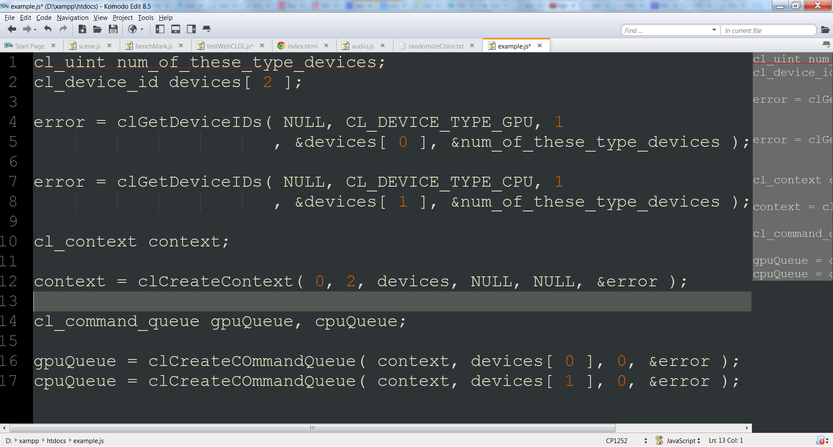
OpenCL

Slide 12
OpenCL
A multi-core CPU is considered a single device when setting up your devices
Work will be done across all cores in parallel
GPU is ultra multi-cored and the same thing applies. One device per GPU.
Data can be shared across devices on the same context

Slide 13
OpenCL
Picking which device to use for a command/set of commands depends on the algorithm(s) and hardware.
Lot’s of branching in algorithm, probably CPU
Large amounts of floating point/matrices calculations, probably GPU
Can query devices for info that may help you choose the best device for the command
clGetDeviceInfo( device, paramName, *out_value );

Slide 14
OpenCL
OpenCL takes in and outputs memory as simple buffers (C-arrays) or as Images( 2D or 3D images )
Images are analogous to 2D and 3D textures in openGL
In a single kernel you can only write to an image or read from and image, not both
Lots of options for images. Channel orders (just alpha, RGB, RGBA), Filter mode(linear interp or nearest neighbor interp), etc.
GPUs have special purpose hardware to handle images, so they should be used when the problem calls for it.

Slide 15
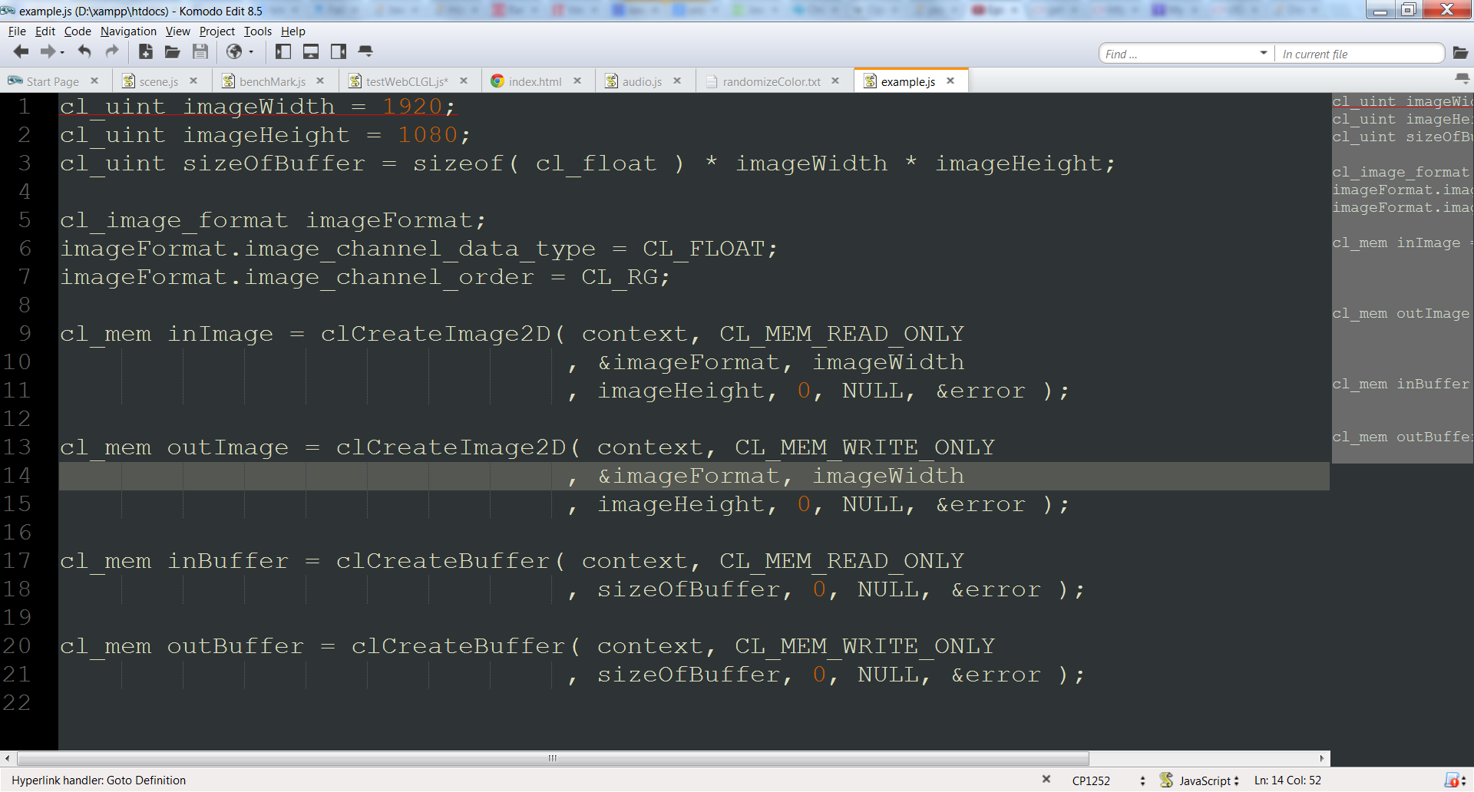
OpenCL

Slide 16
OpenCL
Reading and writing data from and to openCL buffers
clEnqueueReadBuffer( queue, buffer, blocking, offset, size, destination, ..)
clEnqueueWriteBuffer( queue, buffer, blocking, offset, size, source, … )

Slide 17
OpenCL
Program
Contains source code for kernel definitions
Executable for each device
Analogous to a DLL
So program will compile high level code into device specific executables
Kernel objects encapsulate specific kernel functions in a program
Must have a program built before you can create kernel objects

Slide 18
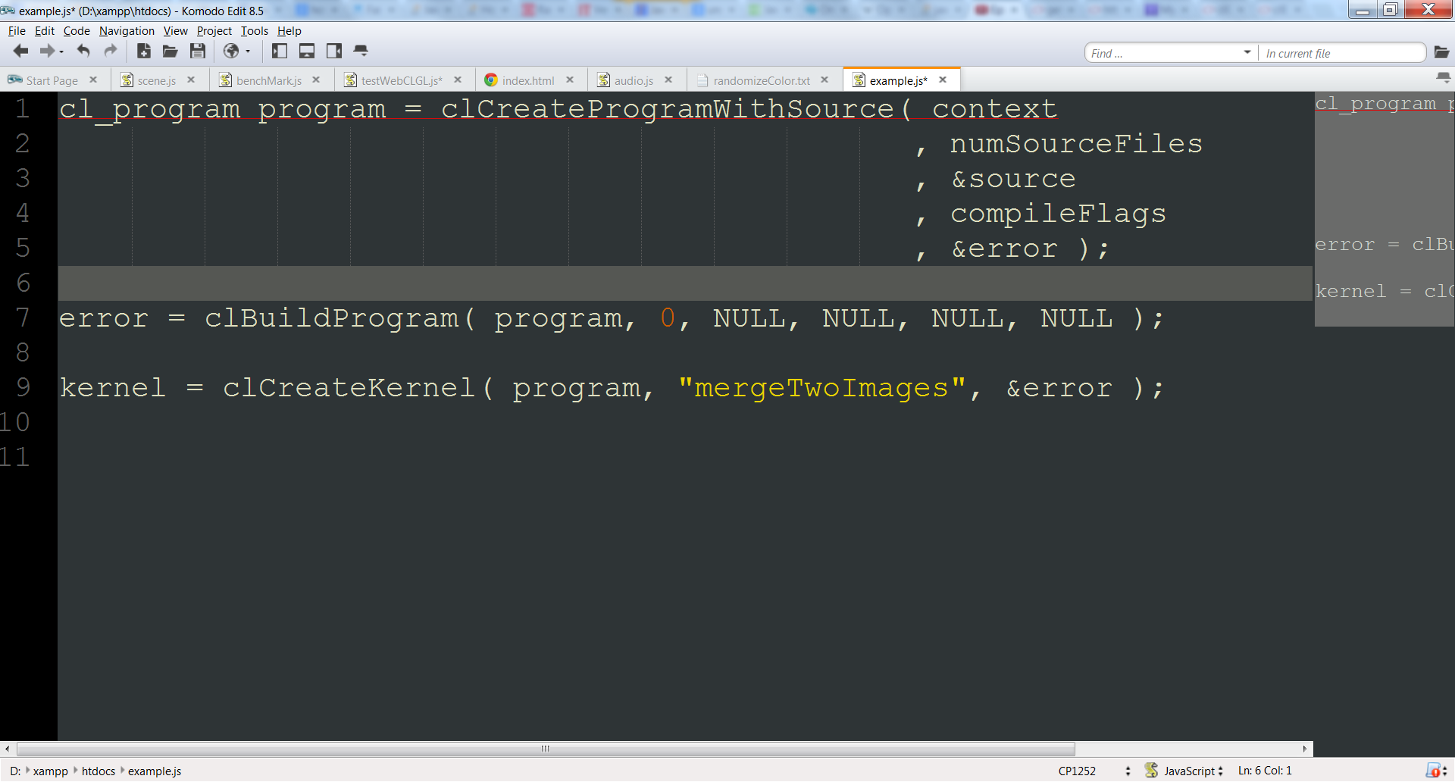
OpenCL

Slide 19
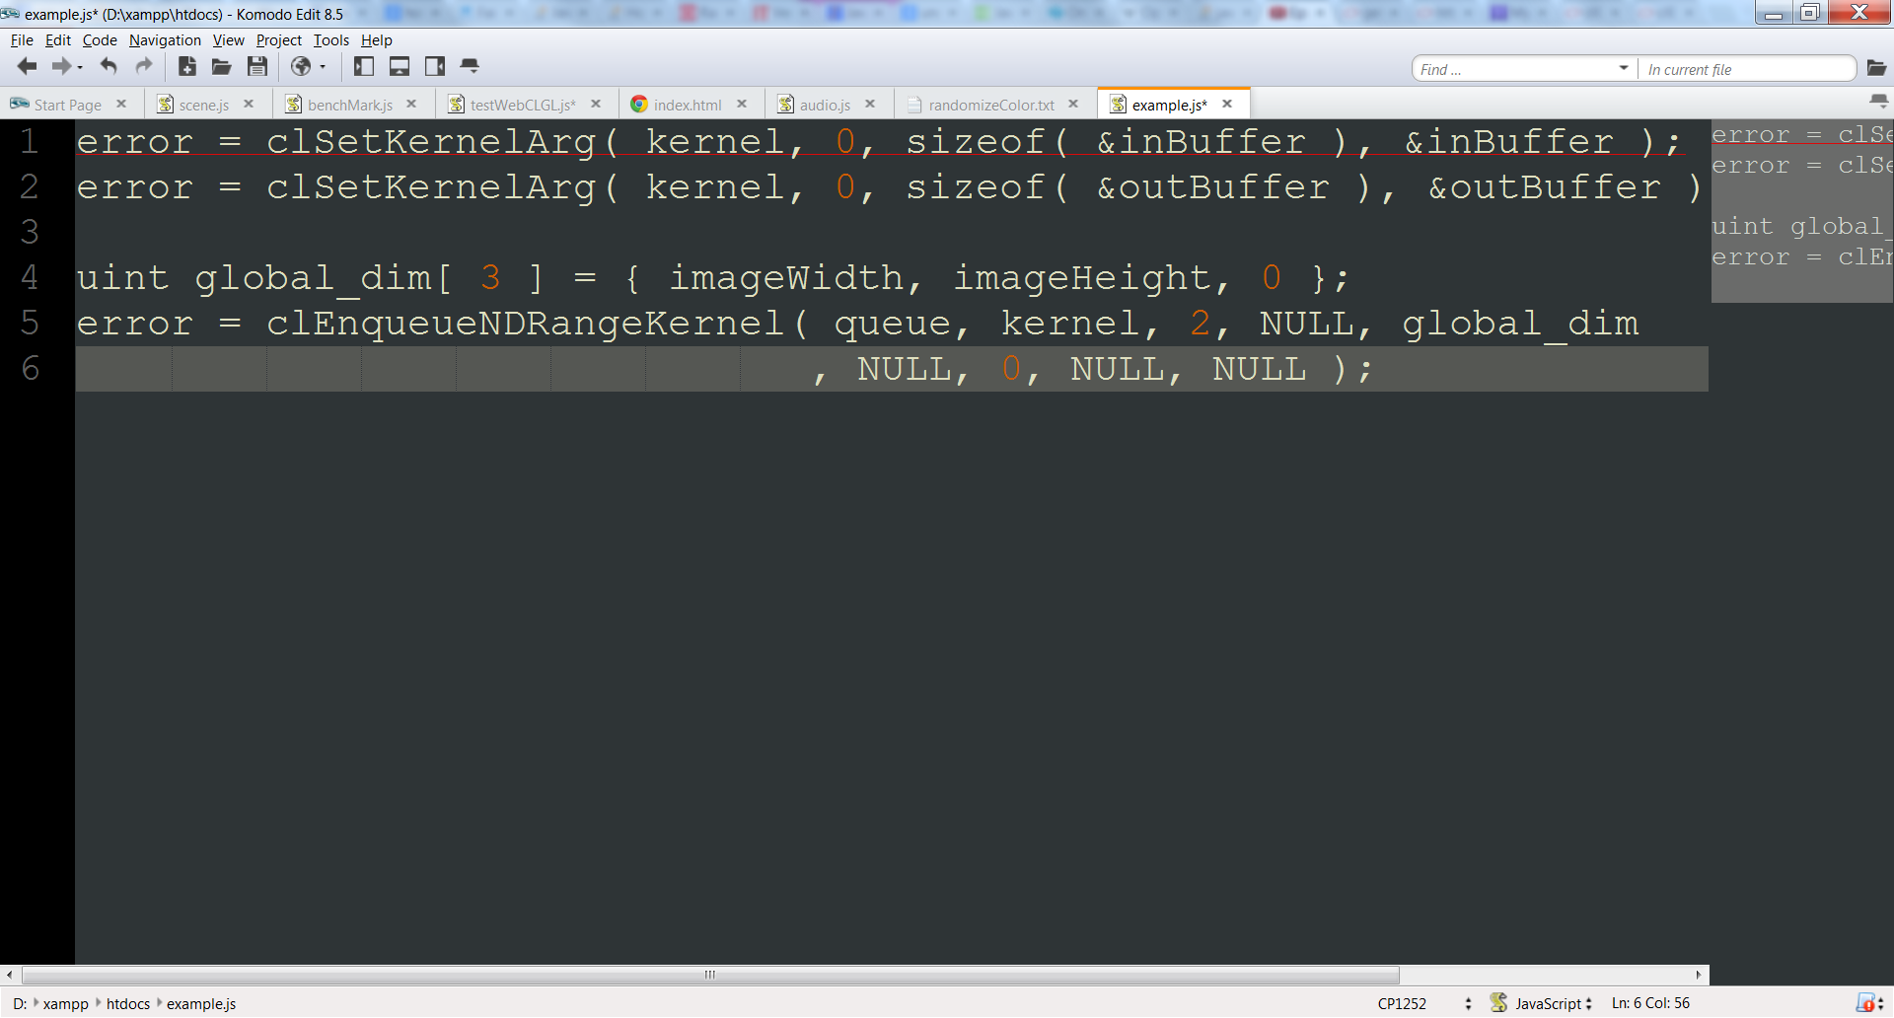
OpenCL

Slide 20
OpenCL
Scheduling and Synchronizing with events
OpenCL queues execute commands either in order or out of order
With in order you guarantee commands are completed in order
Unless tasks are enqueued in multiple threads on host
With out of order or queued commands depending on commands in another queue, use events and wait lists
Commands can wait on commands in wait list to finish (and call their event) before running
Commands can call an event when completed

Slide 21
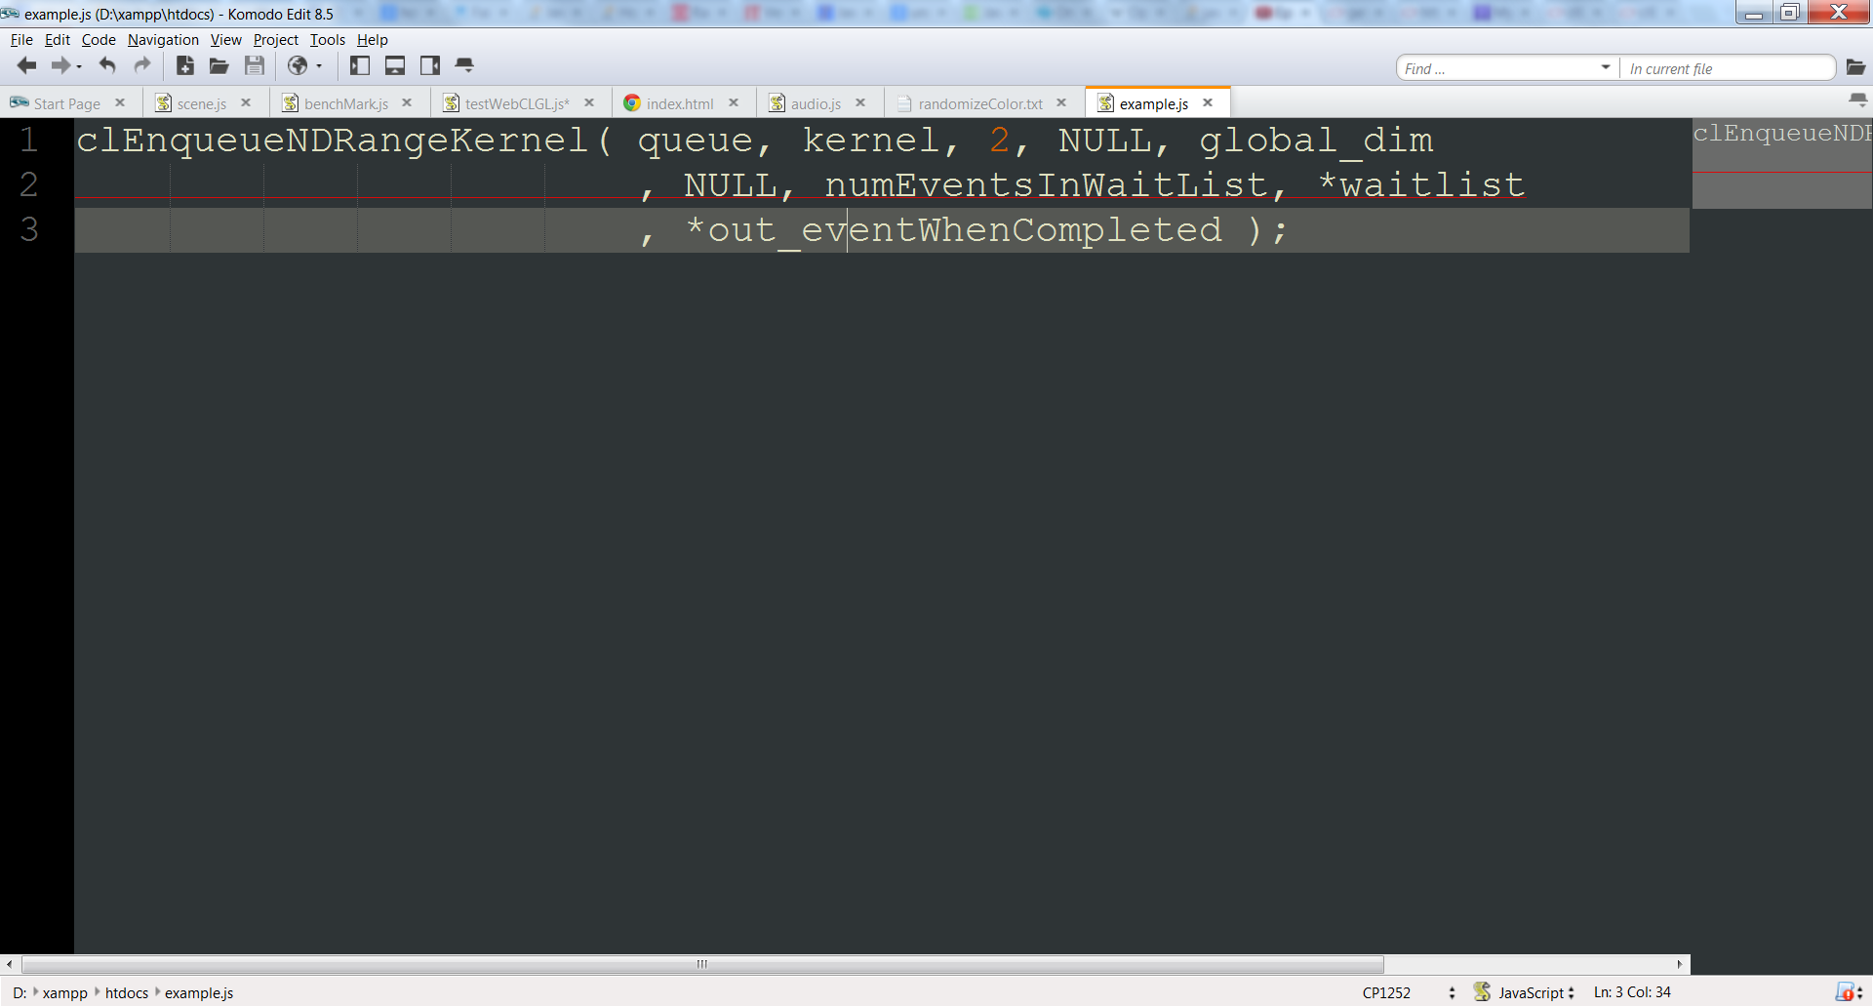
OpenCL

