Slide 1
Retail Case Study
- Group C

Slide 2
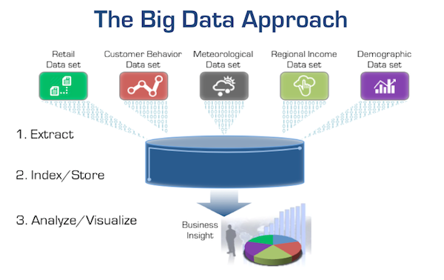
Big Data

Slide 3


CASE STUDY GOAL
HUGE DATA
BUSINESS INSIGHTS

Slide 4

xxxxx
The Foodmart database has data on sales promotions, stores, and regions. In this case study, our goal was to:
  Find the total sales generated on weekdays and weekends for each promotion, region, year, and month.
  Find the most popular promotion which generated highest sales in each region.

Slide 5
TECHNOLOGY/TOOLS
Mysql - Source Data
Python - Automation Scripts
SparkSQL - Data Ingestion Tool
AWS S3 - Data Lake
Airflow DAG - Orchestration/Workflow
Snowflake - Datawarehouse for cloud
Tableau - Data Visualization

Slide 6




DATA INGESTION
Avro
CSV
CSV
Avro
Paruqet
ParquetWrite
SOURCE
CLEANSED
CURATED
DATA VISUALIZATION

Slide 7
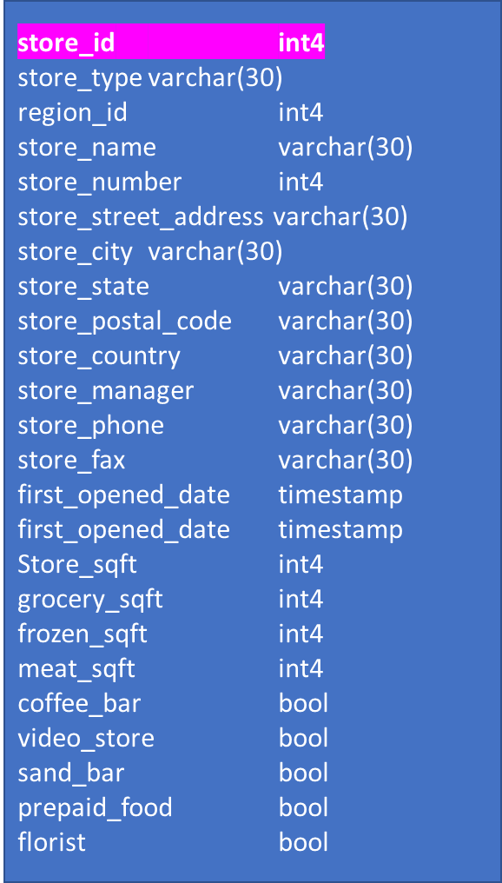
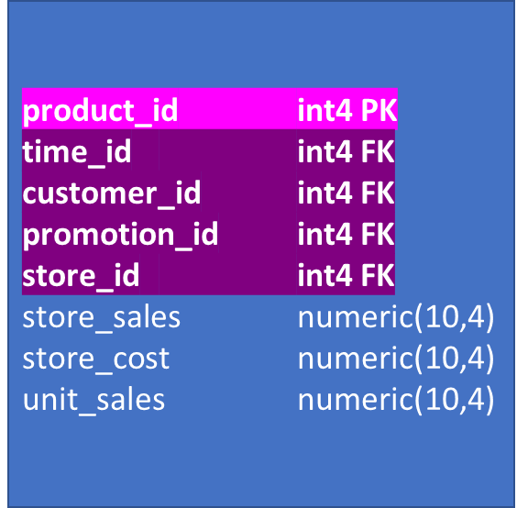
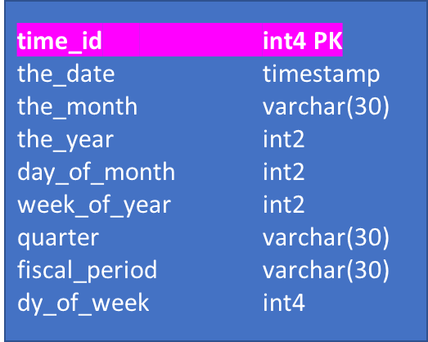
FOODMART SCHEMA
Store
promotion
promotion_id int4 PK
promotion_district_id int4
promotion_name varchar(30)
Media_type varchar(30)
cost Numeric(10,4)
start_date timestamp
end_date timestamp
Sales tables
Time by day

