Slide 1
Applied Cryptography
Lecture 2

Slide 2
Cryptosystems
Symmetric cryptosystems
Asymmetric cryptosystems
Encryption
Cryptographic hash function
Homomorphism cryptography

Slide 3
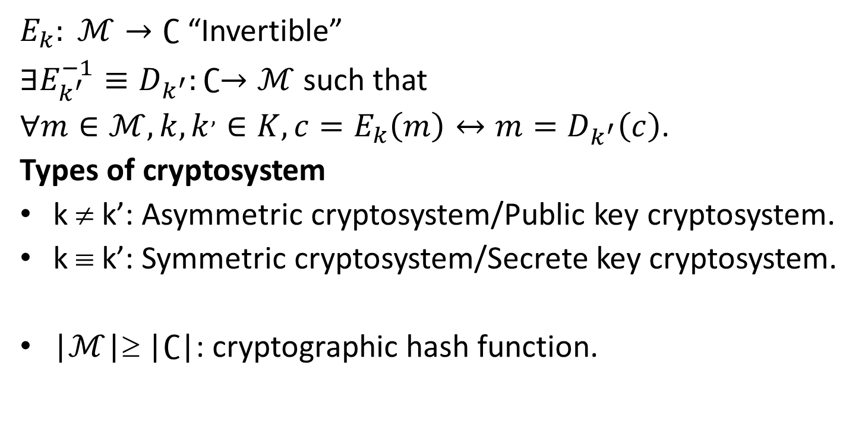
Definition
$E_{k}: ℳ→∁$ “Invertible”
$∃E_{k^{′}}^{−1}≡D_{k^{′}}:∁→ℳ$ such that
$∀m∈ℳ, k, k^{,}∈K, {c=E_{k}\left(m\right)↔m=D}_{k^{′}}\left(c\right)$.
Types of cryptosystem
k ≠ k’: Asymmetric cryptosystem/Public key cryptosystem.
k ≡ k’: Symmetric cryptosystem/Secrete key cryptosystem.
|$ℳ$|≥ |$∁$|: cryptographic hash function.

Slide 4
Kerckhoff’s Principle
The cryptosystem should be unbreakable practically, if not mathematically.
Falling of the cryptosystem in the hands of an intruder should not lead to any compromise of the system, preventing any inconvenience to the user.
The key should be easily communicable, memorable, and changeable.
The ciphertext should be transmissible by telegraph, an unsecure channel.
The encryption apparatus and documents should be portable and operable by a single person.
Finally, it is necessary that the system be easy to use, requiring neither mental strain nor the knowledge of a long series of rules to observe.

Slide 5
Attacks
Attacks are typically categorized based on the action performed by the attacker. An attack, thus, can be passive or active
Passive Attacks. The main goal of a passive attack is to obtain unauthorized access to the information.
Active Attacks. An active attack involves changing the information in some way by conducting some process on the information.

Slide 6
Homomorphic cryptography
In algebra, a homomorphism is a structure-preserving map between two algebraic structures of the same type (such as two groups, two rings, or two vector spaces).
Some homomorphic cryptosystem
RSA
ElGamal
Paillier

