Slide 1
Asymmetric Cryptography
Lecture 4

Slide 2
RSA cryptosystem
Let p, q be two different primes and n = pq and ϕ = ϕ(n) = (p-1)(q-1);
Let e, d be to integers such that ed mod ϕ = 1.
∀m ∈ {0, 1, …, n-1}, if c = m^{e} mod n then m = c^{d} mod n, and vice versa.

Slide 3
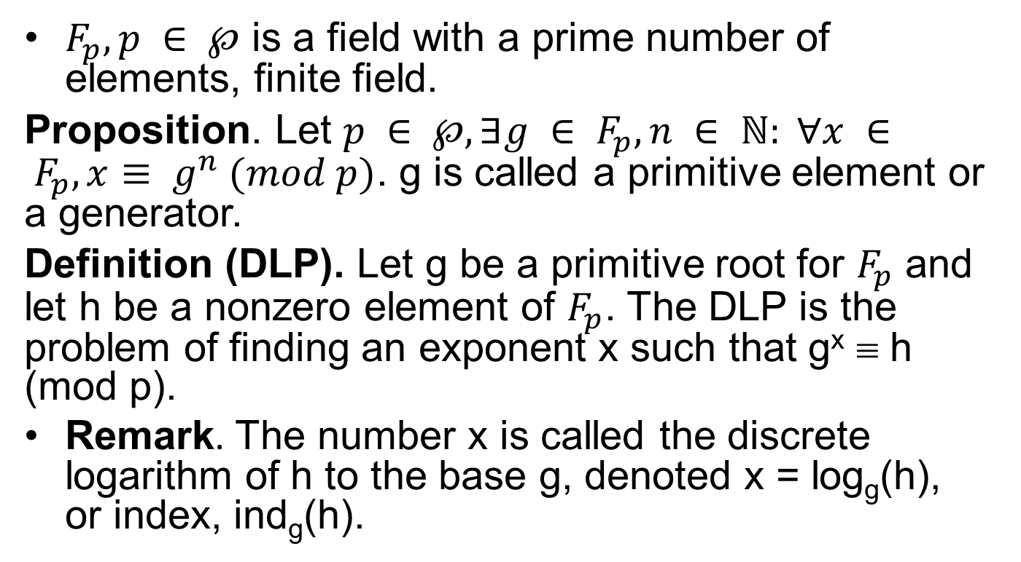
Discrete Logarithm Problem – DLP
$F_{p}, p ∈ ℘$ is a field with a prime number of elements, finite field.
Proposition. Let $p ∈ ℘, ∃g ∈ F_{p}, n ∈ ℕ: ∀x ∈ F_{p}, x≡ g^{n} (mod p)$. g is called a primitive element or a generator.
Definition (DLP). Let g be a primitive root for $F_{p}$ and let h be a nonzero element of $F_{p}$. The DLP is the problem of finding an exponent x such that g^{x} ≡ h (mod p).
Remark. The number x is called the discrete logarithm of h to the base g, denoted x = log_{g}(h), or index, ind_{g}(h).

Slide 4
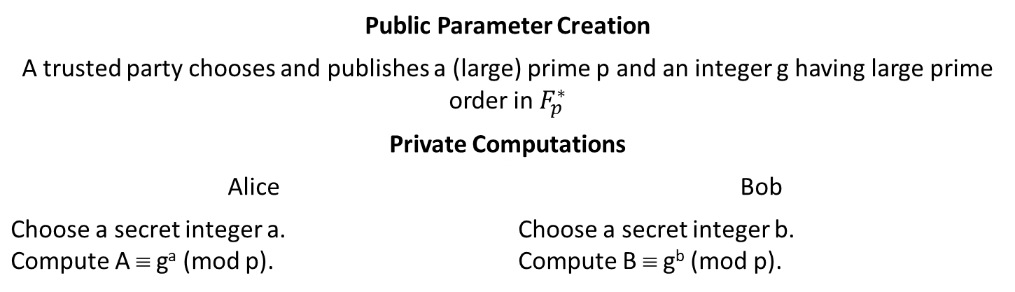
Diffie-Hellman key exchange
Public Parameter Creation
A trusted party chooses and publishes a (large) prime p and an integer g having large prime order in $F_{p}^{∗}$
Private Computations
Alice | Bob
Choose a secret integer a. Compute A ≡ gª (mod p). | Choose a secret integer b. Compute B ≡ g^{b} (mod p).
Public Exchange of Values
Alice sends A to Bob ⎯⎯→ B | A ←⎯⎯ Bob sends to Alice
Further Private Computations
Compute the number K ≡ Bª (mod p) | Compute the number K ≡ A^{b} (mod p)

Slide 5
ElGamal public key cryptosystem
It is just a variation of Diffie-Hellman key-exchange protocol for encryption data

Slide 6
Paillier Cryptosystems
λ = lcm(p-1,q-1); n = pq; g ∈ Z_{n}².
μ = (L(g^{λ} mod n²)⁻¹ (mod n), where L(u)=(u-1)/n
Public key: (n, g)
Private key: (λ,μ)
Encryption: c = g^{m}r^{n} mod n².
Decryption: m = L(c^{λ} mod n²)μ mod n.

Slide 7
Encrypted computing
Computing without decryption.
Using homomorphism property of cryptosystems if they have.
Let G and H be groups. A function φ: G → H is called a (group) homomorphism if it satisfies φ(g₁*g₂) = φ(g₁)°φ(g₂), ∀g₁, g₂ ∈ G.

Slide 8
Homomorphism cryptosystems
RSA: if c₁=m₁e mod n, c₂=m₂e mod n. Let c=c₁c₂=m₁em₂e=(m₁m₂)^{e} mod n, then c=c₁c₂ is cipher text of m₁m₂.
Elgamal: if (g^{r}₁,m₁g^{xr}₁), (g^{r}₂,m₂g^{xr}₂). Let (g^{r}₁g^{r}₂,m₁g^{xr}₁m₂g^{xr}₂)=(g^{r}₁^{+r}₂,m₁m₂g^{x(r}₁^{+r}₂⁾).
Paillier:
E(m₁+m₂, r₁r₂) =g^{m}₁^{+m}₂(r₁r₂)^{n}=(g^{m}₁r₁^{n})(g^{m}₂r₂^{n})=E(m₁,r₁)E(m₂,r₂)

