Slide 1
Calorimeter timing cuts in the MAIA reconstruction chain
How the ECAL and HCAL timing windows remove hits from clusters,
and what cut values avoid shaping the cluster energy
MAIA_v0 · mucoll-sim-ubuntu24:v3.0 Gaudi chain · no BIB overlay · guns at θ = 90°
branch claude/maia-timing-cuts-study-wbtv1n · full write-up in timing_studies/PLAN.md

Slide 2
Context and goal
Why timing cuts, and what “not shaping the energy” means here
Beam-induced background (BIB) arrives out of time, so the reconstruction applies aggressive timing cuts to calorimeter hits.
These cuts are enforced at more than one point in the chain, and their combined effect on signal clusters had not been quantified.
Goal: measure how each timing cut removes hits/energy from ECAL and HCAL clusters, and suggest windows that do not strongly shape the cluster energy.
This round is deliberately BIB-free: it isolates the signal side of the trade-off. The BIB side (occupancy re-admitted per window) is the natural follow-up.
All times are relative: Δt = t_arrival − r_cell/c (time-of-flight from the IP at the speed of light already subtracted — the convention the code itself uses).
Geant4 SimCalorimeterHits every energy deposit keeps its own time (detailed shower mode)
Digitization · RealisticCaloDigi per-contribution window Δt ∈ (−0.5, +10) ns + cell threshold
Selection · CaloHitSelector cell time window (−0.3, +0.3) ns + energy threshold → *Sel
PandoraPFA clustering no timing cuts — clusters inherit whatever survives
MAIA calorimeter timing-cut study · 2

Slide 3
Setup and samples
Tutorial-tagged Gaudi chain (mcd-wiki “Running with Gaudi”), fully containerized and reproducible
Container ghcr.io/muoncollidersoft/mucoll-sim-ubuntu24:v3.0; steering from mucoll-benchmarks + MAIAConfig; algorithms from k4Reco; geometry MAIA_v0.
MAIAConfig pinned to d290d02 (2026-06-17): main requires a newer k4ActsTracking than the v3.0 container ships (the tutorial's known compatibility warning). Calo settings identical to main.
Chain per sample: particle gun → ddsim (FTFP_BERT_HP, detailed shower mode: contributions keep individual times) → k4run digi → k4run reco (Pandora).
Every quirk needed to make this reproducible (entrypoint, threshold-map location, EvtMax, gun steering) is scripted in timing_studies/production/ and documented in PLAN.md.
samples | energies | events | θ | BIB
photon gun (ECAL phase) | 10 / 50 / 200 GeV | 100 per point | 90° (barrel) | none
π⁻ gun (ECAL+HCAL phase) | 10 / 50 / 200 GeV | 100 per point | 90° (barrel) | none
Barrel-only by construction (θ = 90°); endcaps and θ dependence deferred to a follow-up θ scan.
MAIA calorimeter timing-cut study · 3

Slide 4
Where the chain cuts on time
Verified against k4Reco / MAIAConfig source — two timing-cut levels act in sequence; Pandora adds none
level | algorithm (instances) | variable the cut acts on | window / value
1 · digitization | RealisticCaloDigiSilicon / ScinPpd (ECAL/HCAL, barrel+endcap) | each Geant4 contribution: Δt = t − r_cell/c | (−0.5, +10) ns
1b · digi threshold | same | cell energy summed over IN-WINDOW contributions | ECAL 5×10⁻⁵ GeV (≈0.32 MIP) · HCAL 0.5 MIP
2 · selection | CaloHitSelector (→ *CollectionSel, what Pandora sees) | stored digi hit time = EARLIEST accepted contribution Δt | (−0.3, +0.3) ns, exclusive
2b · sel. threshold | same | calibrated cell energy | ECAL: BIB mode map ≈ 1 MIP · HCAL: 5×10⁻⁵ GeV
3 · clustering | DDPandoraPFANewAlgorithm | — | no timing cuts
The key interplay: a cell's ENERGY integrates everything out to +10 ns, but its TIME is the earliest accepted contribution. The ±0.3 ns selector therefore drops whole cells whose first deposit is late, while keeping every late deposit that shares a cell with a prompt one.
Tightening the digi window also kills cells through the threshold (1b acts on the windowed energy) — the two levels are coupled, which is why both are scanned together below.
MAIA calorimeter timing-cut study · 4

Slide 5
Things found while auditing the code
Worth knowing independently of the tuning (details + line refs in PLAN.md §1)
Double TOF correction — saved by a units accident The digi hit time is already propagation-corrected, yet CaloHitSelector subtracts r/TMath::C() again. With r in mm and C in m/s the second term is ~10⁻⁶ ns, so the cut works on the intended variable — but only by accident. If someone “fixes” the units it becomes a real double correction. → report upstream.
cellID truncation in RealisticCaloReco (k4Reco) int cellid = hit->getCellID() truncates 64 → 32 bits: every Rec/Coned/Sel calorimeter hit loses its x/y fields. Layer/stave/module survive, so calibration and the selector still work, but any consumer of full Sel-hit cellIDs gets degenerate IDs. → report upstream.
BIB-derived thresholds bite without BIB The ECAL selector threshold map (≈ 6.5 MeV ≈ 1 MIP per cell at θ = 90°) is derived from BIB occupancy but applied always. This study keeps it in numerator AND denominator so the timing effect is isolated — but it matters when interpreting absolute cluster energies.
Stochastic digitization (validation nuance) ECAL silicon: Poisson e–h smear (sub-%); HCAL scintillator: binomial SiPM pixel smear (~26% at 1 MIP), neither emulated. Sets the closure tolerances; timing behaviour itself is deterministic and reproduced exactly.
MAIA calorimeter timing-cut study · 5

Slide 6
Method: simhit-level emulation of the full chain
Why simhit level: digitization lumps contributions together — only the sim record keeps each deposit's time
1
Flatten — read SimCalorimeterHit contributions from the EDM4hep reco file (podio); per contribution: Δt = t − |cell position|/c and energy; per cell: position, layer, plus the ACTUAL Digi/Sel hits and Pandora clusters for closure.
Structural trick With the digi window MIN fixed, the cell's earliest-time variable does not depend on the digi MAX — the max edge only changes cell energy and survival. The 2D scan is exact and cheap. Emulation, not re-running One sim pass per sample; every cut point afterwards is a numpy reduction, validated against genuine chain re-runs (next slide).
2
Emulate digitization — for any window (min, max): cell energy = Σ in-window contributions; cell time = earliest accepted Δt; mean detector response (HCAL SiPM saturation) + thresholds exactly as in k4Reco.
3
Emulate selection — reco calibration → selector energy threshold (extracted ECAL map / flat HCAL) → selector time window on the cell time. Both windows are free parameters.
4
Scan — full 2D grid: digi max × selector window (symmetric and asymmetric), vectorized numpy → per-event retained energy at every grid point in seconds.
MAIA calorimeter timing-cut study · 6

Slide 7
How the emulation was validated
Closure gates run per sample before any scan is trusted; then genuine re-runs of the chain at shifted cut settings
< 0.1%
0.3 – 1.5%
× 1.0237
ECAL closure, per event emulated vs actual Sel-collection energy sums, at default cuts AND every variant point
HCAL closure, per event entirely the un-emulated binomial SiPM smear; → 0.3% at high occupancy (200 GeV π)
leading cluster / Sel sum exactly Pandora's EM calibration: cluster energy tracks hit selection — hit-level fractions ARE cluster-level fractions
Closure-gate ladder (run per sample, must pass before scanning)
1 · flatten self-consistency: Σ contribution energies = SimCalorimeterHit energy (exact).
2 · prompt Δt peak at ≈ 0 with sub-ns width → no unit or r/c-offset errors.
3 · per-cell join, emulated vs ACTUAL Digi hits (full 64-bit cellIDs): identical cell sets to <0.05%, energies to the stochastic tolerance, times to 10⁻⁶ ns.
4 · emulated vs ACTUAL Sel hits per (event, layer): validates threshold-map lookup, MIP thresholds, SiPM saturation and the time window in one comparison.
5 · event-level Sel energy sums (numbers above).
6 · Real-chain variant re-runs (the decisive check)
k4run digi+reco genuinely re-run on the same sim files with property overrides on all four Digi / all four Selector instances coherently.
Matrix: {selector ±0.15 ns, selector ±1.0 ns, digi max 2 ns} × {γ, π⁻} × {10, 50, 200 GeV} — 18 variant reconstructions.
Emulation matches every variant's Sel sums per event to <0.1% (ECAL) / ~1% median (HCAL), and the Pandora cluster follows the Sel sum at each point.
⇒ one sim pass + emulation is equivalent to re-running digitization and selection at every scan point.
MAIA calorimeter timing-cut study · 7

Slide 8
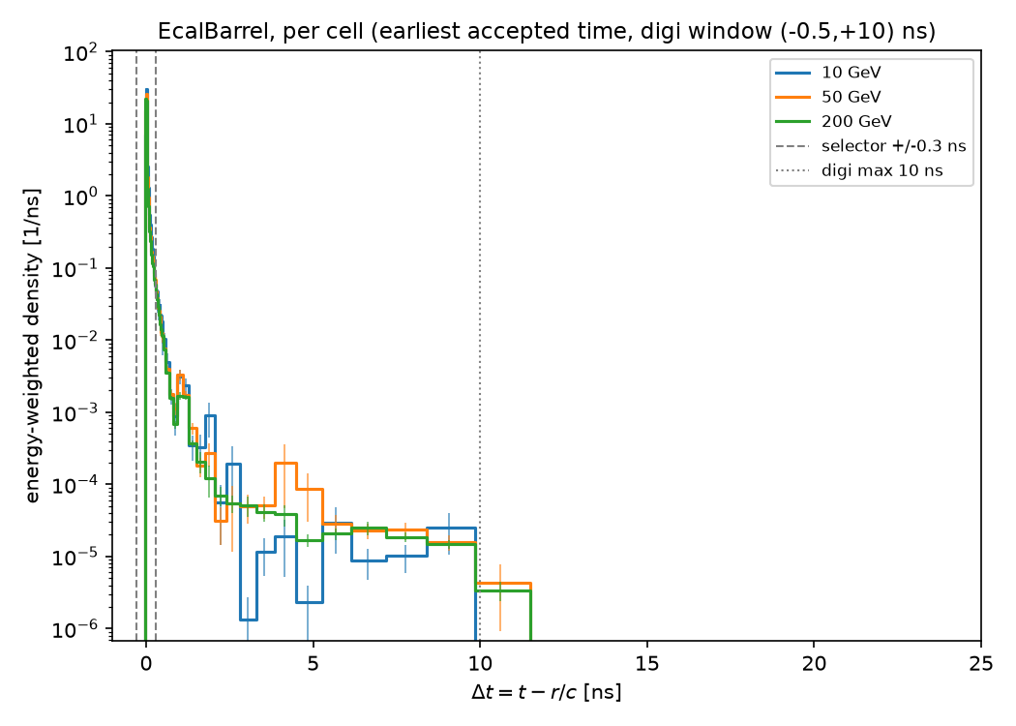
Photons: where the ECAL energy is in time
Cut configuration: spectra built at the DEFAULT digi window (−0.5, +10) ns; no selector cut applied — guide lines mark the current selector ±0.3 ns and digi max 10 ns edges. Cell time = earliest accepted contribution.
Energy-weighted Δt of ECAL barrel cells: a prompt peak at Δt ≈ +0.02 ns carrying ≈99.5% of the energy within ±0.5 ns.
The spectrum falls three orders of magnitude within ~1 ns, then a flat tail at the 10⁻⁵/ns level extends past 10 ns.
Identical shape at 10 / 50 / 200 GeV → whatever a window cuts, it cuts nearly the same fraction at every energy (little scope for shaping — quantified next).
Same conclusion at contribution level (no cuts at all): plot in plots/ecal_photons/dt_contrib_EcalBarrel.png.
MAIA calorimeter timing-cut study · 8

Slide 9
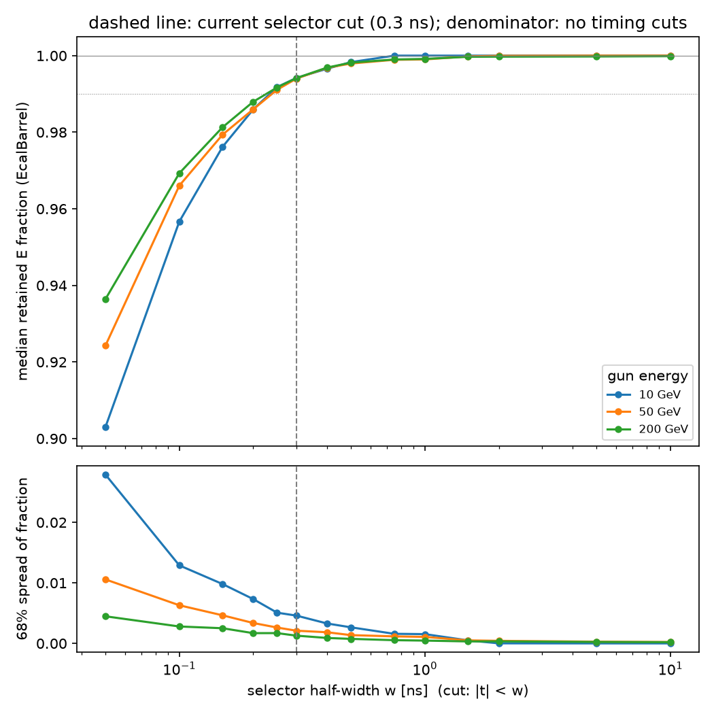
ECAL / photons — selector window scan
Cut configuration: digi window FIXED at default (−0.5, +10) ns; selector window varied, symmetric ±w. Denominator everywhere: same energy thresholds, NO timing cuts at either level (digi max 100 ns, selector open).
selector window | 10 GeV | 50 GeV | 200 GeV
±0.3 ns (current) | 0.9942 | 0.9940 | 0.9941
±0.5 ns | 0.9983 | 0.9979 | 0.9982
±1.0 ns | 1.0000 | 0.9990 | 0.9991
−0.3 < t < +0.5 ns | 0.9983 | 0.9979 | 0.9982
−0.3 < t < +1.0 ns | 1.0000 | 0.9990 | 0.9991
Current ±0.3 ns: a flat 0.6% loss, identical at all three energies — an offset, not a shape.
Asymmetric rows equal symmetric ones → ALL loss is on the late side; the early edge (−0.3 ns) removes nothing.
Event-to-event spread of the retained fraction (a resolution term): 0.46 / 0.21 / 0.13% at ±0.3 ns, halving at ±0.5 ns.
MAIA calorimeter timing-cut study · 9

Slide 10
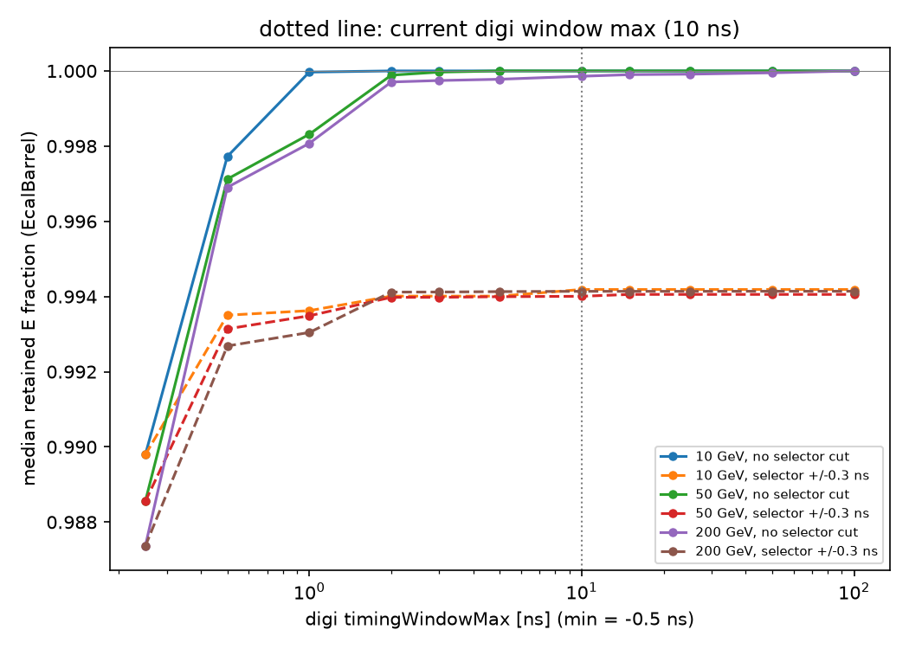
ECAL / photons — digi window scan
Cut configuration: digi max varied with digi min FIXED at −0.5 ns. Two curve families: selector OPEN (solid — isolates the digi cut) and selector at the DEFAULT ±0.3 ns (dashed — the two cuts combined). Denominator as before: no timing cuts.
The digi window is a non-issue for the ECAL: with the selector open, even max = 1 ns keeps > 99.8%; at 2 ns the loss is < 0.1% at all energies.
With the selector at ±0.3 ns (dashed), the curves saturate at the selector's own 99.4% — beyond ~2 ns the digi edge is irrelevant because the selector dominates.
Implication: the current 10 ns is generously safe — or can be tightened to ~2–3 ns for free if BIB energy integrated in the (0.3, 10) ns tail of prompt cells proves harmful.
Digi min scan (−0.25 / −0.5 / −1.0 ns): no effect on photons.
MAIA calorimeter timing-cut study · 10

Slide 11
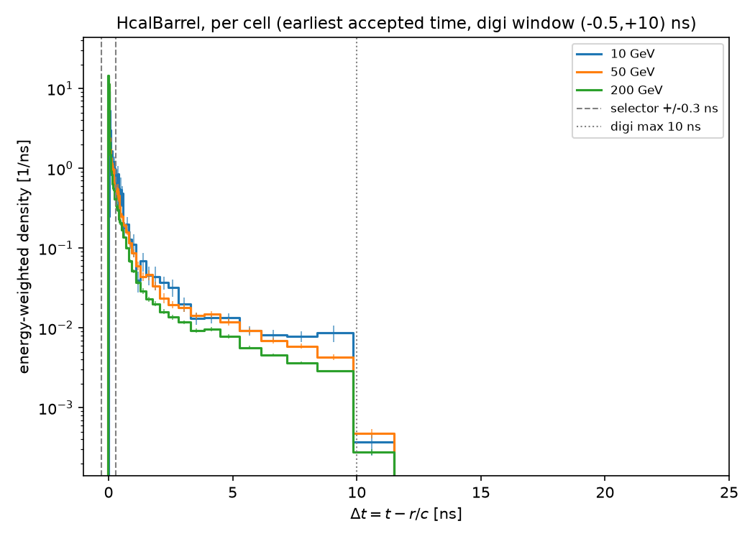
Pions: hadronic showers are late — by construction
Cut configuration: spectra built at the DEFAULT digi window (−0.5, +10) ns; no selector cut applied — guide lines mark the current selector ±0.3 ns and digi max 10 ns edges.
Only ~59% of the HCAL and ~78% of the ECAL pion energy arrives within ±0.5 ns.
The neutron-dominated late component spreads over tens of ns in cell earliest-time (and hundreds of ns at contribution level) — it is intrinsic to hadronic showers, not an artifact.
Many late deposits land in cells whose FIRST deposit is prompt: those survive the selector via the +10 ns digi integration. Cells that light up late are dropped whole — the dominant hadronic loss mechanism.
So for hadrons the window choice is a genuine trade-off; no reasonable window recovers everything.
MAIA calorimeter timing-cut study · 11

Slide 12
Pions: what the current cuts do to cluster energy
Cut configuration: each row states BOTH cut levels explicitly. Retained fraction = median over events, ECAL+HCAL barrel summed; 68% event spread in parentheses. Denominator: same thresholds, no timing cuts.
digi window + selector window | 10 GeV | 50 GeV | 200 GeV
(−0.5, +10) ns + ±0.3 ns ← current defaults | 0.709 (0.129) | 0.789 (0.066) | 0.845 (0.046)
(−0.5, +10) ns + ±1.0 ns | 0.883 (0.071) | 0.908 (0.034) | 0.929 (0.022)
(−0.5, +10) ns + ±2.0 ns | 0.923 (0.051) | 0.938 (0.024) | 0.952 (0.017)
(−0.5, +10) ns + ±5.0 ns | 0.965 (0.025) | 0.969 (0.013) | 0.975 (0.009)
(−0.5, +10) ns + selector OPEN (digi cut alone) | 0.983 (0.013) | 0.987 (0.007) | 0.987 (0.005)
(−0.5, +25) ns + selector OPEN | 0.994 (0.007) | 0.996 (0.003) | 0.996 (0.002)
The current defaults remove 15–29% of the hadronic calorimeter energy, with ~14% response non-linearity between 10 and 200 GeV and a 5–13% event-to-event spread — genuine cluster-energy shaping.
Cross-checked in the REAL chain (not emulation): the median 10 GeV π leading Pandora cluster moves 5.35 → 8.90 GeV between selector ±0.15 ns and ±1.0 ns (digi window at default in both).
MAIA calorimeter timing-cut study · 12

Slide 13
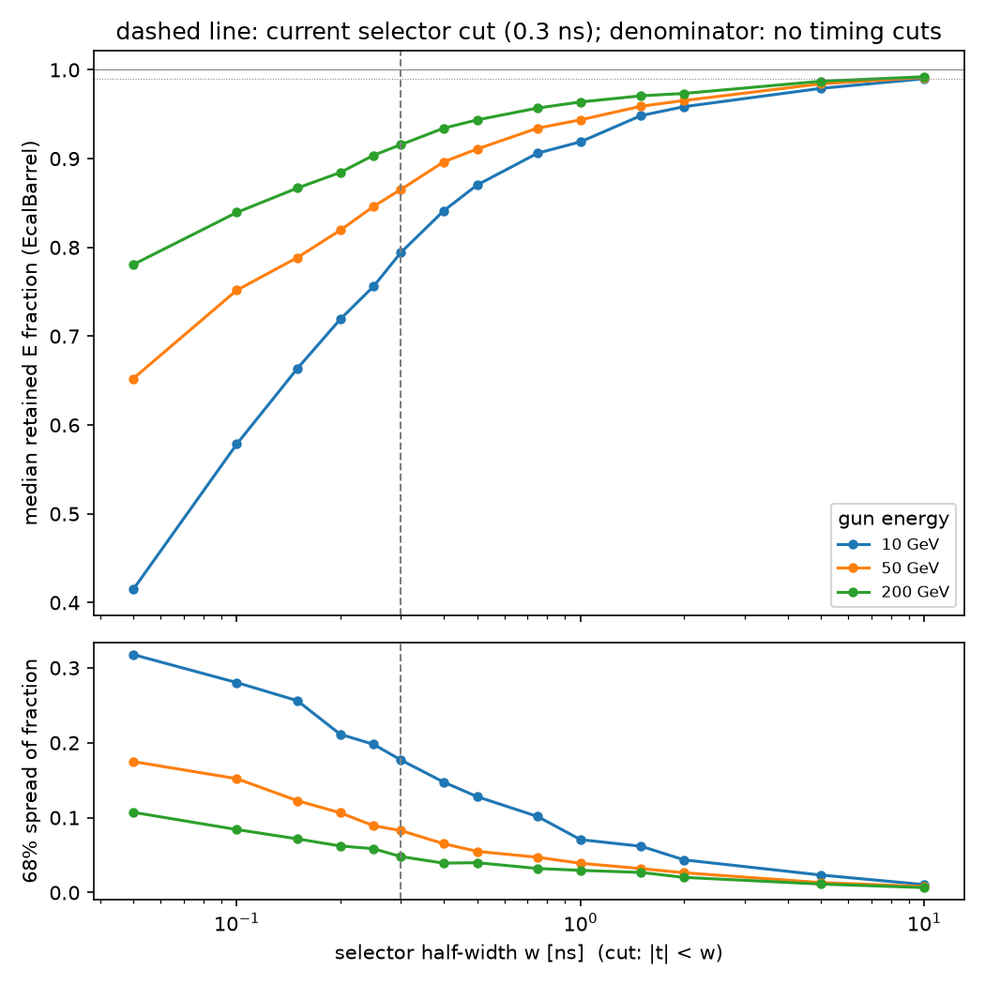
Tuning the ECAL window alone (γ + π)
Cut configuration: ECAL barrel only; digi window FIXED at default (−0.5, +10) ns; ECAL selector window varied. Selector windows factorize per cell, so ECAL and HCAL tune independently. Denominator: no timing cuts.
ECAL window | γ 10 | γ 200 | π 10 | π 50 | π 200 | π 200/10
±0.3 ns (cur.) | 0.994 | 0.994 | 0.794 | 0.865 | 0.916 | 1.153
±0.5 ns | 0.998 | 0.998 | 0.870 | 0.911 | 0.944 | 1.084
±1.0 ns | 1.000 | 0.999 | 0.919 | 0.944 | 0.964 | 1.049
±2.0 ns | 1.000 | 1.000 | 0.959 | 0.965 | 0.973 | 1.016
±5.0 ns | 1.000 | 1.000 | 0.979 | 0.984 | 0.987 | 1.008
π 200/10 = retained(200 GeV) / retained(10 GeV): the response-linearity (shaping) metric.
Photons alone would let the ECAL sit at +0.5 ns — but the ECAL half of hadronic showers is also late.
At ±0.3 ns the pion ECAL response carries 15% non-linearity; (−0.3, +2.0) ns brings it to 1.6% with photons still exactly lossless.
If BIB forces tighter: +1.0 ns is the compromise (5% non-linearity).
MAIA calorimeter timing-cut study · 13

Slide 14
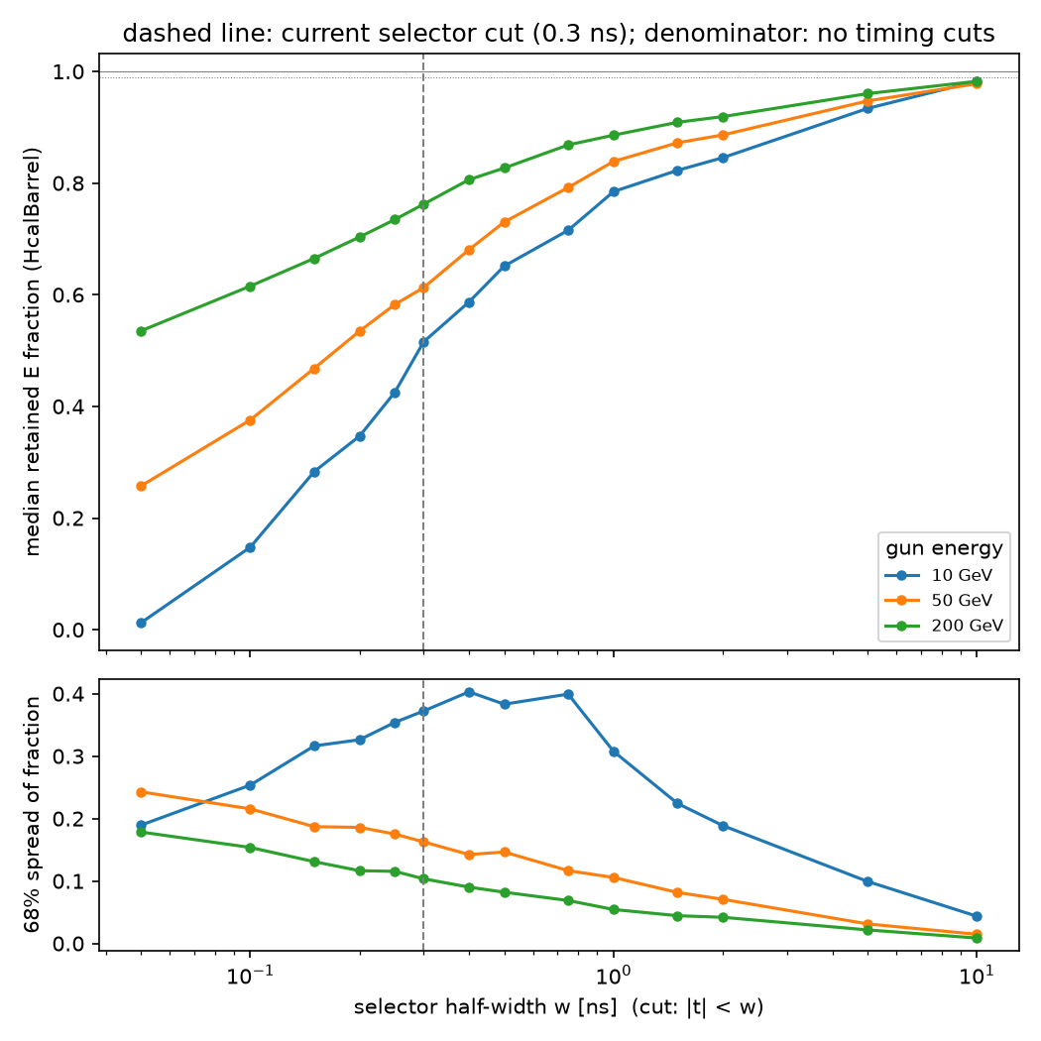
Tuning the HCAL window on its own (pions)
Cut configuration: HCAL barrel only; digi window FIXED at default (−0.5, +10) ns; HCAL selector window varied. Denominator: no timing cuts. Photons contribute only ~0.05% leakage here — pions are the relevant probe.
HCAL window | π 10 | π 50 | π 200 | π 200/10
±0.3 ns (cur.) | 0.515 (0.37) | 0.613 (0.16) | 0.762 (0.10) | 1.479
±1.0 ns | 0.785 (0.31) | 0.839 (0.11) | 0.886 (0.05) | 1.129
±2.0 ns | 0.846 (0.19) | 0.886 (0.07) | 0.919 (0.04) | 1.087
±5.0 ns | 0.934 (0.10) | 0.947 (0.03) | 0.960 (0.02) | 1.028
open | 0.983 (0.04) | 0.978 (0.02) | 0.982 (0.01) | 1.000
The current ±0.3 ns keeps only 52–76% of the HCAL energy, with 48% non-linearity and up to 37% event spread — this cut, not the digi window, drives the hadronic shaping.
Each doubling of the late edge roughly halves loss and spread; the response flattens around +5 ns (2.8% non-linearity).
Loosening the digi window 10 → 25 ns adds 1–2% more, relevant mainly once the selector is at +5 ns.
MAIA calorimeter timing-cut study · 14

Slide 15
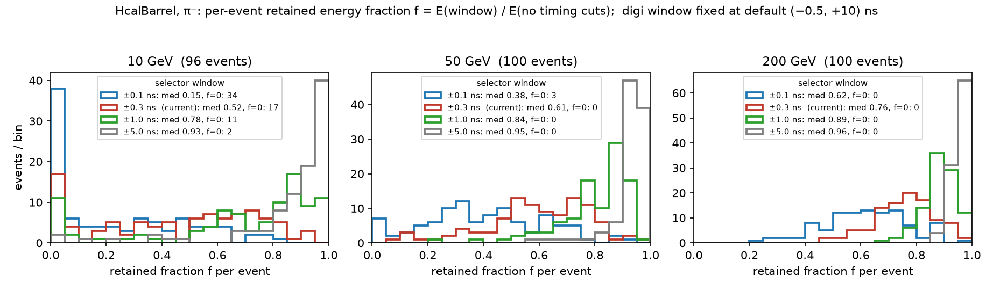
The 10 GeV HCAL spread bump, explained
The 68% band on the previous slide is a percentile of a distribution that is far from Gaussian at low energy — here are the distributions themselves
Cut configuration: HCAL barrel, π⁻; digi window FIXED at default (−0.5, +10) ns; selector windows in the legends. f = per-event E(window) / E(no timing cuts) — the same quantity whose median and 68% band appear on the previous slide.
10 GeV: a distinct population retains f = 0 exactly — 17 events at the current ±0.3 ns, still 9 at ±2 ns: no HCAL cell has an early-enough FIRST deposit (the HCAL piece is small — median ~2 GeV, ~15 cells — late and neutron-dominated). The 16th percentile sits at 0 up to w = 0.3 ns.
Opening the window pulls prompt-rich events to f ≈ 1 while late-dominated events stay near 0: the distribution stretches across [0, 1], so the 68% spread PEAKS (~0.40 at w ≈ 0.4–0.75 ns) where the median crosses mid-range — a p(1−p)-type maximum — then collapses as everything converges to f ≈ 1. The rise-then-fall of the blue curve is expected, not a glitch.
50 / 200 GeV: showers average over many more cells and sub-showers — a single peak that narrows and moves right, no f = 0 spike, monotonic spread. At 10 GeV and ±0.3 ns the HCAL flips between seeing the shower and seeing nothing, event by event — not a smeared measurement.
MAIA calorimeter timing-cut study · 15

Slide 16
Suggested timing cuts (no-BIB baseline)
ECAL selector (−0.3, +2.0) ns photons stay exactly lossless; hadronic-ECAL non-linearity 15% → 1.6%. Compromise under BIB pressure: +1.0 ns. EM-only use case: +0.5 ns suffices.
HCAL selector (−0.3, +5.0) ns response flattens (non-linearity 2.8%, 93–96% retained). Floor: +2.0 ns (8.7%). The current ±0.3 ns should not be used for hadronic calorimetry unless BIB demands it.
digi windows ECAL 2–3 ns · HCAL ~25 ns secondary knobs: ECAL can tighten for free (BIB in the integration tail); HCAL loosening recovers 1–2%, relevant once the selector is at +5 ns.
Early edges stay at −0.3 ns everywhere — they remove nothing from signal at any energy, for either particle type.
Any selector retune shifts the hadronic energy scale by 10–25%: Pandora's hadronic calibration and software-compensation weights must be re-derived alongside.
Caveats: no BIB (the other side of the trade-off), θ = 90° barrel only, 100 events/point.
Next steps: repeat with BIB overlay to plot signal-retained vs BIB-admitted per window on the same axes; θ scan for the endcaps; upstream reports for the two code findings.
code, plots and full write-up: timing_studies/ on branch claude/maia-timing-cuts-study-wbtv1n (PLAN.md)

