Slide 1
nyc0819
File created on: 3/11/21 12:04:51 PM PST

Slide 2
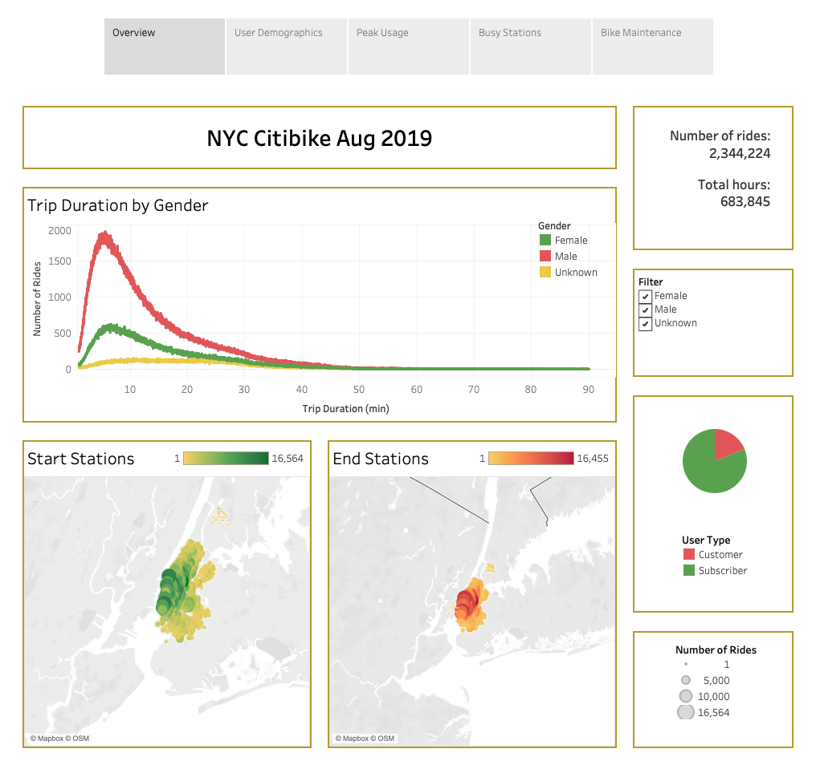

Slide 3
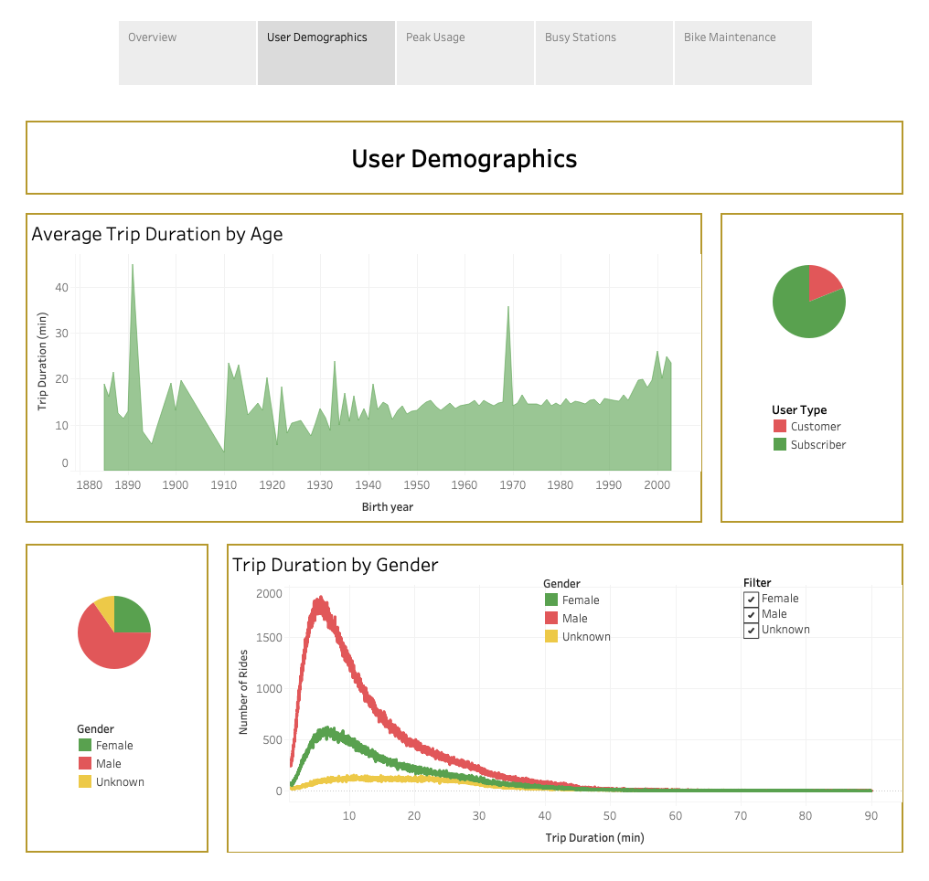

Slide 4
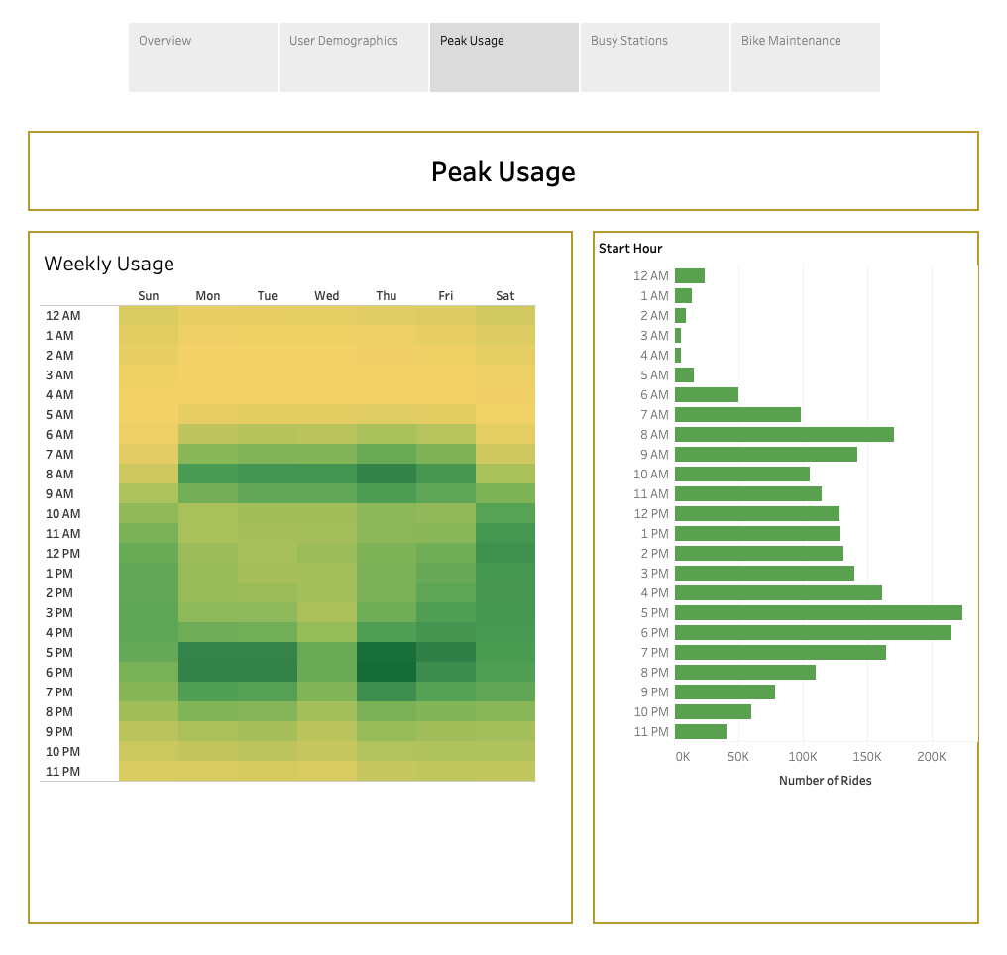

Slide 5
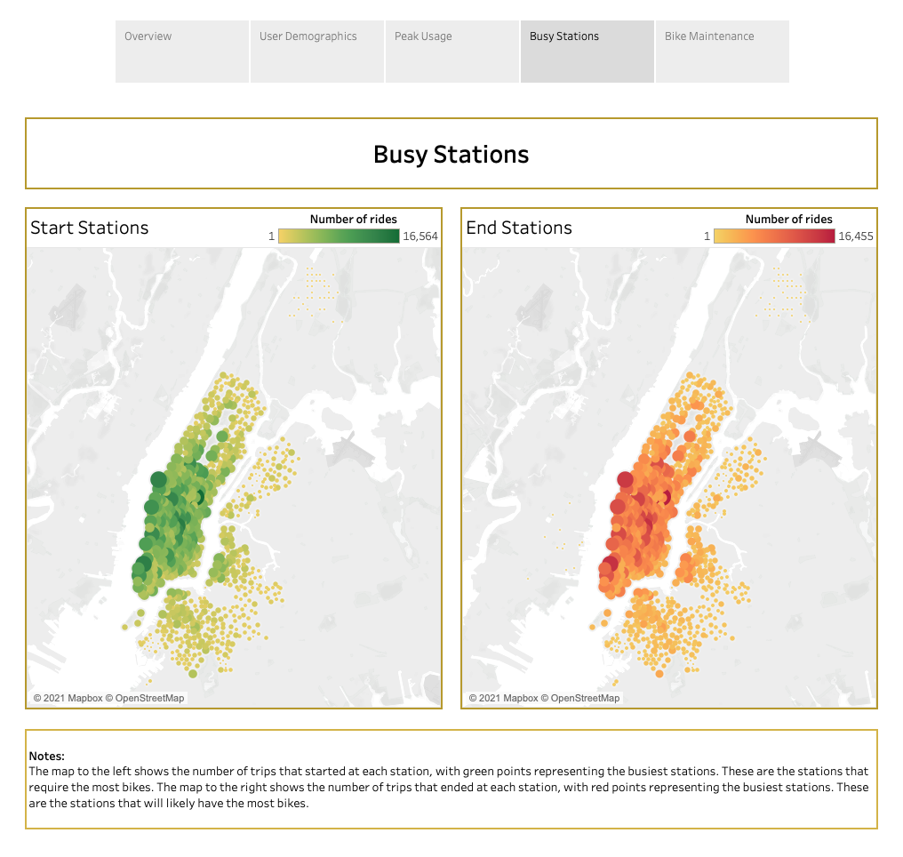

Slide 6
