Slide 1
PAIRWISE Alignment
GS. TS. Lê Sỹ Vinh
(some contents are from internet)

Slide 2
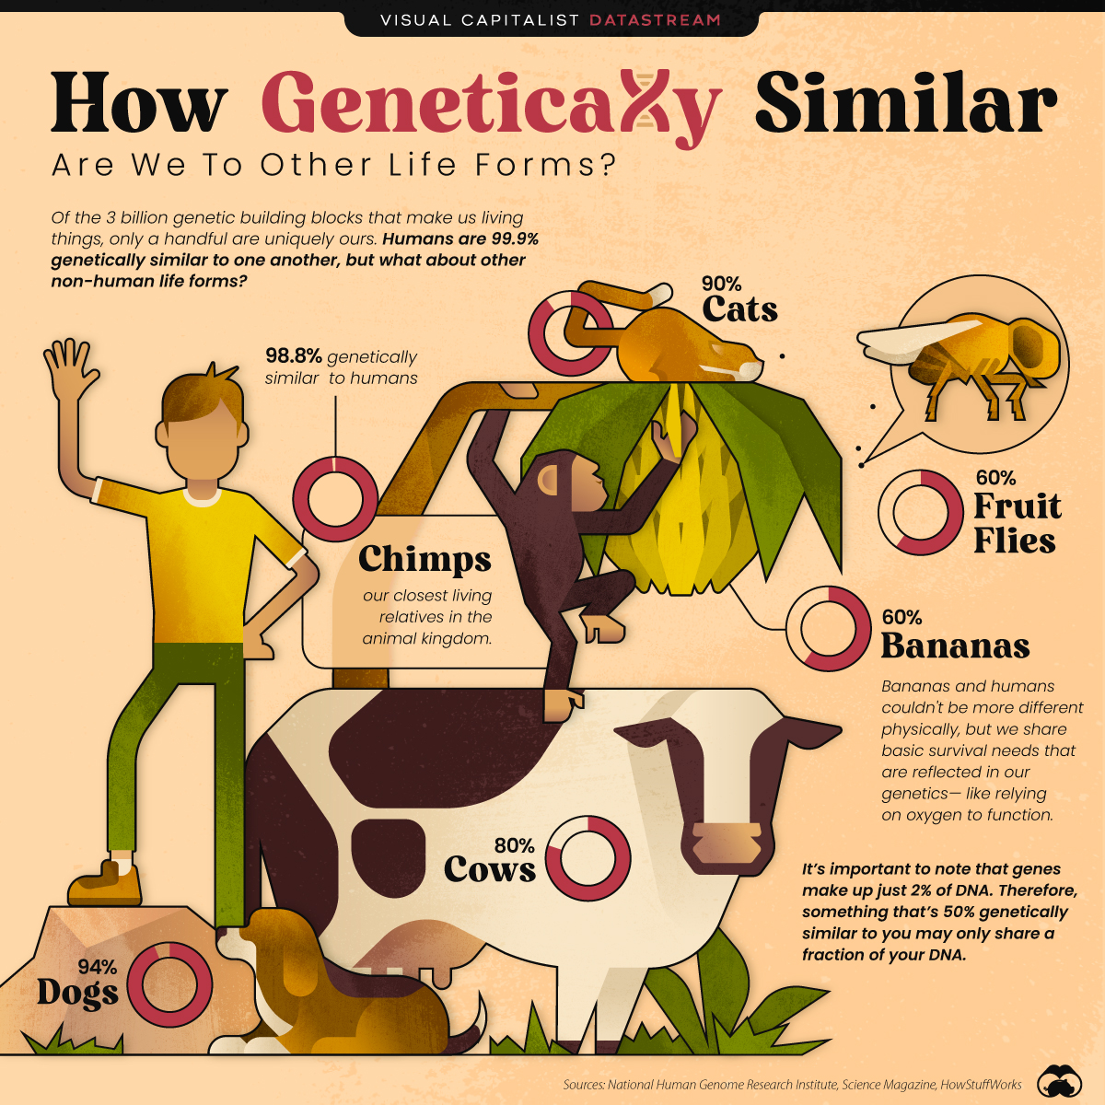
GENOME DIFFERENCE

Slide 3
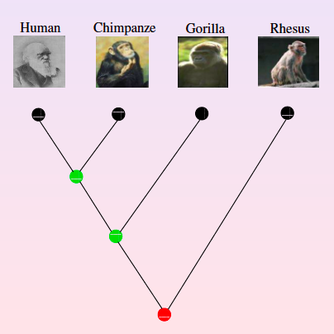
Evolution

Slide 4
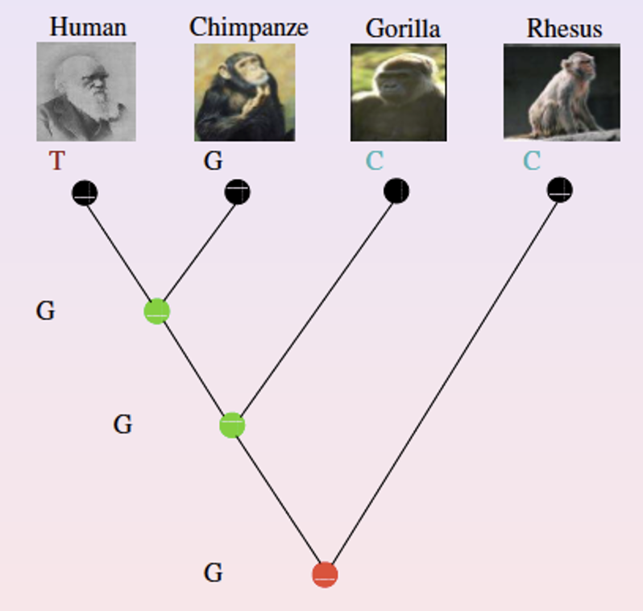
Evolution

Slide 5
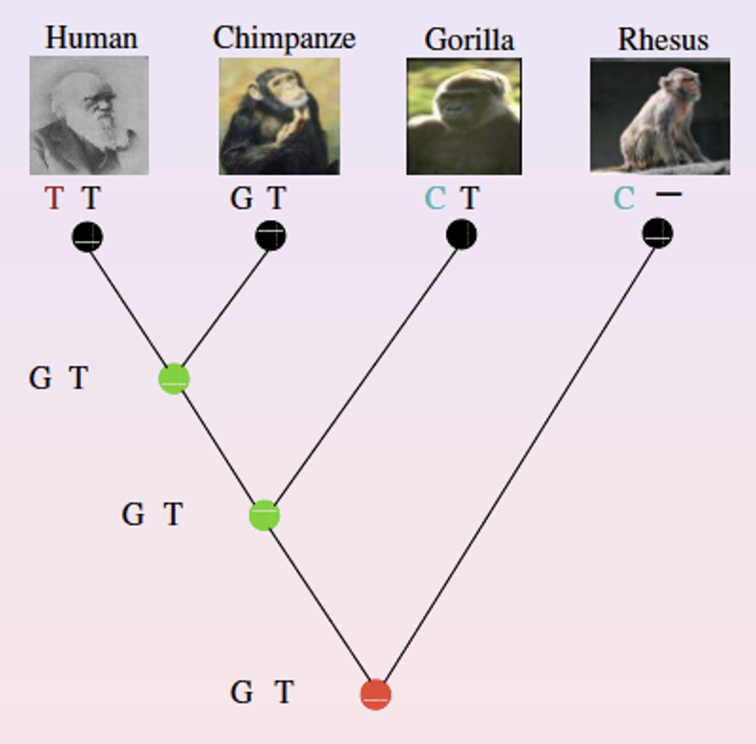
Evolution

Slide 6
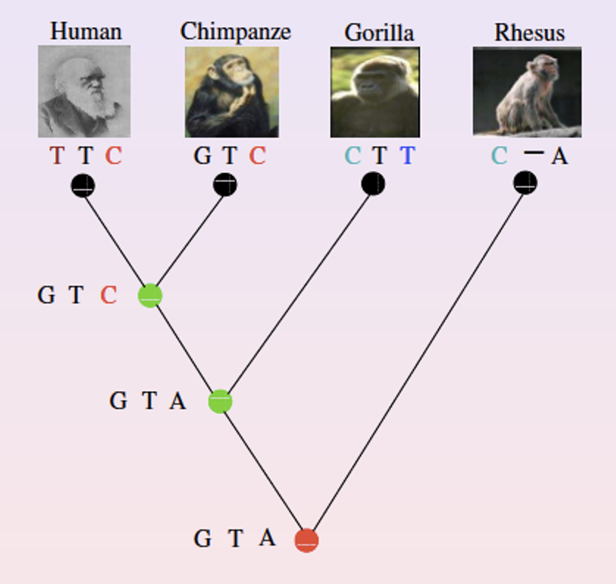
Evolution

Slide 7
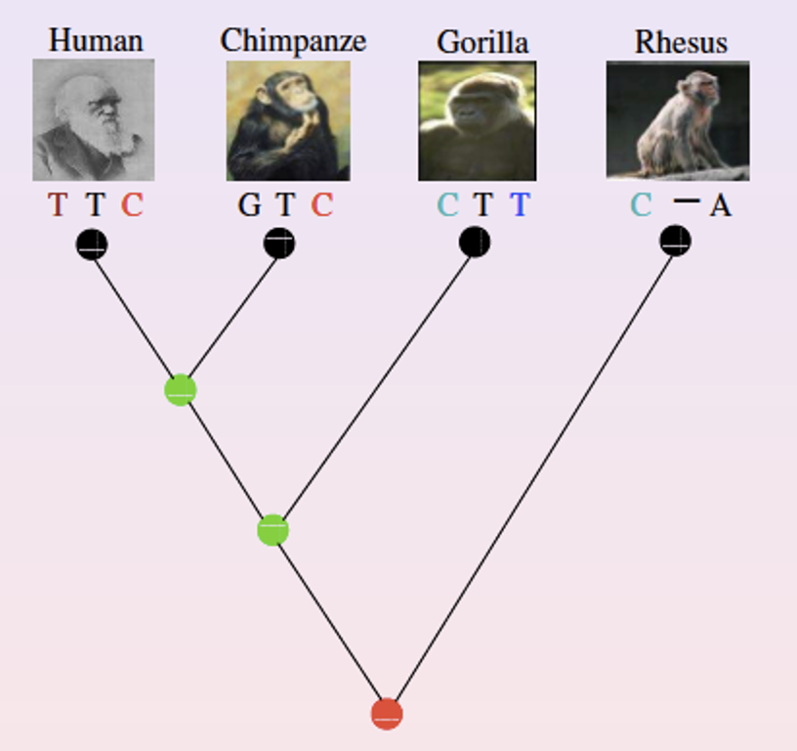
Evolution
Two sequences evolved from the same ancestor/origin are called ‘homology’
Two homologous sequences might be different in both length and content

Slide 8
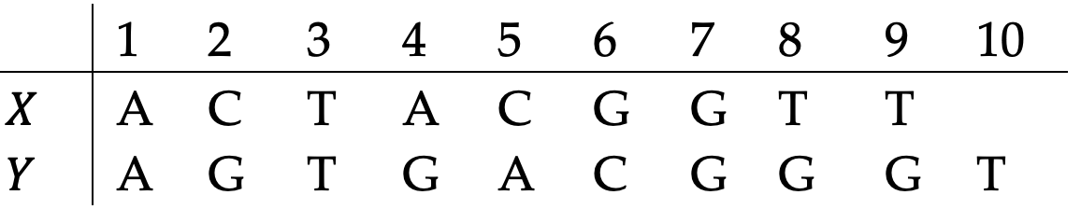
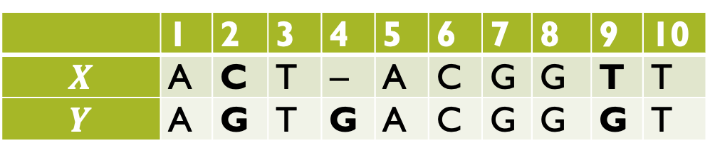
Pairwise alignment
Given two homologous nucleotide sequences X and Y, align nucleotides in the two sequences such that two nucleotides at the same position came from the same ancestor.
 | 1 | 2 | 3 | 4 | 5 | 6 | 7 | 8 | 9 | 10
$$X$$ | A | C | T | − | A | C | G | G | T | T
$$Y$$ | A | G | T | G | A | C | G | G | G | T

Slide 9
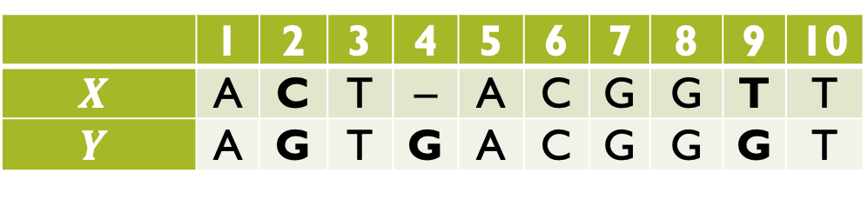
Pairwise alignment
 | 1 | 2 | 3 | 4 | 5 | 6 | 7 | 8 | 9 | 10
$$X$$ | A | C | T | − | A | C | G | G | T | T
$$Y$$ | A | G | T | G | A | C | G | G | G | T
Insert gap character ‘-’into both sequences such that two aligned sequences are mostly similar
Define a matching score system such as
  1: If two nucleotides at the same position are identical
  -1: Otherwise

Slide 10

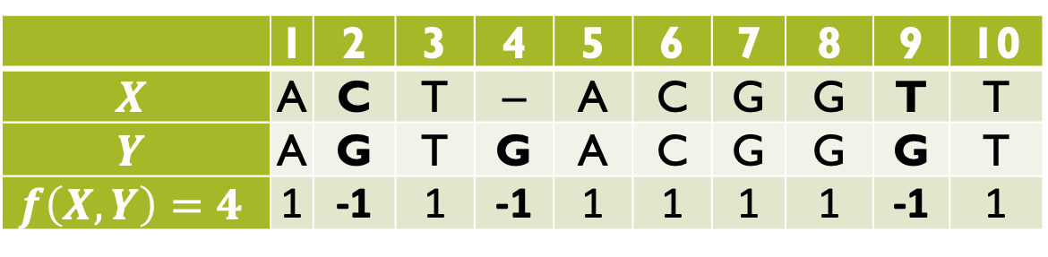
Pairwise alignment: Score
The score of aligned sequences (pairwise alignment score)
$$f(X,Y)=\sum_{i=1}^{k}{C(x_{i}, y_{i})}$$
where $C\left(x_{i}, y_{i}\right)$ is the score between nucleotides $x_{i}$ and $y_{i}$
 | 1 | 2 | 3 | 4 | 5 | 6 | 7 | 8 | 9 | 10
$$X$$ | A | C | T | − | A | C | G | G | T | T
$$Y$$ | A | G | T | G | A | C | G | G | G | T
$$f\left(X, Y\right)=4$$ | 1 | -1 | 1 | -1 | 1 | 1 | 1 | 1 | -1 | 1

Slide 11
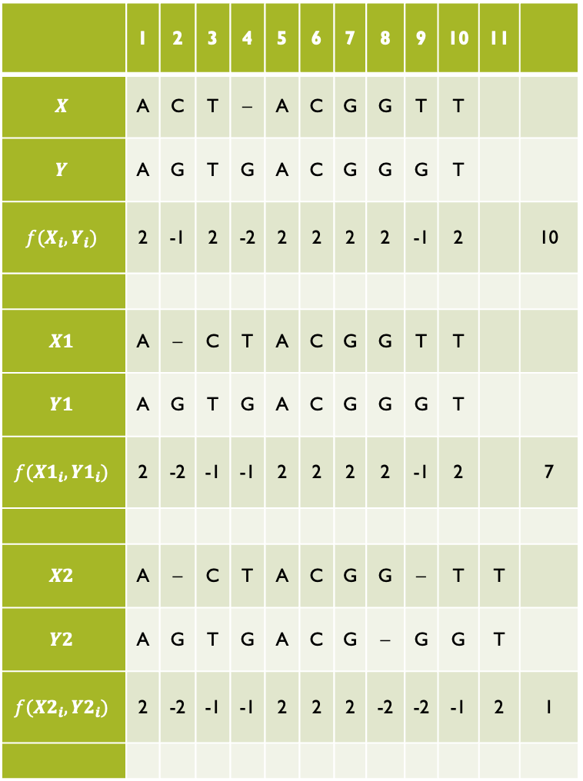
 | 1 | 2 | 3 | 4 | 5 | 6 | 7 | 8 | 9 | 10 | 11
$$X$$ | A | C | T | − | A | C | G | G | T | T
$$Y$$ | A | G | T | G | A | C | G | G | G | T
$$f(X_{i}, Y_{i})$$ | 2 | -1 | 2 | -2 | 2 | 2 | 2 | 2 | -1 | 2 |  | 10
$$X1$$ | A | − | C | T | A | C | G | G | T | T
$$Y1$$ | A | G | T | G | A | C | G | G | G | T
$$f(X1_{i}, Y1_{i})$$ | 2 | -2 | -1 | -1 | 2 | 2 | 2 | 2 | -1 | 2 |  | 7
$$X2$$ | A | − | C | T | A | C | G | G | − | T | T
$$Y2$$ | A | G | T | G | A | C | G | − | G | G | T
$$f(X2_{i}, Y2_{i})$$ | 2 | -2 | -1 | -1 | 2 | 2 | 2 | -2 | -2 | -1 | 2 | 1
Pairwise alignments
 | A | C | G | T | −
A | 2 | -1 | -1 | -1 | -2
C | -1 | 2 | -1 | -1 | -2
G | -1 | -1 | 2 | -1 | -2
T | -1 | -1 | -1 | 2 | -2
− | -2 | -2 | -2 | -2 | 0
Score matrix

Slide 12
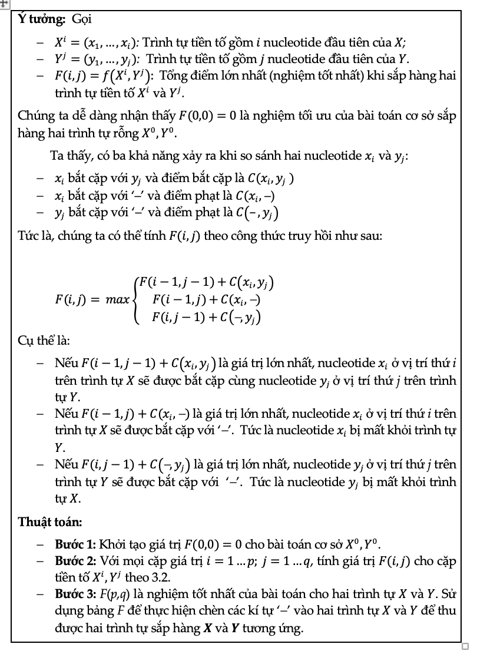
Needlean and Wunsch Algorithm
Complexity: ?

Slide 13
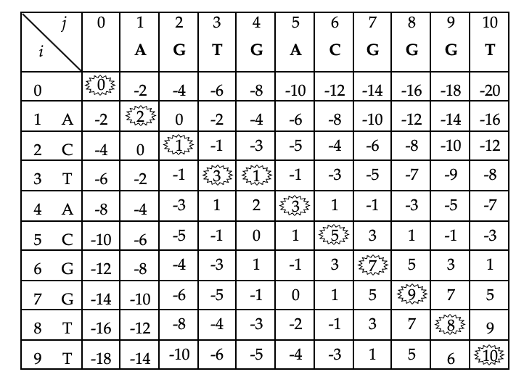

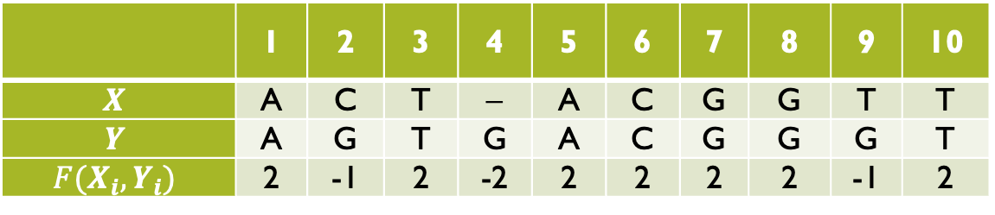
Needlean and Wunsch Algorithm
The $F(i,j)$ table of
$X =′ACTACGGTT′$ and $Y =′AGTGACGGGT′$
 | 1 | 2 | 3 | 4 | 5 | 6 | 7 | 8 | 9 | 10
$$X$$ | A | C | T | − | A | C | G | G | T | T
$$Y$$ | A | G | T | G | A | C | G | G | G | T
$$F(X_{i},Y_{i})$$ | 2 | -1 | 2 | -2 | 2 | 2 | 2 | 2 | -1 | 2

Slide 14


Exercise 1: Fill in the table F and align below sequences
$X1$ = GGTGGACG
$Y$1 = GGGTGGACGA
 | A | C | G | T | −
A | 2 | -1 | -1 | -1 | -2
C | -1 | 2 | -1 | -1 | -2
G | -1 | -1 | 2 | -1 | -2
T | -1 | -1 | -1 | 2 | -2
− | -2 | -2 | -2 | -2 | 0
$X2$ = GGTGGACGT
$Y2$ = TGTGGTCGA
score matrix

Slide 15
Gap penalty models
Constant (linear) gap model: The same cost for all gaps
X1 = ACTAGTGTGATGGTT
Y1 = A-T-G-GT--T----
Affine gap model: The cost of openning gap is much larger than the cost of extension gap
X2 = ACTAGTGATGGTG
Y2 = -------ATGGTT
Why:
More biologically meaning: In biological sequences (DNA, RNA, proteins), insertion/deletion events tend to occur in blocks rather than at single positions. The affine model better represents this by penalizing long gaps less severely than multiple short gaps.
Better alignment quality: Encourages biologically meaningful alignments by avoiding excessive fragmentation.

Slide 16
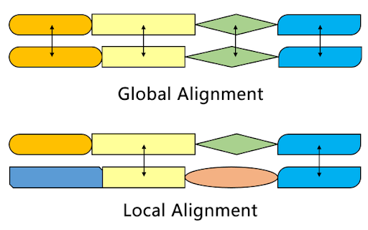
Local pairwise alignment

Slide 17
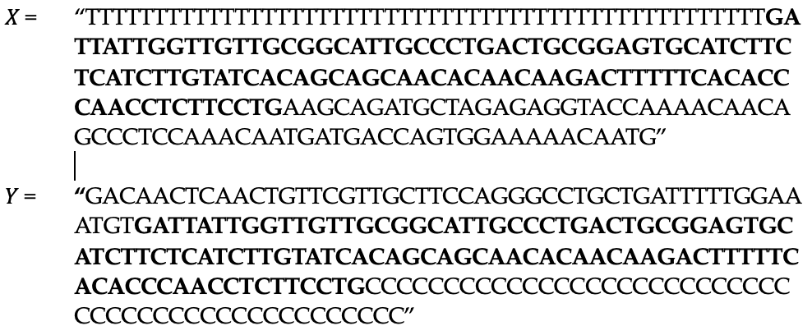

Local pairwise alignment
Problem: X and Y are only similar at some part (e.g., conserved biologically meaningful regions, functional regions,…)
Solution: Find sub-sequences $X\left(i,j\right) in X and Y\left(k,t\right) in Y$ with the highest score

Slide 18
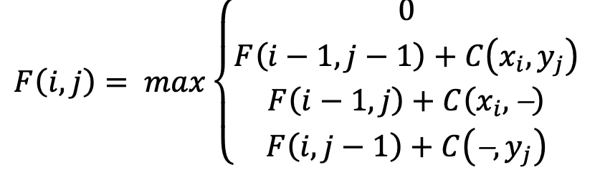
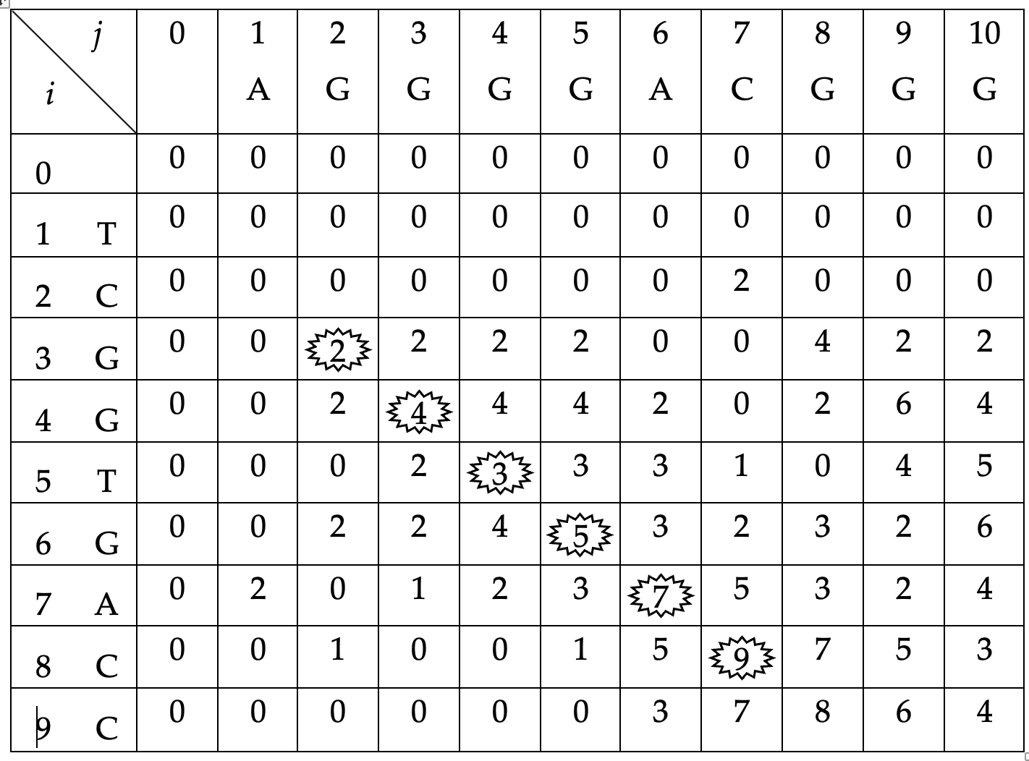

Local pairwise alignment algorithm
Exercise: Fill in the table F of two sequences
$X=′TCGGTGACC′$ and
$Y=‘\text{AGGGGACGGG}$’

Slide 19
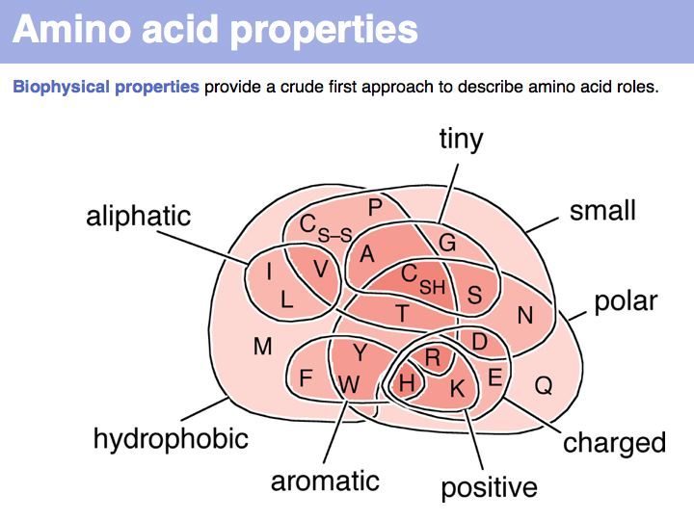
Protein pairwise alignment: score matrix

Slide 20
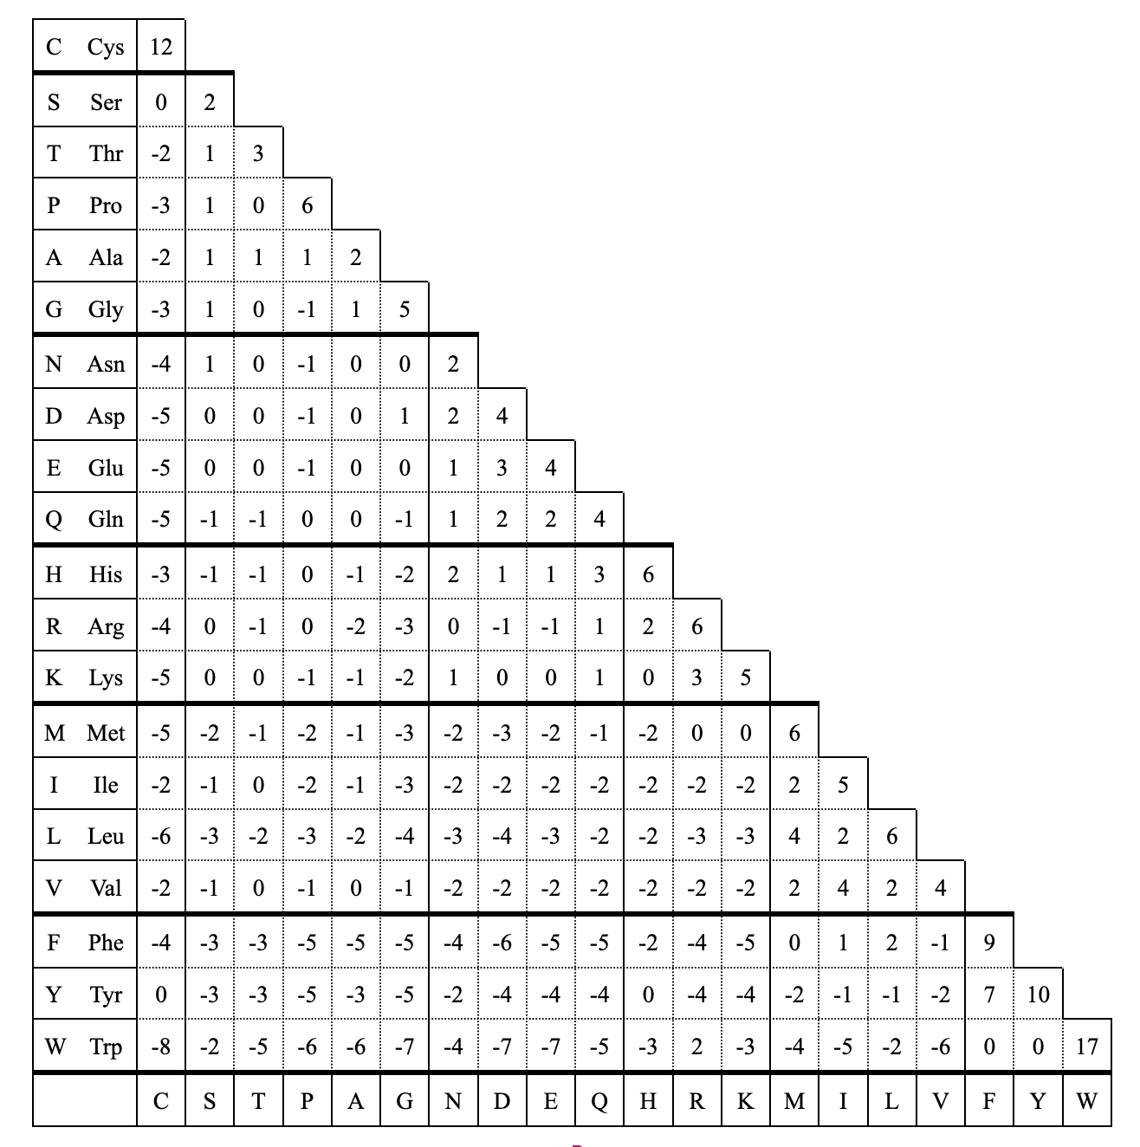
Amino acid score matrix: PAM-250

Slide 21
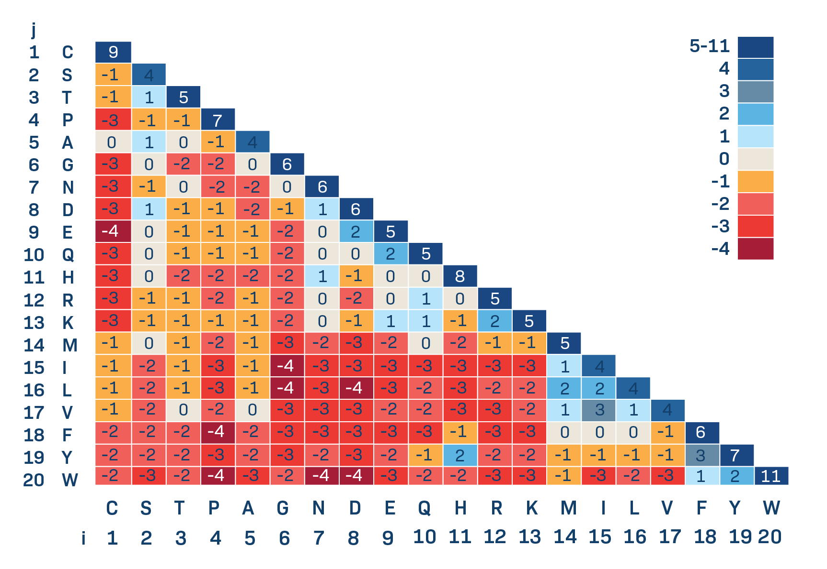
Amino acid score matrix: BLOSUM 62

Slide 22

Exercise: Align below protein sequences with score matrix
  PAM-250
  BLOSUM 62
X1 = ‘TWYYYYTACAA’
Y1 = ‘WYYGTAAAAA’
$X2$ = ‘RNADCQEGH’
$Y$2 = ‘RRNDCQEGHH’

Slide 23
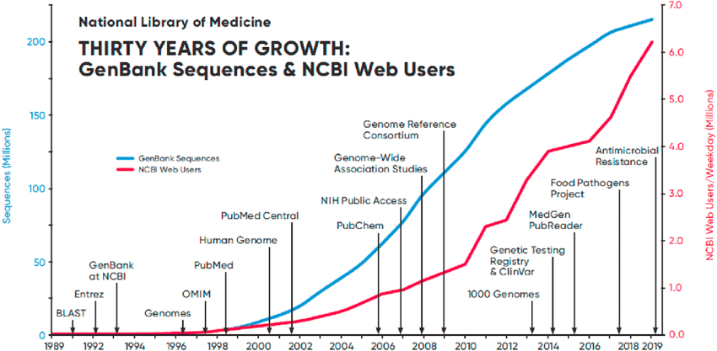
Sequence similarity searching
Given a sequence X, finding regions of similarity between X and sequences in a database. The goal is to identify matches that indicate biological relationships, functional similarities, or evolutionary connections.

Slide 24
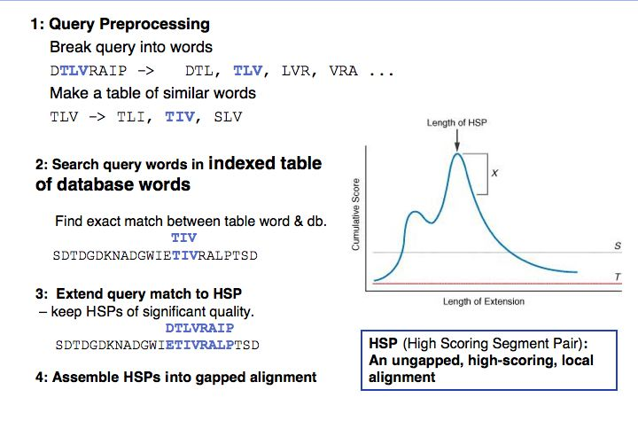
Basic local alignment search tool

Slide 25
Blast with nucleotide sequence
Search the human gene with accession number: M26868
Perform Blast search with the obtained sequence
What is the e-value in the results from Blast search?

Slide 26
Blast with protein sequence
Search the protein sequence with GI:1293615
Perform Blast search using the score matrix:
  PAM-250
  BLOSUM 62
Compare the two obtained results

Slide 27
Implementation
1. Given two nucleotide sequences in the file ‘input.fasta’, implement a program to align the two sequences with the following score system:
  Match: 1
  Mismatch: -1
  Insertion/deletion (indel): -2
2. Using the above score score system with affine gap cost model, i.e., openning gap=-5 and extension gap=-0.5

