Slide 1
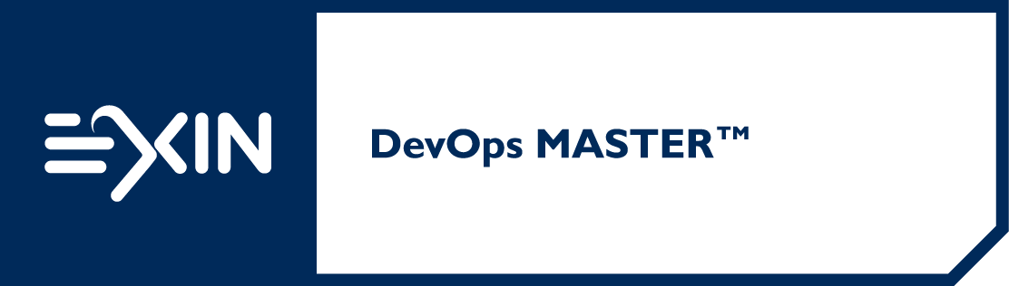
Basic Training Material for the EXIN DevOps Master™ Certificate

Slide 2
Version 201711
Copyright © 2017 EXIN Holding B.V. All rights reserved.
No part of this publication may be published, reproduced, copied or stored in a data processing system or circulated in any form by print, photo print, microfilm or any other means without written permission by EXIN.
EXIN® is a registered trademark
DevOps Master™ is a registered trademark
TMap® and TPI NEXT® are registered trademarks of Sogeti Nederland B.V.
Lean IT Foundation® is a registered trademark of the Lean IT Association.

Slide 3
Welcome to the Basic Training Material (BTM)
These slides contain basic presentation material to prepare students for the EXIN DevOps Master™ examination. They may be used as a basis for an accredited training.
The BTM refers to all exam specifications and basic concepts of this module.
Some trainer notes are included.
A good training requires examples of practical experience, deepening of exam specifications and basic concepts, exercises, elaborating subjects of special interest to the audience.
In case of a minimal training duration candidates are expected to study the literature (compare training duration with study load in Preparation Guide)
The order in which the subjects are presented, follow the order of the exam specifications.
This BTM is not a complete set of courseware. In order to become accredited you will need to enhance and enrich this material. This basis contains max 50% of the presentation material.
When using this Basic Training Material, your organization will still need to go through the normal accreditation procedure at EXIN. You can find the accreditation requirements in the Accreditation Manual.

Slide 4
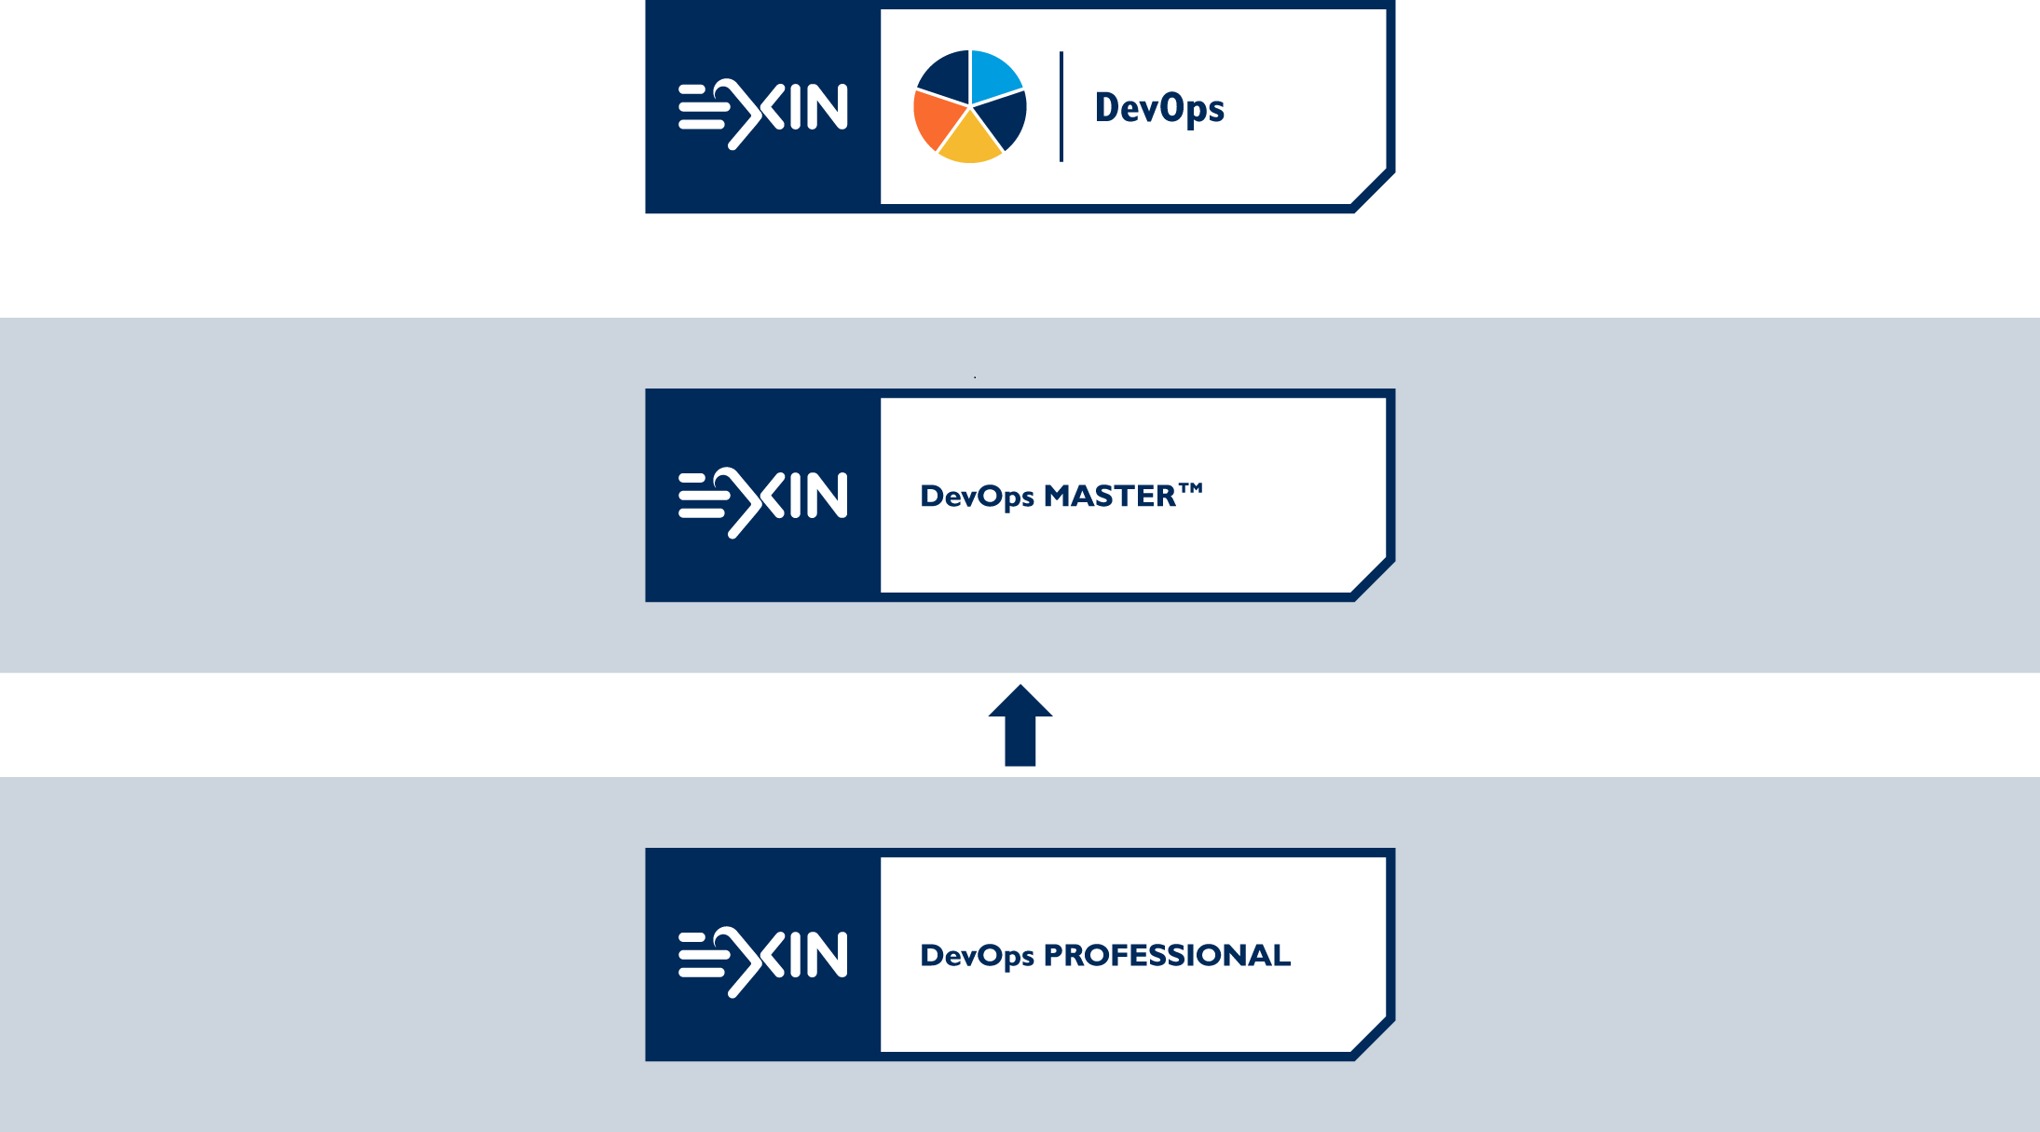

Slide 5
Agenda
Introduction
DevOps adoption
Planning, requirements and design
Development and deployment
Operation and scaling
End-of-life

Slide 6
Course Objectives and Target Audience
The EXIN DevOps Master™ certification tests the candidate’s mastering of DevOps principles and skills. An EXIN DevOps Master™ is able to help facilitate an organization’s transition to DevOps and grow the business in a way that brings the most value to a customer
The exam EXIN DevOps Master™ is meant for anyone working within DevOps or looking to transition to DevOps including:
Application or Service Product Owners
Agile Scrum Masters
Project Managers
Test Managers
IT Service Managers
Process Managers
Lean IT Practitioners

Slide 7
Pre-requisites
Training is a mandatory part of the certification. Because the training is relatively short and will focus on the practical assignments, the candidates are expected to have basic knowledge of DevOps principles. This knowledge can be acquired:
through the EXIN DevOps Professional exam;
or by reading The Phoenix Project (see literature list)
Because this certification is on an advanced level some knowledge of or experience in the domains where DevOps is applied is highly recommended:
EXIN Agile Scrum Foundation knowledge
TPI Next® or TPI Suite® certification
EXIN IT Service Management Foundation knowledge
LITA Lean IT Foundation®
EXIN Application Management Foundation

Slide 8
Basic Concepts
The list of concepts in the student notes below will be considered understood for the exam
The student is advised to research the concepts
Notes:
A/B testing
Acceptance Tests
Affinity (in DevOps)
Agile
Anti-Pattern
Application Deployment
Artifact Management
Architectural Trade-off Analysis Method (ATAM)
Automated testing
Automation
Binary files
Blamelessness
Blue-Green deployment
Build (Management)
Build-time
Canary Releasing
Capacity testing
Change Management
Check-in
Cloud Computing
Collaboration (in DevOps)
Commit (stage)
Communication styles
Compact
Component (tests)
Configuration Management
Containers
Continuous Delivery
Continuous Deployment
Continuous Integration
Cycle time (in Lean)
Definition of Done (in Agile Scrum)
Dependency
(Deployment) Pipeline
Development Team
DevOps engineer
Disciplined Agile
Distributed Team
Effective DevOps
Event (Management)
Exploratory testing
Flow
Forensic (tools)
Functional Acceptance Tests
Gatekeeper
Happy path
Human error
Incident management
Information radiators
Infrastructure Automation
Infrastructure management (team, tools)
Integration tests
INVEST
Iteration
ITSM (IT Service Management)
Ji-Kotei-Kanketsu (JKK)
Just-in-Time (JiT)
Kaizen (in Lean)
Lean time (in Lean)
Lean
Libraries
Light-weight ITSM
Manual testing
Minimum Viable Product
Monitoring strategy
Negotiation styles
Non-functional testing
Obeya (大部屋)
Orchestration
One-piece-flow
Operations Team
Organizational Learning
Plan-Do-Check-Act cycle (PDCA cycle)
Process Master
(Product) Backlog
Product Owner (in Agile Scrum)
Project charter (project management)
Pull system
Quality Assurance (QA)
Regression testing
Release coordinator
Reliability Engineer
Retrospective
Rhythm (in Lean)
Root Cause Analysis
Run time
Sad path
Scaling (of DevOps or Agile Scrum)
Scrum
Scrum Master (in Agile Scrum)
Service Continuity
Service Level Agreement (SLA)
Service Master (Scrum: product owner)
Silos
Sprint
System of Engagement (SoE)
System of Record (SoR)
System testing
Test-Driven Development (TDD)
Tools
Toyota Production System (TPS)
Unit testing
Usability testing
User Acceptance Testing (UAT)
User Story
Velocity (in Agile Scrum)
(Vendor) lock-in
Version Control
Virtualization
Waste (in Lean)
Waterfall
Work-in-Progress (WiP)

Slide 9
Exam Format
Requirements for certification
Accredited training DevOps Master, including successful completion of the Practical Assignments
Successful completion of the EXIN DevOps Master™ exam
Exam details
120 minutes
Computer-based or paper-based multiple-choice questions
Number of questions: 50
Pass mark: 65%
Open book/notes/ Electronic equipment/aides permitted : No
Notes:
Contact hours
The minimum number of contact hours for this training course is 24. This includes group assignments, exam preparation and short breaks. This number of hours does not include homework, the logistics related to the exam session, the exam session and lunch breaks.

Slide 10
Exam Literature
A Effective DevOps: Building a Culture of Collaboration, Affinity, and Tooling at Scale
Jennifer Davis, Katherine Daniels
ISBN-13: 978-1491926307 or ISBN-10: 1491926309
O'Reilly Media; 1 edition (June 25, 2016)
B Continuous Delivery: Reliable Software Releases through Build, Test, and Deployment Automation
Jez Humble, David Farley
ISBN-13: 978-0321601919 or ISBN-10: 0321601912
Addison-Wesley Professional; 1 edition (August 6, 2010)
C Success to Enterprise DevOps
Koichiro (Luke) Toda, President Strategic Staff Services Corporation and Director of TPS Certificate Institution
Nobuyuki Mitsui, CTO of Strategic Staff Services Corporation
White Paper; June 2016 (download from EXIN website DevOps certification page)
The literature references are given in the notes for slides at x.y..z level.
Notes:
Additional literature
The Phoenix Project is strongly recommended reading before the training.
D The Phoenix Project
Gene Kim, Kevin Behr, George Spafford
ISBN-10: 0988262576
ISBN-13: 978-0988262577
IT Revolution Press (January 10, 2013)
E Other sources:
http://newrelic.com/devops
http://devops.com/

Slide 11
1. DevOps adoption

Slide 12
1.1 DevOps Mindset and Benefits
The word DevOps is a contraction of ‘Development’ and ‘Operations’
DevOps is a set of best practices that emphasizes the collaboration and communication of IT-professionals (developers, operators, supporters) in the lifecycle of applications and services
It stresses co-operation throughout the organization and automation of delivery and infrastructure changes, leading to Continuous Integration, Continuous Deployment and Continuous Delivery
Notes:
DevOps aims at establishing a culture and environment where building, testing, and releasing software and services can happen rapidly, frequently, and with minimal support, in order to continuously grow business advantage and customer satisfaction.
The main elements of DevOps are:
Implementing a blame-free, diverse culture, in which it becomes easy to fail fast and often
Providing applications and services for the business Just-in-Time (JiT) by streamlining Continuous Delivery (Agile) and assuring frequent feedback loops
Ensuring continuity of IT services by a risk based approach of business needs
Managing the lifecycle of applications and services, including end-of-life conditions.

Slide 13
1.1.1 Analyze DevOps anti-patterns in a scenario
Pre-Devops Development Team
Design
Build
Test
Pre-Devops Operations Team
Set up release
Deploy
Devops Team
Design, Build, Test
Deploy
Set up Release
Feedback
Slow, Manual, Multi-teams not working together, Prone to error
Fast, Automated, Single team, Higher success rate
Notes:
Literature A: Chapter 5, B: Chapter 1, C: Chapter 2
Here are a few common antipatterns that prevent a reliable release process, but nevertheless are so common as to be the norm in our industry.
Example Antipattern: Deploying Software Manually
Other anti-patterns:
- blame culture
- silos
- Root cause analysis – focus on one root cause rather than many contributing factors
- Human error – human error is always within the context, not blaming an individual

Slide 14
1.1.2 Explain the benefits of DevOps
Companies using DevOps are outperforming those who are not
Shift focus from what to why – question, innovate, collaborate
Repeatable, reliable, and predictable
Faster reaction to business need
Higher return on investment in software
DevOps principles can also be applied to the business
Notes:
Literature B: Chapter 1, C: Chapter 4
A sustainable, successful business is more than the development and operations teams. Limiting our thinking to just those teams who write software or deploy it into production does the entire business a disservice.
The 2015 State of DevOps Report, published by Puppet, found that companies that are doing devops are outperforming those that are not. That an emphasis on having teams and individuals work together effectively is better for business than silos full of engineers who do not exactly play well with others. High-performing DevOps organizations deploy code more frequently, have fewer failures, recover from those failures faster, and have happier employees. Trend of focusing on outcomes rather than people and processes.
Focusing on the culture and processes encourages iteration and improvement in how and why we do things. When we shift our focus from what to why, we are given the freedom and trust to establish meaningfulness and purpose for our work, which is a key element of job satisfaction.
The introduction of DevOps has changed our industry by focusing on people and processes across roles to encourage collaboration and cooperation, rather than competing with specialization.
As we said, our goal as software professionals is to deliver useful, working software to users as quickly as possible. Speed is essential because there is an opportunity cost associated with not delivering software. You can only start to get a return on your investment once your software is released.
DevOps is not just support IT. DevOpd scan also be used to support the business strategy and to improve business processes.

Slide 15
1.1.3 Explain why DevOps fits the current software development process so well
Software does not exist separately from users and developers
Software development methods focus primarily on development with little linkage to deployment and operations
Devops is about adapting and innovating social structure, culture, and technology together in order to work more effectively
Notes:
Literature: A: Chapter 3, B: Chapter 1, C : Chapter 4
Software we create does not exist separately from the people who use it and the people who create it. DevOps is about finding ways to adapt and innovate social structure, culture, and technology together in order to work more effectively.
There are many software development methodologies, but they focus primarily on requirement management and its impact on the development effort. There are many excellent books that cover in detail different approaches to software design, development, and testing; but these, too, cover only a fragment of the value stream that delivers value to the people and organizations that sponsor our efforts.
What happens once requirements are identified, solutions designed, developed, and tested? How are these activities joined together and coordinated to make the process as efficient and reliable as we can make it? How do we enable developers, testers, build and operations personnel to work together effectively?
DevOps describes an effective pattern for getting software from development to release. We describe techniques and best practices that help to implement this pattern and show how this approach interfaces with other aspects of software delivery.
The pattern that is central is the deployment pipeline. A deployment pipeline is, in essence, an automated implementation of your application’s build, deploy, test, and release process. Every organization will have differences in the implementation of their deployment pipelines, depending on their value

Slide 16
1.1.4 Explain why DevOps needs a specific mindset to work
Old View
New view (DevOps)
Blame culture
Holistic systems/methods
Value individuals
Eliminate human error
Sharing stories, feedback
Silos
Notes:
Literature: A: Chapter 1, 2, 4, C: Chapter 4
DevOps is a cultural movement that changes how individuals think about their work, values the diversity of work done, supports intentional processes that accelerate the rate by which businesses realize value, and measures the effect of social and technical change. It is a way of thinking and a way of working that enables individuals and organizations to develop and maintain sustainable work practices. It is a cultural framework for sharing stories and developing empathy, enabling people and teams to practice their crafts in effective and lasting ways. One of the fundamentals of our approach is the need for fast feedback.
DevOps is not a single tools, methodology, skill sets or organization structure. DevOps is a framework combining all of these for organizations to establish stream-lined processes to enable the business to operate faster and react to changes more quickly.
DevOps can also enable maturity by using W.E. Deming’s Plan-Do-Check-Act cycle. The PDCA Cycle (Plan-Do-Check-Act) is a systematic process for gaining valuable learning and knowledge for the continual improvement of a product, process, or service. Also known as the Deming Wheel, or Deming Cycle, this integrated learning - improvement model was first introduced to Dr. Deming by his mentor, Walter Shewhart of the famous Bell Laboratories in New York.
In Lean, Kaizen plays a central role. "Kaizen (改善) is the Japanese word for "continuous improvement "; continuous improvement means circulate PDCA cycle by daily, by weekly. Find a root cause by asking "Why" 5 times. Problems defined by Data. Does everybody recognize the problems clearly? Set hypothesis by found problems, then think counter measure actions for verifying your hypothesis. Counter measure actions must be defined daily base activities and also set KPI by weekly because people can feel a sense of accomplishment."
The first environment views “human error as the cause of trouble.” This “old view” is described as a mindset in which the focus is on elimination of human error. Mistakes are made by “bad apples” who need to be thrown out. This view is found in blameful cultures, as it assumes that errors are often caused by malice or incompetence. Individuals responsible for failure must be blamed and shamed (or simply fired). The second environment views “human error as a symptom of trouble deeper in the system.” This “new view” is a mindset that sees human errors as structural rather than personal. People make choices and take the actions based on their context and what makes most sense to them, not intentional malice or incompetence. Organizations should consider systems holistically when looking to minimize or respond to issues. Understanding and embracing the “new view” is key to understanding the DevOps movement. This view encourages us to share stories, as everything is a learning opportunity.

Slide 17
1.1.5 Explain how DevOps fits with Lean and Agile Scrum practices
DevOps
Agile
Lean
Continual improvement
Responsive to changing needs
Shorter release cycles
Elimination of unnecessary activities
Collaboration
Notes:
Literature: B: Chapter 15, C: Chapter 1, 4
Enterprise DevOps is not only an enhancement of Agile development and continuous delivery but also IT service management and application management to enable growth of the business and to maintain business continuity.
Frequent delivery of usable code, moving toward smaller, more frequent deployments rather than large, infrequent ones;
Reflective improvement, or using reflections on what worked well and what worked poorly in previous work to help guide future work; and Osmotic communication between developers—the idea that if developers are in the same room, information will drift through the background to be picked up informally, as by osmosis.
XP was Agile development that was designed to be more responsive to changing requirements than previous development software methodologies, known for short release cycles, extensive testing, and pair programming
We, and our fellow practitioners, have discovered that in order to achieve these goals—low cycle time and high quality—we need to make frequent, automated releases of our software.

Slide 18


1.2 Organizational Culture

Slide 19
1.2.1 Explain why the 4 Pillars of Effective DevOps are so important
Collaboration
targeting a specific outcome through supporting interactions and the input of multiple people
Affinity
shared organizational goals, empathy and learning between different groups of people
Tools
an accelerator and cost saver but must fit with working methods
Scaling
how DevOps can be applied in different organizations as they grow, mature, and even shrink
Notes:
Literature: A: Chapter 6, 7
The combination of these four pillars will enable you to address both the cultural and technical aspects of your organization. It makes sense for your organization to focus on one or two pillars at a time while trying to make changes, but ultimately it is the combination of all four working together that will enable lasting, effective change.
It is important not to gloss over the first two pillars, which cover the norms and values of our cultures and interpersonal interactions, in favour of skipping straight to reading about tools. Effective tool usage is necessary for a successful DevOps transformation, but not sufficient—if that were the case, we could just provide a list of best practices for Chef or Docker and be done. However, resolving the interpersonal and interteam conflicts that arise within organizations is critical to fostering the lasting relationships that ultimately make a DevOps environment.

Slide 20
1.2.2 Analyze a scenario for missing parts of the DevOps mindset
Fixed mindsets – talents and abilities are innate
Growth mindsets - talents and abilities are learned and improved with practice
Look for:
learning from mistakes, do not blame
positive, frequent, constructive feedback
communication, listening
Notes:
Literature: A: Chapter 7. (For Organizational Learning see literature A: Chapter 4)
Mindsets are our personal beliefs about ourselves, and how we approach our possibilities. With a fixed mindset, people believe talents
and abilities are innate, fixed traits—either they are naturally good at something or they aren’t, and that state is immutable. In a growth mindset, talents and abilities are learned and improved with effort and practice. Mindsets can greatly impact how people work, approach challenges, and deal with failure.

Slide 21
1.2.3 Explain how to create a team from a group of people, through fostering collaboration, a DevOps mindset, and empathy and trust
Achieving objectives
Collabo-ration
DevOps Mindset
Empathy
Trust
Notes:
Literature: A: Chapter 7, 9
Social capital, or the value of people’s social networks and interactions, works through greater information flow, reciprocity and helpfulness, and interdependency and trust.
Compare this to a team that is focused around a superstar employee, where help and information are likely to flow only in one direction, there is no interdependency, and there is likely very little trust.
Social capital takes time to develop, and its benefits become increasingly apparent as time progresses. To get the productive teams and organizations we want, we need to stop focusing on “superstar” employees that erode trust and social capital, and instead focus on growing empathy among our existing teams, and working toward cooperation rather than competition.
For a team to best work toward its goals, its members must be able to work together. Teams with more collaboration are more productive as a whole, as well as being viewed more favourably by their members—and because lower turnover is usually better for team morale and productivity, this is a positively reinforcing cycle.
Collaboration 1
single individual responsible
co-ordination of others
Collaboration 2
Two or more working together
Working continuously towards objective
Both are valid methods appropriate for different scenarios.

Slide 22
1.2.4 Analyze a situation where there is a misconception regarding collaboration and identify the correct troubleshooting method
Problem: Some people on the team are not pulling their weight
Clarify roles and responsibilities
Measure competencies and allow for learning
Watch for reasons – burnout, personal issues etc
Problem: Some people are not communicating enough
Try to assess underlying factors
Ensure trust, lead by example
Notes:
Literature: A: Chapter 7, 8, 9, 16
It is important to recognize the value and purpose of different forms of collaboration. Some collaborative work is done in coordination with others, with a single individual responsible for some piece of the collective work and focused on accomplishing her part toward the mutual goal. Other collaborative work is done continuously, with two or more individuals working together to accomplish an objective. These collaborative approaches are the right choice depending on the work and surrounding context.
Problems arise in collaborating effectively when people have differences in professional and individual backgrounds that create friction if not handled. Being able to help people identify, shape, and actively work toward their different motivations and goals is a big part of being able to lead people, either in an official capacity as a manager or in any individual contributor-level leadership position. Many misconceptions around collaboration ultimately have to do with concerns about how much people are willing or able to learn and grow within their roles or in the organization in general. New skills require time and practice for everyone. Do not assume that anyone older than you, different from you, or with a different background from yours is incapable of learning.
DevOps roles (see Literature C: Chapter 5)
DevOps Engineer; has a mission to improve and maintain automated process. The engineer will examine the whole automated process and tools.
Gatekeeper (AKA Release Coordinator); Responsible for monitoring the operational status and progress of the next release of the IT service. Make go/no go decisions about deployment according to criteria including security, compliance, regulatory requirements, maturity of operation team and their process views.
Process Master; Leads the team leads and facilitates, this role is the same as “Scrum Master” in Scrum. Implements visual control across the entire process and has a strong focus one stablishing stream-lined process with one-piece flow.
Release Coordinator; Responsible for monitoring the operational status and progress of the next release of the IT service. Make go/no go decisions about deployment according to criteria including security, compliance, regulatory requirements, maturity of operation team and their process views.
Service Master (Scrum: product owner); Has all the responsibility for providing IT services Just In Time (JIT). This role is like the “Product Owner” in Scrum, which is managing and prioritizing product backlogs and the new additional responsibility of cost planning for the IT service.
Infrastructure management team. Almost all medium and large companies separate the activities of development and infrastructure management (or operations as it is often known) into different groups or silos. It is often the case that these two groups of stakeholders have an uneasy relationship. This is because development teams are incentivized to deliver software as rapidly as possible, whereas operations teams aim for stability.
Just In Time (JIT)
Just-in-time (JIT) manufacturing, also known as Just-in-Time production or the Toyota Production System (TPS), is a methodology aimed primarily at reducing flow times within production system as well as response times from suppliers and to customers.
Communication and learning
Communication styles
Negotiation styles
Organizational Learning (see Literature A: Chapter 4)

Slide 23
1.2.5 Analyze a situation where there is a need for conflict management and identify the best solution
Think values over culture
Share stories and experiences
What kinds of problems are we trying to solve?
Are we solving the right problems?
Does our team have the necessary knowledge and experience to acknowledge the problem and to understand the repercussions that their potential solutions might have?
Notes:
Literature: A: Chapter 7, 14
Each of us has a different cultural background with unique experiences that inform our choices of how and why we work. Respecting our individual differences can help build mutual understanding and resolve conflict in a way that is crucial to the DevOps compact. There are great benefits to be gained from diverse teams in terms of creativity, problem solving, and productivity, but this differentiation can lead to short-term interpersonal conflicts, either personally or professionally.

Slide 24
1.2.6 Explain how human resource management can foster diversity and which benefits this brings to the organization
Recruit a mix of individuals
Gender, sexuality, religion, race, colour, age, ability, education level, experience
Ensure working conditions and methods adapt to the diversity
Increases different view points and ability to challenge, question, innovate, feedback
Notes:
Literature: A: Chapter 7
Increasing the diversity of a team means ensuring a wider range of personal backgrounds. Including aspects such as gender, sexuality, race, class, primary language, ability, and education level. Diverse personal backgrounds can increase the strength of an engineering, product-focused, or customer-support-driven organization by bringing a greater number of experiences and points of view to the table. A diverse workforce benefits teams, organizations, and the industry as a whole.
An HR department that understands diversity-related concerns is a critical part of the organization in helping prevent friction between individuals due to these kind of personal differences. Individual contributors and managers should be able and encouraged to take unconscious bias training to help explore the assumptions that are impacting and influencing their work interactions.
Studies have shown that more diverse teams will often see more conflict in the short term, these effects are balanced out not only by the fact that the creativity and problem-solving benefits in the long term outweigh these costs, but also by the fact that team members will learn collaborate and work well with a wider variety of people.

Slide 25
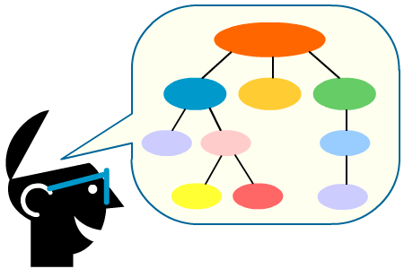
1.3 Principles and Concepts

Slide 26
1.3.1 Explain the use and usefulness of different software development methodologies (Waterfall, Agile, Scrum) and their basic principles
Waterfall
Project management process
Time spent early in lifecycle to cut down on later mistakes
Agile
More lightweight and flexible than previous methods such as Waterfall
Focus on individuals, interactions, and collaboration
Scrum (an Agile method)
Focuses on maximizing a development team’s ability to quickly respond to changes in requirements
Stories, Sprints, Daily scrum meetings, Scrum Master, definition of done
Sequential progression from one stage to the next
Get working software out quickly in short iterations
Notes:
Literature: A: Chapter 4, B: Chapter 1, C: Chapter 5
DevOps is not so rigidly defined as to prohibit any particular methodology. While DevOps arose from practitioners who were advocating for Agile system administration and cooperation between development and operations teams, the details of its practice are unique per environment. A key part of devops is being able to assess and evaluate different tools and processes to find the most effective ones for your environment.
Waterfall - The original stages were requirements specification, design, implementation, integration, testing, installation, and maintenance, and progress was visualized as flowing from one stage to another (hence the name).
Agile values:
individuals and interactions over processes and tools
working software over comprehensive documentation
customer collaboration over contract negotiation
responding to change over following a plan
DevOps adopts and extends Agile principles and applies them to the entire organization, not only the development process. DevOps has cultural implications beyond Agile and a focus that is broader than speed of delivery.

Slide 27
1.3.2 Explain the use and usefulness of different operations methodologies (IT Service Management)
ITSM supports ongoing availability and maintenance of services to ensure the delivery of value and desired service outcomes
Processes such as:
Incident, Event, Configuration and Problem Management
Availability and IT Service Continuity Management
Service Level and Supplier Management
Continual Service Improvement
Most widely used methodology is ITIL covering service strategy, service design, service transition, service operation, and continual service improvement
Notes:
Literature: C: Chapter 3, 4
(fitness for purpose) of a service. If service continuity cannot be maintained and/or restored in accordance with the requirements of the business, then the business will not experience the value that has been promised. Without continuity the utility (fitness for purpose) of the service cannot be accessed.
It is necessary to think about how to reduce management workload. It is necessary to realign ITSM for DevOps, creating light-weight ITSM which is strictly focused on business continuity with a set of minimum required information (MRI). The MRI set for each organization depends on their business.
Incident Management is the process of taking action to rapidly restore interruptions in service due to incidents. Incidents may include, password resets, printer failure, or an error message. (For more information, including Incident Management benefits, roles and responsibilities, process flow, KPIs, and implementation best practices.
Problem Management works to pinpoint and prevent the recurrence problems and incidents. (For more in depth coverage of Problem Management
Availability Management entails making sure that services are always available to the customer.
IT Service Continuity Management involves risk management and ensuring business continuity.
Service Level Management involves planning for and defining organizational service delivery targets, and then measuring performance against those targets. Service level agreements (SLAs) are often used to spell out service level goals for easy measurement and comparisons against actual service performance.
Supplier Management monitors all supplier relationships, including whether parties are adhering to contracts and agreements.
ITIL Continual Service Improvement (CSI) focuses on finding opportunities for service growth and enhancement.

Slide 28
1.3.3 Explain the use and usefulness of the Lean systems methodology
Lean
the maximization of customer value and minimization of waste
Waste in the context of Lean is the opposite of value
Five principles of Lean Thinking:
Value
Value stream
Flow
Push vs. Pull
Perfection
Minimum Viable Product (MVP) and Lean startup
Notes:
Literature: A: Chapter 4
These ideas, especially the pursuit of perfection through systemic identification and elimination of waste, drove the definition of Lean as the maximization of customer value and minimization of waste.
Lean systems focus on the parts of the system that add value by eliminating waste everywhere else, whether that be overproduction of some parts, defective products that have to be rebuilt, or time spent waiting on some other part of the system. Stemming from this are the concepts of Lean IT and Lean software development, which apply these same concepts to software engineering and IT operations.
Waste to be eliminated in these areas can include:
• Unnecessary software features
• Communication delays
• Slow application response times
• Overbearing bureaucratic processes
Minimum viable product (MVP)
A minimum viable product is a product with just enough features to satisfy early customers, and to provide feedback for future product development.
Purposes:
Enables testing of a product hypothesis with minimal resources
Accelerates learning
Reduces wasted engineering hours
Gets the product to early customers as soon as possible
Forms the base for other products
Establishes a builder's abilities in crafting the product required
Allows testing of customer pull
Lean startup
Lean startup is a methodology for developing businesses and products, which aims to shorten product development cycles by adopting a combination of business-hypothesis-driven experimentation, iterative product releases, and validated learning.
Related terminology: continuous deployment (in software development), split testing (aka A/B testing), lean canvas.
Push vs. Pull; Push is when deployment and infrastructure changes are pushed from a central place to the servers, and Pull is when each server queries a central place for deployment and infrastructure changes, and apply the changes locally. Rather than push changes out to clients, each individual client machine needs to be responsible for polling the server at boot, and periodically afterwards, to maintain its own revision level. The more established configuration management (CM) systems use a pull-based approach: clients poll a centralized master periodically for updates.

Slide 29
2. Planning, requirements and design

Slide 30
2.1 Application or Service Lifecycle Management
Lifecycle Management
Focus on the development of the application
Service
Lifecycle Management
Focus on preparing for service delivery during the application development
Application Operation and Maintenance is a cycle of the application lifecycle that delivers the service
Service delivery has its own lifecycle – strategy, design, transition, operation, improvement
Application

Slide 31
2.1.1 Explain how DevOps adds value to modern Application Lifecycle Management
The vision, goal and value of the project are agreed at the start
A value stream map of the whole process is designed
Use an automated process for the acceptance test, performance test and deployment
Consider taking DevOps methods into the business processes so that they can become equally effective and efficient
Notes:
Literature: C: Chapter 1

Slide 32
2.1.2 Explain why DevOps improves customer experience when used for Service Lifecycle Management
Realign ITSM for DevOps, creating light-weight ITSM which is strictly focused on business continuity with a set of minimum required information
The service master and reliability engineer are responsible for collecting customer’s feedback to increase value for them e.g. such as operational problems, user experience and quality issues. If approved, these items are added to the product backlog as requests for change
Notes:
Literature: C: Chapter 4

Slide 33

2.2 Project Charter and Visual Control
Notes:
Project Charter
Why a project should not start without a project charter?
One of the most critical and important documents for every project is the project charter. It is the first document for a project and lays down the foundation for the project. A project charter is a document which explains about the project at a very high level and highlights the stakeholders and the approach towards the project. It introduces the project manager to the project. A project charter is owned by the project sponsor. Project sponsor authorizes the project charter but it can be created by the project manager. Every project charter should be approved by the project stakeholders. Once the project charter is approved, it cannot be changed throughout the project life cycle.
A useful project charter contains three key elements:
1. Vision: The vision defines the “Why” of the project. This is the higher purpose, or the reason for the project’s existence. 2. Mission: This is the “What” of the project and it states what will be done in the project to achieve its higher purpose. 3. Success Criteria: The success criteria are management tests that describe effects outside of the solution itself. (source: simplilearn.com & infoq.com)

Slide 34
2.2.1 Explain how a DevOps project’s scope should be determined
Service master’s (or other similar) role in defining scope:
attends business planning to understand business goals and recommend how to use IT services to achieve goals
creates the vison, goal, and value of the project, and then puts together the DevOps team members
identifies customers of IT services, gathers requirements with business value and agrees a time frame

Slide 35
2.2.2 Explain why Visual Control over a DevOps projects facilitates DevOps practices
Managers, administrators, sales staff, designers, developers, operators, and customer support staff are one team and share all the business information on visual boards
Visual control means “Does everybody easily understand the situation by just looking at the boards without explanations?”
Enables fast view of progress and identification of issues
Notes:
Literature: B: Chapter 5, C: Chapter 7
Tools:
An information radiator, also known as a Big Visible Chart (BVC), is a large graphical representation of project information kept plainly in sight within an agile development team’s shared workspace.
Kanban (看板) (literally signboard or billboard in Japanese) is a scheduling system for lean manufacturing and Just-in-Time manufacturing (JIT). Kanban is an inventory-control system to control the supply chain. Kanban is an integral part of a pull-system. (see 1.3.3)

Slide 36

2.3 Infrastructure and Architecture Design

Slide 37
2.3.1 Explain how DevOps changes or influences the design of IT infrastructure and architecture
Application development and infrastructure management teams collaborate on all aspects of environment management and deployment from the beginning of the project
Use agile techniques for managing infrastructure e.g. automated provisioning and autonomic maintenance
Test on a production like environment to catch problems early
Service continuity planning
Change management for the infrastructure
Notes:
Literature: B: Chapter 11
DevOps goal is that all testing environments (including continuous integration environments) should be production-like, particularly in the way they are managed. An environment is all of the resources that your application needs to work and their configuration. The following attributes describe the environment:
• The hardware configuration of the servers that form the environment (such as the number and type of CPUs, amount of memory, spindles, NICs, and so on) and the networking infrastructure that connects them
• The configuration of the operating system and middleware (such as messaging systems, application and web servers, database servers) required to support the applications that will run within it
The general term infrastructure represents all environments in your organization, along with the services that support them, such as DNS servers, firewalls, routers, version control repositories, storage, monitoring applications, mail servers, and so on. Indeed, the boundary between an application’s environment and the rest of your organization’s infrastructure can vary from very clearly defined (in the case of embedded software, for example) to extremely fuzzy (in the case of service-oriented architectures, in which much infrastructure is shared and relied upon by applications). This combination of automated provisioning and autonomic maintenance ensures that infrastructure can be rebuilt in a predictable amount of time in the event of failure.

Slide 38
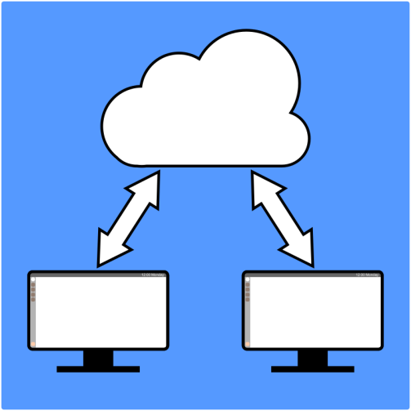
2.3.2 Explain why Cloud computing and virtualization techniques make integrating Dev and Ops easier
Virtualization
fast provisioning of environments
reduce time to deploy software
easier to offer ‘as a service’ infrastructure
standardizing hardware
Cloud computing
fast access, easily scalable
deploy to a completely standardized stack - no need to worry about configuring or maintaining testing, staging, or production environments, or virtual machine images
Notes:
Literature: B: Chapter 11
In general, virtualization is a technique that adds a layer of abstraction on top of one or more computer resources. However, here we are mostly concerned with platform virtualization. Platform virtualization means simulating an entire computer system so as to run multiple instances of operating systems simultaneously on a single physical machine. In this configuration, there is a virtual machine monitor (VMM), or hypervisor, which has full control of the physical machine’s hardware resources. Guest operating systems run on virtual machines, which are managed by the VMM. Environment
virtualization involves simulating one or more virtual machines as well as the network connections between them. Virtualization was originally developed by IBM in the 1960s as an alternative to creating a multitasking time-sharing operating system. The main application for virtualization technology is server consolidation. Indeed there was a period when IBM avoided recommending its VM family to its customers, since it would result in lower hardware sales. However, there are many other applications of this powerful technology. It can be used in a wide range of situations, such as simulating historical computer systems on modern hardware (a common practice in the retro-games community), or as a mechanism to support disaster recovery, or as part of a configuration management system to support software deployment.
The defining characteristic of cloud computing is that the computing resources you use, such as CPU, memory, storage, and so on, can expand and contract to meet your need, and you pay only for what you use. Cloud computing can refer to both the software services themselves, and the hardware and software environments that they run on.

Slide 39

2.4 Service Level Requirements and Agreements

Slide 40

2.4.1 Explain how DevOps changes Service Level Requirements and Agreements
Stories are used to collect, define and prioritize the service level requirements and service level agreements
Notes:
Literature: B: Chapter 12, C: Chapter 4

Slide 41

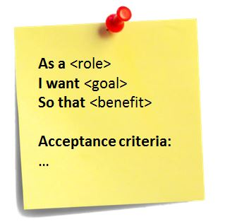
2.5 Implementing a Testing Strategy: User Stories
Notes:
See: Scrum Guide

Slide 42
2.5.1 Explain why and how the Testing Strategy needs to be changed when transitioning to DevOps
Automated and Manual testing
Automated e.g. unit, component, system, deployment, acceptance
Manual e.g. showcasing, usability, exploratory
Functional and non-functional testing
Integration testing, Regression testing, Acceptance testing
Testing is continuous from start of project
Testing is also triggered with changes to application, environment or configuration
Notes:
Literature: B: Chapter 4
Automated testing
Unit test;
Usability test; Usability testing is done to discover how easy it is for users to accomplish their goals with your software.
Functional Test; testing of the end-to-end system to validate (new) functionality. With executable specifications, Functional Testing is carried out by running the specifications against the application.
Manual testing
Showcasing (test); A particularly important form of business-facing, project-critique tests are showcases. Agile teams perform showcases to users at the end of every iteration to demonstrate the new functionality that they have delivered. Functionality should also be demonstrated to customers as often as possible during development, so as to ensure that any misunderstandings or specification problems are caught as early as possible.
Usability test; Usability testing is done to discover how easy it is for users to accomplish their goals with your software.
Exploratory test; Exploratory testing is described by James Bach as a form of manual testing in which “the tester actively controls the design of the tests as those tests are performed and uses information gained while testing to design new and better tests.”
(system) Integration test; is the phase in software testing in which individual software modules are combined and tested as a group. System tests are run against a production-like environment.
Regression test; a type of testing used to verify that software still performs the same way after it was changed or interfaced with other software.
Acceptance tests that concern the functionality of the system are known as functional acceptance tests
Testing is a cross-functional activity that involves the whole team, and should be done continuously from the beginning of the project. Building quality in means writing automated tests at multiple
levels (unit, component, and acceptance) and running them as part of the deployment pipeline, which is triggered every time a change is made to your application, its configuration, or the environment and software stack that it runs on. Manual testing is also an essential part of building quality in: Showcases, usability testing, and exploratory testing need to be done continuously throughout the project.
Building quality in also means constantly working to improve your automated testing strategy. In our ideal project, testers collaborate with developers and users to write automated tests from the start of the project. These tests are written before developers start work on the features that they test. Together, these tests form an executable specification of the behaviour of the system, and when they pass, they demonstrate that the functionality required by the customer has been implemented completely and correctly. The automated test suite is run by the CI system every time a change is made to the application—which means the suite also serves as a set of regression tests.
Acceptance tests are critical in an agile environment because they answer the questions, “How do I know when I am done?” for developers and “Did I get what I wanted?” for users.

Slide 43
2.5.2 Analyze and test User Stories
Testing shows when the story has reached the stage of ‘done’ for the developers and ‘Did I get what I wanted?’ for users
User stories - can be tested using the happy path – ‘given x, when y, then z’
Notes:
Literature: B: Chapter 4
User stories need to follow the INVEST principles [ddVMFH] (they should be Independent, Negotiable, Valuable, Estimable, Small, and Testable).
Acceptance tests should be written, and ideally automated, before development starts on a story. Acceptance tests, like acceptance criteria, can test all kinds of attributes of the system being built, including functionality, capacity, usability, security, modifiability, availability, and so on. Acceptance tests are critical in an agile environment because they answer the questions, “How do I know when I am done?” for developers and “Did I get what I wanted?” for users.
In general, for each story or requirement there is a single canonical path through the application in terms of the actions that the user will perform. This is known as the happy path. This is often expressed using the form “Given [a few important characteristics of the state of the system when testing begins], when [the user performs some set of actions], then [a few important characteristics of the new state of the system] will result.” This is sometimes referred to as the “given-when-then” model for tests.
However, any use case will, in all but the simplest of systems, allow for variations in the initial state, the actions to be performed, and the final state of the application. Sometimes, these variations constitute distinct use cases, which are then known as alternate paths. In other cases, they should cause error conditions, resulting in what is called sad paths.

Slide 44
3. Development and deployment

Slide 45
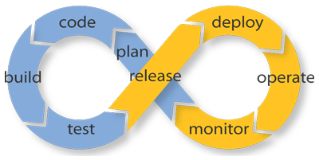
3.1 Continuous Delivery and Continuous Integration
Notes:
There are four basic continuous processes in DevOps:
Continuous Integration
Continuous Delivery
Continuous Testing
Continuous Monitoring

Slide 46
3.1.1 Explain why Continuous Delivery is essential for Effective DevOps
Continuous delivery is the automated implementation of the application build, deploy, test and release processes
Ensures performance (fast delivery) and conformance (to requirements)
Fast delivery enables users to start using the software quickly to realize its value and provide feedback
Maintenance releases enable service delivery to be treated in the same way
Essential to enable continuous integration
Notes:
B: Chapter 13, 15
Continuous delivery, the foundation for DevOps =
TPS (Lean) concept.
Three DevOps pillars: 1. Disciplined Agile 2. Continuous delivery; Continuous delivery is the automated implementation of the application build, deploy, test and release processes. 3. IT Service Management; As technology is a core component of most business processes, continuous or high availability of IT services is critical to the survival of the business as a whole.
Disciplined Agile means: 1. Stabilized Velocity* 2. Adaptability for change 3. Always release high quality bug free code.
*Velocity (Agile scrum)
Team velocity is the rate at which a team delivers stories from the product backlog. If you know your velocity, you'll have an idea about:
How much value you have delivered until now (in story points and done user stories), and
When you will be able to deliver all user stories in the product backlog, and
How many story points will you be able to deliver by a certain date.
(source: scrumalliance.org)
Using these practices, even large organizations with complex applications can deliver new versions of their software rapidly and reliably. That means not only that businesses can get a faster return on their investment, but that they can do so with reduced risks and without incurring the opportunity cost of long development cycles—or worse, delivering software that is not fit for purpose. To use an analogy with lean manufacturing, software that is not being delivered frequently is like inventory stored up in a warehouse. It has cost you money to manufacture, but is not making you any money—indeed, it is costing you money to store it.

Slide 47
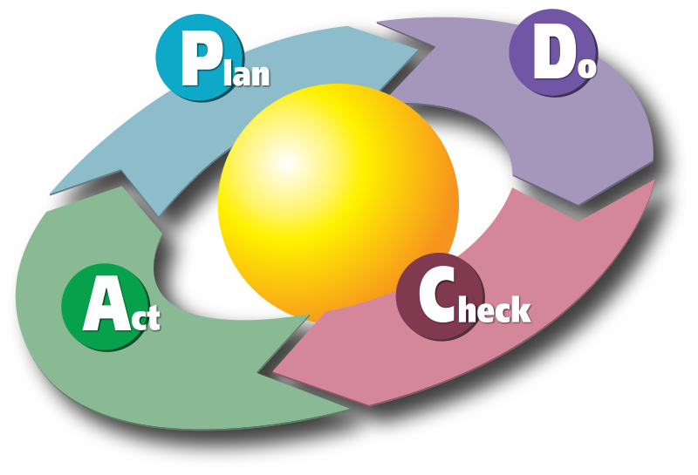
3.1.2 Analyze how to integrate Continuous Delivery in a scenario
Review current situation
Choose area of focus that is immature based on benefits. Agree acceptance criteria
Plan and implement. Consider proof of concept in one small area
Review against criteria
Repeat for other immature areas
Notes:
Literature: B: Chapter 3, 5, 15

Slide 48
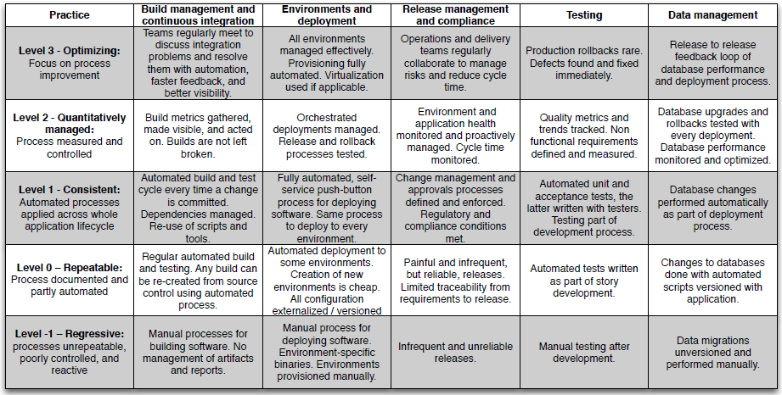
3.1.2 Analyze how to integrate Continuous Delivery in a scenario
Maturity model
practices
levels
Notes:
Literature: B: Chapter 3, 5, 15
Quote: “We believe that this maturity model can act as a guide to help you achieve all of these outcomes. We recommend, as ever, that you apply the Deming cycle—plan,
do, check, act.”
1. Use the model to classify your organization’s configuration and release management maturity. You may find that different parts of your organization achieve different levels in each of the different categories.
2. Choose an area to focus on where your immaturity is especially painful. Value stream mapping will help you identify areas that need improvement. This book will help you understand what each improvement brings to the table and how to implement it. You should decide which improvements make sense for your organization, estimate their costs and benefits, and prioritize. You should define acceptance criteria to specify the results that you expect and how they will be measured, so that you can decide if the changes were successful.
3. Implement the changes. First, create an implementation plan. It will probably make sense to begin with a proof of concept. If so, choose a part of your organization that is really suffering—these people will have the best motivation to implement change, and it is here that you will see the most dramatic change.
4. Once the changes have been made, use the acceptance criteria you created to measure if the changes had the desired effect. Hold a retrospective meeting* of all stakeholders and participants to find out how well the changes were executed and where the potential areas for improvement are.
5. Repeat these steps, building upon your knowledge. Roll out improvements incrementally, and roll them out across your whole organization.
*A retrospective is a discussion of a project that takes place after it has been completed. A retrospective functions as a debriefing. The process may look as follows:
1. Review; project facts: goals, timeline, budget, major events, success factors, metrics.
2. What worked, and what did not?
3. Planning for future improvements
(source: blog.lucidmeetings.com)
Organizational change is hard, and a detailed guide is beyond the scope of this book. The most important advice that we can offer is to implement change incrementally, and measure the impact as you go. If you try and go from level one to level five across your whole organization in one step, you will fail. Changing large organizations can take several years.

Slide 49
3.1.3 Analyze how to solve problems with Continuous Delivery in a scenario
Example problems:
infrequent or buggy deployments
poor application quality
poorly managed continuous integration process
poor configuration management
When a problem occurs
check symptoms
how they could have been spotted earlier
root cause analysis
fix the cause
use risk management as required
Notes:
Literature: B: Chapter 15

Slide 50

3.1.4 Explain why Continuous Integration is essential for Effective DevOps
Build and test entire application at every change
Keep software in a working state
Notes:
Literature: B: Chapter 3
Continuous integration requires that every time somebody commits any change, the entire application is built and a comprehensive set of automated tests is run against it. Crucially, if the build or test process fails, the development team stops whatever they are doing and fixes the problem immediately. The goal of continuous integration is that the software is in a working state all the time. Continuous integration represents a paradigm shift. Without continuous integration, your software is broken until somebody proves it works, usually during a testing or integration stage. With continuous integration, your software is proven to work (assuming a sufficiently comprehensive set of automated tests) with every new change—and you know the moment it breaks and can fix it immediately. The teams that use continuous integration effectively are able to deliver software much faster, and with fewer bugs, than teams that do not. Bugs are caught much earlier in the delivery process when they are cheaper to fix, providing significant cost and time savings. Hence we consider it an essential practice for professional teams.

Slide 51
3.1.5 Analyze how to achieve Continuous Integration in a scenario with a distributed team or a distributed version control system
Tools will support distributed teams
Distributed version control system
Automated build – will combine code from various sources
Automated testing – ensure that the build is not broken; if it is, whoever broke it must fix or revert it so that others can continue working
Automated release and deployment (but test locally before committing code for release)
Electronic communication tools (IM and VoIP) are essential for constant communication
Notes:
Literature: B: Chapter 3

Slide 52
3.1.6 Analyze how to solve problems with Continuous Integration in a scenario
With problems, check that the requirements to ensure continuous integration are in place:
check-in code regularly (ideally twice a day)
create a comprehensive automated test suite
keep the build and test process short
managing your development workspace
Notes:
Literature: B: Chapter 3
Continuous integration is a practice, not a tool. It requires a degree of commitment and discipline from your development team. You need everyone to check in small incremental changes frequently to mainline and agree that the highest priority task on the project is to fix any change that breaks the application. If people do not adopt the discipline necessary for it to work, your attempts at continuous
integration will not lead to the improvement in quality that you hope for.

Slide 53


3.2 Deployment Pipeline

Slide 54
3.2.1 Explain the logic of the anatomy of a DevOps deployment pipeline
Increasing confidence in build’s production readiness
Environments become more production like
User acceptance testing
Commit stage
Complete unit test
Analysis
Build installers
Acceptance test stage
Production
Capacity testing
Faster feedback
Notes:
Literature: B: Chapter 5, 8, C: Chapter 7
Deployment of builds can be to test or live environments. At an abstract level, a deployment pipeline is an automated manifestation of your process for getting software from version control into the hands of your users. Every change to your software goes through a complex process on its way to being released. The commit stage asserts that the system works at the technical level. It compiles, passes a suite of (primarily unit-level) automated tests, and runs code analysis.
• Automated acceptance test stages assert that the system works at the functional and nonfunctional level, that behaviourally it meets the needs of its users and the specifications of the customer.
• Manual test stages assert that the system is usable and fulfils its requirements, detect any defects not caught by automated tests, and verify that it provides value to its users. These stages might typically include exploratory testing environments, integration environments, and UAT (user acceptance testing).
• Release stage delivers the system to users, either as packaged software or by deploying it into a production or staging environment (a staging environment is a testing environment identical to the production environment).
Canary releasing (also known as 'canary process'): Rolling out a system to a small group of users before rolling it out to everybody.
Figure from 5.3 in B, see also figure 5.4

Slide 55
3.2.2 Explain how to use build and deployment scripting
Script – all the automation that supports the build, test, deploy, and release our software
Use the build and deployment process as a guide
then each task in a build or deployment script is simple
End goal - sharing the same deployment mechanism between development, testing and production
Scripts should be version-controlled, maintained, tested, and refactored, and be the only mechanism that you use to deploy your software
Notes:
Literature: B: Chapter 1, 6
We use the term “script” in quite a broad sense. Generally, by this we mean all the automation that helps us build, test, deploy, and release our software. When you approach that broad collection of scripts from the end of the deployment pipeline, it looks dauntingly complex. However, each task in a build or deployment script is simple, and the process itself is not a complex one. A very strong advice is to use the build and deployment process as a guide to your collection of scripts. Grow your automated build and deployment capabilities step by step, working through the deployment pipeline by iteratively identifying and then automating the most painful steps. Keep the end goal in mind all the time—that is, the goal of sharing the same deployment mechanism between development, testing, and production, but do not get too hung up on that thought early in the creation of your tools. Do, however, involve both operations and developers in the creation of these mechanisms. Finally, it bears reiterating that scripts are first-class parts of your system. They should live for its entire life. They should be version-controlled, maintained, tested, and refactored, and be the only mechanism that you use to deploy your software. So many teams treat their build system as an afterthought; in our experience, build and deployment systems are nearly always the poor relation when it comes to design. As a result, such poorly maintained systems are often the barrier to a sensible, repeatable release process, rather than its foundation. Delivery teams should spend time and care to get the build and deployment scripts right. This is not a task for an intern on your team to cut his or her teeth on. Spend some time, think about the goals you want to achieve, and design your build and deployment process to attain them.

Slide 56

3.3 Continuous Deployment
Notes:
A product lifecycle can be broken up into three stages.
Build time
A product begins its life in "build time". This is where the product is created. The WiX toolset usually plays a significant role during the latter phases of "build time" when the product is packaged, signed and released.
Deploy time (aka Install time)
When a product is deployed it enters "install time". This is where the customer's first impression of the product is formed.
Run time
Hopefully, a product spends the bulk of its life doing what it was designed to do in "run time".
The cycle repeats for updates to the product.
(source: firegiant.com)
In Cloud computing, Run time as a Service (RaaS) allows IT pros to avoid paying for idle compute, instead paying for cloud resources when their function, or runtime, is invoked. RaaS is also known as serverless computing and function as a service.

Slide 57
3.3.1 Explain why the iteration plan and the release plan should be changed for effective DevOps
Continuous Deployment - deploy every change that passes your automated tests to production
Iteration plans – aim to deploy at first iteration to prove what can be done and test deployment
Create a release strategy before any release planning and well before the 1st iteration
Orchestration - Orchestration pipeline: tools or products that enable the various automated tasks that make up a Continuous Delivery pipeline to be invoked at the right time.
Notes:
Literature: C: Chapter 5, 7
As your application grows and becomes more complex, so will your deployment pipeline implementation. Since your deployment pipeline should model your test and release process, you need first to work out what this process is. While this is often expressed in terms of promoting builds between environments, there are more details that we care about. In particular, it is important to capture.
• What stages a build has to go through in order to be released (for example, integration testing, QA acceptance testing, user acceptance testing, staging, production)
• What the required gates or approval are
• For each gate, who has the authority to approve a build passing through that gate.
The first deployment of any application should happen in the first iteration when you showcase your first stories or requirements to the customer. Choose one or two stories or requirements that are of high priority but very simple to deliver in your first iteration (assuming your iterations are one or two weeks and you have a small team—you should choose more if these conditions do not apply).
Use this showcase as a reason to make the application deployable to a production like showcase environment (UAT). In our minds, one of the principal goals of the first iteration of a project is to get the early stages of our deployment pipeline running and to be able to deploy and demonstrate something, no matter how small, at the end. This is one of the very few situations where we recommend prioritizing technical value over business value. You can think of this strategy as priming the pump of your development process.

Slide 58
3.3.2 Analyze how to implement Continuous Deployment in a scenario
The people who do the deployment should be involved in creating the deployment process
Log deployment activities
Do not delete the old files, move them
Deployment is the whole team’s responsibility
Have a warm-up period for a new deployment
Fail fast
Do not make changes directly on the production environment
Notes:
Literature: B: Chapter 10
The intuitive objection to continuous deployment is that it is too risky. But, as we have said before, more frequent releases lead to lower risk in putting out any particular release. You cannot do it without automating your entire build, deploy, test, and release process. You cannot do it without a comprehensive, reliable set of automated tests. You cannot do it without writing system tests that run against a production-like environment.
Blue-green deployment. In blue-green model, two identical application stacks are maintained (for convenience, I will refer to our application server instances and service instances as a stack, database deployments are done separately). One of the stack is always live, let us say green is live and blue is standby. When we want to deploy a new build to production, we deploy it on blue stack and do thorough testing. Once new build seems to work fine, the blue stack goes live and green becomes standby. This helps us do a quick rollback if issues are identified during deployment or sanity check. (source: medium.com)

Slide 59
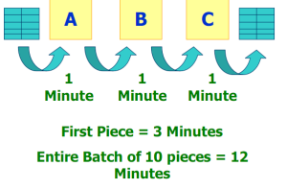
3.4 Ji-Kotei-Kanketsu, Obeya, Rhythm, Work-in-Progress and One-piece-flow

Slide 60
3.4.1 Explain the concepts Ji-Kotei-Kanketsu, Obeya, Rhythm, Work-in-Progress and One-piece-flow
Ji-Kotei-Kanketsu
clear understanding of goals, ensure high quality of work, defects never passed to next process, definition of done is vital
Obeya
"large room" or "war room“; refers to a form of project management used in Asian companies (including Toyota) and is a component of lean manufacturing and in particular the Toyota Production System.
Rhythm
the rhythm that the DevOps team works at and deploys to production
Work-in-progress (WIP)
Reduce WIP to reduce bottlenecks and improve cycle time
One-piece-flow
Working on one item at a time to completion as an individual or a team, fast pace, smooth flow
Notes:
Literature: C: Chapter 4, 7
JKK – Toyota - With this method of approach, which means that “to ensure that no defects occur at the lines and that defective items are never passed on to the next process”, required actions are taken to achieve “zero defect” goal in all production processes.
One-piece continuous flow can take place in a single team working as a tightly-knit unit, in a single work cell (or Scrum team), to apply several transformations to work in progress (which is limited to a single piece at a time). The team does a little analysis, a little design, a little building, and a little testing all at once in very short cycles. Individuals are multi-talented. Limiting the amount of WIP you have (in other words, the amount of work you have started but is not yet completed) is an excellent way to increase throughput in your software development pipeline.
Toyota Production System (TPS)
A production system which is steeped in the philosophy of "the complete elimination of all waste" imbuing all aspects of production in pursuit of the most efficient methods. (source: Toyota)
Cycle time and Lead time
Cycle time and lead time are both measures of work and productivity that have roots in the Kanban system, a scheduling system for Lean production developed at Toyota in the 1950s.19 Lead time is the time from when a request is made to when the final result is delivered, or the customer’s point of view on how long something takes to complete. Cycle time also ends with delivery but begins instead when work begins on a request, not when a request is received.

Slide 61
3.4.2 Analyze a scenario for a problem with Ji-Kotei-Kanketsu, Rhythm, Work-in-Progress or One-piece-flow and find a suitable solution
Useful checks:
Are defects ever passed to next process?
Is definition of done clear?
Is there a constant rhythm to the deployment?
How much work in progress?
How many people are working on more than one item?
Notes:
Literature: A: Chapter 1, 2, 9, B: Chapter 1, C: Chapter 4

Slide 62

3.5 Automation, Tools and Testing

Slide 63
3.5.1 Explain why automation is important for effective DevOps
Automation supports the goals of DevOps
by simplifying and removing the repetitive tasks that can be subject to human error
to improve quality, precision and accuracy
and by reducing labour, energy and/or materials
Notes:
Literature: B: Chapter 1, 8
Continuous delivery and continuous deployment have freed humans up to focus on what matters. Automated shortened feedback cycles through build automation with tests give us additional confidence and insight into our systems.
Server installation is the automation of configuring and setting up individual servers.
Fundamentally, infrastructure automation is provisioning elements of infrastructure through code—treating this code just like the rest of your software, with the ability to recover business through data backups, code repository, and compute resources.
While companies once had to plan, buy, and provision hardware in data centres, now they have the option to invest in cloud infrastructure. Build automation tools today usually specify both how the software is to be built (what steps need to be done and in what order) and what dependencies are required (what other software needs to be present in order for the build to succeed).
Monitoring - Over time, you will want to tune and adjust your monitoring and alerting as you learn more about the true impact of your issues and events. We recommend monitoring the trends of your alerting, including information such as whether or not any action was taken for each event, how many of your alerts were actionable overall, and how many of them occurred off-hours.

Slide 64
3.5.2 Explain how to use tools to facilitate DevOps in general
DevOps teams need the tools to get their jobs done effectively
Software development
Local development environment
Version control
Artifact management (repository management)
Containerization
Testing
Infrastructure management
IT Operations Management (dashboards)
Application, network & system monitoring
IT Service Management
service desk & incident management
Service level management
Notes:
Literature: B: Chapter 8
Software development tools help with the process of programming, documenting, testing, and fixing bugs in applications and services. Not restricted to specific roles, these tools are important to anyone who works on software in some capacity.
DevOps specific tooling exists to support and automate provisioning, orchestration and configuration management, containerization, clustering, artifact management, etc.
Artifact management
Artifact; An artifact is one of many kinds of tangible by-products produced during the development of software. Some artifacts (e.g., use cases, class diagrams, and other Unified Modeling Language (UML) models, requirements and design documents) help describe the function, architecture, and design of software. Other artifacts are concerned with the process of development itself—such as project plans, business cases, and risk assessments.
Version control of artifacts; version control is one of the top two predictors of deployment lead time, deployment frequency and MTTR. (source: jfrog.com)
Artifact repository (aka artifactory); artifact repositories manage collections of artifacts (binaries or any type of files really) and metadata in a defined directory structure. E.g.
any type of binary (aka binary ‘artifacts’ i.e. those parts of software like models, use cases and diagrams that describe and denote functions (and architecture form) of software.
source archives
flash archives
documentation bundles, etc.) (source: automic.com)
Containers/containerization
Containerization is a lightweight alternative to full machine virtualization that involves encapsulating an application in a container with its own operating environment. (own process space, can run commands, can install ad-hoc packages, can run services.
DevOps benefits: easy solution for making development, testing and production environments consistent, simple updates, support for multiple frameworks
Similar to virtual machines, containers provide a way of sandboxing the code that runs in them, but unlike virtual machines, they generally have less overhead and less dependence on the operating system and hardware that support them. This makes it easier for developers to develop an application in a container in their local environment and deploy that same container into production, minimizing risk and development overhead while also cutting down on the amount of deployment effort required
of operations engineers.
Regular reviews of current processes and tools should be done to make sure that their usage is still effective. Automation and technical debt tracking can help identify processes and tools that should be eliminated. This can help prevent situations where a tool has been causing additional work for those using it, and help identify and eliminate tools that serve the same purpose, reducing both cost and confusion.
Examples of other methods and tools:
Architectural Tradeoff Analysis Method (ATAM; Software Engineering Institute). Helps teams decide upon a suitable architecture by a thorough analysis of its Non Functional Requirements (NFR).
Test-Driven Development (TDD) A development practice in which small tests to verify the behavior of a piece of code are written before the code itself. The tests initially fail, and the aim of the developer(s) is then to add code to make them succeed.
A/B testing is a technique in which a new feature, or different variants of a feature, are made available to different sets of users and evaluated by comparing metrics and user behavior. (also known as 'split-testing')
Canary process: A go-live strategy in which a new application version is released to a small subset of production servers and heavily monitored to determine whether it behaves as expected. If everything seems stable, the new version is rolled out to the entire production environment.
Information radiators, also known as a Big Visible Chart (BVC), is a large graphical representation of project information kept plainly in sight within an agile development team’s shared workspace.
Event management
Forensic tools
ITSM tools
Operations management tools

Slide 65
3.5.3 Explain how to use tools to support DevOps mindset and culture
Direction
Tool Set
Culture
Mindset
Notes:
Literature: A: Chapter 12
The DevOps culture is one of collaboration across teams, organizations, and industries. When developing solutions, it is important to think about their impact on teams and organizations, not just individuals. DevOps tools stress “we” over “me”; they allow teams and organizations to build mutual understanding to get work done. Your choice of tools is a choice in a common language.
Tools are accelerators, increasing our velocity by driving change based on an organization’s current culture and direction.
While these tools are an important part of a devops environment, it is important to emphasize that they enhance, but can never replace, the interpersonal and cultural aspects of that environment. How tools are used, and the ease with which they can be used, impacts the acceptance and proliferation of specific aspects of culture. When we talk about devops tools, we mean both the tools themselves and the manner of their use, not their fundamental characteristics.
Finally, keep in mind that tools are not completely separate from the other three pillars of effective DevOps. Ultimately, tools are used by people, to help them work with other people, to create solutions for people, and we cannot remove this human side from the tooling equation. Tools can impact and be impacted by how we work and interact, and all of these factors and interactions must be considered in order to bring about significant, lasting change.

Slide 66
3.5.4 Explain why it is important that DevOps testing is automated
Automated testing
Manual testing
‘Done’
Feedback
Notes:
Literature: A: Chapter 1, B: Chapter 3
Too many projects rely solely on manual acceptance testing to verify that a piece of software conforms to its functional and nonfunctional requirements. Even where automated tests exist, they are often poorly maintained and out-of-date and require supplementing with extensive manual testing.
Building quality in means writing automated tests at multiple levels (unit, component, and acceptance) and running them as part of the deployment pipeline, which is triggered every time a change is made to your application, its configuration, or the environment and software stack that it runs on. Manual testing is also an essential part of building quality in: Showcases, usability testing, and exploratory testing need to be done continuously throughout the project. Building quality in also means constantly working to improve your automated testing strategy.
In many projects, testing is treated as a distinct phase carried out by specialists. However, high-quality software is only possible if testing becomes the responsibility of everybody involved in delivering software and is practiced right from the beginning of the project and throughout its life. Testing is primarily concerned with establishing feedback loops that drive development, design, and release. Testing is fundamentally interconnected with your definition of “done,” and your testing strategy should be focused on being able to deliver that understanding feature by feature and ensuring that testing is pervasive throughout your process.
Quality assurance (QA) is a way of preventing mistakes or defects in products and avoiding problems when delivering solutions or services to customers. Software Quality Assurance encompasses the entire software development process, which includes processes such as requirements definition, software design, coding, source code control, code reviews, software configuration management, testing, release management, and product integration. Some members of the DevOps community believe that implementing proper DevOps will eventually kill the traditional QA role. Built-in-quality and automation already diminishes this role.

Slide 67
3.5.5 Analyze a scenario and choose the correct way of automating an acceptance test
Acceptance criteria
Given
When
Test implementation layer
Code uses domain language
Application driver layer
Understands how to interact with the application to perform actions and return results
Then
No reference to user interface elements
Notes:
Literature: B: Chapter 8
Acceptance tests are a crucial stage in the deployment pipeline: They take delivery teams beyond basic continuous integration. Once you have automated acceptance tests in place, you are testing the business acceptance criteria of your application, that is, validating that it provides users with valuable functionality.
An individual acceptance test is intended to verify that the acceptance criteria of a story or requirement have been met. Acceptance criteria come in many different varieties; for one thing, they can be functional or nonfunctional. Nonfunctional acceptance criteria include things like capacity, performance, modifiability, availability, security, usability, and so forth.
The acceptance test suite as a whole both verifies that the application delivers the business value expected by the customer and guards against regressions or defects that break pre-existing functions of the application.
Acceptance tests are business-facing, not developer-facing. They test whole stories at a time against a running version of the application in a production-like environment. Unit tests are an essential part of any automated test strategy, but they usually do not provide a high enough level of confidence that the application can be released. The objective of acceptance tests is to prove that our application does what the customer meant it to, not that it works the way its programmers think it should.
The cost of a properly created and maintained automated acceptance test suite is much lower than that of performing frequent manual acceptance and regression testing, or that of the alternative of releasing poor-quality software.

Slide 68
4. Operation and scaling
Notes:
:

Slide 69

4.1 Managing Data; Infrastructure and Environments; and Components and Dependencies

Slide 70
4.1.1 Explain which problems can be encountered when managing data in databases within DevOps
Huge volume of information
Lifecycle of application data differs from that of other parts of the system
Difficulty in automating the database migration process
Management of test data and use of production data for testing can be issues
Notes:
Literature: B: Chapter 12
Data and its management and organization pose a particular set of problems for testing and deployment processes for two reasons. First, there is the sheer volume of information that is generally involved. The bytes allocated to encoding the behaviour of our application—its source code and configuration information—are usually vastly outweighed by the volume of data recording its state. Second is the fact that the lifecycle of application data differs from that of other parts of the system. Application data needs to be preserved—indeed, data usually outlasts the applications that were used to create and access it. Crucially, data needs to be preserved and migrated during new deployments or rollbacks of a system.

Slide 71
4.1.2 Analyze a scenario where a database is used in DevOps and provide the best solution to a problem
Version your database and use a tool to manage migrations automatically
Strive to retain both forward and backward compatibility with schema changes
Make sure tests create the data they rely on as part of the setup process
Reserve the sharing of setup between tests only for data required to have the application start
Try to use the application’s public API to set up the correct state for tests wherever possible
In most cases, do not use dumps of the production dataset for testing purposes. Create custom datasets by carefully selecting a smaller subset of production data, or from acceptance or capacity test runs
Notes:
Literature: B: Chapter 12
As with any other change to your system, any changes to any databases used as part of your build, deploy, test, and release process should be managed through automated processes. That means that database initialization and all migrations need to be captured as scripts and checked into version control. Due to its lifecycle, the management of data presents a collection of problems different from those we have discussed in the context of the deployment pipeline.
Here are some of the more important principles and practices:
• Version your database and use a tool like DbDeploy to manage migrations
automatically.
• Strive to retain both forward and backward compatibility with schema changes so that you can separate data deployment and migration issues from application deployment* issues.
• Make sure tests create the data they rely on as part of the setup process, and that data is partitioned to ensure it does not affect other tests that might be running at the same time.
• Reserve the sharing of setup between tests only for data required to have the application start, and perhaps some very general reference data.
• Try to use the application’s public API to set up the correct state for tests wherever possible.
• In most cases, do not use dumps of the production dataset for testing purposes. Create custom datasets by carefully selecting a smaller subset of production data, or from acceptance or capacity test runs.
*Application deployment; also known as software deployment. Application deployment is the process of planning, maintaining, and executing on the delivery of a software release. Application deployment is a critical aspect to engineering quality software.
Activities: release, installation and activation vs. deactivation, uninstallation (when no longer used), update, version tracking, adaptation

Slide 72
4.1.3 Analyze a scenario and identify the best way to prepare an infrastructure environment for deployment or manage it after deployment
Holistic approach to managing all infrastructure:
The desired state of your infrastructure should be specified through version-controlled configuration
Infrastructure should be autonomic i.e. it should correct itself to the desired state automatically
You should always know the actual state of your infrastructure through instrumentation and monitoring
Notes:
Literature: B: Chapter 11
An environment is all of the resources that your application needs to work and their configuration. The following attributes describe the environment:
• The hardware configuration of the servers that form the environment (such as the number and type of CPUs, amount of memory, spindles, NICs, and so on) and the networking infrastructure that connects them
• The configuration of the operating system and middleware (such as messaging systems, application and web servers, database servers) required to support the applications that will run within it.
Holistic approach to managing all infrastructure, based upon the following principles.
• The desired state of your infrastructure should be specified through version-controlled configuration.
• Infrastructure should be autonomic—that is, it should correct itself to the desired state automatically.
• You should always know the actual state of your infrastructure through instrumentation and monitoring.
Monitoring strategy
With the arrival of DevOps development has increased, which imposes greater load on the customer feedback loop and deployment tooling. There is much more to monitor than before, so where we use DevOps-style tooling to automate integration, testing, provisioning, and deployment, we need to use DevOps-style tooling to monitor our builds, resources, and performance. This requires a monitoring strategy roughly describing the following monitoring categories: application log output, server health, development milestones, vulnerabilities, deployments, and user activity. (source: SEI)
There are four areas to consider when creating a monitoring strategy for your infrastructure and applications:
• Instrumenting your applications and your infrastructure so you can collect the data you need
• Storing the data so it can easily be retrieved for analysis
• Creating dashboards which aggregate the data and present it in a format suitable for operations and for the business
• Setting up notifications so that people can find out about the events they care about

Slide 73
4.1.4 Analyze a scenario and suggest a commonly used strategy to manage components
Well-designed application that is amenable to a componentized build
Define a component
Organize teams by functional area/group of stories rather than components
Build components in pipelines and then move to an integration pipeline
Take into account dependencies
Use the artefact repository
Notes:
Literature: B: Chapter 13
What is a component? This is a horribly overloaded term in software, so we will try to make it as clear as possible what we mean by it. When we talk about components, we mean a reasonably large-scale code structure within an application, with a well-defined API, that could potentially be swapped out for another implementation. A component-based software system is distinguished by the fact
that the codebase is divided into discrete pieces that provide behaviour through well-defined, limited interactions with other components.
There are several reasons why components make the software development process more efficient:
1. They divide the problem into smaller and more expressive chunks.
2. Components often represent differences in the rates of change of different parts of the system, and have different lifecycles.
3. They encourage us to design and maintain software with clear delineation of responsibilities, which in turn limits the impact of change, and makes understanding and changing the codebase easier.
4. They can provide us with additional degrees of freedom in optimizing our build and deployment process.

Slide 74
4.1.5 Explain how to manage dependencies
Reports Engine
Framework
Settlement Engine
Portfolio management Application
Library
Pricing Engine
Notes:
Literature: B: Chapter 13
Example - The portfolio management application depends on a pricing engine, a settlement engine, and a reports engine. These in turn all depend on a framework. The pricing engine depends on a credit default swap (CDS) library that is provided by a (now struggling) third party. In general, we refer to a component further to the left of the diagram as an “upstream” dependency, and a component further
to the right as a “downstream” dependency. Thus the pricing engine has two upstream dependencies, the CDS pricing library and the framework, and one downstream dependency, the portfolio management application. The most important constraint on these scenarios is that the portfolio management application should only build against one version of the framework. We particularly do not want to end up with a version of (say) the pricing engine built against one version of the framework, and the settlement engine built against another version. This is the classic “diamond dependency” problem—which is the build-time analogue of the runtime “dependency hell” problem we discussed earlier in this chapter.
A dependency occurs whenever one piece of software depends upon another in order to build or run. In any but the most trivial of applications, there will be some dependencies. Most software applications have, at a minimum, a dependency on their host operating environment.

Slide 75

4.2 Configuration Management and Version Control

Slide 76
4.2.1 Explain why version control is a key to effective DevOps
Keeps multiple versions of files to enable tracking of different versions and always be able to go back to working version
Every artifact related to the software should be under version control
Fundamental to collaboration
DevOps practices to reduce cycle time and increase quality, from continuous integration and automated testing to push-button deployments, depend on having everything in a version control repository
Notes:
Literature: B: Chapter 2
Configuration management refers to the process by which all artefacts relevant to your project, and the relationships between them, are stored, retrieved, uniquely identified, and modified. Although version control systems are the most obvious tool in configuration management, the decision to use one (and every team should use one, no matter how small) is just the first step in developing a configuration management strategy.
Version control systems, also known as source control, source code management systems, or revision control systems, are a mechanism for keeping multiple versions of your files, so that when you modify a file you can still access the previous revisions. They are also a mechanism through which people involved in software delivery collaborate.
One reason that we use the term version control in preference to source control is that version control is not just for source code. Every single artefact related to the creation of your software should be under version control.
The objective is to have everything that can possibly change at any point in the life of the project stored in a controlled manner. This allows you to recover an exact snapshot of the state of the entire system, from development environment to production environment, at any point in the project’s history. This level of configuration management ensures that, provided you keep the repository intact, you will always be able to retrieve a working version of the software.

Slide 77
4.2.2 Explain how to keep version control over data, infrastructure and components
Data
Infrastructure
Components
Version Control
Notes:
Literature: B: Chapter 10, 11
The deployment pipeline is a paradigm for moving code from check-in to production in a controlled way. However, it is only one of the three degrees of freedom that you have to work with in large software systems.
In addition to storing source code and configuration information, many projects also store binary images of their application servers, compilers, virtual machines, and other parts of their toolchain in version control. This is fantastically useful, speeding up the creation of new environments and, even more importantly, ensuring that base configurations are completely defined, and so known to be good. Simply checking everything you need out of the version control repository assures a stable platform for development, test, or even production environments. One thing that we do not recommend that you keep in version control is the binary output of your application’s compilation – too big and be recreated.
If your system grows or you have components that several projects depend on, you may consider splitting out your components’ builds into separate pipelines. If you do so, it is important to have binary dependencies between your pipelines rather than source dependencies. Recompiling dependencies is not only less efficient; it also means you are creating an artifact that is potentially different from the one that you already tested. Using binary dependencies can make it hard to track back a breakage to the source code change that caused it, but a good CI server will help you with this problem.

Slide 78
4.2.3 Analyze a scenario and suggest the best strategy to manage a configuration management problem
Problem: network infrastructure between the development sites was both slow and unreliable
create a local repository for the team and merge the team’s changes to the mainline daily
Problem: Very large project with parallel branches
develop a clearly described merge strategy with a separate continuous integration server for each of these relatively long-live branches and a small, dedicated merge team to manage the process
Problem: Separate branches for every customer of a product and tests were in a separate version control repository from their code
Use a common version control repository for code and tests so that they can be clearly linked
Notes:
Literature: B: Chapter 2
There are three good reasons to branch your code.
First, a branch can be created for releasing a new version of your application. This allows developers to continue working on new features without affecting the stable public release. When bugs are found, they are first fixed in the relevant public release branch, and then the changes are applied to the mainline. Release branches are never merged back to mainline.
Second, when you need to spike out a new feature or a refactoring; the spike branch gets thrown away and is never merged. However, it is important that every time you branch, you recognize that there is a cost associated with it. That cost comes in increased risk, and the only way to minimize that risk is to be diligent in ensuring that any active branch, created for whatever reason, should be merged back to mainline daily or more frequently. Without this, the process can no longer be considered to be based on continuous integration.
Finally, it is acceptable to create a short-lived branch when you need to make a large change to the application that is not possible with any of the methods described in the last chapter—an extremely rare scenario if your codebase is well structured. The sole aim of this branch is to get the codebase to a state where further change can be made either incrementally or through branch by abstraction.

Slide 79

4.3 Cloud and Immutable Infrastructure

Slide 80
4.3.1 Explain when it is and when it is not necessary to move to Cloud-based infrastructure for effective DevOps
Move to Cloud
Remove overhead of purchase, install and maintain hardware
Flexible resource usage to expand and contract
Quick start for new organization
Standardised stack
Fits with many DevOps principles
Do not move to Cloud
Moving to Cloud or buying tools will not make DevOps work – it is more than that
Investment in existing infrastructure and to retain/grow own infrastructure
Avoid cloud vendor and platform lock-in
Third party, Service level and Security concerns
Performance – high performance servers can be faster than some cloud services for large dataset manipulation
Notes:
Literature: A: Chapter 17, B: Chapter 11, C: Chapter 5, 7

Slide 81
4.3.2 Explain how Cloud-based infrastructure should be managed within DevOps
Investigate various options for
Services – infrastructure, platform…..
Service levels
Security, compliance requirements
Flexibility
Monitoring, reporting
Cloud-based infrastructure needs less management but not zero
Notes:
Literature: B: Chapter 11

Slide 82

4.4 Business Continuity

Slide 83
4.4.1 Explain how DevOps can facilitate Business Continuity practices
High availability of IT services is critical to the survival of the business as a whole
Use risk reduction measures and recovery options
Ongoing maintenance of the recovery capability is essential
Notes:
Literature: C: Chapter 4
The enterprise holds both the System of Engagement (SoE) and the System of Record (SoR). The SoE is focused on speed. The SoR is focused on business continuity. The problem is how the SoR can adapt quickly to changes to the SoE to maintain business continuity.
Enterprise DevOps is not only an enhancement of Agile development and continuous delivery but also IT service management and application management to enable growth of the business and to maintain business continuity. As technology is a core component of most business processes, continuous or high availability of IT services is critical to the survival of the business as a whole. This is achieved by introducing risk reduction measures and recovery options. Like all elements of IT service management, successful implementation of the service continuity process can only be achieved with senior management commitment and the support of all members of the organization. Ongoing maintenance of the recovery capability is essential if it is to remain effective. Service continuity is an essential part of the warranty (fitness for purpose) of a service. If service continuity cannot be maintained and/or restored in accordance with the requirements of the business, then the business will not experience the value that has been promised. Without continuity the utility (fitness for purpose) of the service cannot be accessed.
Traditional IT service management (ITSM) best practice such as ITIL looks heavyweight and not suited for the quick processes of DevOps. It is necessary to think about how to reduce management workload. It is necessary to realign ITSM for DevOps, creating light-weight ITSM which is strictly focused on business continuity with a set of minimum required information (MRI). The MRI set for each organization depends on their business.

Slide 84
4.5 Scaling
Scaling is about the evolution, growth and advancement of the organization as a whole throughout its entire lifecycle
Scaling successfully is the art and science of realizing when and how to change direction as necessary to navigate the ever-changing environment.

Slide 85
4.5.1 Analyze a scenario, explain if and why it is important to scale up or down in that situation, and identify the best way to do that
Scale up
Scale down
Notes:
Literature: A: Chapter 14
The DevOps compact is just as central to developing strength, balance, and agility within a large company as it is in smaller organizations. It is the application or implementation of the principles that differs in larger organizations, not the principles themselves.
Researchers found that the cultural principles of devops could be applied to organizations of any size, and that technical principles such as continuous delivery and improving deployment processes could be applied to any well-designed and architected software project, even legacy code running on mainframes. A brand new micro service-based project is not going to be successful because it is new and has
micro services—it has to be well-designed, testable, and easily deployable as well. These principles apply to all software projects, old and new.
Be clear on what scaling means. Scaling might mean:
• Expanding the customer base
• Growing revenue
• Expanding a project or team to meet demand
• Maintaining or improving a ratio of people to systems or money spent
• Growing faster than competitors
• Expanding locations
Consider outsourcing some work to scale up. Then it can easily be scaled down. Either full outsource or use of contractors.

Slide 86
4.5.2 Analyze a scenario for what went wrong with scaling, and identify a good way to solve the problem
Problem: Scale down but some large projects are taking up resources and cost
Recognize projects that will not add value to scaled down organization and cancel them
Problem: Scale up to very frequent releases for all software is impossible to maintain with resource levels
Analyze which software is required to be available 24/7/365 or to have constantly updating content and which is not. Have different release cycles for each
Problem: Managing conflicts
Do not tolerate bullying/blame culture but recognize and encourage healthy conflict as a way of identifying new ideas and solutions to problems
Notes:
Literature: A: Chapter 15, B: Chapter 11
Vampire (feed off the resources and energy of other projects) and zombie (take up time and resources) projects can both be very difficult, because there are core individuals whose lifeblood is essentially feeding the project. They might not even realize how much of a drain the project is overall for the company. When approached with the reality of the project, they may feel that they are being attacked personally. Convincing an individual to abandon “the precious” project to which they have given so much time and effort will be challenging, but it can have immense returns. The people who are passionate about projects, already have passion. You do not have to instil it in them; you just have to redirect that passion to something that has value for your company.
As pervasive as the internet is these days, not every piece of software developed is designed to be immediately available 24/7/365 or to have constantly updating content.
Understand and weigh the importance and complexity of projects and their releases in order to figure out what release cycle makes the most sense for each one. Different projects throughout the organization might work better with different release cadences.

Slide 87
4.5.3 Explain how social policy and hiring practices support scaling DevOps
Look at team size – small teams of 5 – 7 work well
Larger teams become bureaucratic and can stifle innovation
Promote from within as well as hire from outside
Maintain knowledge and motivation but also bring in new ideas and required skills
Address interpersonal and cultural aspects as well as technical needs when hiring
Invest in training and supporting junior staff or new hires
Look at motivational factors – benefits, opportunities, and workload as well as competitive salary
Notes:
Literature: A: Chapter 6, 7, 14
In order to grow a company past a certain point, you will have to figure out how to make distributed teams work. Failing to do so will slow down your ability to respond and react to changes affecting your organization, lead to duplication of effort, and decrease individual and team satisfaction as people struggle to bridge these distances effectively.
Organizational structures that lock people into roles or that are fear driven can lead to a focus on optimizing work for the me, not the we. Choosing processes and tools that favour an individual can lead to short-term gains that are not sustainable for the team or organization over the long term.
More than hiring people who simply know about infrastructure automation or the cloud or containers, organizations and teams need to focus instead on assessing their specific needs and addressing the interpersonal and cultural aspects of hiring that are key to creating and maintaining a DevOps culture.

Slide 88
5. end of life

Slide 89

5.1 Conditions for End-of-Life of a product or service

Slide 90
5.1.1 Explain which conditions should be met before terminating a service or product
End of Life is treated as a story like other conditions
The story will say why e.g. no more business need, replacement by cheaper/simpler/more effective service
The story will say what the conditions are e.g.
what happens to any data/documentation/tools/other components
how to ensure any replacement service is ready before close down old
when to close down and in which sequence
Notes:
Literature: C: Chapter 7

Slide 91

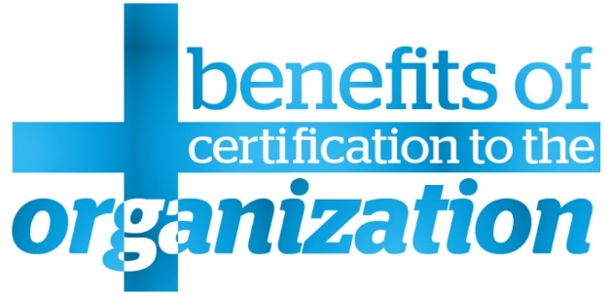

Certificate leverages career opportunities
Certificate contributes to productivity
Training and certification are satisfaction drivers
Save 25% of costs by training the talent you already have (Gartner).
Defence against aging IT workforce
Enhanced employee self-esteem
Better quality in process and IT infrastructure
Developing team skills reduces failure, decreases costs, increases effectiveness
Staff retention
Beat the competition
Notes:
Benefits for professionals:
Professionals want to have some certification to boost their chances of being promoted to a better job.
Hiring managers feel certified professionals were more productive than their non-certified peers.
Certified professionals feel their ability to be more productive on the job was directly attributable to certification.
For IT professionals, training and certification ranks second as a satisfaction driver (after eLearning).
Benefits for the organization:
Savings. Research indicates that 25% of costs spent on hiring contractors can be saved by training the talent you already have (Gartner).
Defence against aging IT workforce. By training internal staff, you save money on replacing those hard-to-find skills when baby boomers – one third of the total workforce - retire in the next 5 years.
Enhanced employee self-esteem. According to Towers Watson research, more than three out of four employees (78%) remain with their employer if there are long-term career opportunities for them; boosting skills, therefore, represents a key investment.
Better quality in process and IT infrastructure. People who know what they’re talking about can make better decisions in the long term.
Proactively developing team skills is the best way to improve organisational performance: “Training represents one concrete step IT managers can take to assure project teams possess the skills necessary to reduce failure risk, decrease costs, and increase project effectiveness.”
Retention. Research shows that employees remain with their employer if there are long-term career opportunities for them. Furthermore, there is no advantage in retaining your staff if they are under-skilled.
Beat the competition. Firms that take time to develop in-house skills outperform other firms in subsequent years.

Slide 92
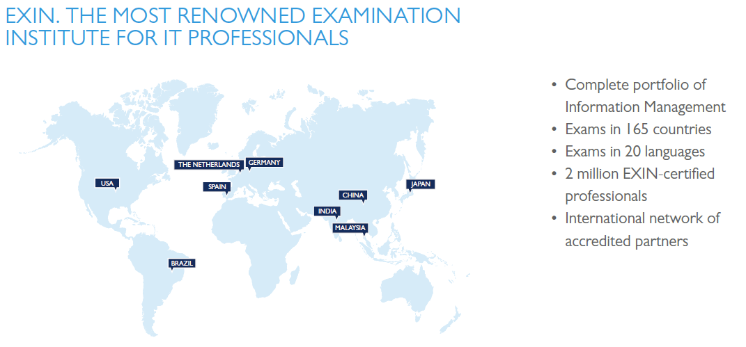
ABOUT EXIN
Published and designed by EXIN. EXIN is the global independent certification institute for professionals in the IT domain. With more than 30 years of experience in certifying the competences of over 2 million IT professionals, EXIN is the leading and trusted authority in the IT market. With over 1000 accredited partners EXIN facilitates exams and e-competence assessments in more than 165 countries and 20 languages. EXIN is co-initiator of the e-Competence Framework, which was set up to provide unambiguous ICT certification measurement principles within Europe and beyond.

Slide 93
Questions?
Thank you – EXIN DevOps Master™

