Slide 1
Topology in Solid State Physics
--An Application of Berry Phase

Slide 2
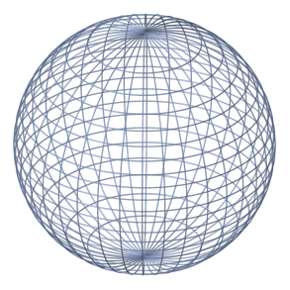
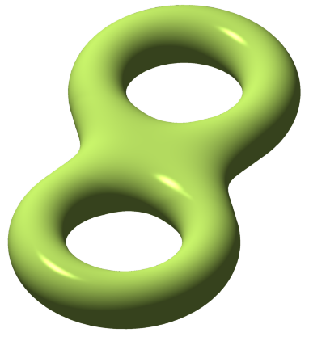
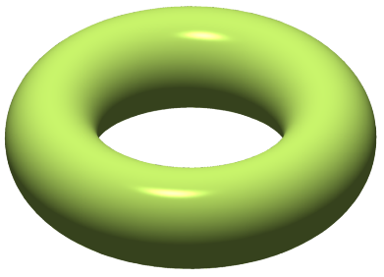
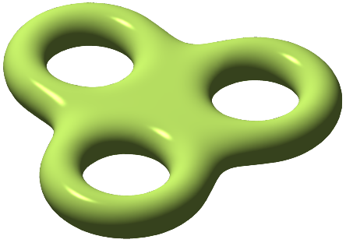
Introduction: Gauss-Bonnet theorem on 2-D manifold
To distinguish different manifolds( surfaces), let us introduce an integer “topological index”, it only depends on the topology of the manifolds. For a 2-D manifold, the index is Euler characteristic :
where is the Gaussian curvature. The result above is called Gauss-Bonnet
theorem.
only cares about the topology of the manifolds. If you deform a manifold adiabatically, it remains the same.
for different 2-D manifolds:
Sphere: 2
Torus: 0
Double torus: -2
Triple torus: -4

Slide 3

Physical equivalents of Gaussian curvature
The following tings are mathematically equivalent: the magnetic field , the Berry curvature , and the Gaussian curvature .
The integrals of , , and on a closed 2-D manifold are all quantized due to topological reason, known as topological quantization.
is the single magnetic charge .
is Euler characteristic.
is an integer, known as the
Chern number.
$$n$$

Slide 4
The local phase symmetry in real space and gauge field
Define local phase transition: , but the Schroedinger equation is variant under this phase transition.
Consider a charged particle in the electromagnetic field , the Schroedinger equation for has the following form:
Define gauge transformation: , , thus the Schroedinger equation is invariant.
Schroedinger equation of a charged particle in electromagnetic field is in variant under local phase transition of the wave function, which is called local U(1) symmetry.

Slide 5
The local phase symmetry of Bloch waves
According to Bloch’s theorem, Bloch waves is invariant under discrete translation: .In Brillouin zone(BZ), which are simply equivalent to .
Define the Berry connection: for the nth band.
Under a local phase transition: , .The Berry connection transforms like a gauge field(vector potential),but it changes in the momentum space.
Define the Berry curvature: , which is the curl of the Berry connection, just like the case the magnetic field is the curl of a vector potential.
Any wave function can be written as a superposition of Bloch wave functions:

Slide 6
The position operator in the momentum space is not , however,
added a Berry connection term: , just like what we are familiar for charged particles: .
The expected value of position is invariant under the local phase transition, thus the position operator is a U(1) invariant in momentum space.
The Berry curvature is also a U(1) invariant in momentum space.
The Berry phase , obviously a U(1) invariant according to its definition.
The presence of Berry connection in the position operator contributes to “anomalous velocity” in anomalous Hall effect, which we will talk about later in thermal Hall effect of ferromagnetic pyrochlore.

Slide 7
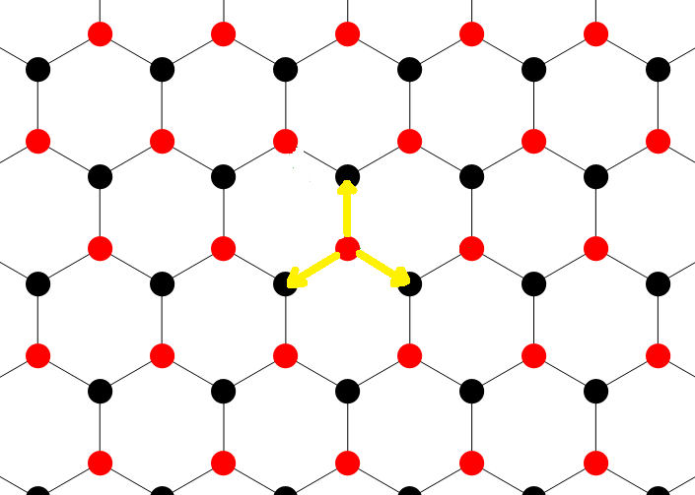
The simplest 2D Weyl semimetal--Graphene
The tight binding model I used here considers only hoppings nearest-neighbor(NN) sites.
The Hamiltonian: , where and are indices of 2 sites in a unit cell.
After discrete Fourier transformation, the Hamiltonian finally lives in the momentum space. The kernel of Hamiltonian :
where ,the vectors are marked in the
figure.

Slide 8
The eigenvalue of gives the dispersion relation:
At the corner point of BZ, and , the two bands are degenerate .
Expand at the vicinity of and :
The kernel of the Hamiltonian:

Slide 9
The Hamiltonian at and ( de facto the kernel of it) describe 2 Weyl fermions, they are of opposite helicity.(Definition of helicity ).
Dirac equation in quantum electrodynamics:
At the vicinity of the two Dirac points, one can calculate the Chern number of each band, i.e. the flux of Berry curvature of each band over the whole BZ:
After some trivial calculation, we finally obtain for the lower band at the Chern number equals +1, and for the upper band the Chern number equals -1, the same case for point.
The application in of topology in Weyl semimetals is not so striking as in the
case of quantum Hall effect.

Slide 10
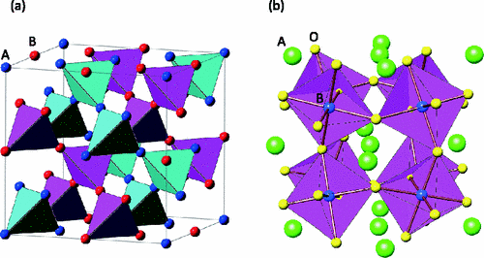
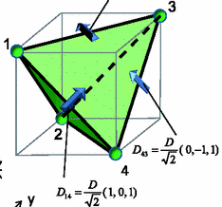
The structure of the pyrochlore Lu₂V₂O₇
In Lu₂V₂O₇, the four vanadium ions are magnetic with one 3d electron point to each vanadium site.
Aside from Heisenberg exchange interaction, there exits Dzyaloshiskii-Moriya (DM) interaction between two nearest-neighbor vanadium site. The effective Hamiltonian at low magnetic field for a unit cell reads:
where the vector is the DM vector between sites i and j.

Slide 11
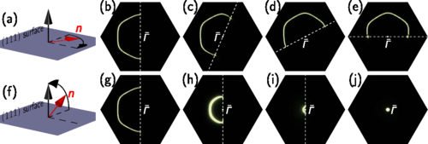
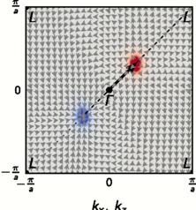
Magnon Weyl fermion in ferromagnetic pyrochlore Lu₂V₂O₇
The theoretical prediction of magnon in Lu₂V₂O₇ was made by Alexander Mook et al. However, they expressed themselves in such a ambiguous way that they first took nearest-neighbor interaction for consideration but then they wrote down terms of next-nearest-interaction, which made me confused.
I don’t think “tunable” is a striking phenomenon. On the contrary, it is just a natural result of the zero contribution of perpendicular components of the DM vector to effective Hamiltonian .
The dispersion relation at the 2 Dirac points is quadratic to momentum, I don’t know how can they obtain such a beautiful result from their paper.

Slide 12
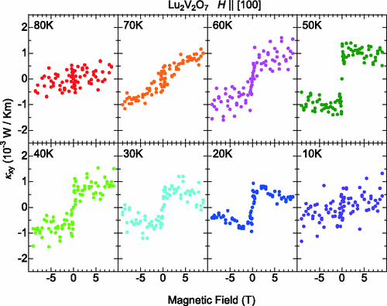
Thermal Hall effect in ferromagnetic pyrochlore Lu₂V₂O₇
The thermal Hall conductivity steeply increases and saturates in the low-magnetic-field region. So it is not the normal Hall effect, but the anomalous
Hall effect.
The thermal current carrier is either phonon or magnon, but the phonon mechanism cannot explain the decrease of the thermal Hall conductivity in the high field region at low temperature.

Slide 13
The structure of this pyrochlore is stable under thermal fluctuation(
for ).
Rewrite the Hamiltonian in the ladder operator form, then apply Holstein-Primakoff transformation on it, and later transform it to momentum space
with Fourier transformation, finally we can show the effective Hamiltonian
in the following form:
Where is the bose annihilation operators, which corresponds to the th
sites of vanadium ions in a unit cell.
The spin-wave Hamiltonian is a 4-rank
square matrix, and is an Hermitian matrix depending on DM vector .
Thus, the energy density operator of this system can be written in the following form:
all the miracles of thermal Hall conductivity come from formula above.

Slide 14
The spin-wave Hamiltonian can be diagonalized into diagonal matrix
consisting of the eigenvalues of . and are connected
by a unitary matrix : .Our journey begins there.
In a new basis of bosons , the energy density operator can be described
as
Berry connection: , then the energy density operator could be decomposed into diagonal terms and off-diagonal terms:
The commutator term gives the off-diagonal anomalous velocities, similarly
to the case of intrinsic anomalous Hall effect. The anomalous velocities are
caused by Berry connection induced by DM interaction.

Slide 15
Our journey of Berry phase hasn’t finished yet. Start from a TKNN-type non-interacting Bosons, consider the lowest energy band only under Curie temperature ,and use a correction for rotational magnons, we finally obtain the thermal conductivity tensor :
where is the distribution of free Bosons for nth band, and the
eigen function of nth band. The formula explains the temperature
dependency of thermal conductivity, furthermore, it is independent of
magnetic field.
The Berry curvature is defined as ,thus we obviously
conclude that the thermal Hall conductivity in Lu₂V₂O₇ is nothing but a kind
of topology index of the first Brillouin Zone.

