Slide 1
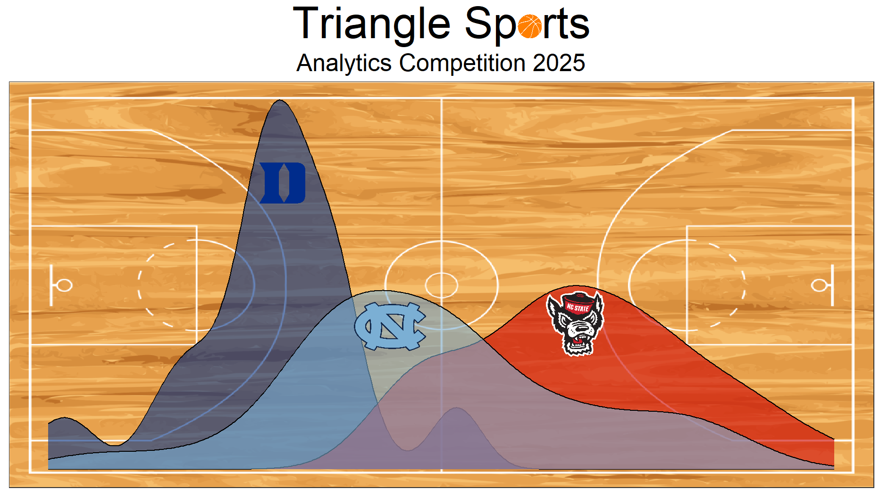

Website: https://triangle-sports.github.io
Register Now

