Slide 1
Code Snippet Classification
Big Data Computing Project
Andrea Trianni - Emanuele Mercanti

Slide 2
The Task

Slide 3



Given a short snippet of code, predict the programming language.
Useful for Visual IDE tool :
to highlight keywords
to check syntax error
Useful for Online forums :
clusters un-tagged questions

Slide 4



The environment
Development
Training stage

Slide 5
The Dataset

Slide 6
GitHub SQL Dataset
Version available: FULL (60GB) and LITE (3GB)
20 Different languages covered + Unknown Class
Length of snippets is 5 rows
We have access also to other Fields, like License Type

Slide 7
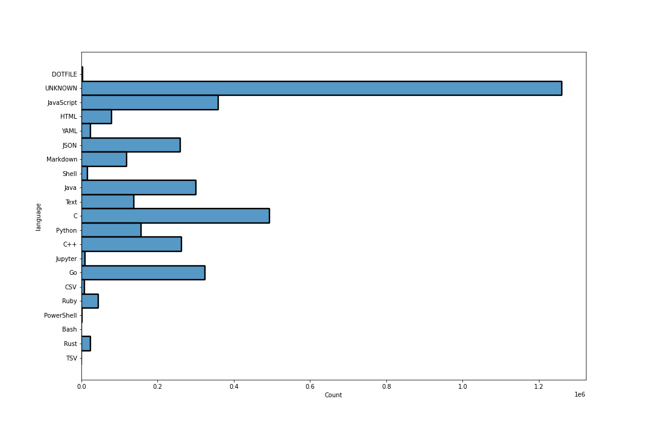
Visualize the data
class sizes

Slide 8
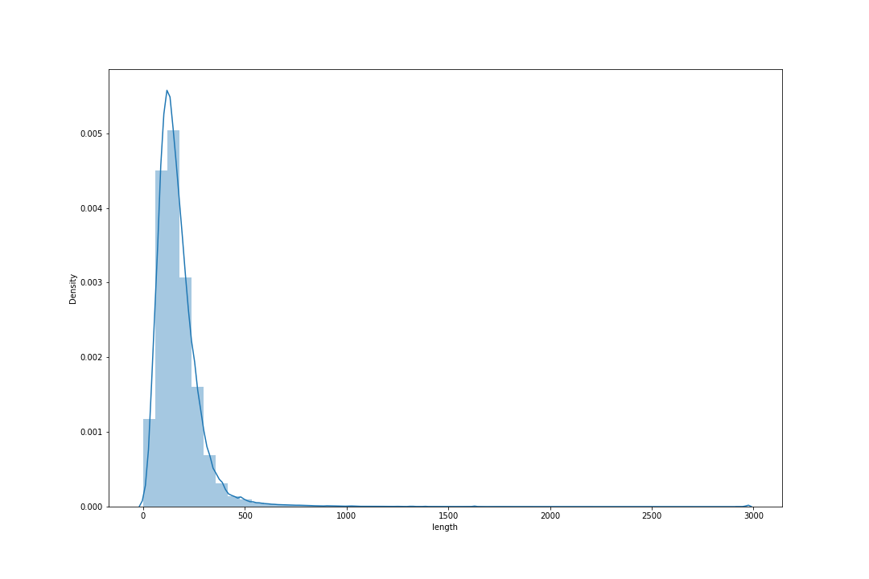
Visualize the data
snippet length distribution

Slide 9
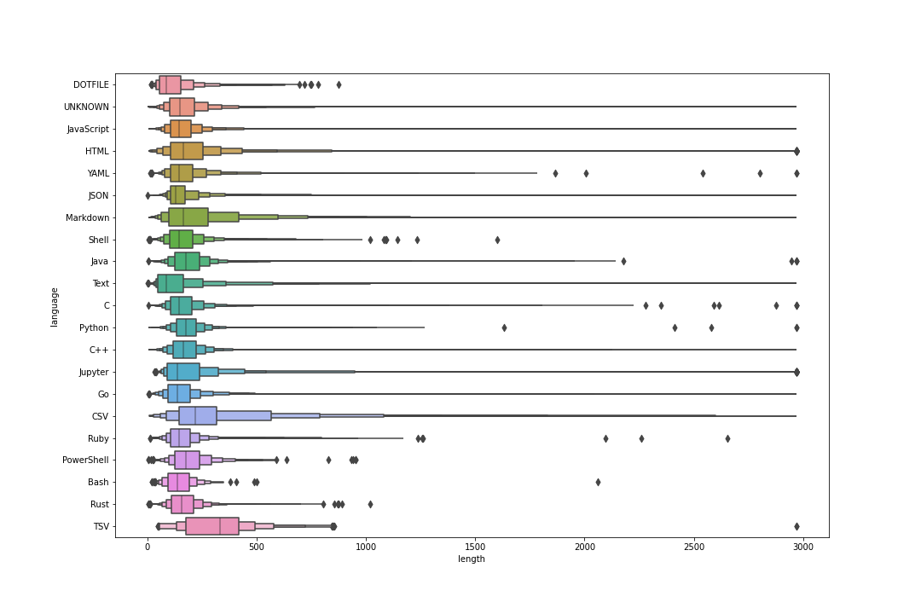
Visualize the data
boxenplot: snippet length distribution by class

Slide 10
Our Approach
The preprocessing pipeline

Slide 11
Cleaning the data
Manual stratify split in train, dev and test set
Remove non-programming languages (csv, json, ..)
Remove noisy unknown class
Merge Shell family languages (shell, bash, ..)
Remove outlier rows
Check for missing data
Calculating class weights

Slide 12
Tokenize the snippet
Our first try:
A small Vocabulary manually built from a fixed set of keywords + punctuation
Tokenizing finding substring matches, using the vocabulary.
Strength:
Low dimensionality of vectors helps simple models to achieve high performance
Weakness:
Powerful models not able to reach their best performances
No parallelization possibile with simple implementation

Slide 13
Tokenize the snippet
So, we rely on Spark RegexTokenizer :
( [\\n\\t] | ([A-Za-z_]+\\b) | [!\#\$%\&\*\+:\-\./<=>\?@\^_\|\~]+ | [ \(\),;\{\}\[\]`\"'] )
Indentation Keywords + Var. Operators Brackets

Slide 14


Encoding the snippet
We tried 2 encoding strategy :
BOW
TF-IDF
5k Max Vocabulary Size
Sometimes, less is more.

Slide 15
Our Approach
The training stage

Slide 16
Training the models
We train and evaluate the following models:
Decision tree classifier
Gradient-boosted tree classifier [OVR] (failed)
Random forest
Multinomial logistic regression
Naive Bayes classifier
Linear Support vectors machines [OVR]

Slide 17

Evaluating the models
We obtain the following results:
MODEL | F1 Score (dev) | Accuracy (dev)
Decision tree classifier | 0.38 | 0.45
Gradient-boosted tree | ? | ?
Random forest | 0.55 | 0.53
Multinomial logistic reg. | 0.83 | 0.83
Naive bayes | 0.74 | 0.73
Linear SVM | 0.82 | 0.82

Slide 18
Results explanation
Winners
Logistic regression Linear SVM
Data is linearly separable
Data can be modeled by a multinomial distribution
Losers
Decision tree Random Forest
Data is very sparse
Data might not be aligned to axis

Slide 19
Benchmark the model
So, we select the best model and we benchmark it on test set, using:
Cross Validation + Grid Search
Accuracy + F1 score
Confusion matrix
Learning curve

Slide 20
Results

Slide 21
Benchmarks:
(Grid Search) 5 Fold Cross-Validation F1: 82.5%
Test set results:
F1-Score: 82.2 %
Accuracy: 82 .0%

Slide 22
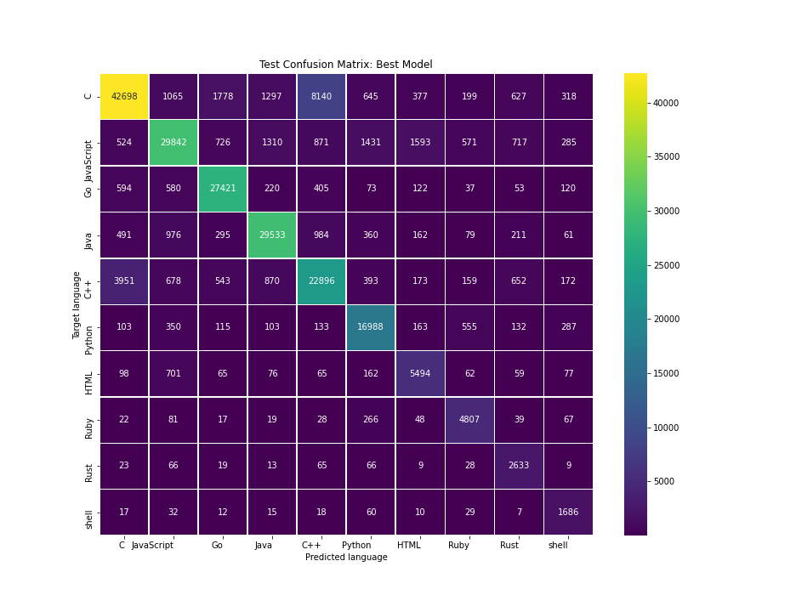
Confusion Matrix

Slide 23
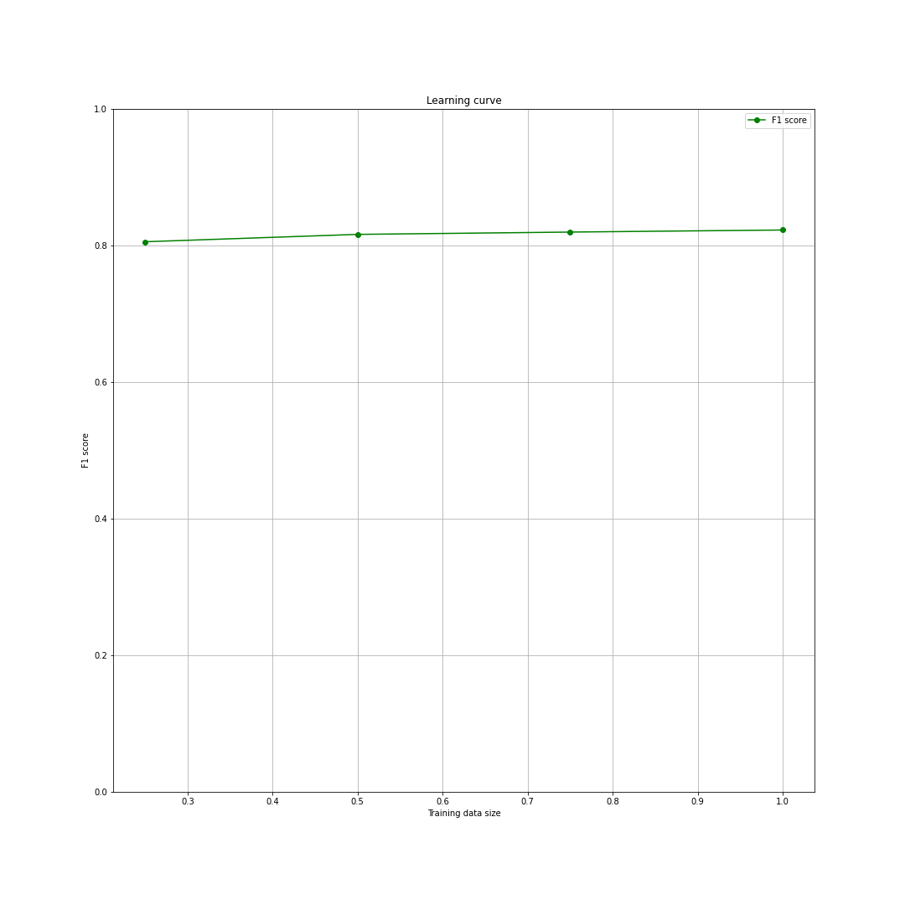
Learning Curve

Slide 24
Web Application

Slide 25
How Does it Works?
Instead of leveraging Docker (local) and build a Web Application using Flask REST API..
We decided to use Colab Runtime as a virtual machine, configure Spark with a Master Node
and deploy our application using Streamlit
Actually, you can try to use it (the link will be provided during the live presentation)

Slide 26
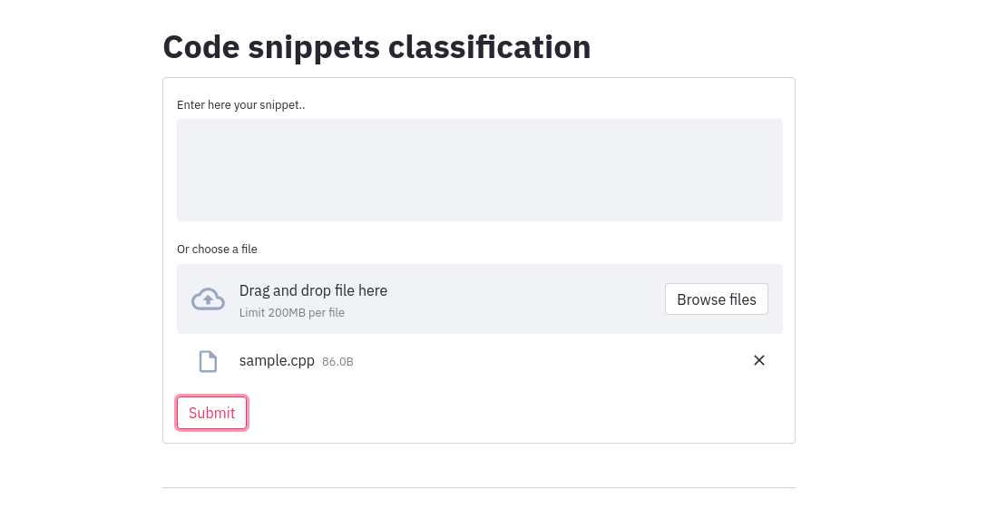

Slide 27
Thank you!

