Slide 1
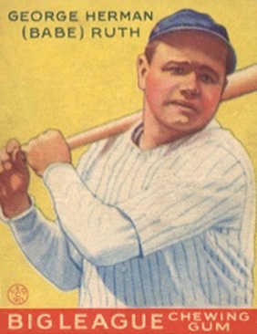

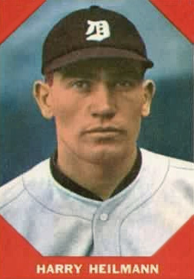

I’VE BEEN A BABE
AND A BOOB
In a “confession” in Collier’s magazine, Ruth admitted he’d lost ¼ to ½ million dollars on “high living” (including nine cars—the “most expensive” American kind), $125,000 gambling ($35,000 on a single horse!), $100,000 in failed businesses, $25,000 on lawyers, etc.
At the urging of his manager, Ruth bought a $50,000 20 year annuity from Heilman.
Enter Harry Heilmann…
It was the first time he had soundly invested any of his earnings.
Heilmann was a friend of Ruth’s. He played for the Detroit Tigers and was a 4-time American League batting champion.
As Heilmann accepted Ruth’s check, he told him: “You’re a very lucky man.”
Ruth joked: “But you got my money!”
In the off-season he was a licensed agent with Equitable Life Assurance (now part of the
AXA Group).
©2009 UNDERHILL FINANCIAL ADVISORS

