Slide 1
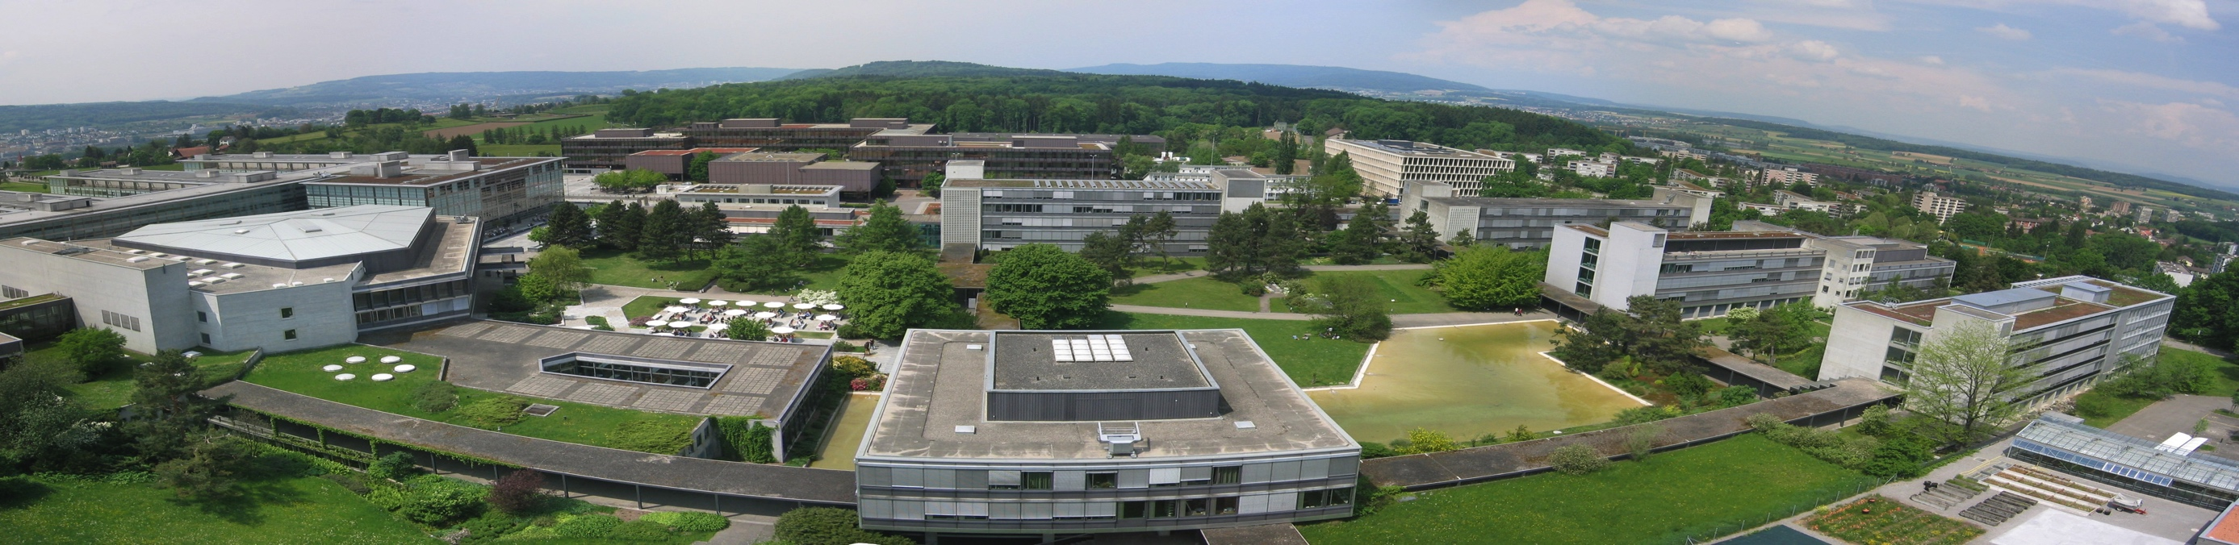
Case Studies in Process Design II Clemens Isert, Selina Schlotterbeck, Tobias Seidler, Mithurshan Tharmalingam, Pauline Oeuvray

Slide 2
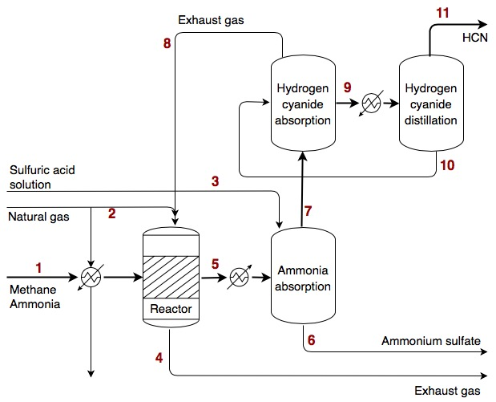
Reactor flow sheet

Slide 3
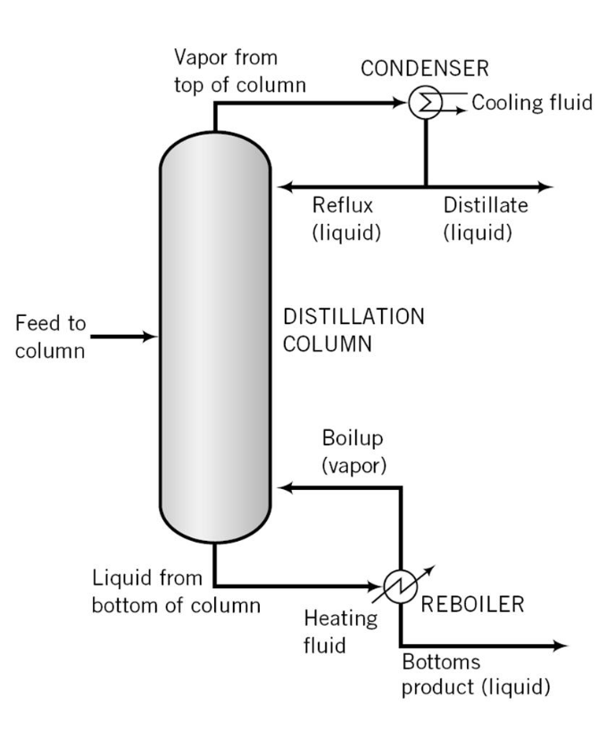
HCN Distillation
Ideal or non-ideal (NRTL for liquid phase)
No ΔP / ΔP
Fenkse-Underwood-Gilliland method (justified since relative volatilities were pretty similar)
x_{HCN}^{D} = 0.995,x_{HCN}^{B} = 10 ppm (going below these limits only makes the separation more difficult → higher CAPEX/OPEX)
total condenser, q = 1 (requires another heat exchanger before the distillation column)

Slide 5
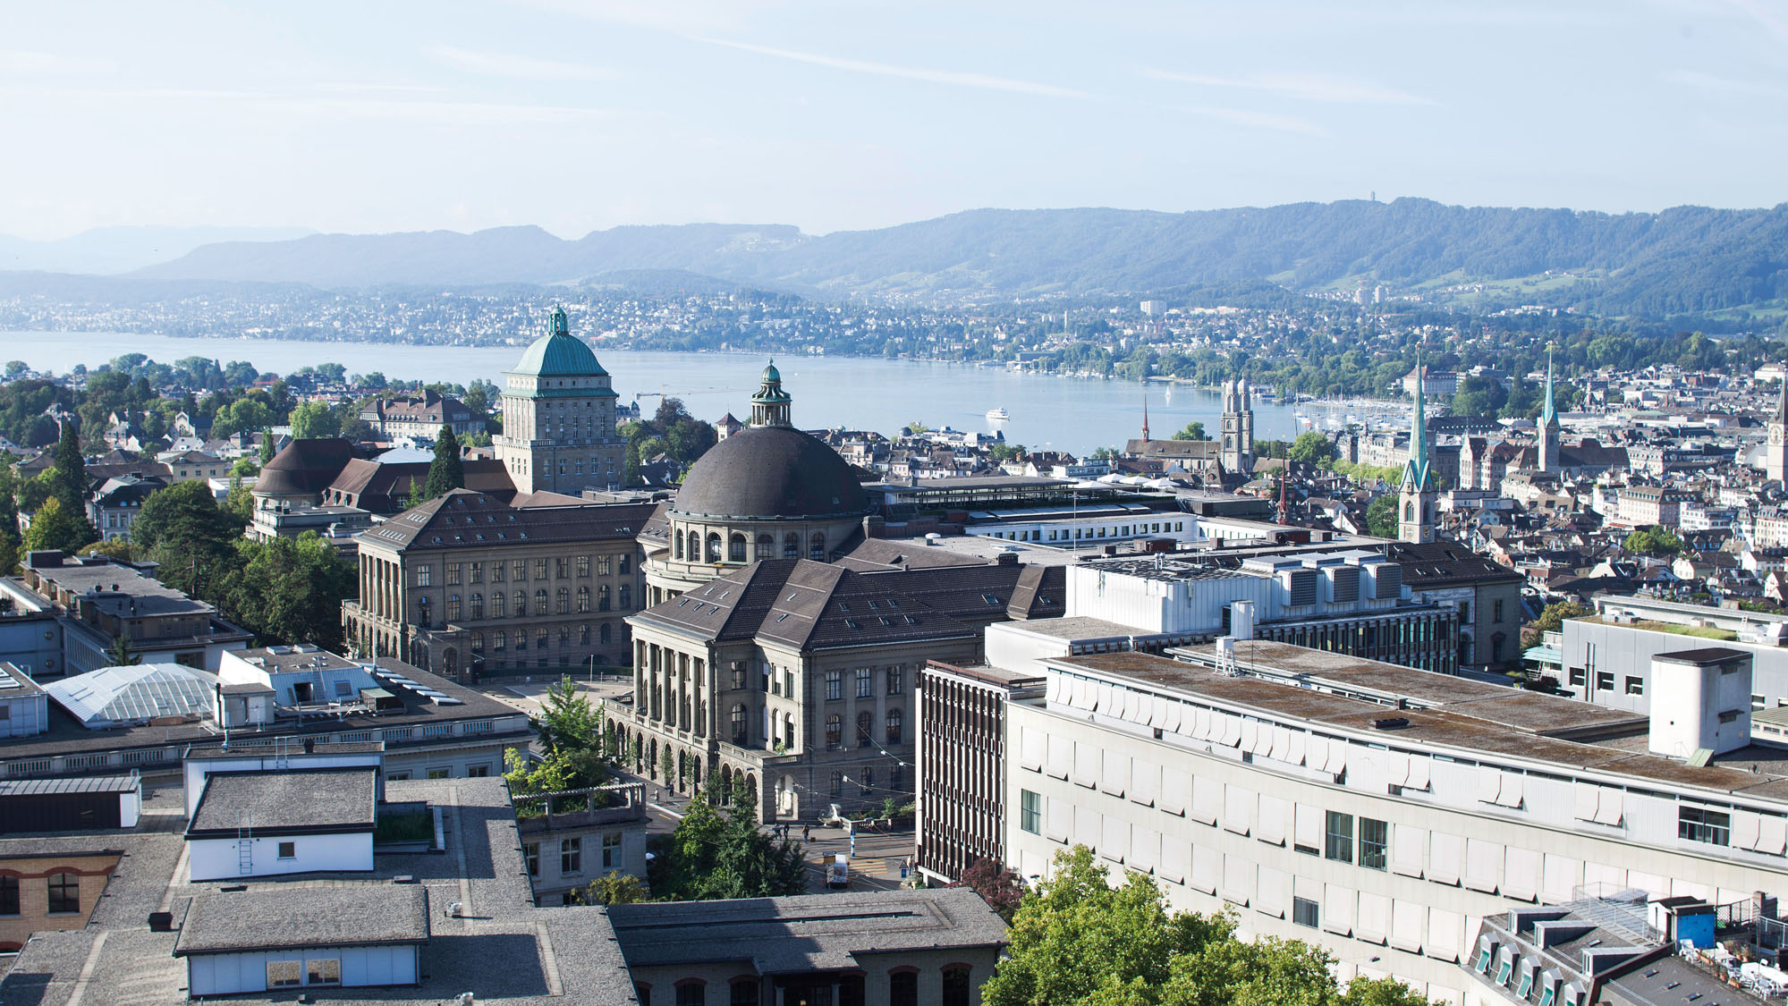

Slide 9
Contact information and credits
ETH Zurich
Organisational unit
Street address
Postcode City
www.ethz.ch/en.html
Publisher: Organisational unit of ETH Zurich
Design: Designer Name
Images: Credit (slide xx), Credit (slide xx)
© ETH Zurich, December 2013

